Slide 1
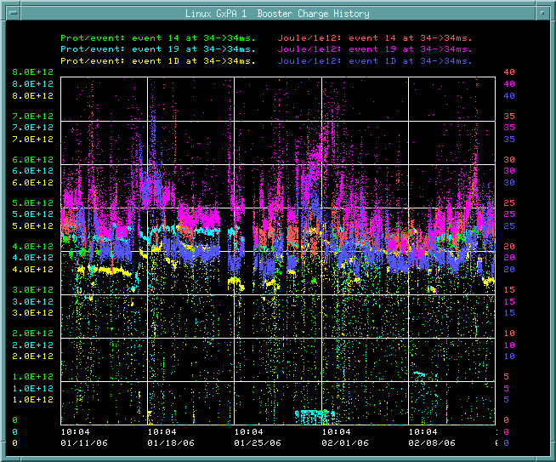
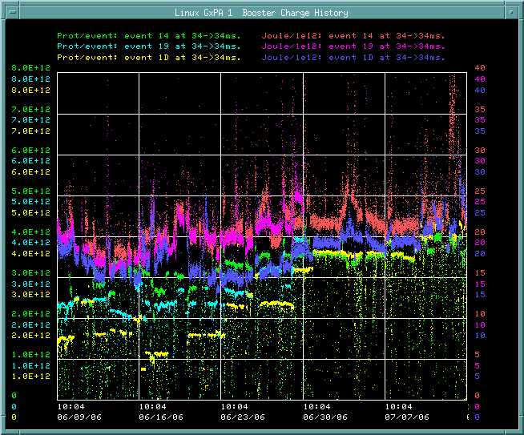
How are we doing (batch size/eloss)
Jan/Feb
Since shutdown

Slide 2
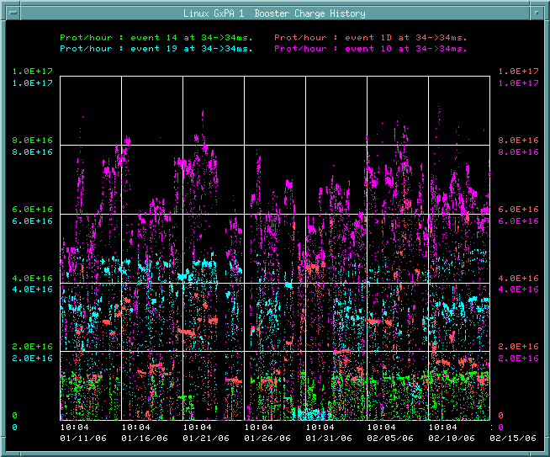
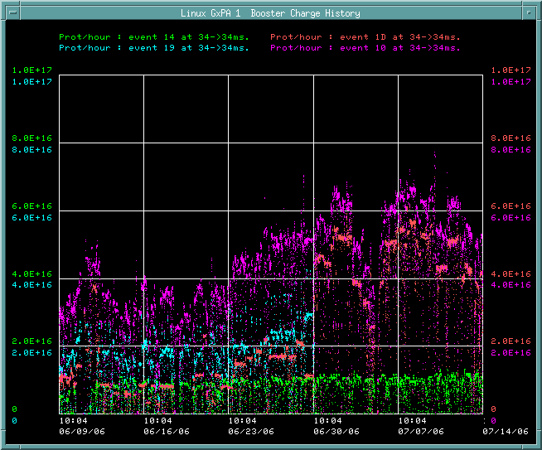
How are we doing (total rate)?
Jan/Feb
Since shutdown

Slide 3
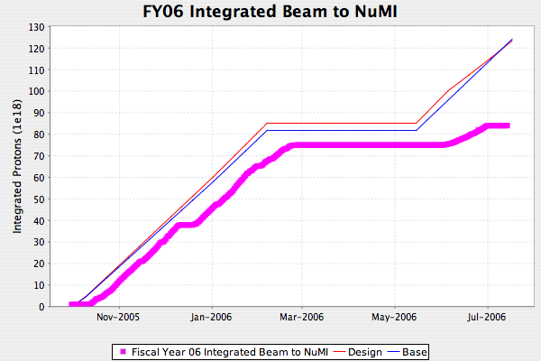
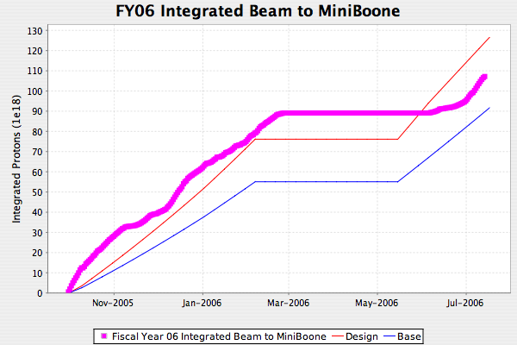
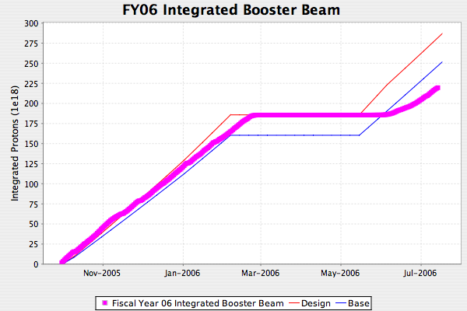
Proton Delivery

Slide 4
Issues
Increasing batch size/total intensity
Where are gamma-t studies going?
Slip stacking issues
  Longitudinal emittance
  Batch rotation
  Mainaining what was achieved in RRT era
Non-beam issues
  Certify Linux applications!!

