Slide 1
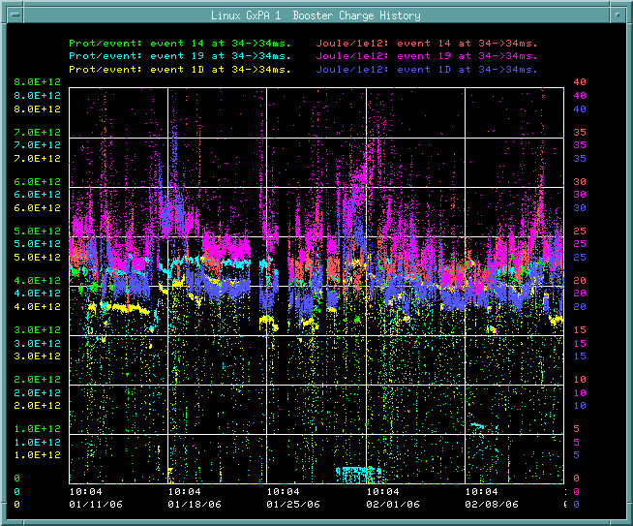
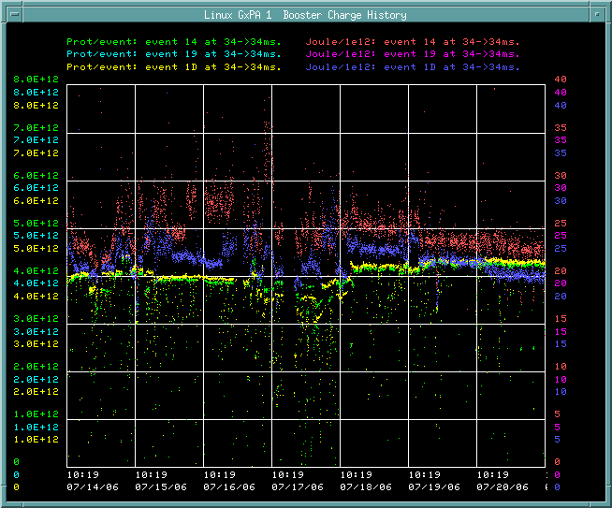
How are we doing (batch size/eloss)
Jan/Feb
Last Week

Slide 2
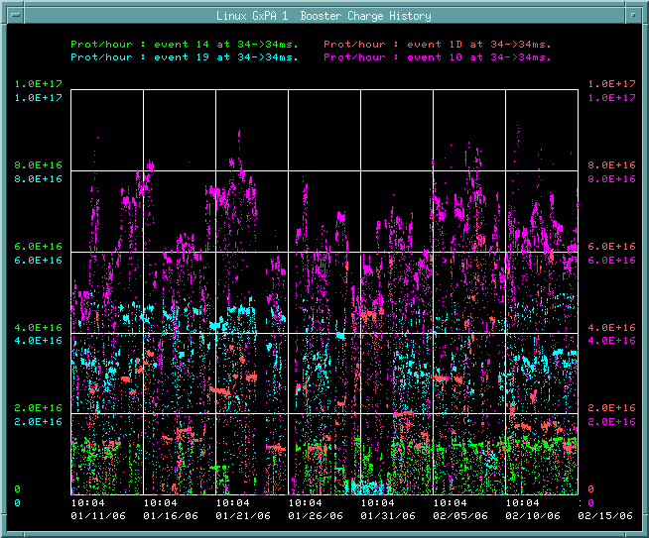
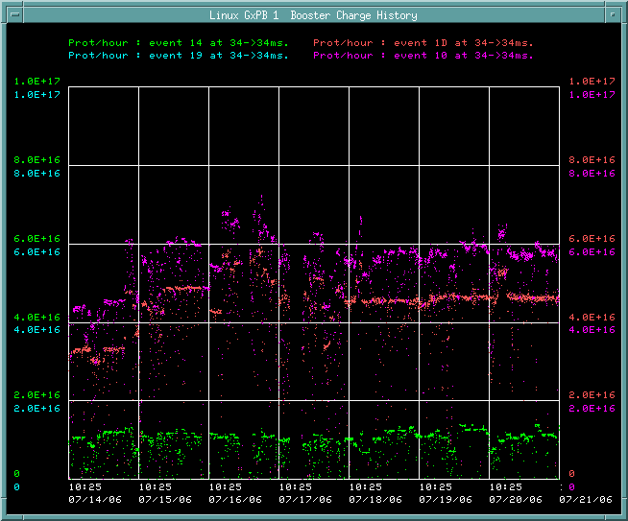
How are we doing (total rate)?
Jan/Feb
Since shutdown

Slide 3
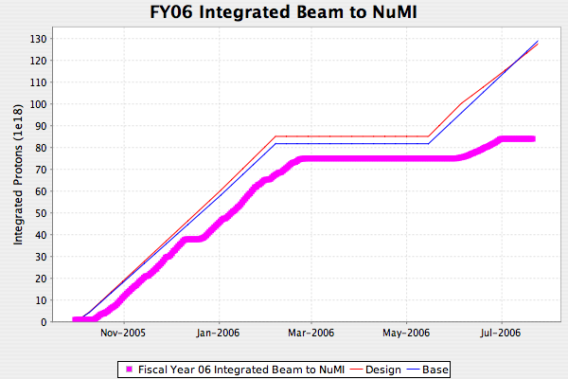
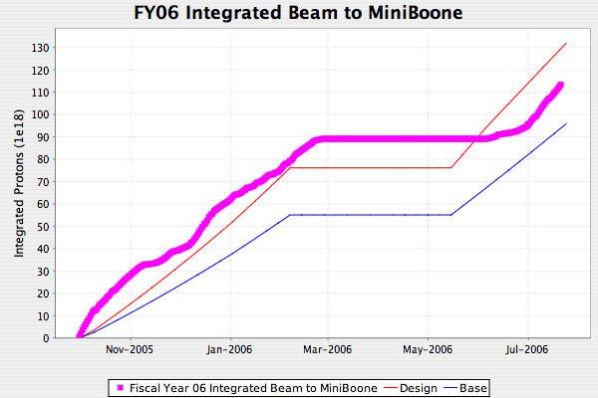
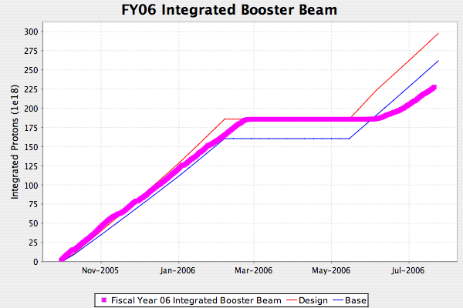
Proton Delivery

Slide 4
App Testing (Linux certification)
Alex Waller coordinating
  He has the authority to pressure you to test your applications.
Remember, insensitive and moderately sensitive applications do not have to be coordinated with the control room, but sensitive applications have to be mentioned at the 9AM meeting!
See link in Alex’s email for list of apps

Slide 5
High rate testing
RF groups would like to do some high rate testing of the Booster (9 Hz average).
We probably can’t send beam at 9Hz.
Is there an easy way to put in empty cycles w/o affecting operations?
  Does anything prevent us from putting in a bunch of NuMI cycles while they’re off?

