Slide 1
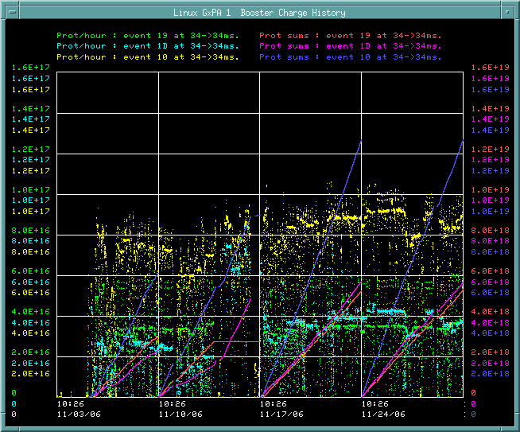
Last Four Weeks

Slide 2
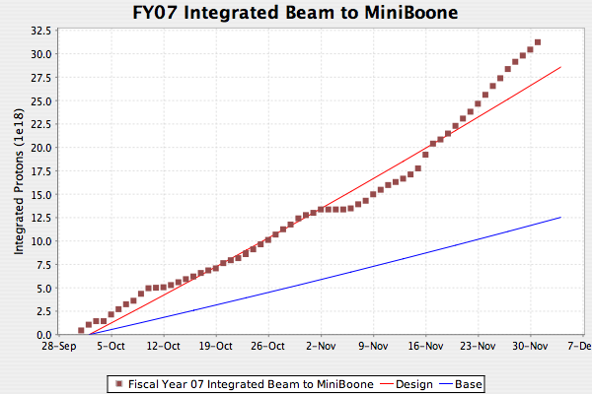
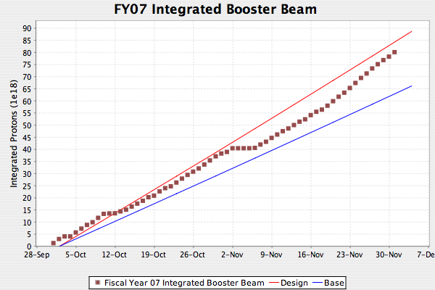
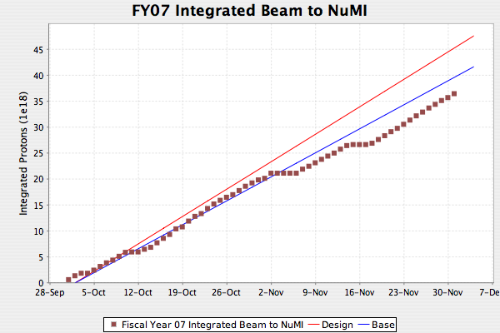
Proton Delivery

Slide 3
Kicker, Notching, etc
Notch in Linac
  Source
  750 keV line
  Transport issues?
Chopper notcher?
  When
Fast extraction kicker
  Fast magnetic? (fast enough?)
  Electrostatic (in two long straights)
    Too fast? (Recycler slip stacking)
New extraction?
  Milorad’s scheme?

