Slide 1
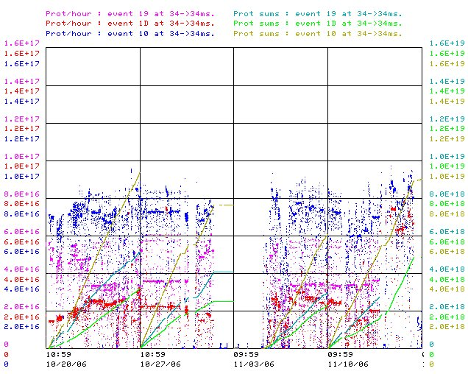
Recent Weeks

Slide 2
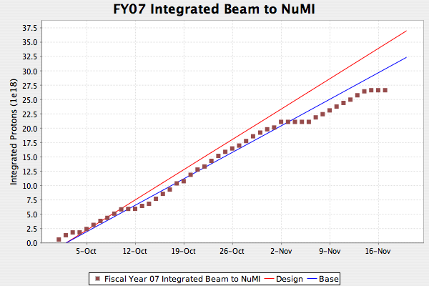
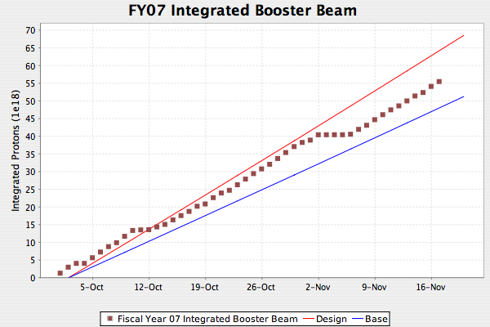
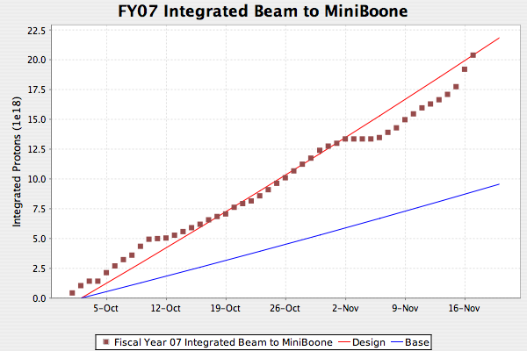
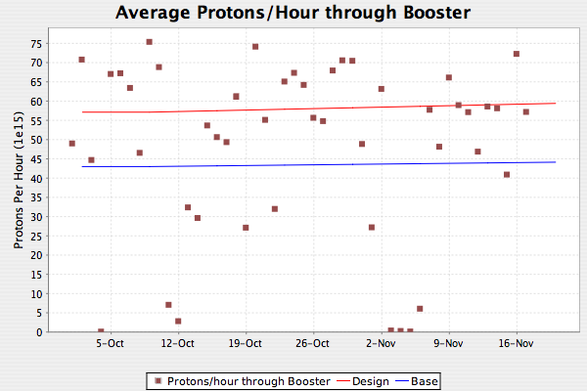
Delivery

Slide 3
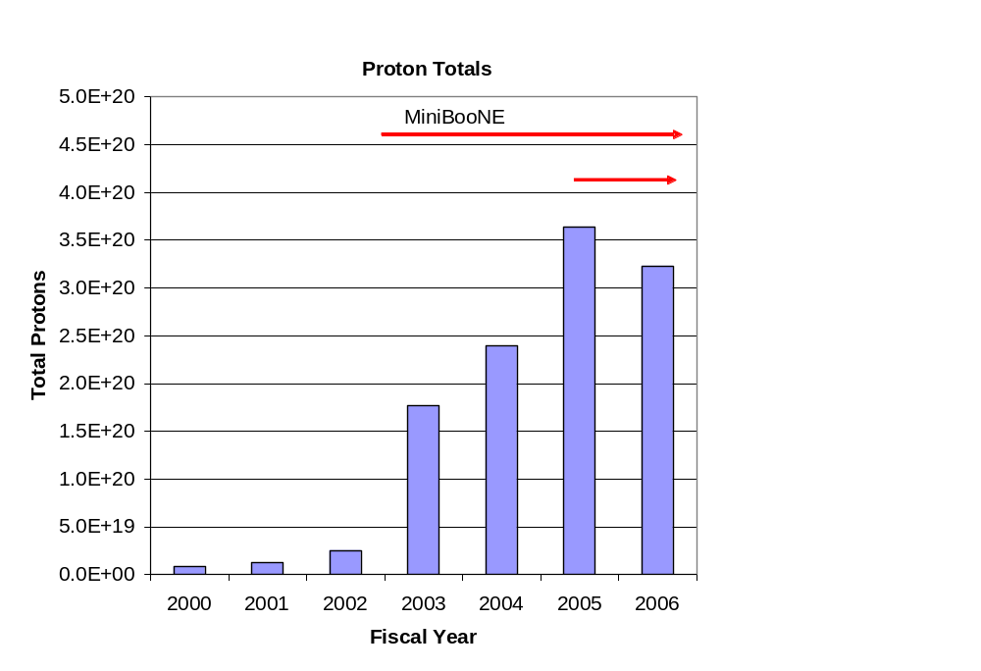
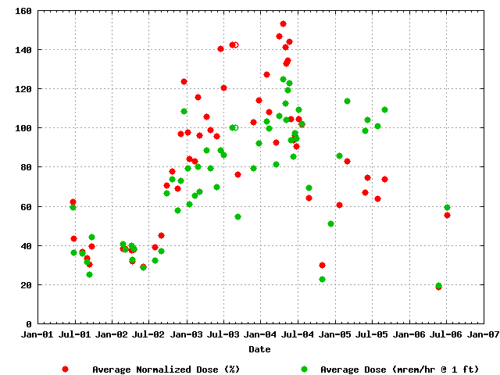
How far we’ve come (shown at SNuMI review)
Total Protons Delivered
Average Booster Activation
MiniBooNE
NuMI
Factor of 15-20 increase in protons

Slide 4
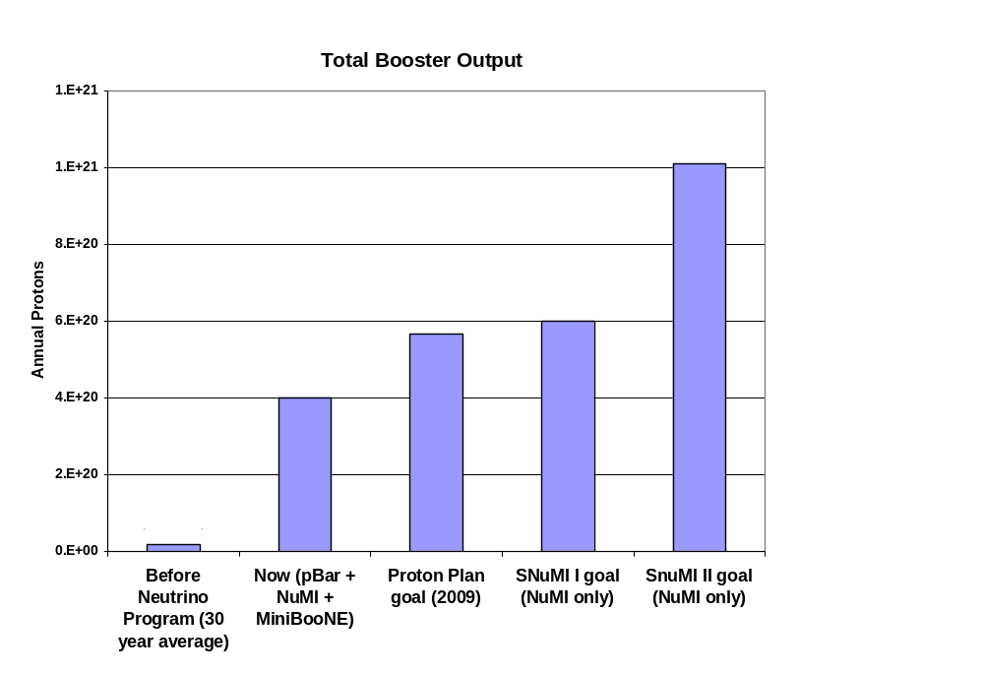
The future (shown at SNuMI review)
Present

