Slide 1
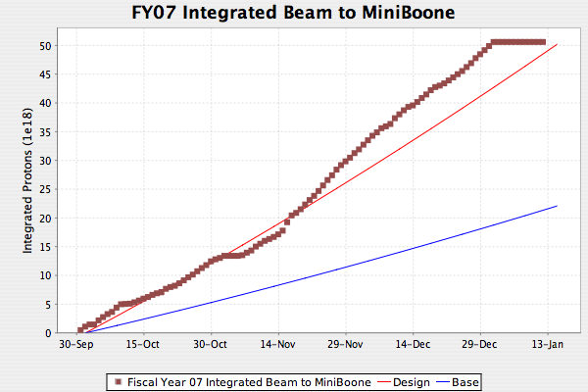
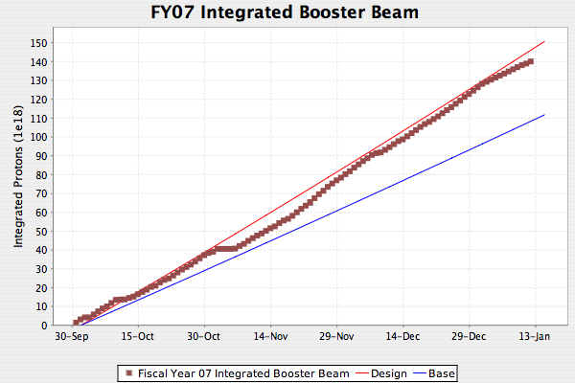
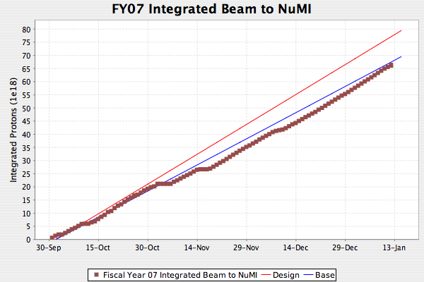
Proton Delivery
Because MiniBooNE is off

Slide 2
General
The new Booster corrector system will have dramatically enhanced capability, however…
We are installing it at a time when there is great pressure to keep the machine running reliably for Run II and NuMI - neither of which will benefit in the short term from the improvements.
We could easily waste a lot of time commissioning the new system
It’s vital that we bring up the new system in a way such that it can be operated in a way very similar to the existing system
  This means ignoring some of the new capabilities
We can worry about taking for advantage of the new features later.

Slide 3
Important Differences between present (465) and new (473) ramp Modules
Update rate:
  465: 10 kHz
  473: 100 kHz
DC Offset:
  465: not available on the module; implemented in hardware for quads.
  473: implemented within the module.
MDAT:
  465: can load up to two lookup tables based on MDAT inputs
    We do not use this feature at the moment
  473: not implemented in the prototype
    Do we want it?

Slide 4
Trim Dipole Control
Now:
  Low beta points (B:VSn, B:HLn)
    Constant DC level
  High beta points (B:VLnRT, B:HSnRT)
    Controlled by individual 465 ramp modules
After 2007 Shutdown:
  All long sections (B:VLn??, B:HLn??)
    Controlled by individual 473 ramp module
  Short vertical trims (B:VSn)
    Constant DC level
  Short horizontal trims (B:HSnRT)
    Controlled by 465 ramp modules
After 2008 shutdown:
  All trims (B:VSn??,B:VLn??,B:HSn??,B:HLn??)
    Controlled by independent 473 ramp modules

Slide 5
Trim Quads and Skew Quads
Now
  All quads and skew quads have individual DC levels (B:QSn, B:QLn, B:SSn, B:SLn).
  On top of this a common ramp is added (in hardware) for each type of quad
    B:QLRMP, B:QSRMP, B:SSRMP, B:SLRMP
    Note: each of these types actually has four ramped controllers, but these are always controlled in unison as one pseudo-device
After 2007 shutdown:
  All long quads and skew quads will have dedicated 473 ramped controllers
    Individual DC levels are now implemented within the module, rather than with a hardware sum.
  Short quads and skew quads remain as they are
After 2008 shutdown:
  All quads and skew quads will have dedicated 473 ramped controllers

Slide 6
Sextupole and Skew Sextupole
Now
  Odd short sections only
    Sextupoles controlled by single ramp (B:SEXTS)
    No individual DC control
    Correct horizontal chromaticity
  Long sections 4, 10, and 18
    Sextupoles (3 in each section) controlled by a single ramp (B:SEXTL)
    No individual DC control
    Correct vertical chromaticity
  Long sections 4, 5, 6, and 7
    Pairs of normal and skew sextupoles
    Controlled in pairs by DC levels (no ramps)
      B:SEXL4 = normal 4 and 7
      B:SEXL5 = normal 5 and 6
      B:SEXL6 = skew 5 and 6
      B:SEXL7 = skew 4 and 7
    Used to cancel 6.667 resononces
After 2007 shutdown
  All long sections will have individually ramped normal and skew sextupoles
After 2007
  All sections will have individually ramped normal and skew sextupoles

Slide 7
Affected Applications
B2: Injection Parameters
B6: Aperture scan bumps (do we still use this?)
B11: All the individual trim parameters
B14-16: 465 ramp control
B71: Harmonic params
B75: Aperture scan program
B76: Harmonic corrector
B80: Closed orbit
B82: Ramped 3-bump
B93: Beta bumps (probably obsolete?)
B121: Booster tune scans (still used?)
Others?

Slide 8
Topics for Discussion
By now, Booster tuners have a “feel” for what a particular current change means for both dipoles and quadrupoles:
  This will be very different for the new corrector system.
  Is this important enough to consider defining a new unit (“old_amp”?) to make things look and feel like they are now?
In the case of the DC elements of the QUADS and DIPOLES, can we simply redefine the device names in such a way that we can leave the parameter pages alone?
  Is it too much to hope this might also be done with the time slots of the ramp cards?
Is there any problem generalizing the B:QLRMP, etc meta-devices to set 24 ramp cards, rather than 4 as they do now?
How much work is involved in generalizing the B14-16 ramp control devices to handle the 473’s and who will do it?
How are we going to deal with sextupoles in the new scheme?
  Could emulate existing system, but no particular reason not to go immediately to a more accurate set of harmonic corrections.
How do we proceed and who will be in charge?

