Slide 1
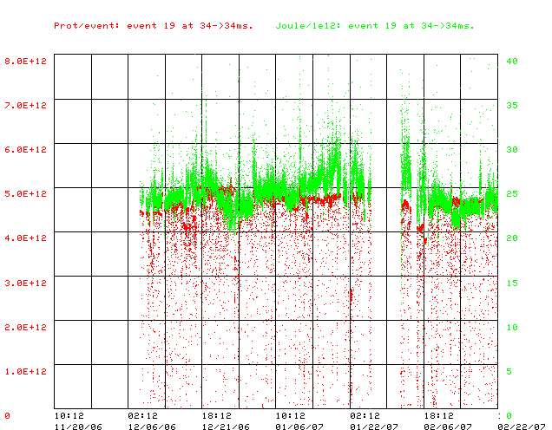
Energy Loss on NuMI cycles
Energy Loss (J/E12)
Protons/batch

Slide 2
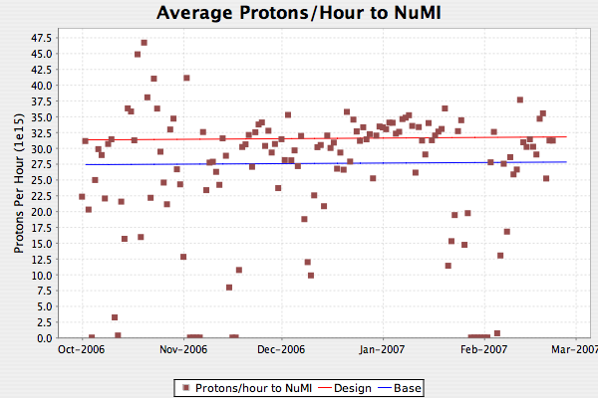
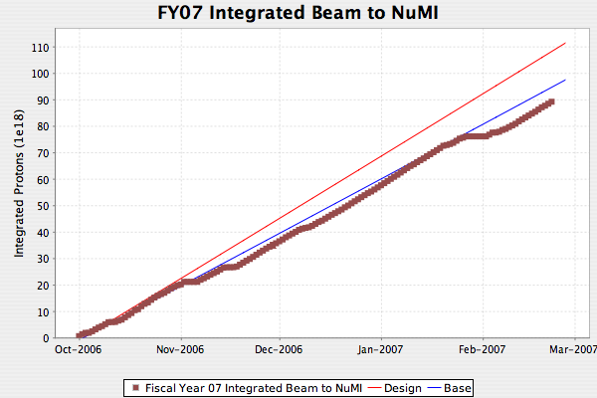
NuMI
Dotted lines are 2.4 second rep rate

Slide 3
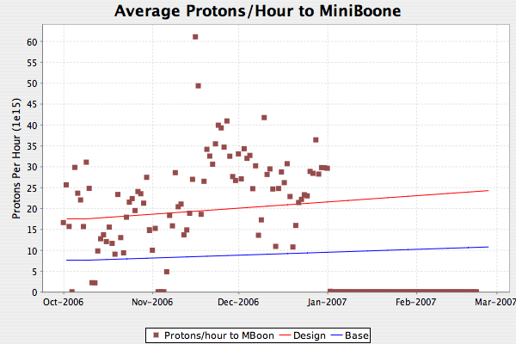
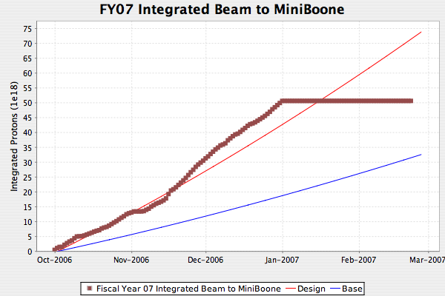
MiniBooNE
What can I say?

Slide 4
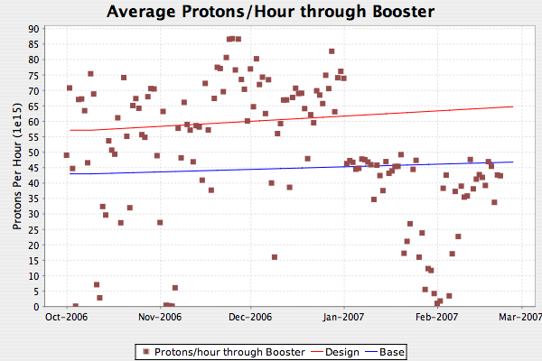
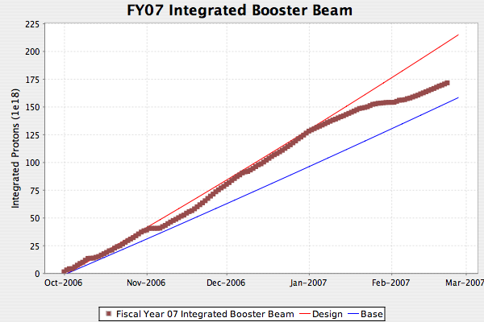
Total Booster Output
Mostly reflects loss of MiniBooNE

