Slide 1
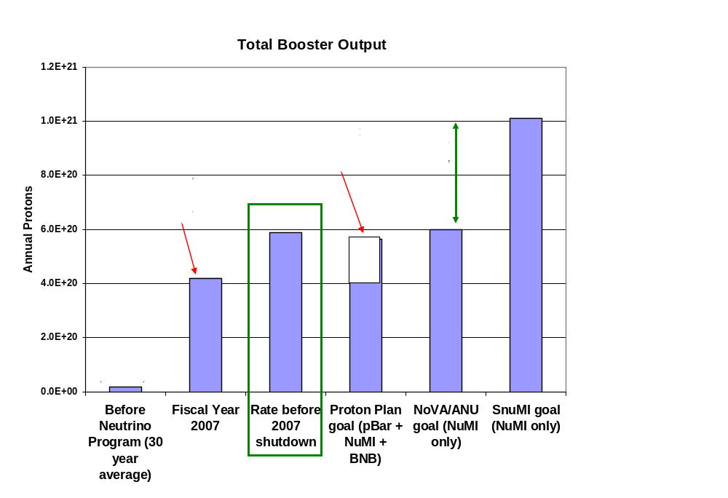
First, do no harm
2012

Slide 2
General Guidelines
Prior to the shutdown, the Booster was demonstrating ~all the proton capacity which it has promised through the start of high intensity NOvA operation in 2012.
Our overriding goal will be to return to this level of performance as quickly as possible.
  Want tuning to have the same “look and feel” as before.
Enhanced functionality of the new system (ramped HL correctors, distributed sextupoles) should not be used until we have demonstrated pre-shutdown performance without it
  i.e. we don’t want to use new features to compensate for tuning problems.

Slide 3
Proposed initial operation
Vertical Dipoles
  Ramped as before
  Preloaded with scaled versions of old ramps (??)
Horizontal Dipoles
  Run DC, using offset or direct DAC write.
  Preloaded with scaled pre-shutdown values
Quads
  Offset register loaded with scaled preshutdown DC values.
  Ramps: see next page
Sextupoles
  Initially off
  Later: harmonically controlled DC levels

Slide 4
Quad Ramp Operation
Want an aggregate devices, like B:QLRMP and B:SLRMP, to set all quads in parallel, BUT
Should not affect OFFSET register
  Want to tune those individually, as we do now
Options for mixed ramps
  Separate device for new and old in addition to existing QLRMP and SLRMP
    Sounds complicated to operate
  Redo QLRMP and SLRMP to include new and old ramps, with proper scaling
    Best initial option
    How hard?

Slide 5
To do list
Database entries – Triplett
Initial translation of old settings - Prebys
Parameter pages/mults (B2,3,6,11,12,etc) - ??
Ramp Applications (B14,15,16) – Waller (?)
Harmonic Corrector (B71) – Prebys (?)
Closed Orbit (B87)
  Initial porting – Prebys
  Upgrades for new ramps – Marsh
Ramped 3-bumps (B82) – Prebys
Aperture Scan (B75) - ??
What else?

