Slide 1
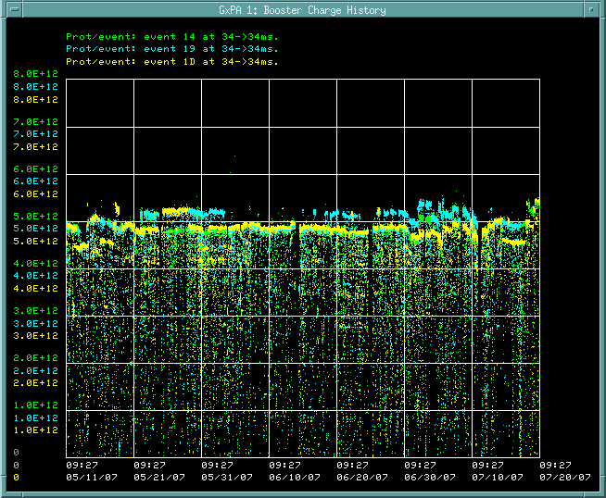
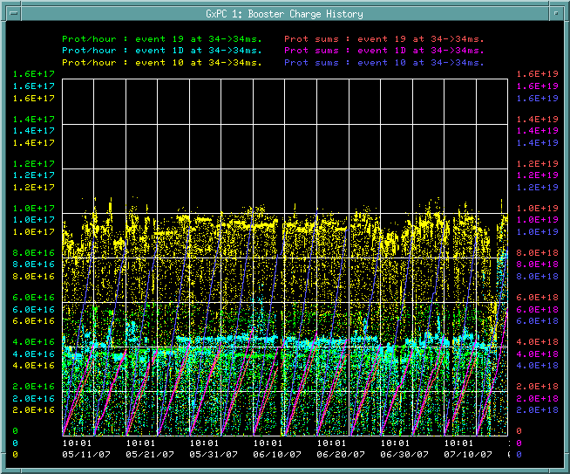
Best Running (June-July, 2007)
Batch Size
Intensity
5e12
1e17

Slide 2
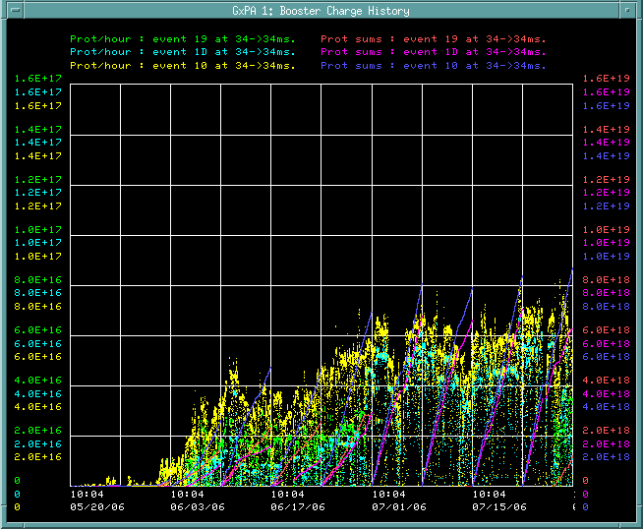
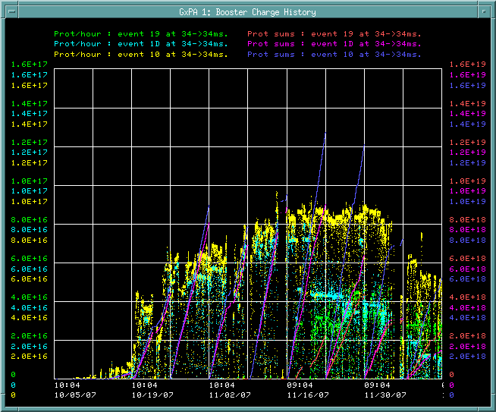
Intensity Ramp Up
1e17
1e17
After 2006 Shutdown
After 2007 Shutdown

Slide 3
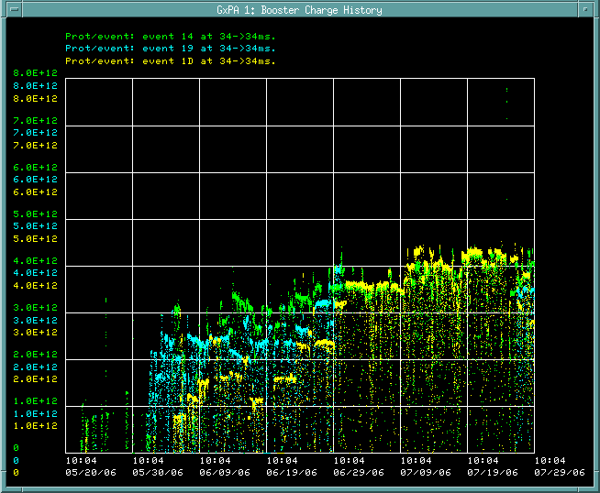
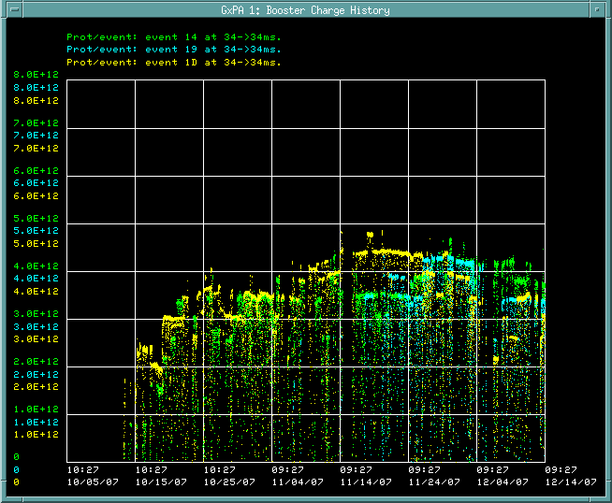
Batch Size Ramp Up
5e12
5e12
After 2006 Shutdown
After 2007 Shutdown

