Slide 1
Some Historical Issues with the Proton Source
Design predates good modeling tools.
Historically seen as “workhorse” of the lab.
Not always productive interaction between linac and booster.
Booster
Linac
400 MeV “DMZ”

Slide 2
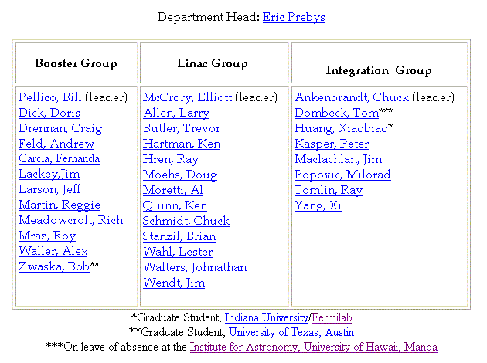
Jumping on the Restructuring Bandwagon…
Proton Source Department
New
New group. Responsibilies:
Coordinate modeling and studies
Address global issues

Slide 3
Some Specific Responsibilities within Department
Doug Moehs, Ray Hren: ion source
Lester Wahl: old linac RF (7835’s)
Al Moretti: new linac RF (klystrons)
Elliott McCrory: linac control loops
Larry Allen: Linac tuning
Jim Lackey: Everything Booster
Roy Mraz: Booster power supplies
Bill Pellico: Low-level RF
Ray Tomlin: Booster tuning
Chuck Ankenbrandt: Coordinates studies, liaison (and filter) to other beam physics people.

Slide 4
Issues to be resolved
Too many things overly “expert-dependent”.
Too many things “right-brained”.
Reproducibility still a big issue.

