Slide 1
Proton Plan Stage I
Eric Prebys

Slide 2
Charge
Develop a plan for a set of upgrades and operational improvements to maximize proton delivery to:
  NuMI beamline (120 GeV from MI)
  Booster Neutrino Beam (BNB) (8 GeV from Booster)
Goal: complete the upgrades over the next 3 years, and operate through 2015 or beyond
  Note: this plan precedes the Proton Driver replacement of the existing Proton Source (Linac+Booster)
Develop the budget and timeline for these improvements
Estimate projected proton delivery (PoT) to both beam lines

Slide 3
Limits to Proton Intensity
Total proton rate from Proton Source (Linac+Booster):
  Booster batch size
    Typical ~5E12 protons/batch
  Booster repetition rate
    15 Hz instantaneous
    Currently 7.5Hz average (limited by injection bump and RF cooling)
  Beam loss
    Damage and/or activation of Booster components
    Above ground radiation
Total protons accelerated in Main Injector:
  Maximum main injector load
    Six “slots” for booster batches (3E13)
    Up to ~11 with slip stacking (5.5E13)
    RF stability limitations (currently ~4E13)
  Cycle time:
    1.4s + loading time (1/15s per booster batch)
Operational Limit

Slide 4
Plan Strategy
See document: BEAMS-DOC-1441 (11/09/04) at http://beamsdocs.fnal.gov/cgi-bin/public/DocDB/DocumentDatabase
Increase the proton delivery from the Booster (to both NuMI and BNB)
  Increase acceptance by improving orbit control and beam quality
  Increase maximum average Booster repetition rate
Increase the beam intensity in the Main Injector for NuMI
  Main Injector multi-batch operation
  Slip stacking in Main Injector (probably requires RF upgrade?)
Improve operational reliability
  Alleviate 7835 Problem
  Linac quad supplies

Slide 5
Current Budget Guidance
After the cancellation of BTeV, we have the following budget guidance (M&S+SWF):
Most Likely Scenario
  Main Injector RF project and Booster Corrector System get delayed by one year, relative to the original plan
  Booster RF Solid State PA upgrade deferred indefinitely
 | FY05 | FY06 | FY07 | FY08 | Total
Present Guidance | 7327 | 7845 | 6915 | 6116 | 28203

Slide 6
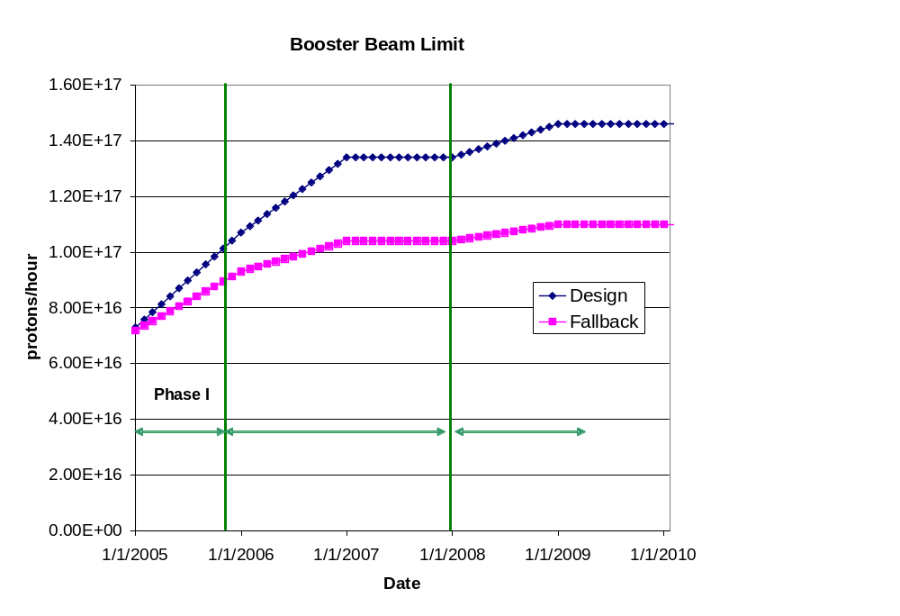
Booster Throughput
Major Improvements:
  New ORBUMP system (2005 shutdown)
  Relocate L13 dump to MI-8 line (2005 shutdown)
  New corrector system (2007)
  19th and 20th cavities added
Performance
  Rep rate (after 2005)
    7.5 Hz -> 8-9 Hz
  Total protons (by end 2008)
    8E16 pph -> 1.45E17 pph
  Batch size (by end 2008):
    5E12 -> 5.5E12
~7E20 p/yr

Slide 7
Main Injector Loading
Initial NuMI operation (“2+5”):
  Two batches are slip stacked for antiproton production
  Five more batches loaded for NuMI
  All are accelerated together
Ultimate NuMI operation (“2+9”):
  Five batches will be loaded into the Main Injector, leaving one empty slot
  Six more batches will be loaded and slipped with the first to make two for antiproton production and 9 for NuMI
  This may exceed the capacity of the current RF system

Slide 8
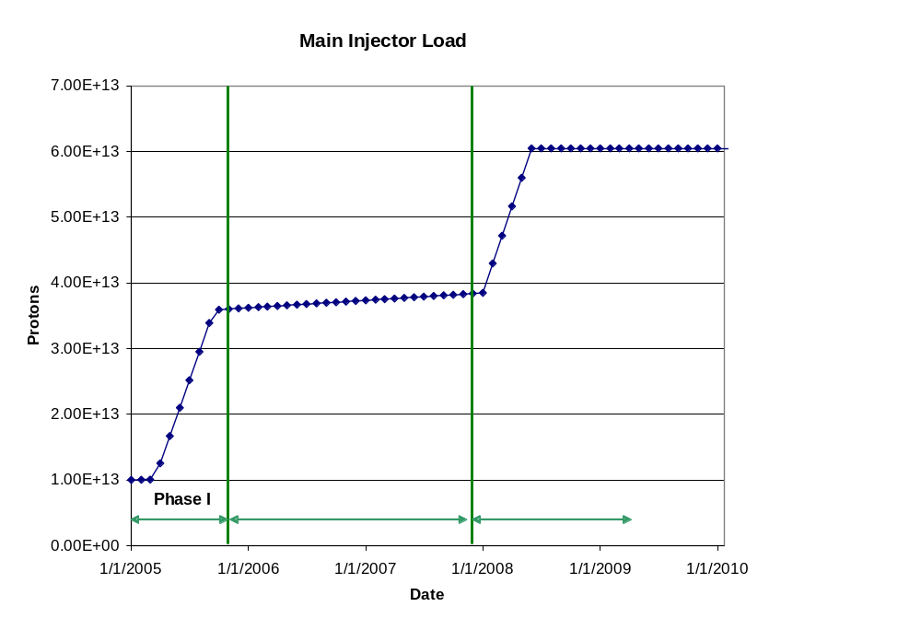
Main Injector Loading (cont’d)
Major Improvements:
  Large Aperture Quads (2005 shutdown)
  Loss monitoring and collimations system (TBD)
  Multi-batch operation
  Dual PA upgrade (??)
Performance
  2 (pbar) + 5 Numi 5E12 batches @ 2 sec in 2005
  2 (pbar) + 9 NuMI 5.5E12
  Batches @ 2.2 sec in 2008

Slide 9
Main Injector RF Issues
The Main Injector Upgrade path remains the single largest uncertainty in the Proton Plan
  Might be possible to reach intensities of the current Plan without upgrades of any kind.
Towards a decision
  Proceed with two/PA prototype
  Proceed with systematic studies in the Main Injector
  Organize a workshop this summer
    Will consider the following
      Potential of feed forward system
      Potential and concerns with two PA solution
      New RF system proposals.
    Will coordinate needs of current plan, Stage II Plan, and Proton Driver
    Generate a perfomance/price table
  Goal: reach a decision for Stage I by end of FY05

Slide 10
Proton Projections
Phases of Operation
  Phase I (now)
    Booster lattice distortions ameliorated
    Booster limited to 7.5Hz total repetition rate
    Main Injector limited to 4E13 protons (2+5 operation)
  Phase II (after 2005 shutdown)
    Injection bump (ORBUMP) replaced
    Drift tube cooling in Booster RF cooling finished
    Booster capable of 8-9Hz operation
    MI still limited to 2+5 operation
  Phase III (after 2007 shutdown)
    MI RF upgrade complete
    2+9 operation to NuMI

Slide 11
“Design” PoT from the document
 | Booster Batch Size | Main Injector Load | Cycle Time | MI Intensity | Booster Rate* | Total Proton Rate | Annual Rate at end of Phase
 |  | (AP + NuMI) | (sec) | (protons) | (Hz) | (p/hr) | NuMI | BNB
Actual Operation
July, 04 | 5.0E+12 | 1+0 | 2.0 | 0.5E+13 | 5.1 | 0.8E+17 | 0 | 3.3E+20
Proton Plan
Phase I | 5.10E+12 | 2+1→2+5 | 2.0 | 3.6E+13 | 6.3 | 1.0E+17 | 2.0E+20 | 1.5E+20
Phase II | 5.3E+12 | 2+5 | 2.0 | 3.7E+13 | 7.5 | 1.2E+17 | 2.2E+20 | 2.8E+20
Phase III | 5.50E+12 | 2+9 | 2.2 | 6.0E+13 | 8.3 | 1.5E+17 | 3.4E+20 | 2.2E+20
Beyond Scope of Present Plan
11 Hz | 5.50E+12 | 2+9 | 2.2 | 6.1E+13 | 11.0 | 2.0E+17 | 3.4E+20 | 5.0E+20

Slide 12
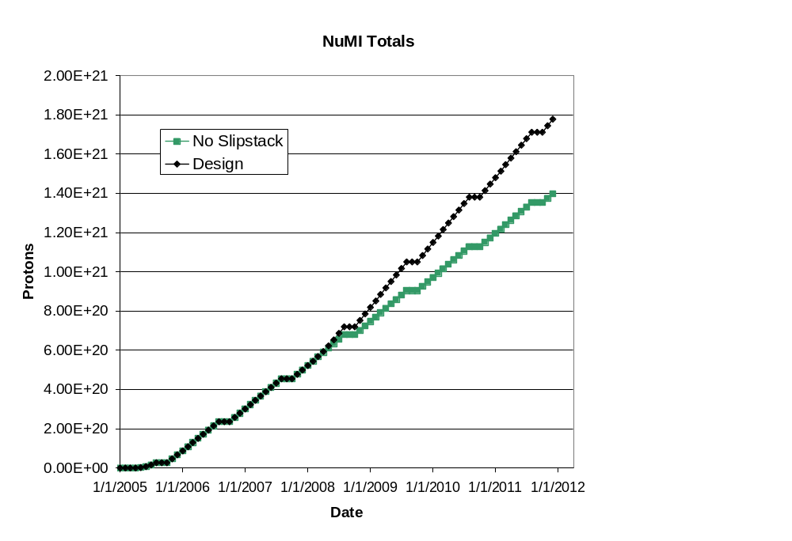
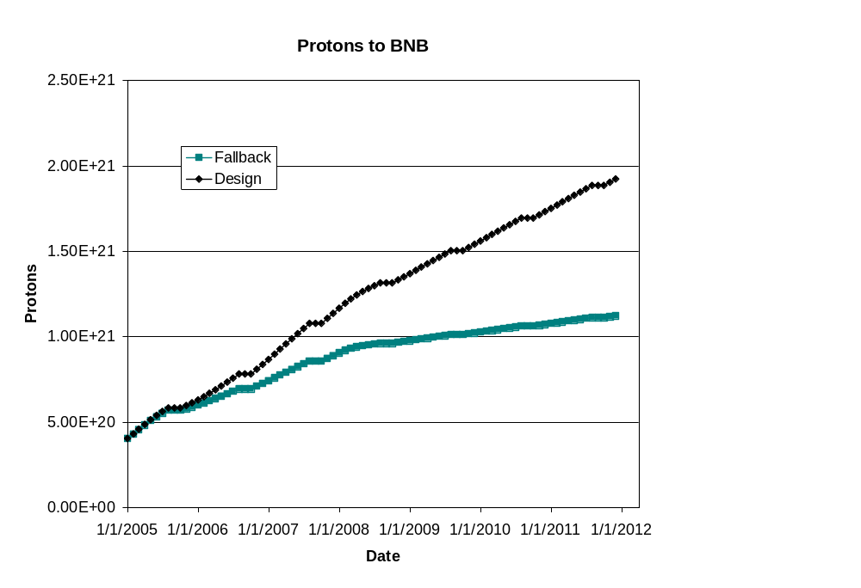
Long Term Projections
Note! Does NOT reflect NuMI’s recent troubles!
This turn-on is slower than in document
NuMI fallback = slip-stacking fails
BNB fallback = poor performance of Booster aperture upgrades
BNB only runs during shot setup

Slide 13
Issues beyond Stage I
In the existing proton plan, total proton rates continue to be limited by beam loss in the Booster:
  We believe this will go to ~1.45E16 pph over the next few years.
  This is about enough for the basic Recycler retasking proposal, but it would have to go to 2E16 or more for some of the more aggressive schemes.
Once ORBUMP is replaced and RF cooling is implemented, the Booster rep. rate will be limited by main power to the RF system (modulators + bias supplies):
  Exact limit being determined, but believe it is 8-9 Hz
  Probably significant upgrade to enable 15 Hz operation.
Linac also has total throughput limitations:
  Primarily beam loss in the 400 MeV labyrinth
  These would have to be investigated to go beyond Stage I.

