Slide 1
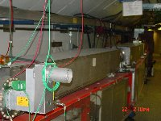
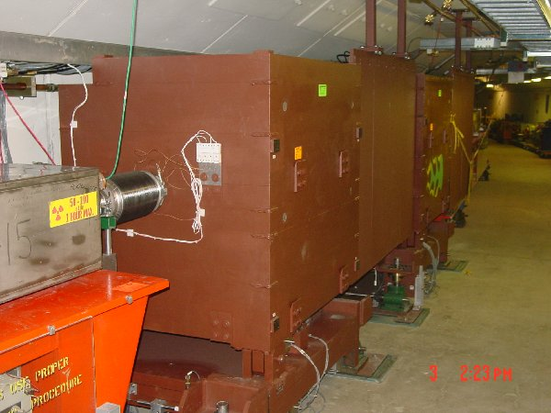
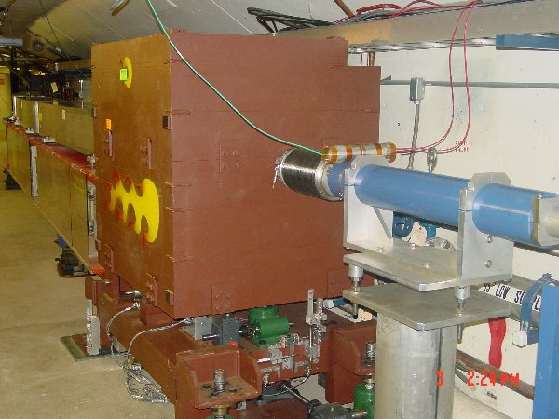
New Collimator System
Basic Idea…
A scraping foil deflects the orbit of halo particles…
…and they are absorbed by thick collimators in the next periods.
Should dramatically reduce uncontrolled losses

Slide 2

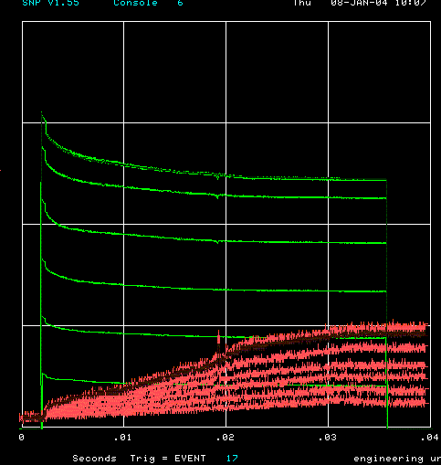
How far have we come?
Before MiniBooNE
Now (same scale!!)
Charge through Booster cycle
Time (s)
Energy Lost
Note less pronounced injection and transition losses

Slide 3
Collimator Control
Each collimator has 4 independent motions
  Vertical: ALL can completely occlude the beam from top or bottom.
  Horizontal: ALL can at least partially occlude the beam from either side.
  Pitch: +- 10 mrad. Pivot approx. at upstream face.
  Yaw: +- 10 mrad. Pivit approx. at upstream face.

Slide 4
Tools for Evaluating Collimators
B136
  Snapshot all BLM’s as a function of time for a particular cycle.
  Can average several cycles for increase accuracy:
    Cycle to cycle variations are a major complication.
  Can display in a variety of ways
    Absolute
    Difference from reference set
    Percentage difference from Reference Set

Slide 5
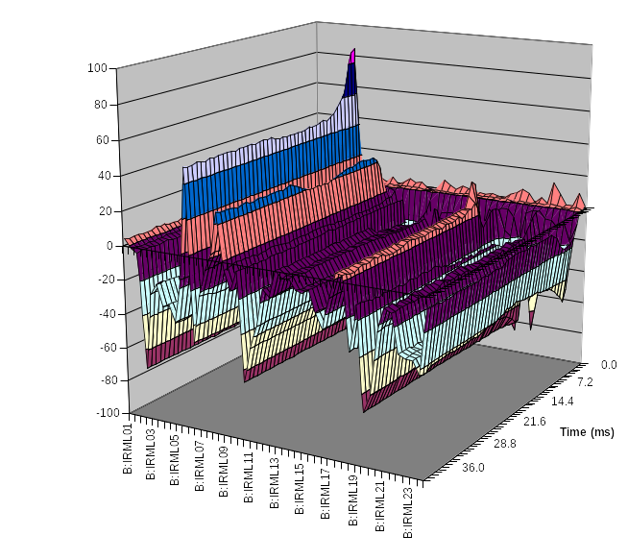
Collimator Studies
Collimator location
Shown is the effect of putting in one of the secondary collimators as a percentage change in losses as a function of time around the ring.
So far, putting in primaries has limited effect, if any.
location

Slide 6
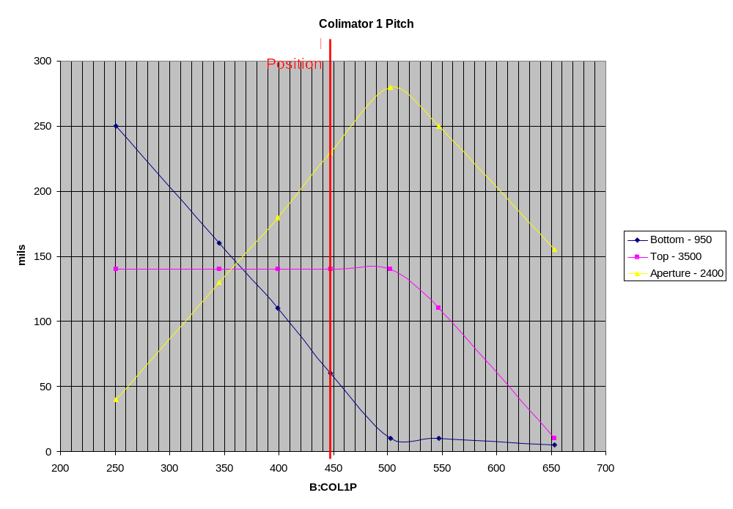
Collimator Alignment to Beam (COL1 Pitch)
Adjust Pitch and do scans.
Find position where beam is fully occluded for each pitch setting.
Aperture should be maximum when collimator parallel to beam.
Works well in vertical plane
Accuracy ~100 urad probably possible.

Slide 7
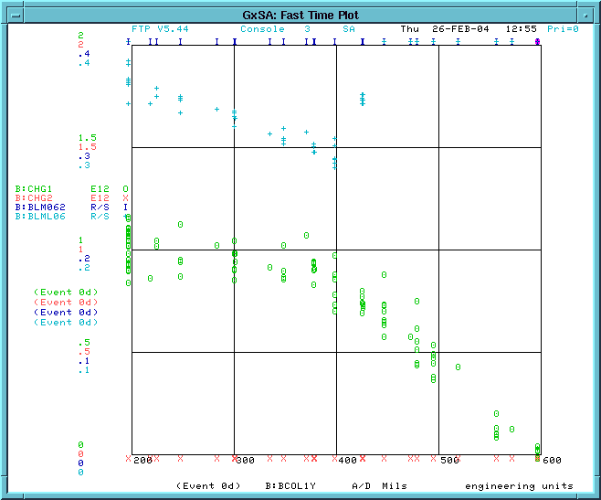
Alternate Technique for Horizontal Plane
Not enough range to fully occlude beam, so try alternate technique
  Put col as far into beam as it will go.
  Scan yaw position.
  Expect no dependence until collimator passes parallel point.
Surveyed Position

Slide 8
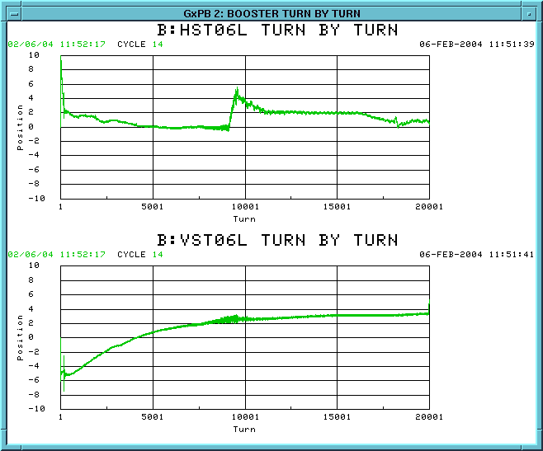
Beam Motion in Cycle
Injection Slewing

Slide 9
Some Questions
What is the best optimum primary collimator thickness?
How parallel must we get the collimator to the beam?
How important is beam motion?
What is the best procedure for determining the optimum collimator positions?

