Slide 1
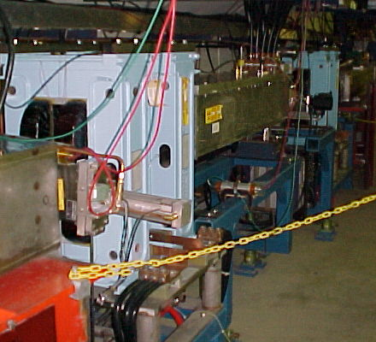
Dogleg Problem
Septum
Each of the two Booster extraction septa has a set of vertical dogleg magnets to steer the beam around it during acceleration.
More powerful doglegs were installed in 1998 to reduce losses early in the cycle.
These magnets have an edge focusing effect which distorts the horizontal injection lattice:
  50% increase in maximum β
  100% increase in maximum dispersion.
  Harmonic contributions.
Effect goes like I². Now tune to minimize.
Working on schemes to reduce or remove problem.
Dogleg Magnets

Slide 2
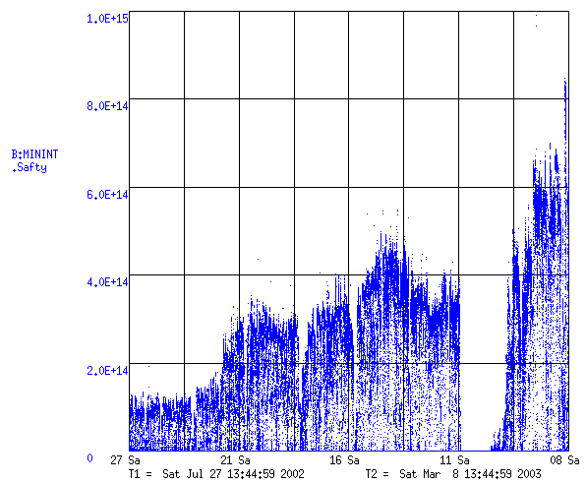
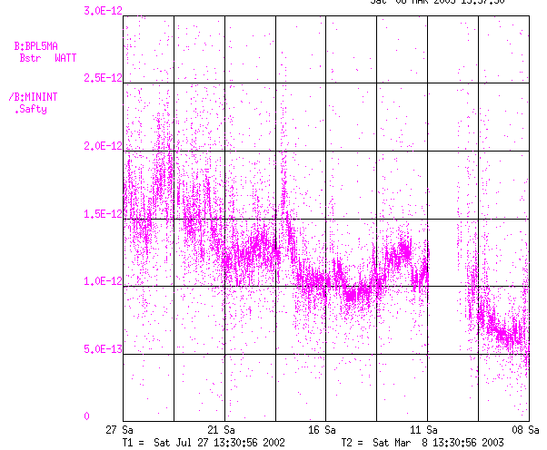
Booster Performance
Tune to reduce dogleg currents
MiniBooNE
Total Booster Output (protons/minute)
Test with one dogleg off (halfway to MiniBooNE goal!)
Energy Lost per Proton
(W-min/proton)

Slide 3
Other Major Booster Projects
Collimation system:
  Previous design scrapped as unworkable
  New design almost complete. Procurement started.
  Complete ~June 1
Large Aperture RF Cavities:
  Increase aperture from 2 ¼ “ to 5”
  Powered prototype tested
  Two vacuum prototypes being built for summer shutdown, with majority of machining done at MiniBooNE and NuMI universities (Princeton, Columbia, Indiana, CalTech, Tufts, Texas).
  Propose to build whole new system (18 cavities).
  Would also like to replace power supplies (would pay for itself in a few years).
Booster studies:
  Recent physics staff increases and dramatic increase in involvement of Beam Physics Department.
  Already paying off (e.g. dogleg problem).

