Slide 1
A Robot for the Booster??
Everybody loves robots.
Everybody thinks a robot is a good idea in the Booster.
Everybody has a very different idea what such a robot should do.
General questions to be answered:
  Robot features:
    Single radiation measurement?
    Differential ionization measurement caliper (i.e. two sides of beam pipe)?
    Live camera (rad issues)?
    Temerature?
  Robot motion:
    Track?
    Line on floor?
    Free roaming?
  Robot control and communication:
    Radio (RF interference)?
    IR (bandwidth)?
    Automated motion or fly by wire (or both)?
  Radiation issues
Nuts and bolts
  Who will design?
  Who will build (good project for universities??)

Slide 2
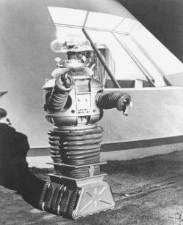
B9 “Robot” – Example of a Bad Design
Powerpack in very vulnerable spot
Very impractical hands
Could not bend to reach the ground
Wheels very bad for alien terrain

