Slide 1
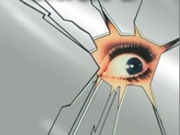
The Mirror Crack’d*: History and Status of CP Violation Studies
Eric Prebys (UR ‘90*), Fermi National Accelerator Laboratory
Representing the
BELLE Collaboration
*apologies to Agatha Christie

Slide 2
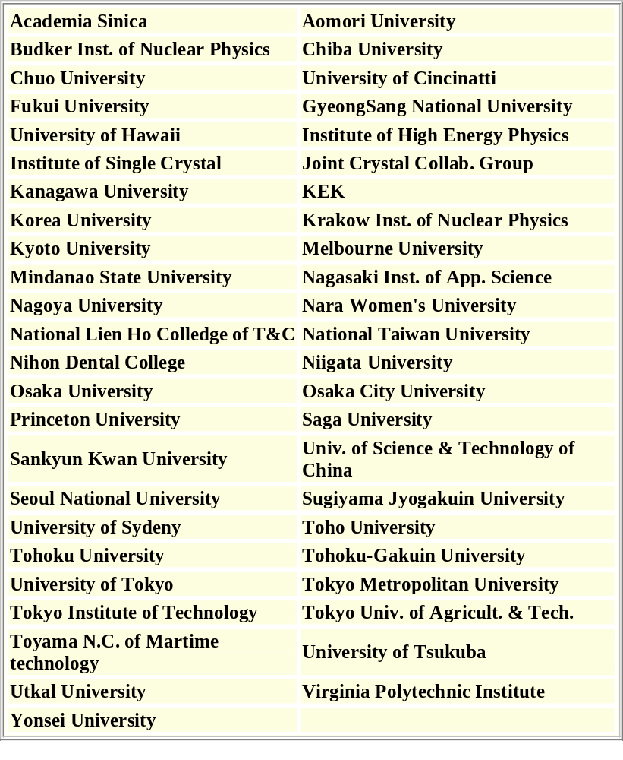
The BELLE Collaboration
≈300 people from 49 Institutions in 11 Countries:
Australia, China, India, Korea, Japan, Philippines, Poland, Russia, Taiwan, Ukraine, and USA

Slide 3
Just to set the tone….
Dear Eric,
I just returned to Rochester and I am happy to know that Tom has invited you for a colloquium on Sep 26. Can you send me a title of your talk at the earliest. I would like to tell you a few things that Tom may not have mentioned. First, you will be the first speaker of the semester and, therefore, you carry a great responsibility for presenting a very good colloquium. Second, since our colloquium attendance has thinned over the years (because of bad talks, specialized talks), I have assured the students that I will only invite extraordinary speakers who can give a very general talk to graduate students across all disciplines. So, I would like you to prepare your talk keeping this in mind. In particular, what this means is that please do not make it a talk on experimental physics, rather on physics. Remember the time when you were a student and the kinds of things you hated in colloquia, please avoid them. Not all the students will be from high energy physics. In fact, many are from optics, astronomy and so a talk with less display of detectors etc and with a greater balance of theoretical motivation and the explanation of results would be highly appreciated.
Why am I telling you all this? Well, first of all, you were our former student and as such I have a right to ask you for things. Second, you will be the first speaker and if the students are not thrilled with your talk, the attendance may shrink in the subsequent talks. On the other hand, if your talk is superb, which I hope it will be, more people will show up for the later talks (people have a tendency to extrapolate). In any case, please keep in mind that you will be talking to a general audience and not to a group of experimentalists.
Let me know when your itinerary is complete, but please send me a title in a couple of days.
With very best regards,
Ashok.

Slide 4
Outline
Why do we care?
History
  Parity Violation
  V-A Currents and CP (almost) Conservation
  CP Violation in the Neutral K System
  The Cabbibo-Kobayashi-Maskowa Mechanism
  “The” Unitarity Triangle
The Present
  Direct CP Violation in the Neutral K System (ε’/ε)
  Indirect CP Violation in the B meson System (B-Factories)
The Future?

Slide 5
Why do We Care?
Dirac first predicted antimatter in 1930 as a consequence of the “extra” solutions to his relativistic formulation of quantum mechanics - and was widely ridiculed.
The positron (anti-electron) was discovered by Anderson in 1932 and the anti-proton was discovered by Segre and Chamberlain in 1955.
Now we are all quite comfortable with the idea of antimatter as “equal and opposite” to matter, e.g.
…but why does the universe seem to be made entirely of matter?
Why do there seem to be tiny differences in the physics of matter and antimatter?
These legitimately qualify as “big questions”.
“Of course, there is only one correct mixing ratio of matter and antimatter: one to one!” – Star Trek, The Next Generation

Slide 6




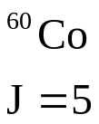
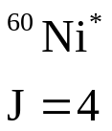

Parity Violation
The “parity” operation transforms the universe into its mirror image (goes from right-handed to left-handed).
Maxwell’s equations are totally parity invariant.
BUT, in the 50’s huge parity violation was observed in weak decays…
Example: β decay of polarized Co...
electron preferentially emitted opposite spin direction

Slide 7

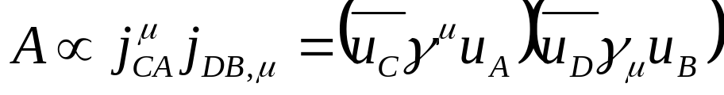








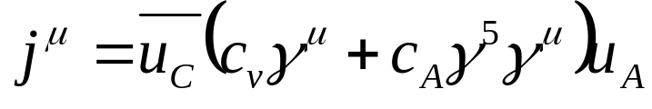


Weak Currents and Parity Violation
Review: QED
Transform like vectors
For weak interactions, try (“four fermion interaction”)
axial vector
vector
Manifestly Violates Parity!!

Slide 8
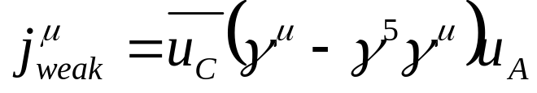
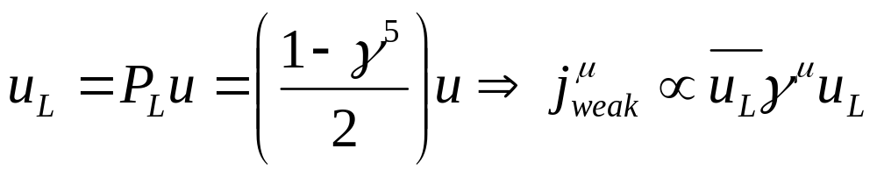
“V-A” Current
Experimentally, it was found that data were best described by
Maximum Parity Violation!!!!
Recall that for Direct Spinors, the left handed projection operator is
“Left-handed” current
For massless particles, spinor state = helicity state
Only Left-handed Neutrinos

Slide 9
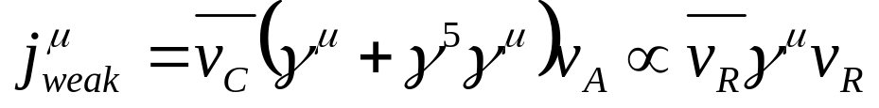
CP Conservation (sort of)
When we apply the usual Dirac gymnastics, we find that for anti-particles
Right-handed current
Only Right-handed anti-Neutrinos
Overall symmetry restored under the combined operations of C(harge conjugation) and P(arity).
CP Conservation!!!
well, maybe not….

Slide 10
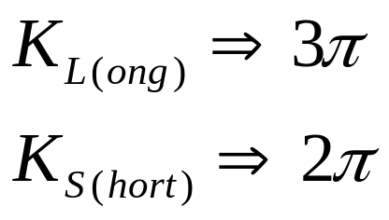
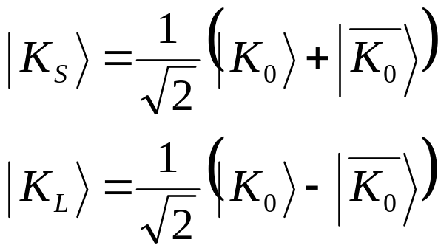
The Neutral Kaon System
In experiments in the 1950s, it was found that there were two types of neutral strange particles, of indistinguishable mass (498 MeV), but with different decay properties.
CP = -1
CP = +1
Because 3*m_{π} ≈ m_{K} , the K_{L} lives about 600 times longer than the K_{S}, hence the names.
Strangeness eigenstates
Possible explanation:
close, but not quite correct…

Slide 11
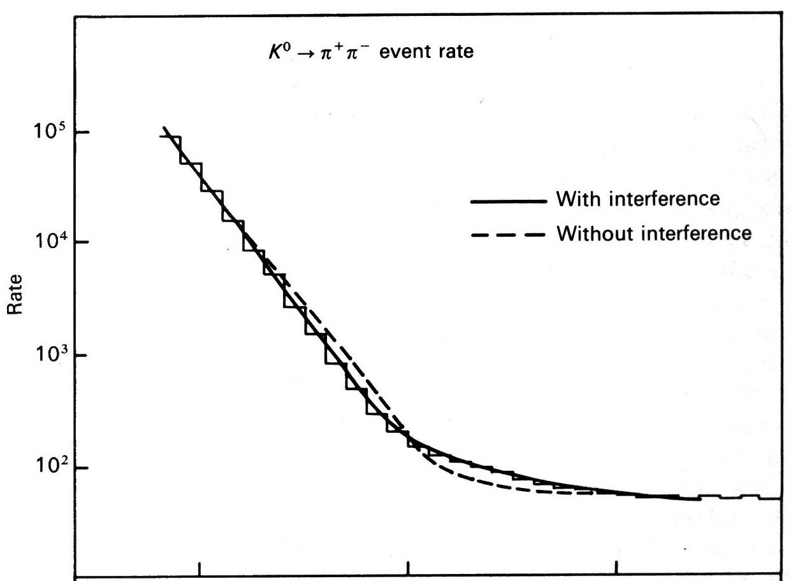
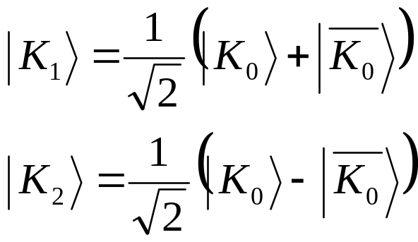
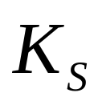
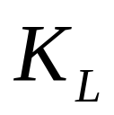
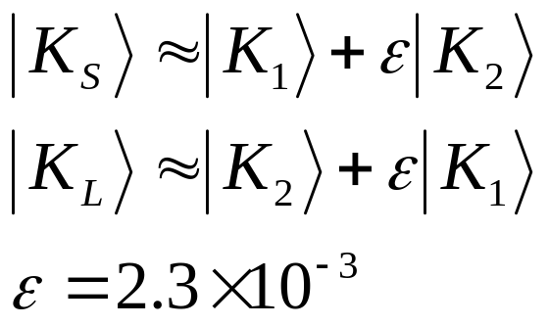



CP Violation in the Neutral K System
In 1964, Fitch, Cronin, etal, showed that in fact K_{L}⇒2π with a branching ratio on the order of 10⁻³.
Interpretation:
CP Eigenstates
Mass Eigenstates

Slide 12
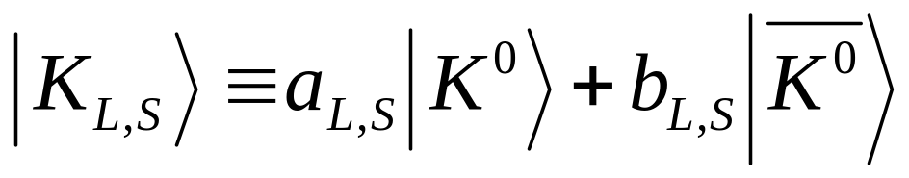
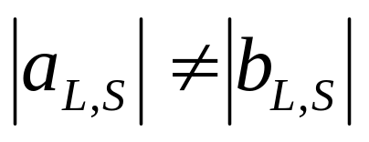

The Significance
In other words…
where
This generated great interest (not to mention a Nobel Prize), and has been studied in great detail ever since, but until recently had only been conclusively observed in the kaon system.
Unlike parity violation, it is not trivial to incorporate CP violation into the standard model. To understand how it is done, we must now digress a bit into some details of fundamental particle interactions….

Slide 13
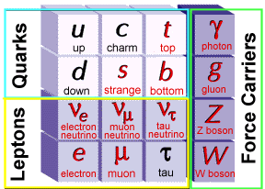







Weak Interactions in the Standard Model
In the Standard Model, the fundamental particles are leptons and quarks
quarks combine as
to form hadrons
leptons exist
independently
In this model, weak interactions are analogous to QED.
OR

Slide 14
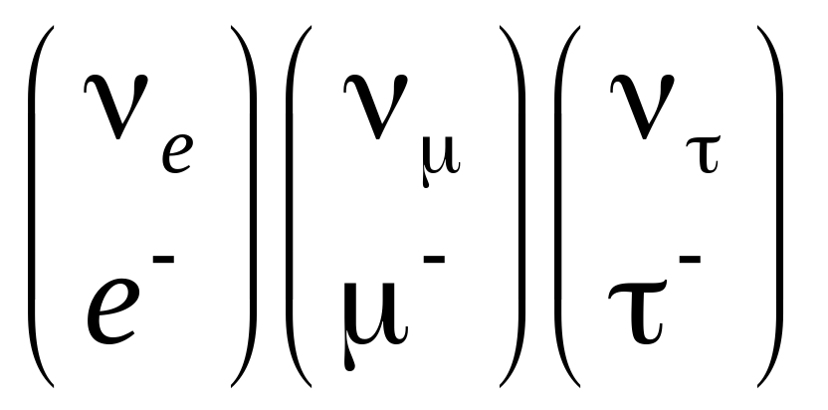
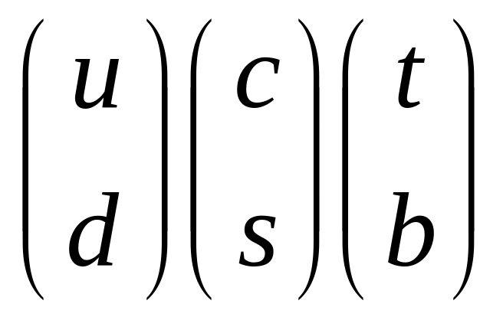
Quark Mixing
In the Standard Model, leptons can only transition within a generation (NOTE: probably not true!)
Although the rate is suppressed, quarks can transition between generations.

Slide 15
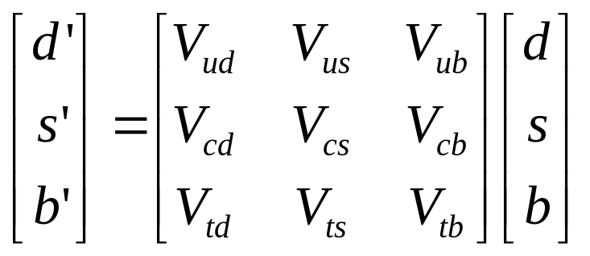
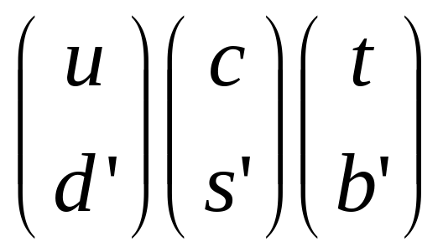






The CKM Matrix (1973)
The weak quark eigenstates are related to the strong (or mass) eigenstates through a unitary transformation.
Cabibbo-Kobayashi-Maskawa (CKM) Matrix
The only straightforward way to accommodate CP violation in the SM is by means of an irreducible phase in this matrix
This requires at least three generations and led to prediction of t and b quarks … a year before the discovery of the c quark!

Slide 16
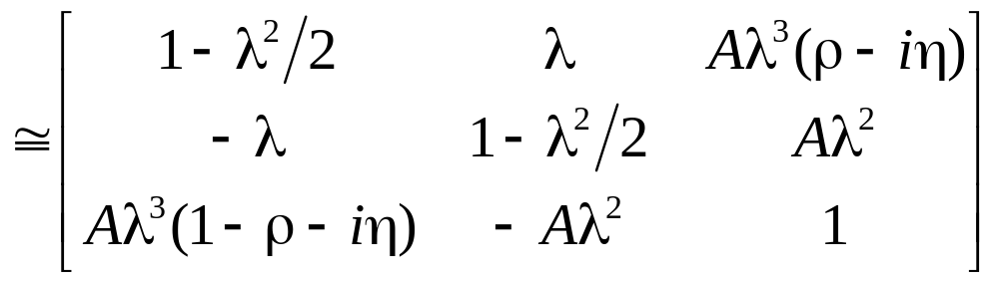
Wolfenstein Parameterization
The CKM matrix is an SU(3) transformation, which has four free parameters. Because of the scale of the elements, this is often represented with the “Wolfenstein Parameterization”
CP Violating phase
First two generations almost unitary. λ= sine of “Cabbibo Angle”

Slide 17
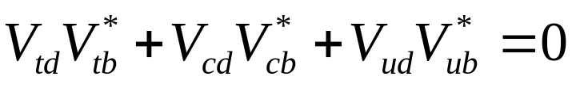
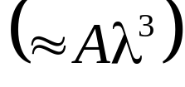
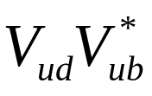

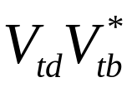


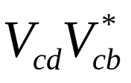
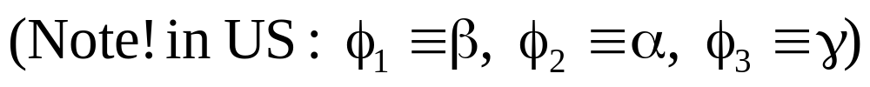
“The” Unitarity Triangle
Unitarity imposes several constraints on the matrix, but one (product first and third columns)...
results in a triangle in the complex plane with sides of similar length , and appears the most interesting for study

Slide 18

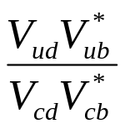
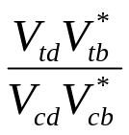


The ρ−η Plane
Remembering the Wolfenstein Parameterization
we can divide through by the magnitude of the base (Aλ³)….
CP violation is generally discussed in terms of this plane

Slide 19
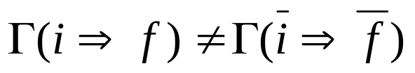
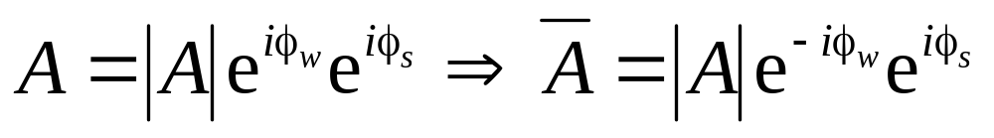
Direct CP Violation
CP Violation is manifests itself as a difference between the physics of matter and anti-matter
Direct CP Violation is the observation of a difference between two such decay rates; however, the amplitude for one process can in general be written
Weak phase changes sign
Strong phase does not
Since the observed rate is only proportional to the amplitude, a difference would only be observed if there were an interference between two diagrams with different weak and strong phase.
⇒ Rare and hard to interpret

Slide 20
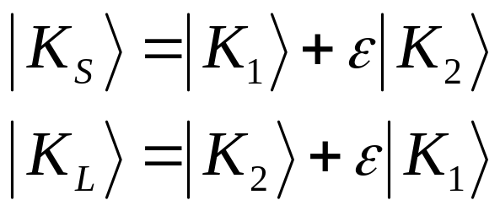
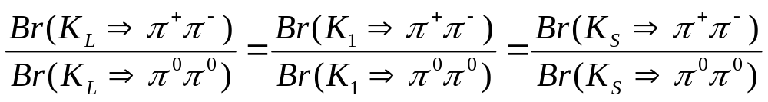
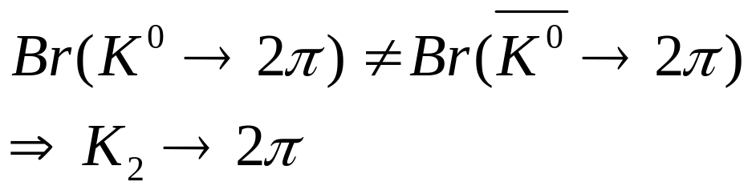
Direct CP Violation in the Neutral Kaon System (ε’/ε Measurement)
Recall…
If there is only indirect CP violation, then ALL 2π decays really come from K₁ , and we expect (among other things)
But the Standard Model allows
Direct CP Violation

Slide 21
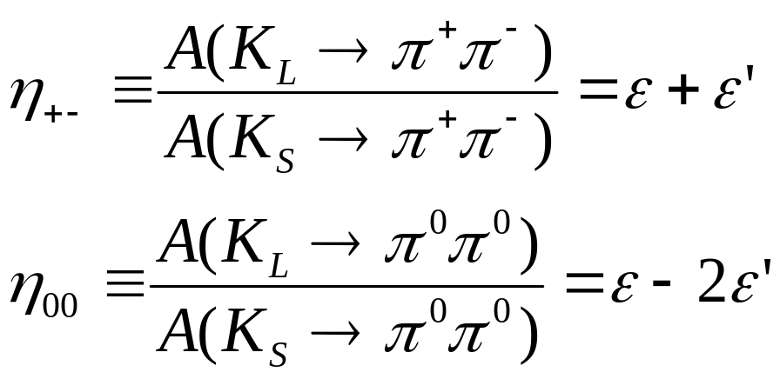
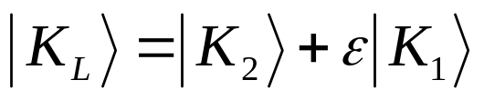
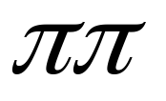
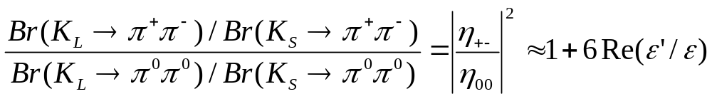
Direct CP Violation in the Neutral Kaon System (cont’d)
Formalism:
CP=-1
CP=+1
ε’
CP=+1
Theoretical estimates for ε’/ε range from 4-30 x 10⁻⁴

Slide 22




Easy to Measure….NOT!
Must take great steps to understand acceptances and systematic errors!!
Detector

Slide 23
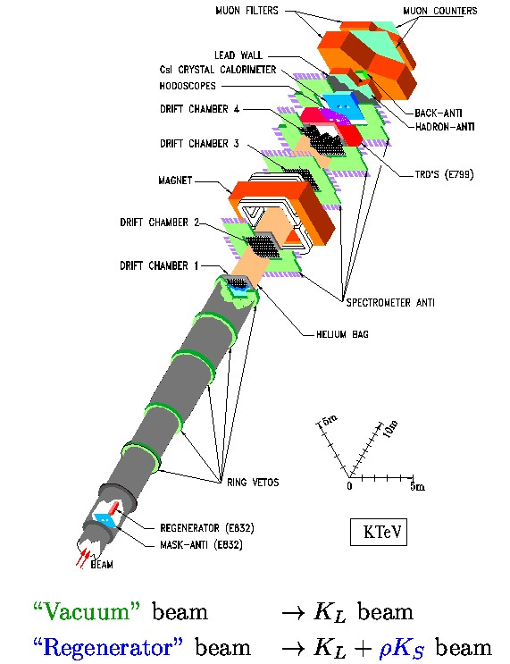
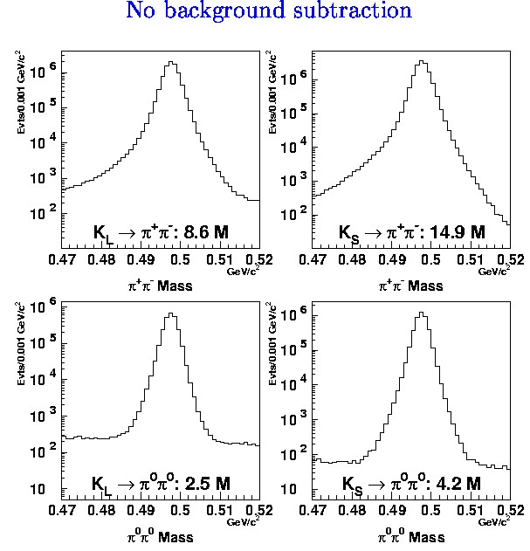
KTeV Experiment (Fermilab)
(Images from Jim Graham’s Fermilab “Wine and Cheese” Talk)

Slide 24
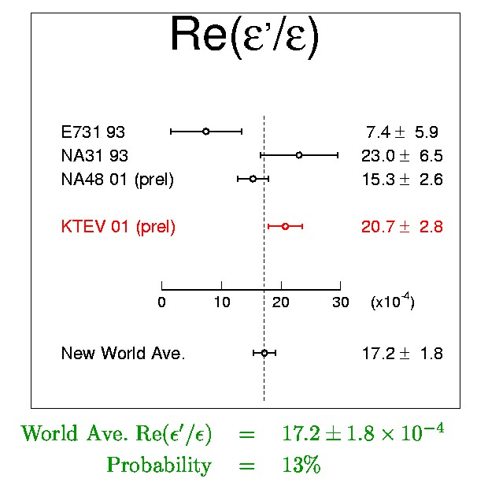
Current Status of ε’/ε
This bothered people
At this point, the accuracy of this measurement is better than that of the theoretical prediction:
(4-30 x 10⁻⁴)
(ibid.)

Slide 25
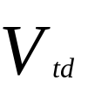




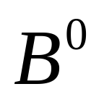
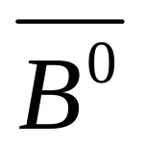




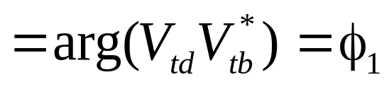
Indirect CP Violation in the B Meson System
Let’s Look at B-mixing…
Mixing phase

Slide 26



Indirect CP Violation (cont’d)
If both can decay to the same CP eigenstate f, there will be an interference
And the time-dependent decay probability will be
Difference between B mass eigenstates
Decay phase
CP state of f
Mixing phase

Slide 27







The ϒ Resonances
At the right energies, electrons and positrons can produce a spectrum of bound resonant states of b and anti-b quarks
The 1⁻ states are called the
“ϒ (‘Upsilon’)resonances”
ϒ
Starting with the ϒ(4S), they can decay strongly to pairs of B-mesons.
ϒ
The lighter states must decay through quark-antiquark annihilation
ϒ
ϒ

Slide 28







The Basic Idea
We can create pairs at the resonance.
Even though both B’s are mixing, if we tag the decay of one of them, the other must be the CP conjugate at that time. We therefore measure the time dependent decay of one B relative to the time that the first one was tagged (EPR “paradox”).
PROBLEM: At the resonance, B’s only go about 30 μm in the center of mass, making it difficult to measure time-dependent mixing.

Slide 29

The Clever Trick (courtesy P. Oddone)
If the collider is asymmetric, then the entire system is Lorentz boosted.
In the Belle Experiment, 8 GeV e⁻’s are collided with 3.5 GeV e⁺’s so
⇒
So now the time measurement becomes a z position measurement.

Slide 30
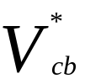


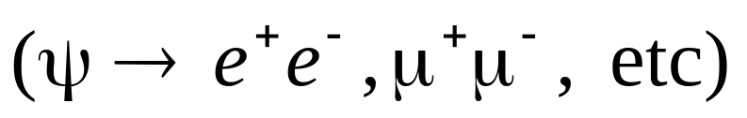








“Gold-Plated” Decay
Total state CP

Slide 31

Predicted Signature
t = Time of tagged decays

Slide 32








“Tin-Plated” Decay
Complicated by “penguin pollution”, but still promising

Slide 33



Review - What B-Factories Do...
Make LOTS of pairs at the ϒ(4S) resonance in an asymmetric collider.
Detect the decay of one B to a CP eigenstate.
Tag the flavor of the other B.
Reconstruct the position of the two vertices.
Measure the z separation between them and calculate proper time separation as
Fit to the functional form
Write papers.
Over the last ~8 years, there have been two dedicated experiments under way to do this – BaBar (SLAC) and Belle (KEK)

Slide 34
Motivations for Accelerator Parameters
Must be asymmetric to take advantage of Lorentz boost.
The decays of interest all have branching ratios on the order of 10⁻⁵ or lower.
  Need lots and lots of data!
    Physics projections assume 100 fb⁻¹ = 1yr @ 10³⁴ cm⁻²s⁻¹
    Would have been pointless if less than 10³³ cm⁻²s⁻¹

Slide 35

The KEKB Collider (KEK)
Asymmetric Rings
  8.0GeV(HER)
  3.5GeV(LER)
E_{cm}=10.58GeV= M(ϒ(4S))
Target Luminosity: 10³⁴s⁻¹cm⁻²
Circumference: 3016m
Crossing angle: ±11mr
RF Buckets: 5120
⇒ 2ns crossing time

Slide 36

The PEP-II Collider (SLAC)
Asymmetric Rings
  9.0GeV(HER)
  3.1GeV(LER)
E_{cm}=10.58GeV= M(ϒ(4S))
Target Luminosity: 3x10³³s⁻¹cm⁻²
Crossing angle: 0 mr
4ns crossing time

Slide 37
Motivation for Detector Parameters
Vertex Measurement
  Need to measure decay vertices to <100μm to get proper time distribution.
Tracking…
  Would like Δp/p≈.5-1% to help distinguish B→ππ decays from B→Kπ and B→KK decays.
  Provide dE/dx for particle ID.
EM calorimetry
  Detect γ’s from slow, asymmetric π⁰’s → need efficiency down to 20 MeV.
Hadronic Calorimetry
  Tag muons.
  Tag direction of K_{L}’s from decay B→ψK_{L .}
Particle ID
  Tag strangeness to distinguish B decays from Bbar decays (low p).
  Tag π’s to distinguish B→ππ decays from B→Kπ and B→KK decays (high p).
Rely on mature, robust technologies whenever possible!!!

Slide 38

The Belle Detector

Slide 39

BaBar Detector (SLAC)

Slide 40

The Accelerator is Key!!!
STOP Run
+HV Down
+Fill HER
+Fill LER
+HV Up
+START Run
= 8 Minutes!

Slide 41








Luminosity
Our Records:
Instantaneous:
Per (0-24h) day:
Per (24 hr) day:
Per week:
To date:
World Records!!
Daily integrated luminosity
Total integrated luminosity
(on peak)
Note: integrated numbers are accumulated!
Total for these Results:
Total for first CP Results (Osaka):

Slide 42

The Pieces of the Analysis
Event reconstruction and selection
Flavor Tagging
Vertex reconstruction
CP fitting

Slide 43





J/ψ and K_{S} Reconstruction
σ=4 Mev
Require mass
within 4σ of PDG

Slide 44


B→ψK_{S} Reconstruction
In the CM, both energy and momentum of a real B⁰ are constrained.
Use “Beam-constrained Mass”:
Signal
123 Events
3.7 Background

Slide 45

All Fully Reconstructed Modes (i.e. all but ψΚ_{L})
Mode | Events | Background
B→ψΚ_{S} | 457 | 12
All Others | 290 | 46
Total | 747 | 58

Slide 46

B→ψK_{L} Reconstruction
KLM Cluster
K_{L}
J/ψ daughter particles
Measure direction (only) of K_{L} in lab frame
Scale momentum so that M(K_{L}+ψ)=M(B⁰)
Transform to CM frame and look at p(B⁰).

Slide 47

B→ψK_{L} Signal
0<p_{B}*<2 GeV/c
Biases spectrum!
346 Events
223 Background

Slide 48






Flavor Tagging
X

Slide 49








Flavor Tagging (Slow Pion)
Very slow pion
Combined effective efficiency ε_{eff} = ε_{t}(1-2w)² = 27.0±.2%

Slide 50

Vertex Reconstruction (SVD)
Overall efficiency = ~85%. In total 1137 events for the CP fit.

Slide 51

CP Fit (Probability Density Function)
f_{BG} = background fraction. Determined from a 2D fit of E vs M.
R(Δ t) = resolution function. Determined from D*’s and MC.
PDF_{BG}(Δ t) = probability density function of background. Determined from ψΚ sideband.

Slide 52


Resolution Function
Fit with a double-Gaussian…

Slide 53


Test of Vertexing – B Lifetime

Slide 54

The Combined Fit (All Charmonium States)

Slide 55


Sources of Systematic Error
Bottom Line
Published in Phys.Rev.Lett. 87, 091802 (2001)

Slide 56


The BaBar Measurement
Based on 32 million B-Bbar pairs
Phys.Rev.Lett. 87 (2001)

Slide 57

Summary of 2φ₁ Measurements

Slide 58


How About That ρ−η Plane?
World Average Sin2φ₁ (±1σ)
Constraints of Everything but Sin2φ₁
Looks good for the Standard Model, but a little dull for experimenters !

Slide 59
Current Status
The study of CP Violation has been going on for almost 40 years!
A number of experiments are currently taking data which seem to be confirming the Standard Model (CKM) explanation of CP Violation, and thereby constraining that model
  Direct CP violation is observed in the neutral K system!
  CP is violated in the B-Meson system!
Over the next several years, the existing B-Factories will continue to take data, providing tighter and tighter constraints.
New players are also coming on the scene:
  Fermilab Run II (CDF and D0) - now
  BTeV (dedicated B Experiment at Fermilab) - ~2005
  LHC (Atlas and CMS) - 2006
  LHC-B (dedicated B Experiment at LHC) - ?

Slide 60

More “Out There”
CP Violation in the ν sector? (probably there, hard to study)
CPT Violation?
  CPT Conservation is a direct consequence of the Lorentz invariance of the Lagrangian.
  Evidence of its violation would be observation (direct or indirect) of
  and would be big news.
We still can’t answer why the unverse is all matter. Maybe it isn’t!
  The AMS experiment, set to fly on the ISS, will look for massive anti-nuclei to test the hypothesis that distant parts of the universe might be antimatter (!!)

Slide 61
Are Two B-Factories Too Many?
These are not discovery machines!
Any interesting physics would manifest itself as small deviations from SM predictions.
People would be very skeptical about such claims without independent confirmation.
Therefore, the answer is NO (two is not one too many, anyway).

Slide 62
Differences Between PEP-II (BaBar) and KEKB (Belle)
  PEP-II has complex IR optics to force beams to collide head-on.
  Pros: Interaction of head-on beams well understood.
  Cons: Complicates IR design.
  More synchrotron radiation.
  Can’t populate every RF bucket.
  In KEK-B, the beams cross at ±11 mr.
  Pros: Simple IR design.
  Can populate every RF bucket.
  Lower (but not zero!!!) synchrotron radiation.
  Cons: Crossing can potentially couple longitudinal
  and transverse instabilities.
At present, both designs seem to be working.

Slide 63
Differences (cont’d)
Readout:
  BaBar uses an SLD-inspired system, based on a continuous digitization. The entire detector is pipelined into a software-based trigger.
  Pros: Extremely versatile trigger.
  Less worry about hardware-based trigger systematics.
  Can go to very high luminosities.
  Cons: Required development of lots of custom hardware.
  Belle’s readout is based on converting signals to time-pulses. The trigger is an “old-fashioned” hardware-based level one. Events satisfying level one are read out after a 2 µs latency.
  Pros: Simple.
  Readout relies largely on “off-the-shelf” electronics.
  Cons: Potential for hardware-based trigger systematics.
  Possible problems with high luminosity.

Slide 64


Particle ID needs

