Slide 1
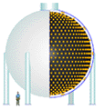



The Fermilab Neutrino Program – Status and Challenges Ahead
Eric Prebys*
Fermilab Accelerator Division/MiniBooNE
*with acknowledgements to everyone who leaves talks where I can find them

Slide 2
Preface
The turn-on of the LHC in ~2007 will mark the end of the Fermilab Tevatron’s unprecedented 20+ year reign as the world’s highest energy collider.
With the cancellation of the BTeV (B physics) project, the collider program is scheduled to be terminated in 2009, possibly sooner.
The lab has a strong commitment to the International Linear Collider, but physics results are at least 15 years away.
-> Neutrino physics will be the centerpiece of Fermilab science for at least a decade.

Slide 3
Luckily, neutrinos are very interesting
Many unanswered questions
  Type: Dirac vs. Majorana
  Generations: 3 active, but possibly sterile
  Masses and mass differences
  Mixing angles
  CP and possibly even CPT violation
Multi-disciplinary
  Study
    Solar
    Atmospheric
    Reactor
    Lab based (beta-decay)
    Accelerator Based
  Application
    Particle physics
    Astrophysics
    Cosmology
Trying to coordinate the effort and priorities
  See “APS Multidivisional Neutrino Study”
    http://www.aps.org/neutrino/

Slide 4
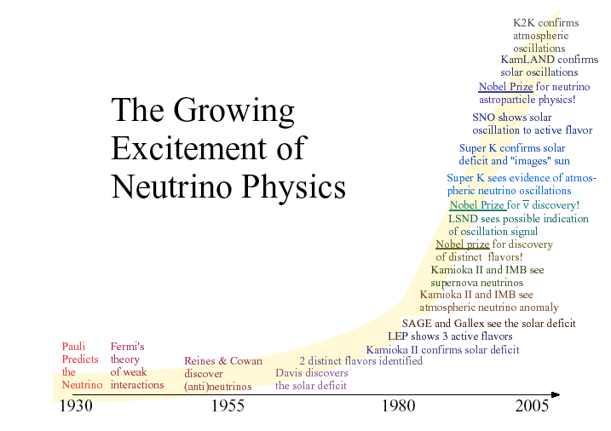

Slide 5
This Talk
A Brief History of Neutrinos
  Background
  Neutrino “problem”
  Neutrino oscillations
Some Key Experimental Results
  SuperKamiokande
  SNO
  Reactor Summary
  K2K
  LSND (????)
  Where do we stand?
Major Fermilab Experiments
  MiniBooNE
  NuMI/Minos
  Nova
Meeting the Needs of these Experiments
  Existing Complex
  Post-Collider
  Longer Term

Slide 6
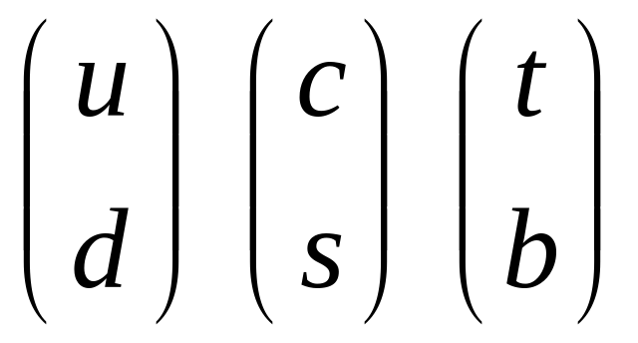
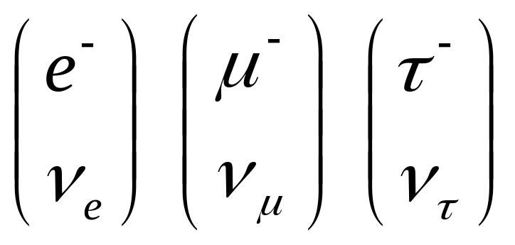





Neutrinos in the Standard Model
Each Generation lepton has an associated neutrino, just as each “up-type” quark has a “down-type” partner
Initially massless by definition
A charged weak interaction causes a “flip” between partners

Slide 7
The Neutrino “Problem”
1968: Experiment in the Homestake Mine first observes neutrinos from the Sun, but there are far fewer than predicted. Possibilities:
  Experiment wrong?
  Solar Model wrong? (⇐ believed by most not involved)
  Enough created, but maybe oscillated (or decayed to something else) along the way.
~1987: Also appeared to be too few atmospheric muon neutrinos. Less uncertainty in prediction. Similar explanation.
Both results confirmed by numerous experiments over the years.
1998: SuperKamiokande observes clear oscillatory behavior in signals from atmospheric neutrinos. For most, this establishes neutrino oscillations “beyond a reasonable doubt” (more about this shortly)
Solar Problem
Atmospheric Problem

Slide 8
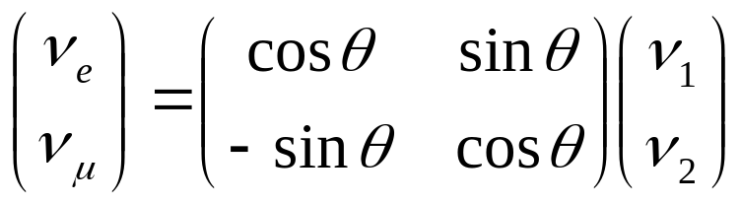
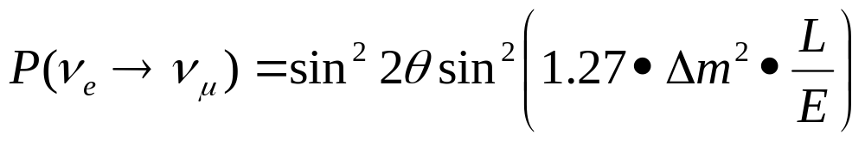

Theory of Neutrino Oscillations
Neutrinos are produced as weak eigenstates (ν_{e} ,ν_{μ}, or ν_{τ} ).
In general, these can be represented as linear combination of mass eigenstates.
If the above matrix is not diagonal and the masses are not equal, then the net weak flavor content will oscillate as the neutrinos propagate.
Example: if there is mixing between the ν_{e} and ν_{μ}:
then the probability that a ν_{e} will be detected as a ν_{μ} after a distance L is:
Flavor eigenstates
Mass eigenstates
Distance in km
Energy in GeV
Only measure magnitude of the difference of the squares of the masses.

Slide 9
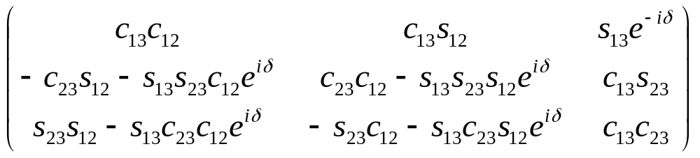
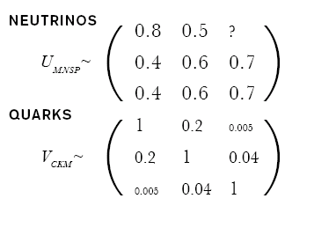
Three Generation Mixing
General Mixing Parameterization
CP violating phase
Almost diagonal
Third generation weakly coupled to first two
“Wolfenstein Parameterization”
Mixing large
No easy simplification
Think of mass and weak eigenstates as totally separate

Slide 10
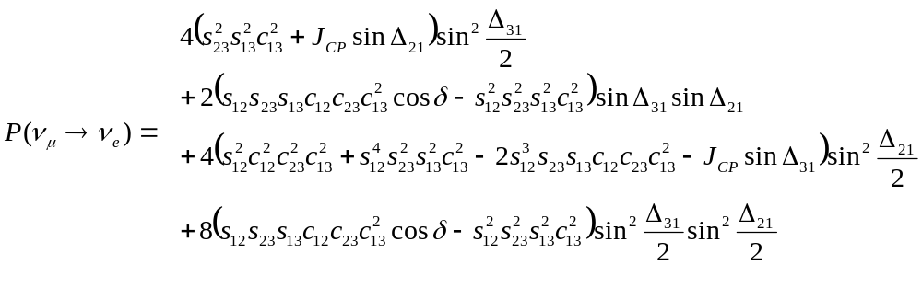
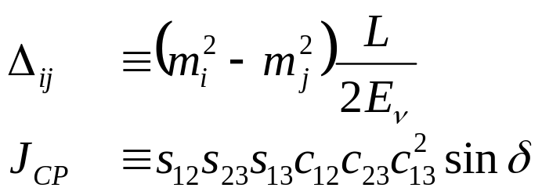
Large mixing makes it complicated!
In vacuum:
=sinθ₁₃
=changes sign for CP conjugate
Where:
Oscillatory behavior
Jarlskog invariant (measure of CP violation)
Problem: need a heck of a lot of neutrinos to study this

Slide 11
Sources of a Heck of a Lot of Neutrinos
The sun:
  Mechanism: nuclear reactions
  Pros: free
  Cons: only electron neutrinos, low energy, exact flux hard to calculate, can’t turn it on and off.
Atmosphere:
  Mechanism: Cosmic rays make pions, which decay to muons, electrons, and neutrinos.
  Pros: free, muon and electron neutrinos, higher energy than solar neutrinos, flux easier to calculate.
  Cons: flux fairly low, can’t turn it on and off.
Nuclear Reactors:
  Mechanism: nuclear reactions.
  Pros: “free”, they do go on and off.
  Cons: only electron neutrinos, low energy, little control of on and off cycles.
Accelerators:
  Mechanism: beam dumps -> particle decays + shielding -> neutrinos
  Pros: Can get all flavors of neutrinos, higher energy, can control source.
  Cons: NOT free

Slide 12

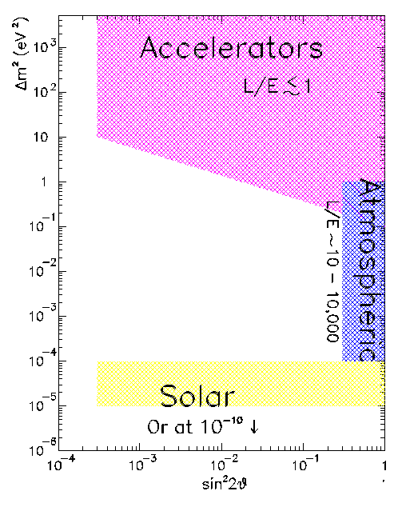
Probing Neutrino Mass Differences
Path length
Different experiments probe different ranges of
Energy
Accelerators use π decay to directly probe ν_{μ} → ν_{e}
& Reactors
Reactors use use disappearance to probe ν_{e} → ?
Cerenkov detectors directly measure ν_{μ} and ν_{e} content in atmospheric neutrinos. Fit to ν_{e}↔ν_{μ} ↔ ν_{τ} mixing hypotheses
Also probe with “long baseline” accelerator and reactor experiments
Solar neutrino experiments typically measure the disappearance of ν_{e.}

Slide 13
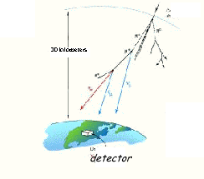
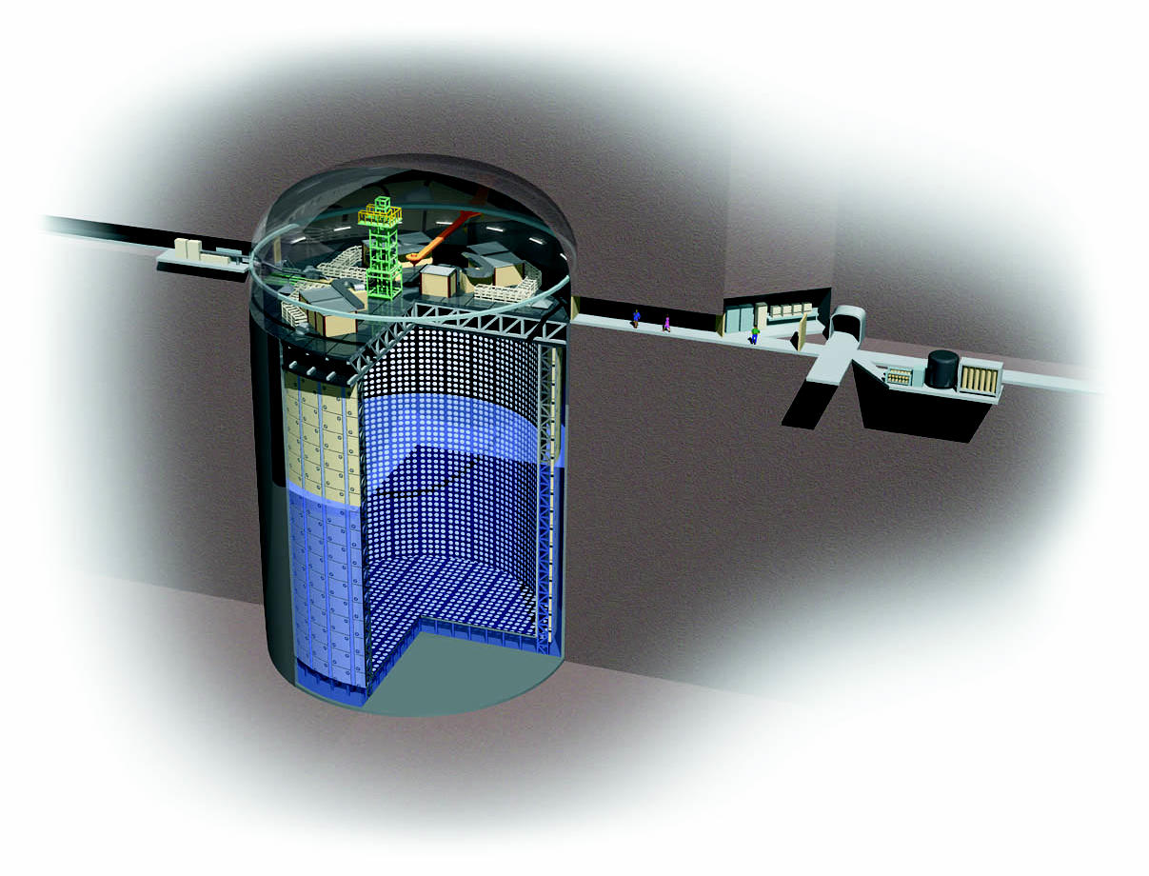
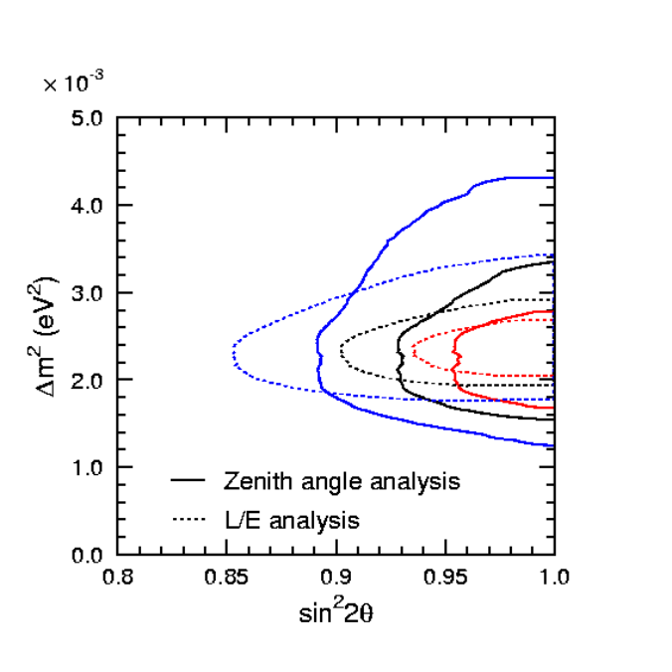
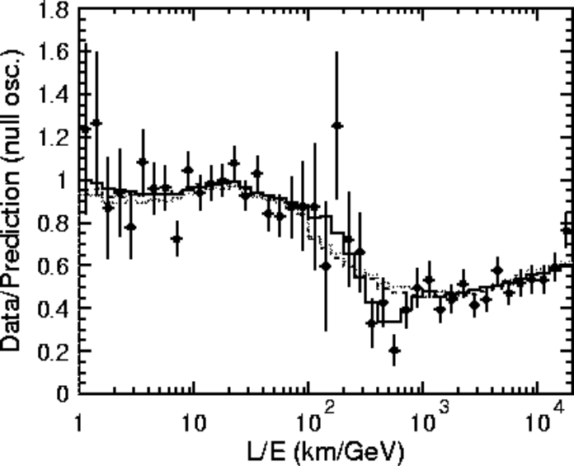
SuperKamiokande Atmospheric Result
Huge water Cerenkov detector can directly measure ν_{μ} and ν_{e} signals.
Use azimuthal dependence to measure distance traveled (through the Earth)
Positive result announced in 1998.
Consistent with ν_{μ} ↔ ν_{τ} mixing.
41.4m
39m
Inner detector
Outer detector

Slide 14
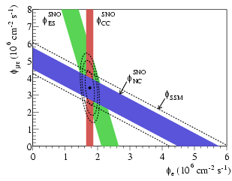
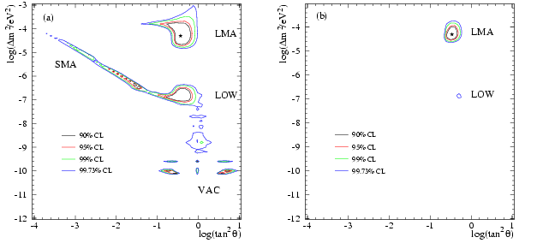
SNO Solar Neutrino Result
Looked for Cerenkov signals in a large detector filled with heavy water.
Focus on ⁸B neutrinos
Used 3 reactions:
  ν_{e}+d→p+p+e⁻: only sensitive to ν_{e}
  ν_{x}+d→p+n+ν_{x}: equally sensitive to ν_{e} ,ν_{μ} ,ν_{τ}
  ν_{x}+ e⁻→ ν_{x}+ e⁻: 6 times more sensitive to ν_{e} than ν_{μ} ,ν_{τ} d
Consistent with initial full SSM flux of ν_{e}’s mixing to ν_{μ} ,ν_{τ}
Just SNO
SNO+others

Slide 15
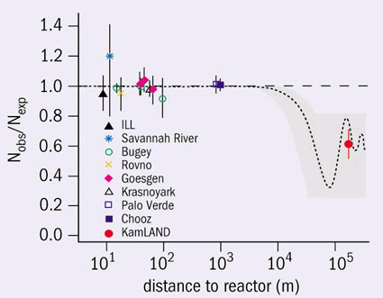
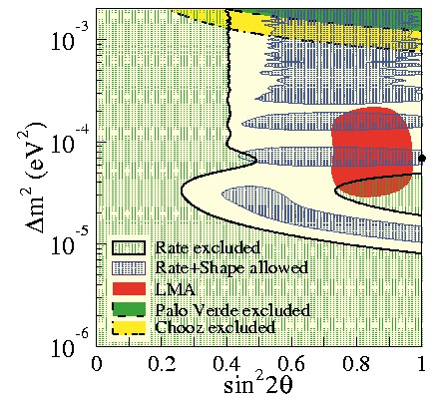
Reactor Experimental Results
Single reactor experiments (Chooz, Bugey, etc). Look for ν_{e} disappearance: all negative
KamLAND (single scintillator detector looking at ALL Japanese reactors): ν_{e} disappearance consistent with mixing.

Slide 16
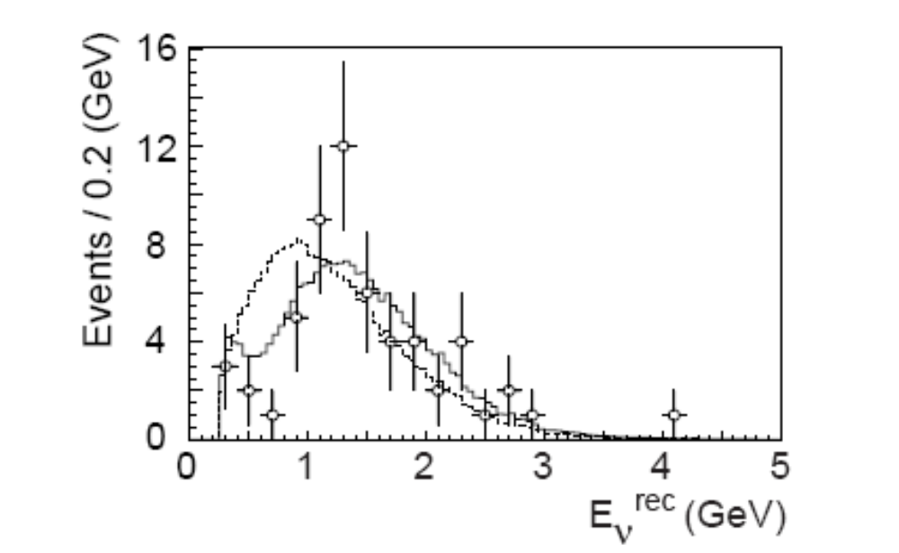
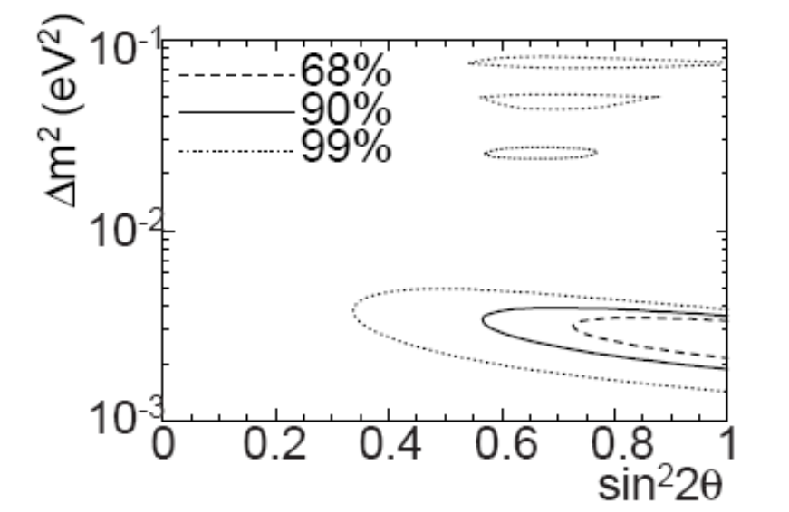
K2K
First “long baseline” accelerator experiment
  Beam from KEK PS to Kamiokande, 250 km away
  Look for ν_{μ} disappearance (atmospheric “problem”)
  Results consistent with mixing
No mixing
Allowed Mixing Region
Best fit

Slide 17


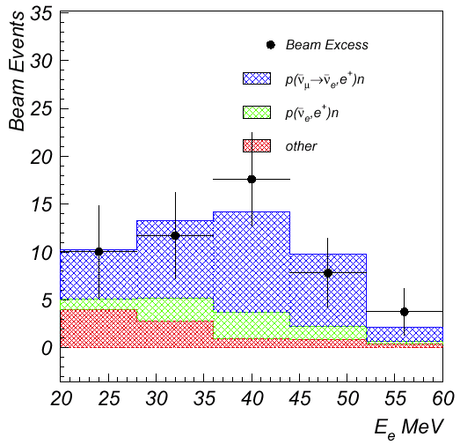
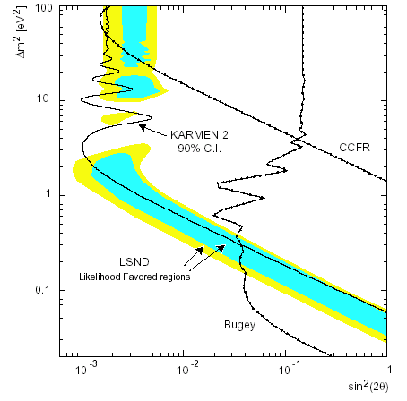

LSND Experiment (odd man out)
Looked for ν_{μ} → ν_{e} and ν_{μ} → ν_{e} in π decay from the 800 MeV LANSCE proton beam at Los Alamos
  Look for ν_{e} appearance via:
  Look for ν_{e} appearance via:
Observe excess in both channels (higher significance in ν_{e})
Only exclusive appearance result to date.
Doesn’t fit “nicely” with the other results!
LSND
positron
energy
Oscillation
signal expectation
backgrounds

Slide 18
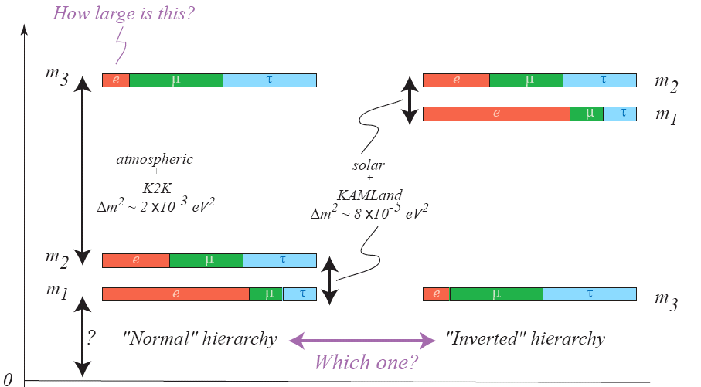
Where we stand (w/o LSND)

Slide 19







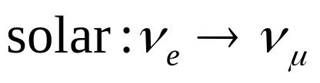
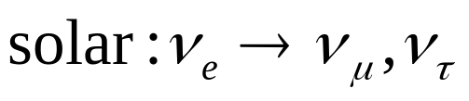
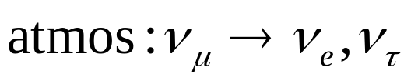
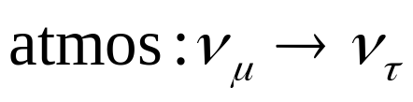



Incorporating LSND
We have 3 very different Δm²’s. Very hard to fit with only three mass states…
Only 3 active ν:
3 active+1 or more sterile ν:
CPT violation:
ν mass
OR...
ν mass
OR...
ν mass
OR...
- not a good fit to data
- possible(?)
- possible(?)
Can fit three mass states quite well without LSND, but no a priori reason to throw it out. Must check…

Slide 20
Big Questions in Neutrino Physics
Size of the mixing angles*
  Particularly θ₁₃
Mass heirarchy*
  Normal or Inverted
Absolute masses
Is neutrino Dirac or Majorana
  i.e. is the neutrino its own antiparticle
CP violation parameters**
Is the LSND result correct?*
  Are there sterile neutrinos?
  CPT violation?
*Addressed by currently planned FNAL physics program
**Possibly addressed by future program

Slide 21
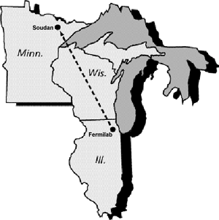
Enter the Fermilab Neutrino Program
MiniBooNE-neutrinos from 8 GeV Booster proton beam (L/E~1):
absolutely confirm or refute the
LSND result
NuMI/Minos – neutrinos from 120 GeV Main Injector proton beam (L/E~100):
precision measurement of ν_{μ} ↔ ν_{τ}
oscillations as seen in atmospheric neutrinos.

Slide 22






Producing Neutrinos At an Accelerator
Target
Proton beam
Mostly pions
We will look for these to oscillate
Pion sign determined whether it’s a neutrino or anti-neutrino
Mostly lower energy
Beam needs:
  Lots of beam!!!
  Short spills
    to distinguish from cosmic background
  Bucket structure
    Use TOF to distinguish subrelativistic particles (mostly kaons)

Slide 23






Neutrino Horn – “Focusing” Neutrinos
Can’t focus neutrinos themselves, but they will go more or less where the parent particles go.
Coaxial “horn” will focus particles of a particular sign in both planes
Target
Horn current selects π⁺ -> ν_{μ} or π⁻ -> ν_{μ}
p

Slide 24
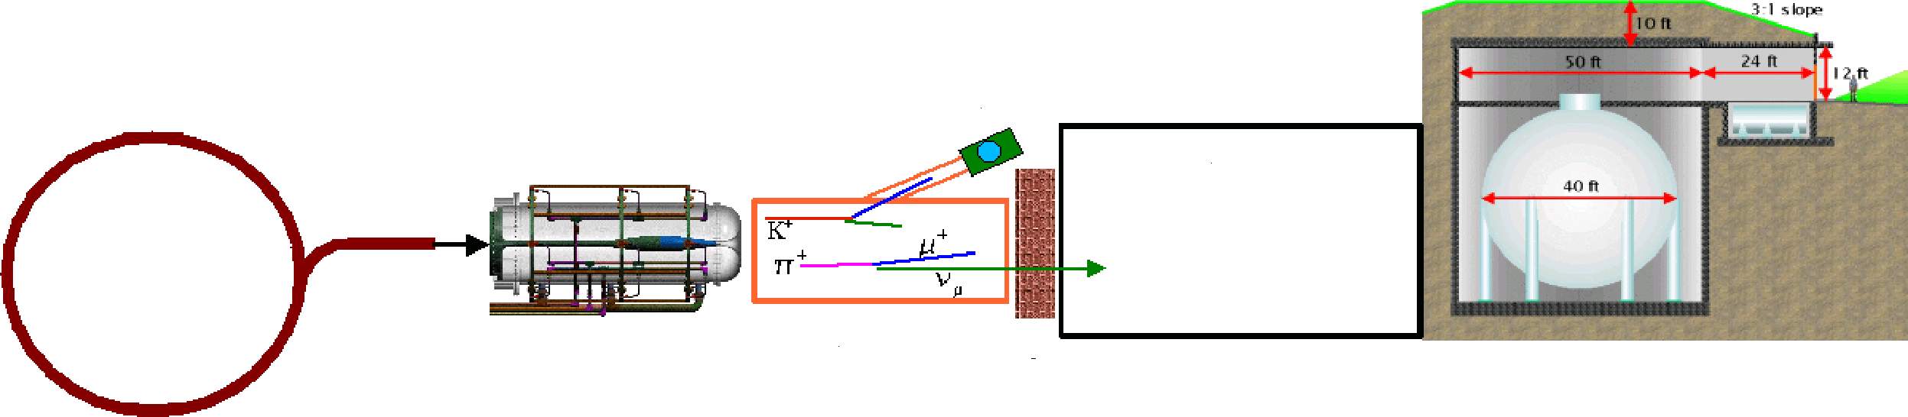
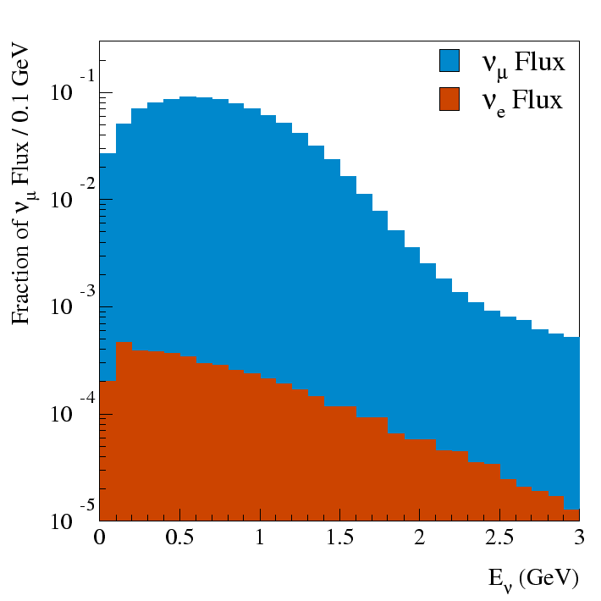
MiniBooNE Experiment
“Little Muon Counter” (LMC): to understand K flux
FNAL
Booster
500m dirt
Be Target
and Horn
50 m Decay Region
Detector
8 GeV protons
Proton flux ~ 6E16 p/hr (goal 9E16 p/hr)
  ~ 1 detected neutrino/minute
  L/E ~ 1
  Directly address LSND result

Slide 25
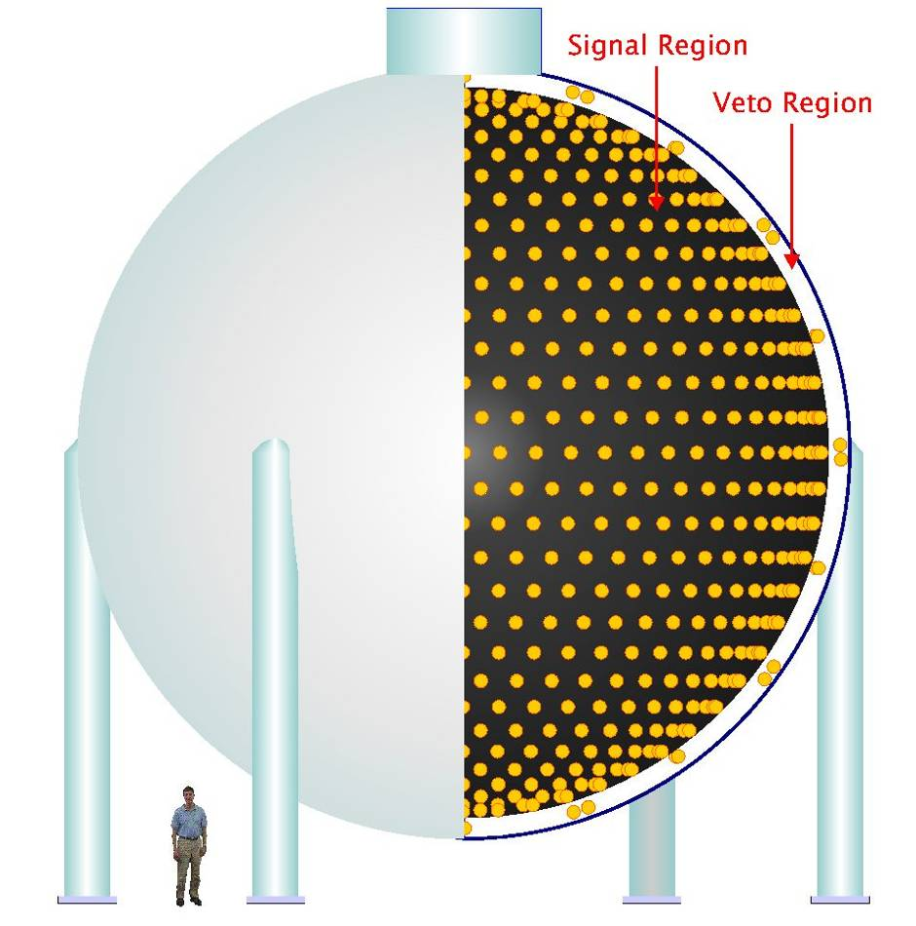

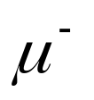


The MiniBooNE Detector
Our beam will produce primarily muon neutrinos at high energy
807 tons of mineral oil
Oscillation!!!
This is what we’re looking for

Slide 26
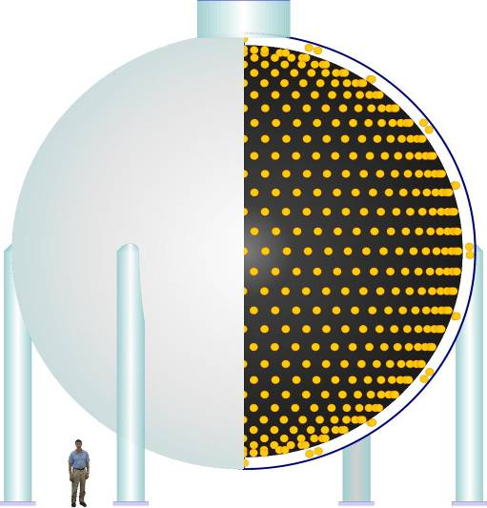
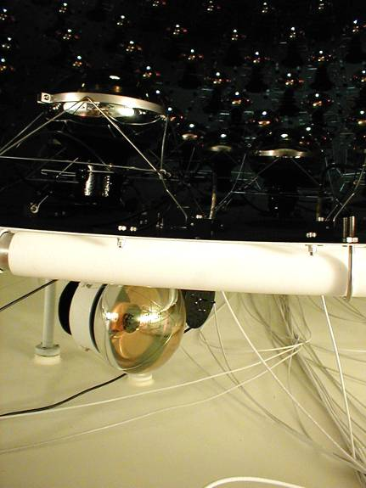
Detector
950,000 l of pure mineral oil
1280 PMT’s in inner region
240 PMT’s outer veto region
Light produced by Cerenkov radiation and scintillation
Trigger:
  All beam spills
  Cosmic ray triggers
  Laser/pulser triggers
  Supernova trigger
Light barrier

Slide 27
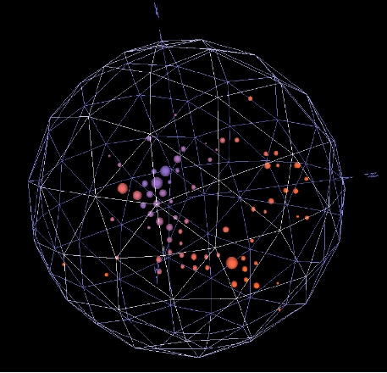
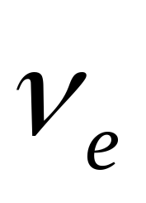
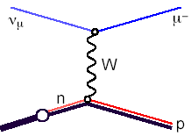
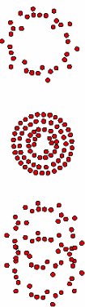

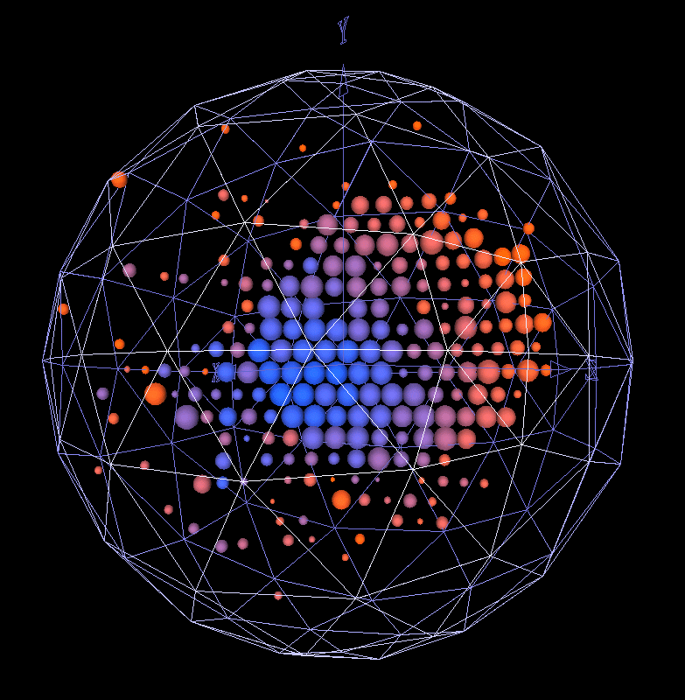
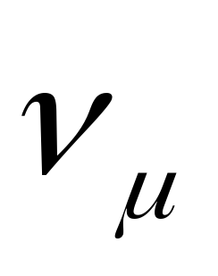
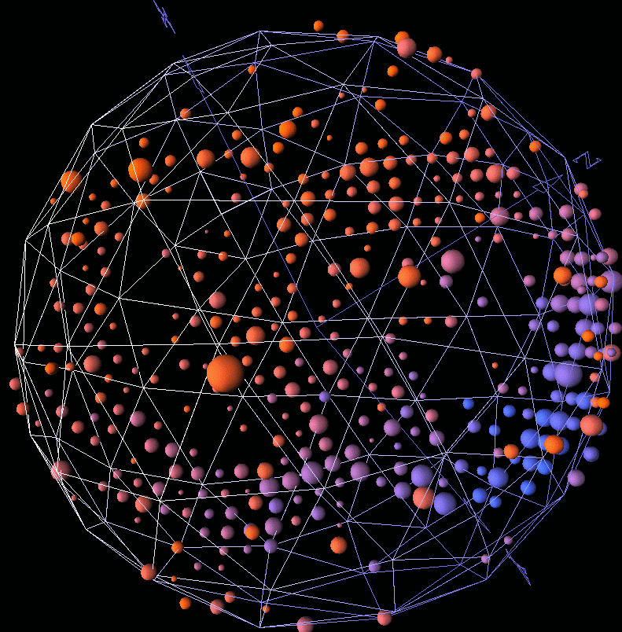
Neutrino Detection/Particle ID
ν_{e}
e⁻
W
n
p
ν_{μ}
μ⁻
W
n
p
ν_{μ}
ν_{μ}
Z
n
Δ⁰
π⁰
p
Important Background!!!

Slide 28
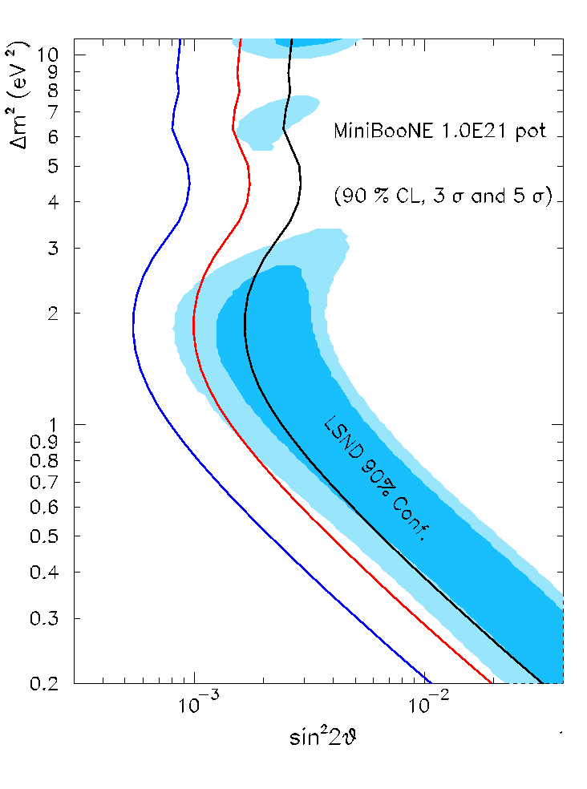
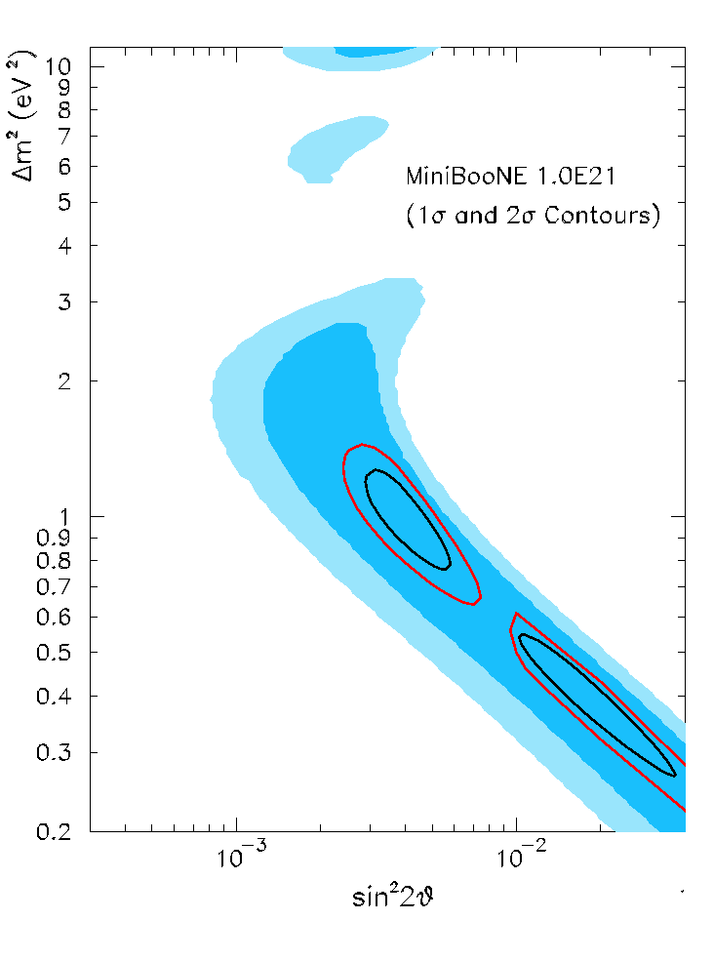
Experimental Sensitivity (1E21 POT)
Signal
  Can achieve good Δm² separation
No signal
  Can exclude most of LSND at 5σ

Slide 29
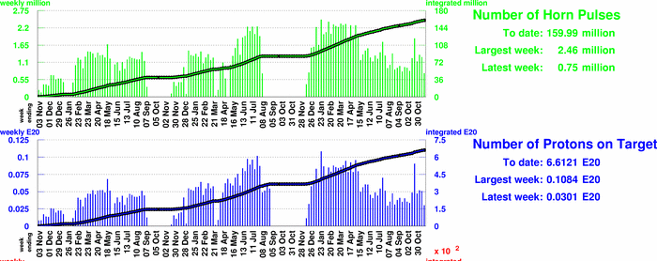
Beam to MiniBooNE
NuMI
6.6E20 to date
Plan for ~2E20/year during NuMI running
First oscillation results in 2006

Slide 30
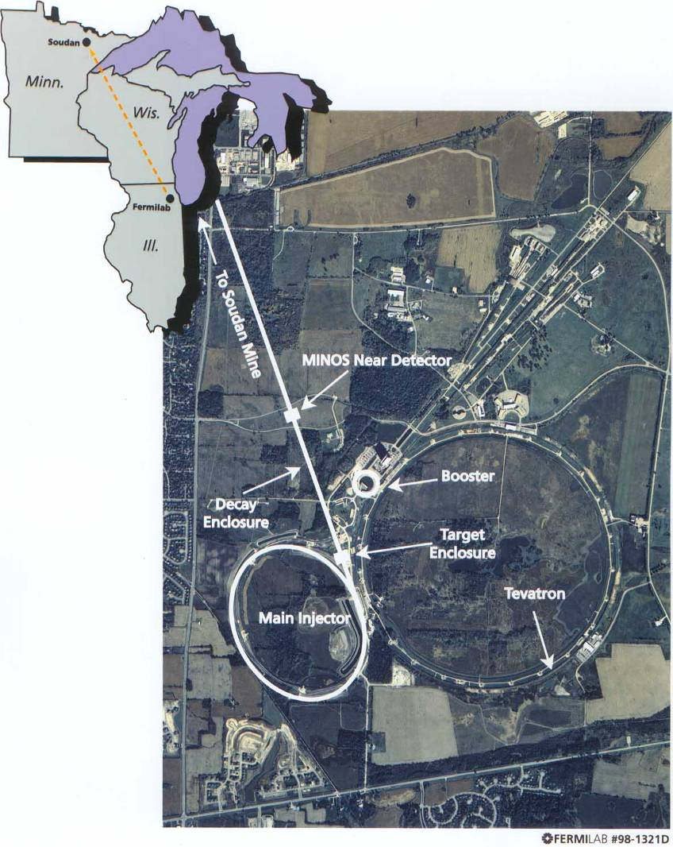
MINOS: Main Injector Neutrino Oscillation Study
8 GeV Booster beam is injected into Main Injector.
Accelerated to 120 GeV
Transported to target
Two detectors for understanding systematic
  Near detector: FNAL (L=1km)
  Far detector: Soudan Mine in Minnesota (735 km away)

Slide 31
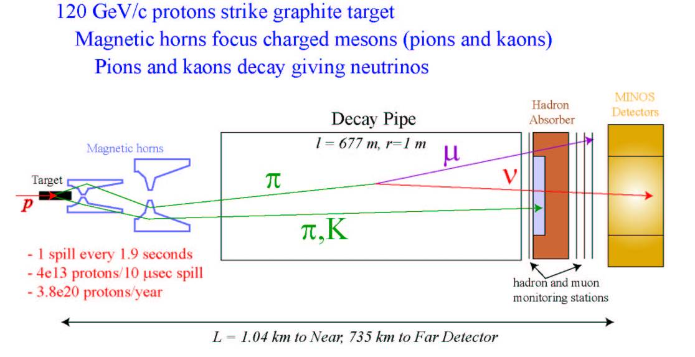
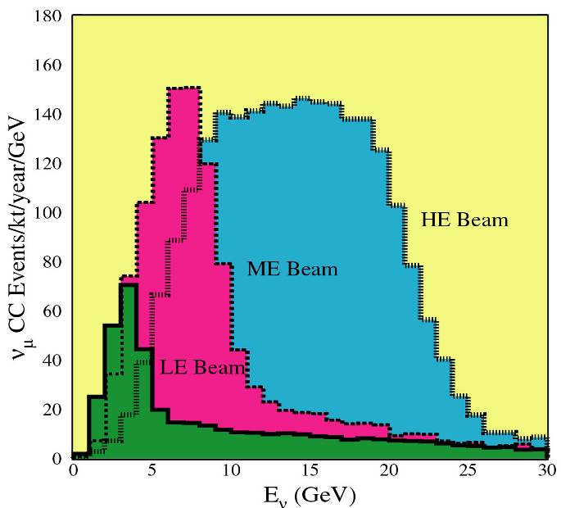
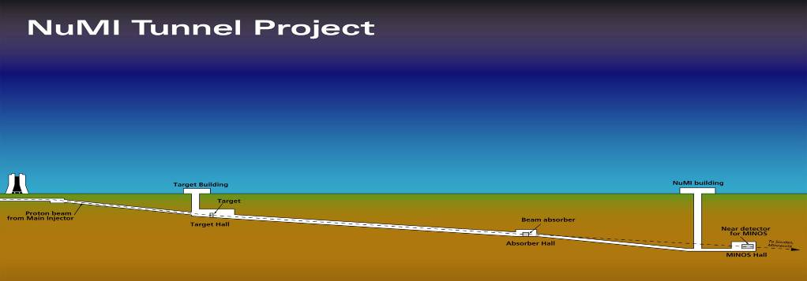
NuMI beams
Two horns (second moveable) -> adjustable beam energy
677 m decay pipe
Near
Detector
Target

Slide 32
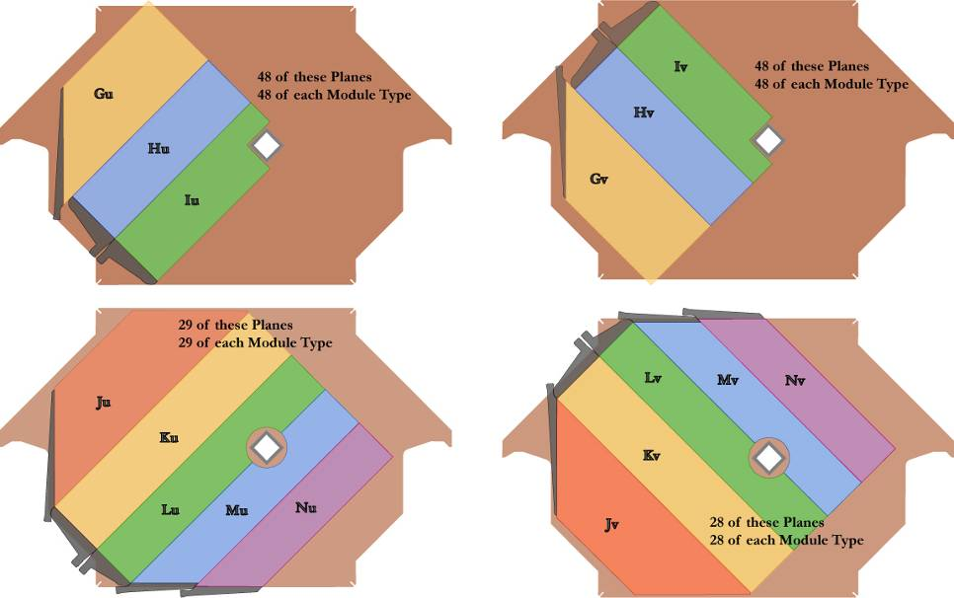

Near – 1040 m away
1 kton of steel plates
Detect neutrinos through appearance of charged particles
Magnetic field in plates determines sign
Range of particles separates particle types.
ν target region
μ spectrometer region
Near detector will provide high event
statistics for “mundane” neutrino physics

Slide 33




Far Detector – 735.3 km away
Located in Soudan mine
5.4 kton
Operation as similar as possible to near detector
Two detectors used to reduce systematic effects
B ~ 1.5T (R=2m)
HAD ~ 55% / E ^{1/2}
EM ~ 23% / E ^{1/2}
shaft
Soudan 2/CDMS II
MINOS

Slide 34


Minos Status
Test Beam in December 2004
Startup in March, 2005
Collecting data steadily
Detectors working well
Far detector (fully contained event)
Near detector (different target positions)

Slide 35

Beam to NuMI/MINOS
Target water leak problems
Horn ground fault problems
Accumulating data at ~2-2.5E20/yr
Can do initial oscillation (disappearance) result with 1E20 (~end of year, not counting analysis)

Slide 36


MINOS Ultimate Sensitivity
~3 years
~7 years

Slide 37

Beyond Minos – an Off-Axis experiment
Putting a Detector Off the NuMI Axis probes a narrower neutrino energy distribution than an on-axis experiment (albeit at a lower total intensity)
By constraining L/E, one is able to resolve different contributions to the signal by comparing neutrino and anti-neutrino events
  sin(θ₁₃)
  Sign of Δm²
    Neutrinos and antineutrinos
    see different matter effects,
    which depend on mass
    resolve hierarchy question
  Next step to measuring
  CP violation

Slide 38


Noνa Proposal
Place a 30 kT fully active liquid scintillator detector about 14 mr off the NuMI beam axis

Slide 39



Nova dependence on δ
Nova results will have an inherent dependence on the CP violation parameter δ
Future experiments will measure and energy dependent asymmetry between
and
to measure δ

Slide 40



Noνa Sensitivity
Off-Axis Goal
Fraction of δ covered

Slide 41
Noνa Status and Schedule
Stage I approval: April, 2005
Project Start: October, 2006
First kton operational: October, 2009
All 30 ktons operations: July, 2011
Problems:
  Would really like a LOT of protons

Slide 42

Proton Demands
Highest number I could find on a plot

Slide 43

The Fermilab Accelerator Complex
Mostly 35 years old
MinBooNE
NUMI
= ProtonSystem
=Proton Customer

Slide 44
Limits to Proton Intensity
Total proton rate from Proton Source (Linac+Booster):
  Booster batch size
    Typical ~5E12 protons/batch
  Booster repetition rate
    15 Hz instantaneous, lower average due to power limits and component heating
  Beam loss
    Damage and/or activation of Booster components
    Above ground radiation
Total protons accelerated in Main Injector:
  Maximum main injector load
    ~5-6E13 presently
  Cycle time:
    1.4s + loading time (1/15s per booster batch)
Present Operational Limit

Slide 45
Staged Approach to Neutrino Program
“Proton Plan”
Stage 0 (now):
  Goal: deliver 2.5E13 protons per 2 second MI cycle to NuMI (~2E20 p/yr)
  Deliver 1-2E20 protons per year to Booster Neutrino Beam (currently MiniBooNE)
Stage 1 (~2007):
  A combination of Main Injector RF improvements and operational loading initiatives will increase the NuMI intensity to ~5E13 protons per 2.2 second cycle (~3.5E20 p/yr)
  It is hoped we can continue to operate BNB at the 2E20 p/yr level during this period.
Stage 2 (post-collider):
  Proton to NuMI will immediately increase by 20%
  Consider (for example) using the Recycler as a preloader to the Main Injector and reducing the Main Injector cycle time (~6.5E20 p/yr)
  The exact scope and potential of these improvements are under study
Stage 3 (proton driver or equiv.)
  Main Injector must accommodate 1.5E14 protons every 1.5 seconds
  2MW @ 120 GeV
  NuMI beamline and target must also be compatible with these intensities.

Slide 46


Re-tasking the Recycler
At present, the Main Injector must remain at the injection energy while Booster “batches” are loaded.
  Booster batches are loaded at 15 Hz
  When we slip stack to load more batches, this will waste > 1/3 of the Main Injector duty factor.
After the collider, we have the option of “preloading” protons into the Recycler while the Main Injector is ramping, thereby eliminating dead time.
Small invenstment
  New beamline directly from Booster to Recycler
  Some new RF
Big payoff
  At least 50% increase in protons to NuMI

Slide 47

Thinking Big: A Proton Driver
ILC/TESLA
β< 1 ILC LINAC
ILC LINAC

Slide 48

The Benefits of an 8 GeV Linac Proton Driver (stolen slide)
Neutrino
“Super-
Beams”
SY-120
Fixed-Target
Damping Rings
for TESLA @ FNAL
With 8 GeV e+ Preacc.
NUMI
Off-
Axis
X-RAY FEL LAB
Anti-
Proton
8 GeV
neutrino
8 GeV Linac
~ 700m Active Length
1% LC Systems Test
Main
Injector
@2 MW
Bunching
Ring
Target and Muon Cooling Channel
Recirculating
Linac for Neutrino Factory
Neutrino Target
& Long-Pulse
Spallation Source
Short Baseline Detector Array
Neutrinos
to “Homestake”
VLHC at Fermilab

Slide 49
Possible “budget” Alternative to Proton Driver (D. McGinnis proposal)
Retire Booster
Build new transfer line
Replace pBar Debuncher with new Booster
Prestack in Accumulator
Transfer to recycler/Main Injector
Less Expensive than the Linear Proton Driver
Can get to 2 MW
None of the side benefits
No synergy with ILC

Slide 50

Evolution of Proton Delivery

Slide 51


Evolution of θ₁₃ discovery limit
Bands show dependence on CP violation parameter δ
(from: FNAL proton driver study, to appear)
=located at Fermilab (NUE~Noνa)

Slide 52
Other Activities at the lab (some very big)
Other Neutrino:
  FLARE: Same physics motivation as Noνa, but with a liquid Argon detector
  Cross section and production experiments as input to neutrino physics
    MIPP
    Minerνa
    Finese
    SciBar
Fixed Target
  Active 120 GeV program, mostly test beams
LHC
  Big player in CMS
  Level 2 Physics Center
  LARP accelerator collaboration
ILC
  Major Commitment ramping up over the next few years
  Major superconducting RF effort
Non-HEP
  Sloan Digital Sky Survey
  Auger
  Computing Grid development

Slide 53
Conclusions
It’s a little disorienting to see the end of the Fermilab collider program
We are disappointed at the cancellation of the BTeV project, nevertheless
Fermilab is poised to hold a leading position in neutrino research for the next 10-15 years.

