Slide 1
Dog(leg)s of War
Eric Prebys
Run II Meeting
March 13, 2003

Slide 2
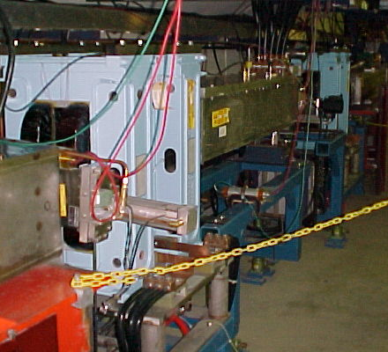
Dogleg Problem
Septum
Each of the two Booster extraction septa has a set of vertical dogleg magnets to steer the beam around it during acceleration.
More powerful doglegs were installed in 1998 to reduce losses early in the cycle.
These magnets have an edge focusing effect which distorts the horizontal injection lattice:
  50% increase in maximum β
  100% increase in maximum dispersion.
  Harmonic contributions.
Effect goes like I². Now tune to minimize.
Recently got an unusual opportunity to explore potential improvements from fixing the problem.
Working on schemes to reduce or remove problem.
Dogleg Magnets

Slide 3
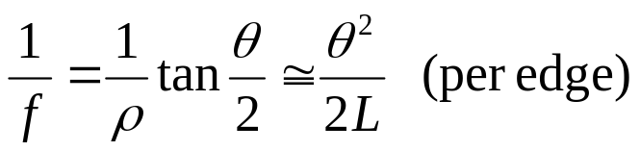
Parasitic Focusing
Rectangular (RBEND) magnet:
vertical focusing if beam has component into page
vertical focusing if
beam has component
out of page
Focusing in
non-bend plane!!
f
f
θ/2
θ/2
Side View
Top View
Always focusing!!

Slide 4
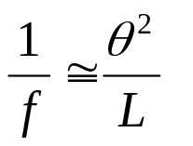




Parasitic Focusing (cont’d)
Sector (SBEND) magnet:
Focusing in
bend plane!!
Longer L
Nominal L
B ~constant
Shorter L
Trade-off:
SBEND
RBEND
Exit angle
Non-bend plane focusing
bend plane focusing

Slide 5
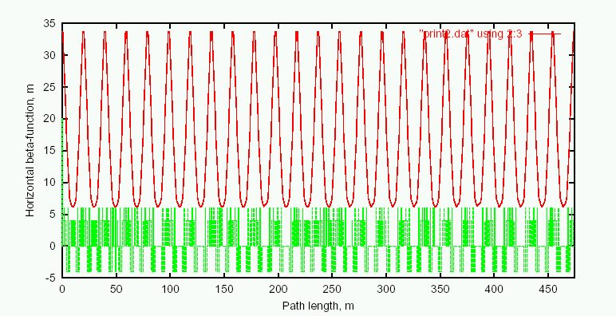
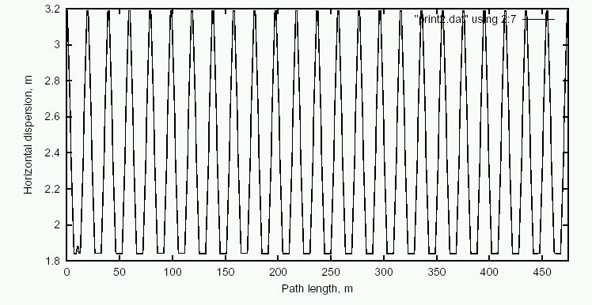
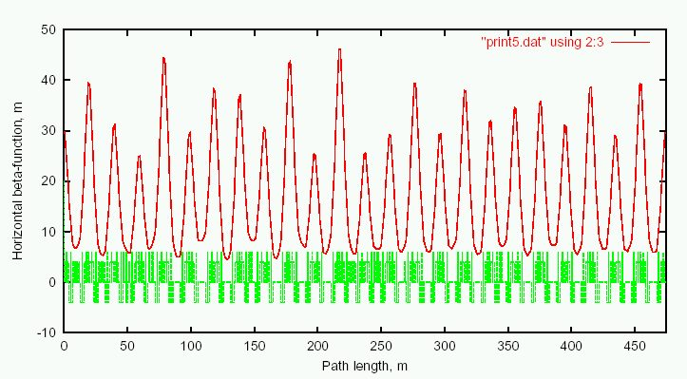
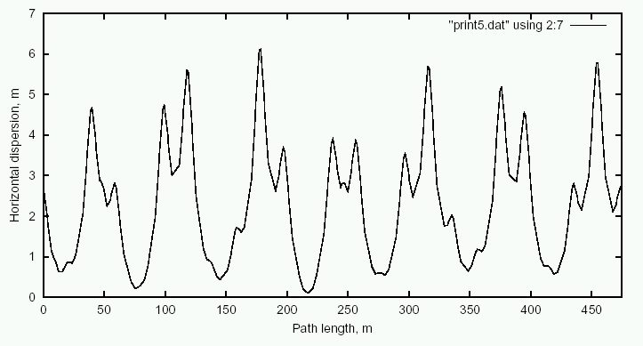
Predicted Effect of Doglegs
Ideal Lattice
β_{x}
D_{x}
Add Doglegs
β_{x}
D_{x}

Slide 6
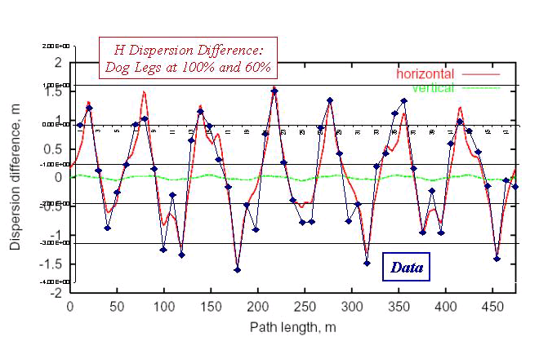
Preliminary Study: Dispersion
Measured dispersion for different dogleg currents:

Slide 7
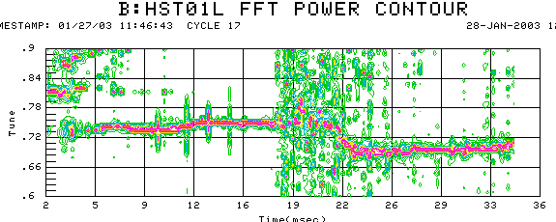
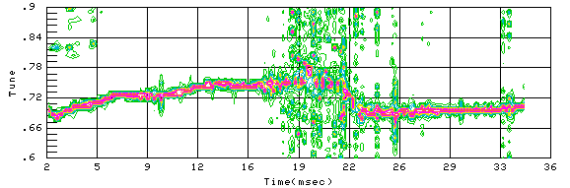
Preliminary Study: Tune
100% Dogleg Current
Tuneshift ~ prediction
60% Dogleg Current

Slide 8
Dead Dog Studies
Took advantage of recent TeV Magnet failure to raise the Long 13 (dump) septum and turn off the associated dogleg.
Doglegs almost exactly add, so this should reduce the effect by almost half.
The mode of operation prevents short batching, booster study cycles and RDF operation.
Had about 36 hours of study in this mode.
Bottom Line: major improvement.

Slide 9
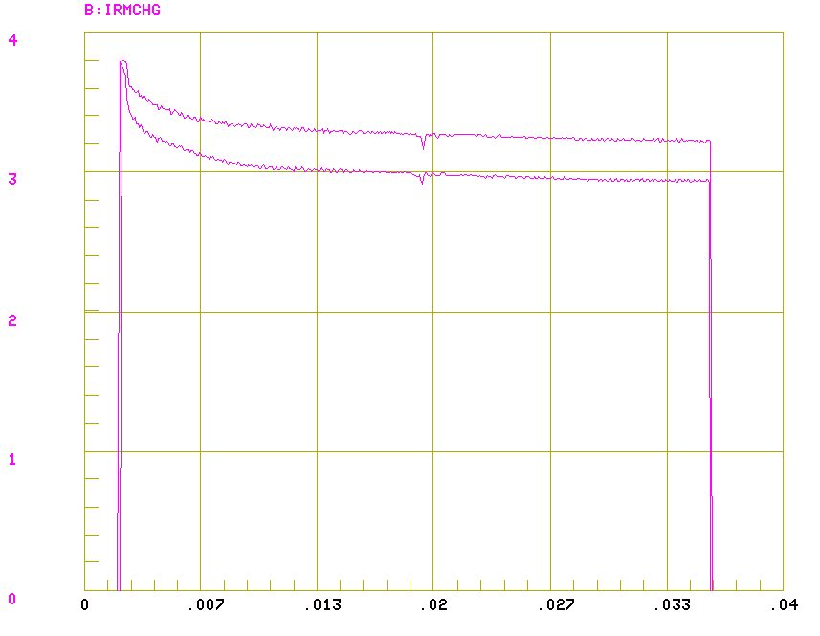
Transmission After Tuning
March 6, 7 turns, 1 dog
March 3, 7 turns, both dogs

Slide 10
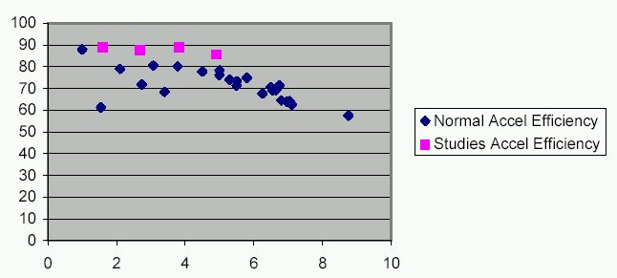
Transmission with One Dogleg
%
Injected Charge (E12)

Slide 11
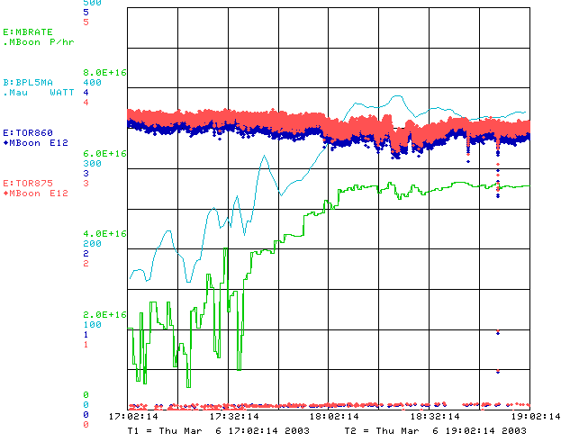
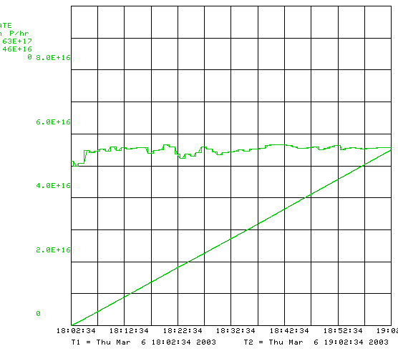
Record Running w/o Dogleg

Slide 12
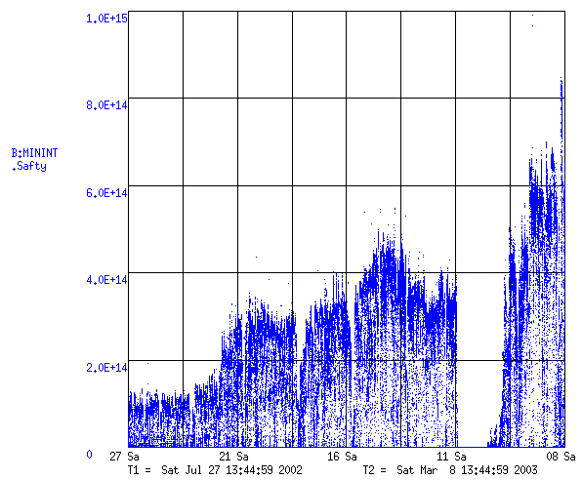
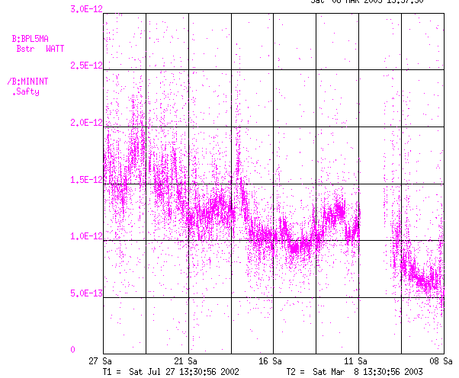
Booster Performance Over Time
Discovered Problem: tune to reduce dogleg currents
MiniBooNE
Total Booster Output (protons/minute)
Test with one dogleg off (halfway to MiniBooNE goal!)
Energy Lost per Proton
(W-min/proton)

Slide 13
Comments
We have verified the dogleg effect and that it is a problem.
We’ve tuned in our present configuration for 5 years, and were able to achieve record performance with only 36 hours of tuning in the one dog configuration. Almost certainly more room for improvement.
Remember, only one dogleg was removed!
Now, how fix the problem:
  Short term: ameliorate problem ASAP
  Long term (~2005): eliminate problem.

Slide 14
Short Term Solutions
Tune to minimize current?
  helped so far, but near limit.
  Maybe raise L13 septum a bit?
Motorize L13 septum to switch modes quickly?
  Operational nightmare
Eliminate L13?
  Find another way to short-batch
  Make a dump in MI-8 for Booster study cycles?
Correctors?:
  These don’t look like quads, so can’t find a fix – yet.
Spread out doglegs (effect goes down with square of separation):
  Not a lot of room. Maybe separate downstream magnets?
Three-legged dog?
  Turn of the third of the four magnets.
  Need to increase first two reduces net improvement.

Slide 15
Long Term Solutions
Large Aperture Lattice Magnets?
  Obviously the “right” idea.
  Must match lattice AND (preferrably work with existing resonant circuit).
  Potential for big screw-up.
Pulsed extraction bump (Lackey)?
New ideas welcome
  Brainstorming session tomorrow at 10:30

Slide 16
Final Comments
After several false starts, Beam Physics began to get seriously involved with Booster matters in late 2002.
This problem was almost immediately found.
What other surprises await?

