Slide 1
Booster Beam Quality Variables
B:LGEM8G
  Booster longitudinal emittance
  Measured by resistive wall monitor
  Currently logged on $14 (pBar) and $17 (test)
B:BNCHRT
  Bunch length after bunch rotation
  Measured by resistive wall monitor
  Currently logged on $14 and $17
I:8G(H/V)E14
  Booster (Horizontal/Vertical) emittance
  Calculated from Texas multiwires
  Logged on MI event $26
Also have a gap monitor to measure coupled-bunch modes, but this is not logged, since its meaning depends on sample time settings.

Slide 2
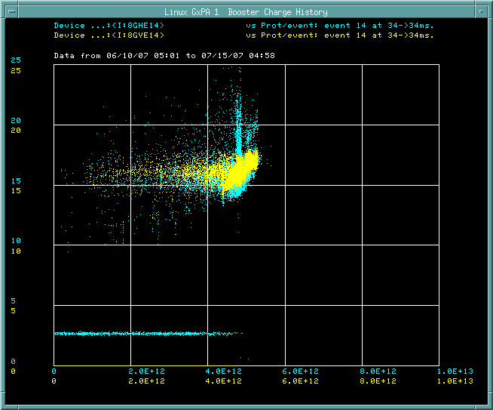
Transverse Emittance vs. Charge

Slide 3
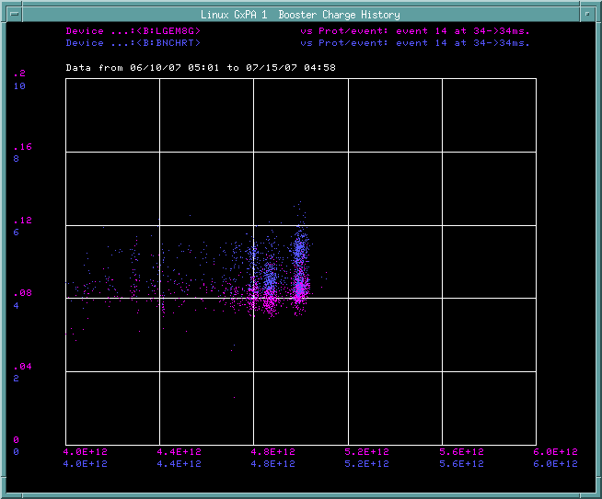
Longitudinal Emittance vs. Charge

Slide 4
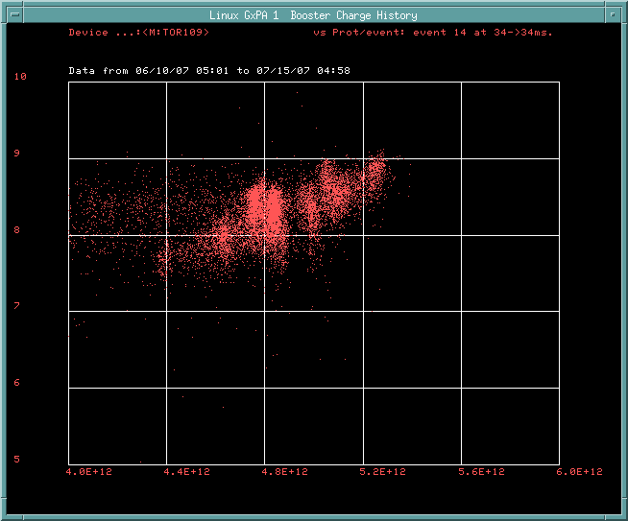
pBar protons vs. Booster Charge

Slide 5
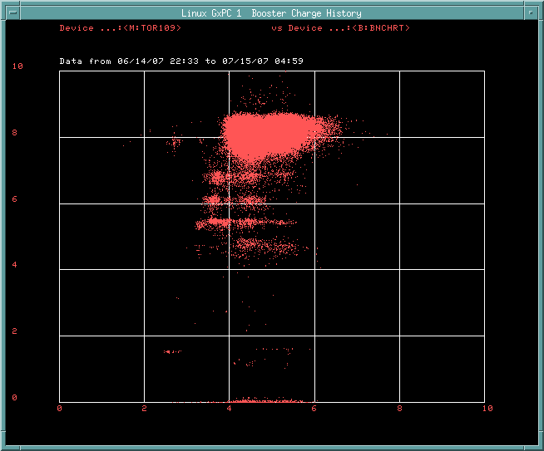
pBar protons vs. Bunch length

Slide 6
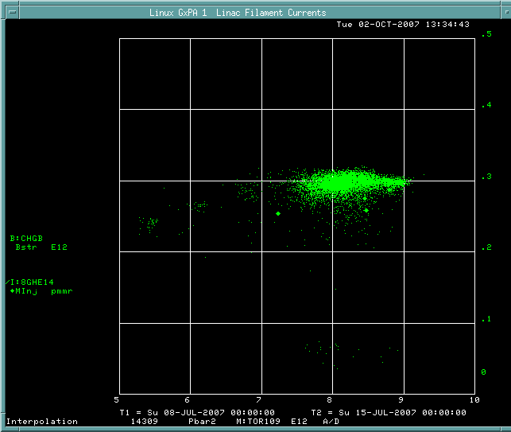
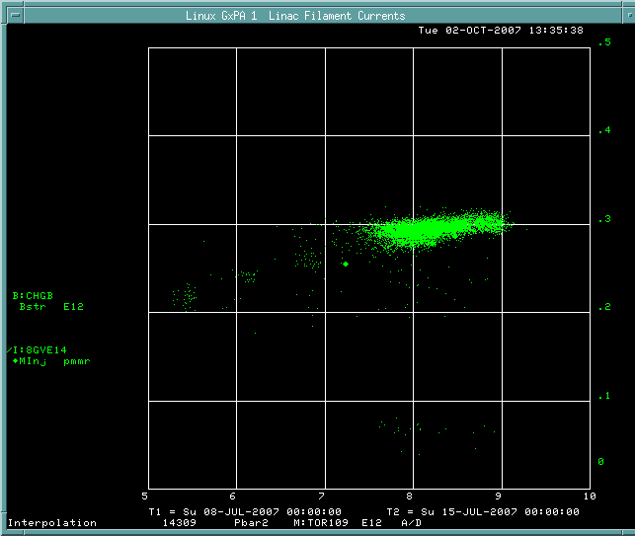
pBar protons vs brightness

Slide 7
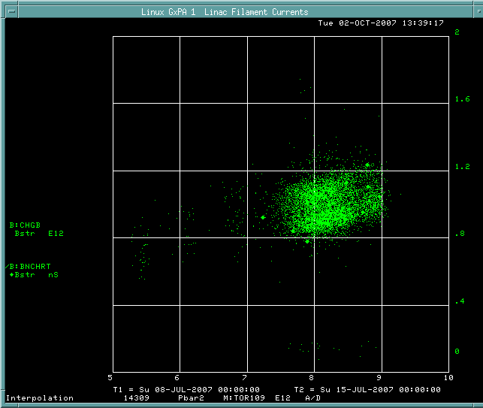
pBar protons vs. “Longitudinal brightness”

Slide 8
Conclusions
Both transverse and longitudinal emittance increase with Booster batch size
Slip stacked intensity remains ~linearly dependent on Booster intensity even at high intensity (would expect a turn-over if brightness were the figure of merit)
Still need to keep emittances good enough to efficiently slip stack protons.
If longitudinal parameters are reflected at extraction, might still affect stacking rate.
  Need to study this.

