Slide 1
Satellite Imagery
An Unusual Approach to Introducing Physics
A Princeton University “Freshman Seminar” created by Dan Marlow and Eric Prebys

Slide 2
The Problem
Try as we might, we have a hard time teaching students:
  Physics can be fun.
  Physics can be relevant.
  Physics can be intuitive.
Perhaps one problem is that by focusing on minute details, the students often miss the “big picture”.

Slide 3
The Idea
Build a class which revolves around a single project, which the students follow from beginning to end.
Introduce necessary physics concepts along the way.
For a change, concentrate on breadth, rather than depth.

Slide 4
Why focus on weather satellites?
Although it sounds like an obscure hobbyist’s niche, this topic will allow us to highlight a wide variety of basic physics topics, including…
  Newton’s laws and Kepplerian orbits (rocket and satellite motion).
  Basic optics (image formation)
  Electromagnetic waves (signal transmission)
  Signal encoding (amplitude modulation, frequency modulation)
  Fundamental electronics (construction of the FM receiver)
  Computerized data acquisition and analysis (decoding the signal and displaying the picture)
  Dynamics of weather (convection, Coriolis force, etc).

Slide 5
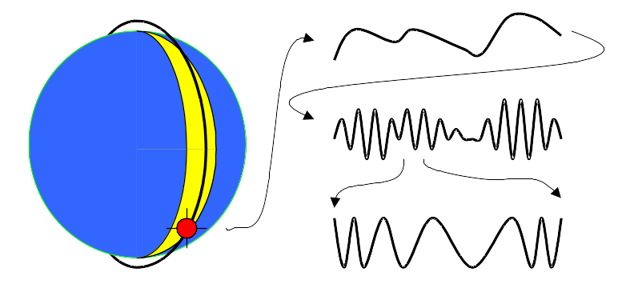
How do weather satellites work?
Weather satellites have been in use since the early 60’s. We are primarily interested in those operated by the National Oceanographic and Atmospheric Administration (NOAA).
These travel in a low polar orbit, remaining in a fixed plane as the earth rotates beneath them. With each orbit, they see a new “swath” of the earth below them.
Images are broadcast “real time”, so people below can receive images from their part of the world.
Light levels from surface
2400 Hz AM signal
137.5 MHz FM signal

Slide 6
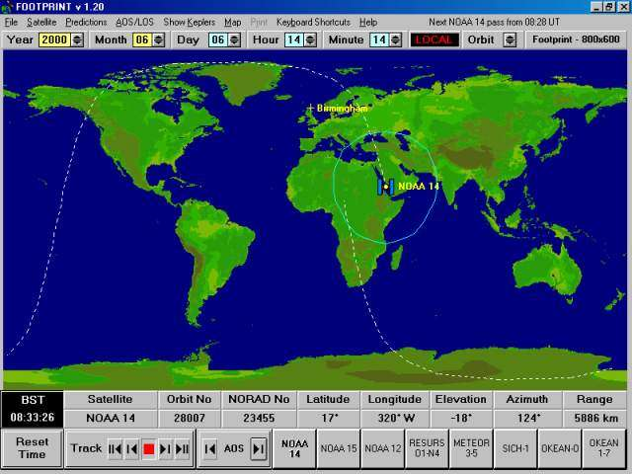
The satellite’s “footprint”

Slide 7
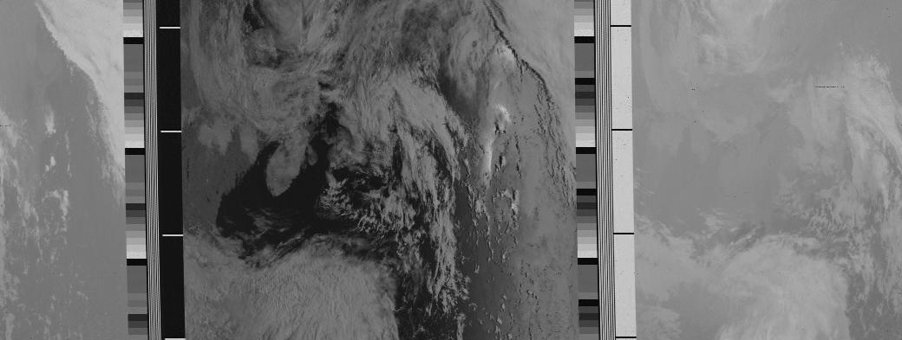
APT transmission format
Telemetry information
Visible Image
IR Image
A-sync: 7black-white cycles @ 1040 Hz
B-sync: 7black-white cycles @ 832 Hz
No vertical sync on ARPT pictures

Slide 8
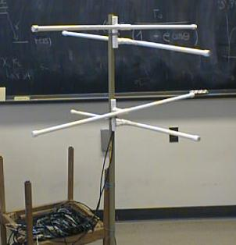
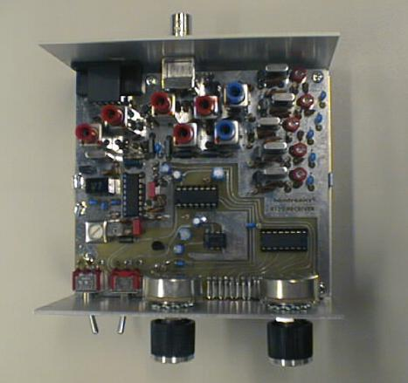

Receiving the satellite signals
The students constructed antennas to receive the FM signals from the satellites which are overhead. These will be placed on the roof of Jadwin hall.
They also constructed an FM demodulator to convert this signal into a 2400 Hz AM signal, which goes to the sound card of a PC (more about this later..).

Slide 9
What is a “freshman seminar”?
At Princeton, freshman seminars are special small courses, open only to freshman by application.
The idea is that they are small and and involve close interaction with faculty.
In most cases, faculty receive no credit for teaching these courses, so they are always a “labor of love”.
Although they fall outside the standard curriculum, most do fulfill some sort of “distribution requirement” - in our case, one of two required semesters of a science with a lab.

Slide 10
Format of the course…
The course was nominally one 3 hour lecture and one 3 hour lab each week.
In fact, the “lecture” was usually 1-1/2 hours, after which we would move to the lab room and do practical demonstrations and pedagogical exercises.
The lab was taken up primarily with the construction of the radio and the software. Students had keys and were free to do these things at their leisure.

Slide 11
Approximate course syllabus
Week 1- Intro, Overview, Ohm’s Law
Week 2- Frequency Domain, RLC Circuits, Resonance.
Week 3- Radio Spectrum, Receiver components, modulation
Week 4- Transistors, Amplifiers, Oscillators, Mixers
Week 5- Practical details of receiver
Week 6- Orbital mechanics
Week 7- Maxwell’s eqns., EM waves, antennas
Week 8- Image acquisition and decoding
Week 9- Blackbody radiation, Image interpretation
Week 10- Dynamics of weather (convection, Coriolis force, etc). Image interpretation
Week 11- APT telemetry data, pixel remapping, false color, more advanced image tools.
Week 12- Software issues, some details of practical electronics design and fabrication.

Slide 12

Lecture Example: Resonance
If you push someone on a swing, you will obviously be most effective if you apply force at the same point each time the swing goes by
…in other words, it the frequency of the driving force is the same as the natural frequency of the swing.

Slide 13
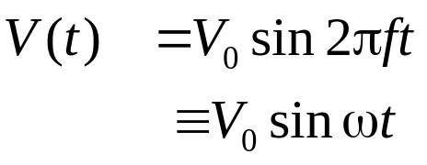
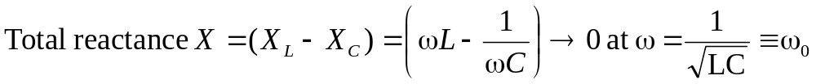
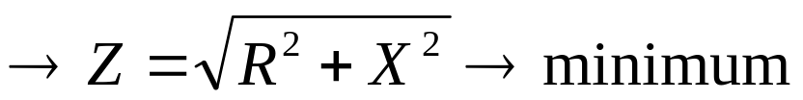
Lecture Example: Resonance in RLC Circuits
R
L

Slide 14
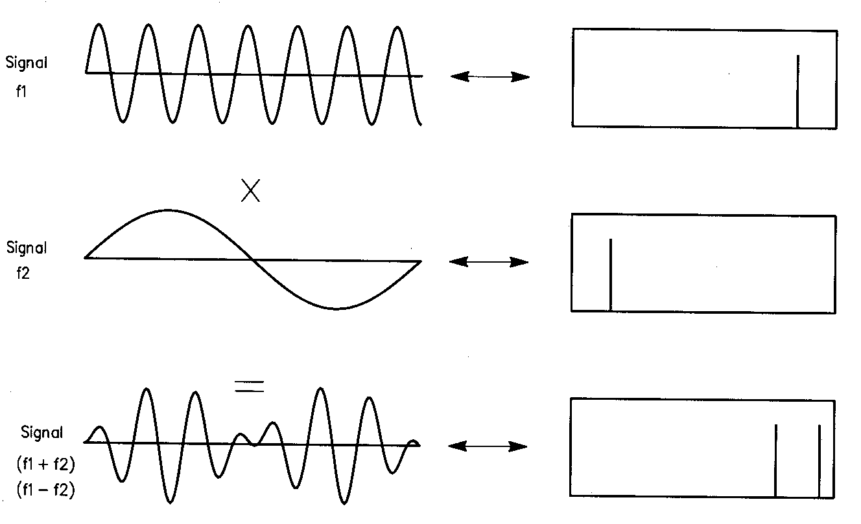
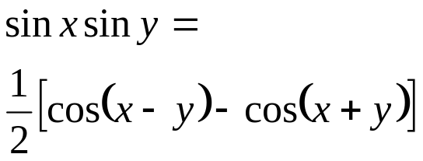
Lecture Example: Signal Multiplication (Heterodyning)
If we multiply two signals, we use the relationship
We see the sum and the difference of the two signals!

Slide 15
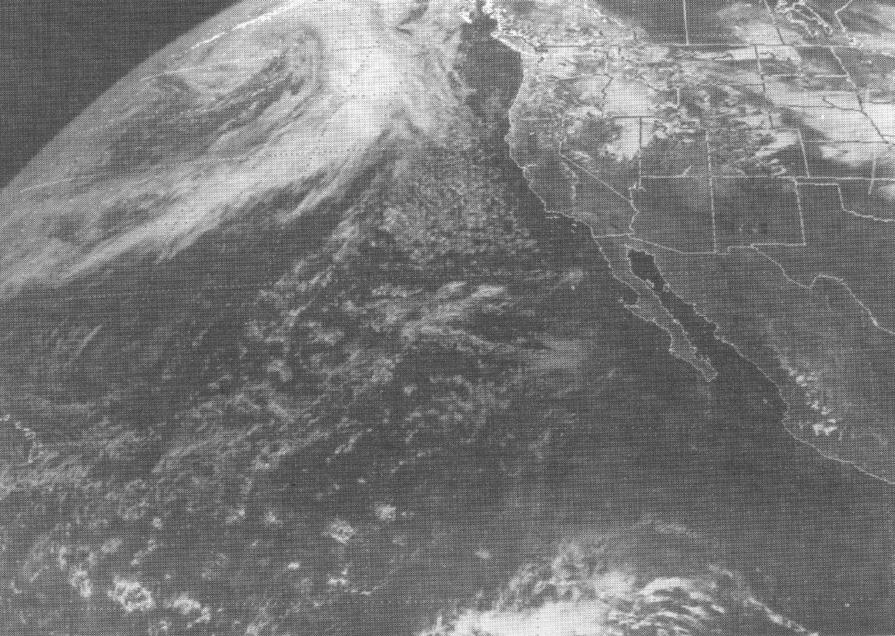
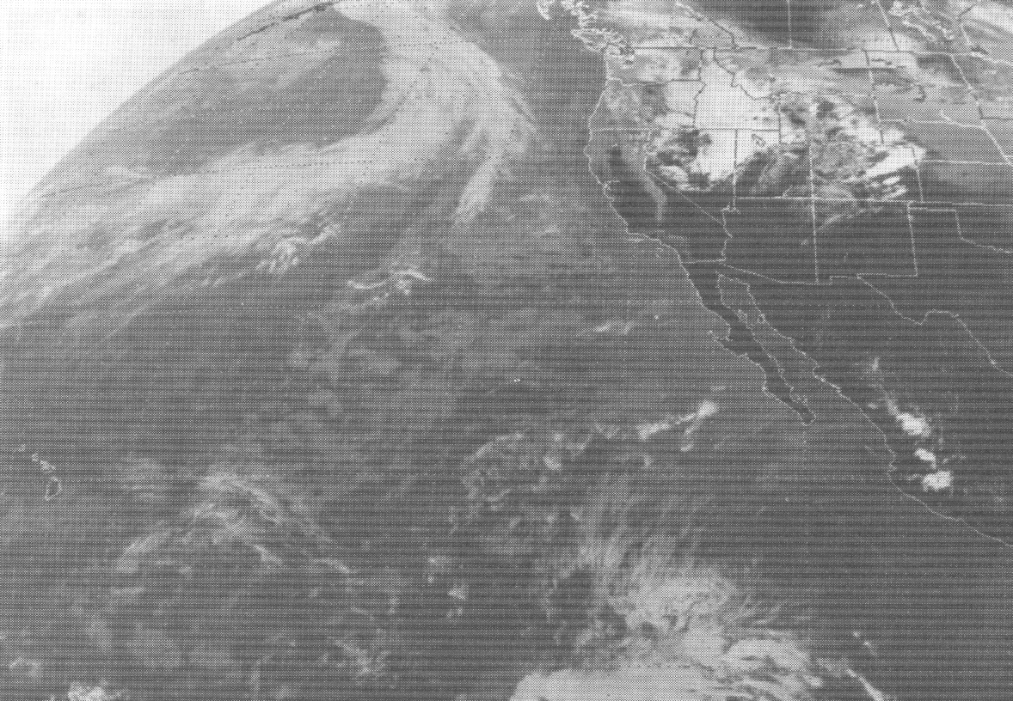
Lecture Example: Putting it all Together
Visible
Cumulo-nimbus
IR
Cirrus
Stratus
Strato-Cumulus

Slide 16
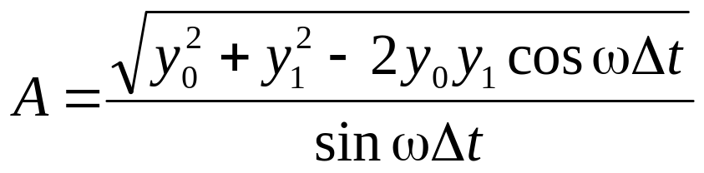

Decoding the signal
For much of the course, students could use a canned freeware program (WXSAT) to decode the image.
As an exercise, the students also had to write their own program to decode the signal.
This was done in the Java programming language, with some utility routines which we provided.
Demodulation algorithm….
y
t
Discrete samples

Slide 17
A student program...
public class Sat {
//------(CUT)---------
public static void main(String [] argv) {
SatWaveFile wf = new SatWaveFile(); // This does nothing
//-------(CUT)-----------
while(iSample<nSamples) {
// Read in a block of data and loop over it
int samples[] = wf.getRawData(BLOCKSIZE);
int nRead = samples.length; // Number of samples read in
for(int i=0; i<nRead ;i++) {
double t= iSample*deltaT; // The time to this point
double y1 = samples[i]; // the value of this sample
//
int a = (int) ((Math.sqrt((Math.pow(y1,2))+
(Math.pow(y0,2))-2*(y0)*(y1)*
(Math.cos(beta))))/(Math.sin(beta)));
// Calculate the pixel number associated with this sample
int iPixel = (int) (t/pixelDeltaT);
amplitudes[iPixel] = a;
y0 = y1; // Set for the next interation
iSample++;
}
}
SatImagePanel image = new SatImagePanel();
image.makeGrayPixels(amplitudes,0,XSIZE,YSIZE);
//---------(CUT)----------
}
}
We provide routines to read wave file, and display an image.
Students demodulate signal to generate pixels

Slide 18
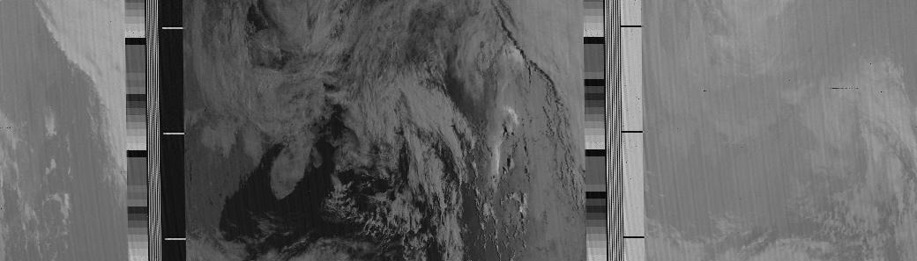
Shortcomings of simple program
More samples than pixels leads to “aliasing” (banding effect)
No horizontal synchronization

Slide 19
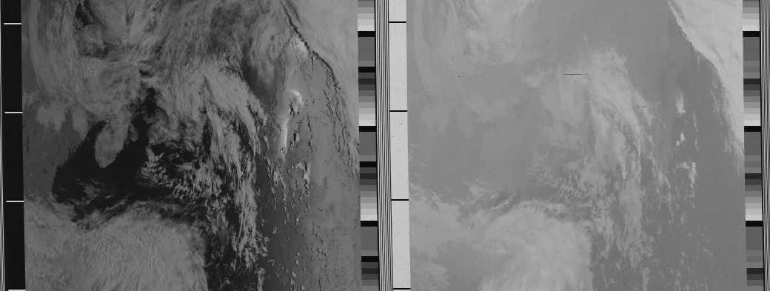
Some extra credit...
For extra credit, students could add pixel averaging
If they were really motivated, could add sync finder
In the end, a very nice picture is obtained.

Slide 20
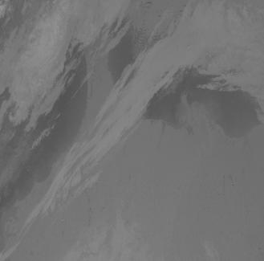
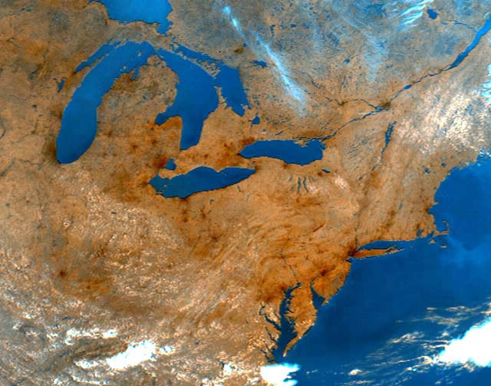
Interpreting the images
The satellites simultaneously transmit visual and infrared images. The visual data produces a black and white image
The infrared information can be added in the form of false color. This can be used to estimate the surface temperature as well as the water content of clouds and underlying precipitation.
By observing the motion of clouds over time, one can get an idea of the prevailing winds and major fronts.

Slide 21
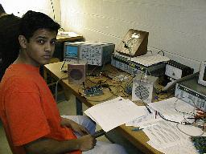
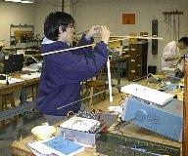
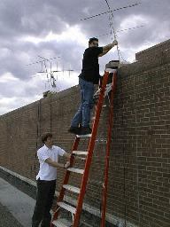
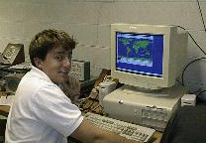
The class at work..
Kalid Azad working on his radio
Orion Crisafulli building his antenna
Gabe Fossati and Atul Pkharel mounting an antenna on the roof.
Gabe Fossati working at the computer

Slide 22
How did the class go?
12 Students took the course. They ranged from potential physics majors to humanities students who were terrified of the “ST” requirement.
The course turned out to be very adaptable
  More technically-minded students enjoyed the radio and programming aspects
  More “right-brained” students really liked manipulating and interpreting the images.
All reviews were good!
  Students loved the hands-on aspect (“Do I really get to solder?”)
  They generally felt “empowered” by the concrete nature of the topic.

Slide 23
How much did they really learn?
This sort of thing certainly won’t replace a rigorous curriculum; however
Most students commented that they had a much better feeling for the “big picture” of several physics topics.
Significantly, one student who has gone on to major in physics, has commented repeatedly that now he “understands the point” of several of the advanced topics. This was, really, our goal.

