Slide 1
Proton Plan
Eric Prebys, FNAL Accelerator Division

Slide 2
Proton Plan Charge
Develop a plan for a reasonable set of improvements and operational initiatives to maximize proton delivery to NuMI and the Booster Neutrino Beam (BNB) over the next ten years or so.
Estimate the budget and timeline for these improvements.
Estimate proton delivery to both beam lines if the Plan proceeds on schedule.
Note: this plan precedes the Proton Driver replacement of the existing Proton Source (Linac+Booster).

Slide 3
Staged Approach to Neutrino Program
This plan
Stage 0 (now):
  Goal: deliver 2.5E13 protons per 2 second MI cycle to NuMI (~2E20 p/yr), limited by MI RF system.
  Deliver 1-2E20 protons per year to Booster Neutrino Beam (currently MiniBooNE)
Stage 1 (~2007):
  A combination of Main Injector RF improvements and operational loading initiatives will increase the NuMI intensity to 4-5E13 protons to NuMI per 2.2 second cycle (~3E20 p/yr).
  This will increase by ~20% as protons currently used for pbar production become available.
  It is hoped we can continue to operate BNB at the 2E20 p/yr level during this period.
Stage 2 (post-collider):
  In this phase, we will consider using the Recycler as a preloader to the Main Injector and possibly reducing the Main Injector cycle time.
  The exact scope and potential of these improvements are under study.
Stage 3 (proton driver or equiv.)
  Main Injector RF must accommodate 1.5E14 protons every 1.5 seconds
  NuMI beamline and target must also be compatible with these intensities.

Slide 4
Limits to Proton Intensity
Total proton rate from Proton Source (Linac+Booster):
  Booster batch size
    ~4-5E12 protons/batch
  Booster repetition rate
    15 Hz instantaneous
    Prior to shutdown: 7.5Hz average (injection bump+RF)
  Beam loss
    Damage and/or activation of Booster components
    Above ground radiation
Total protons accelerated in Main Injector:
  Maximum main injector load
    Six “slots” for booster batches (3E13)
    Up to ~11 with slip stacking (4.5-5.5E13)
    RF stability limitations (under study)
  Cycle time:
    1.4s + loading time (1/15s per booster batch)
Historically our biggest worry

Slide 5
Proton Plan Developments Since Last Ops Review
AD Review, July 2005
Director’s Review, August 2005
“Baseline”, September 2005
Since baseline:
  Plan tracked with monthly PMG meetings
  Change control through formal change request (CR) procedure.
    So far, five complete CR’s with three more in process

Slide 6
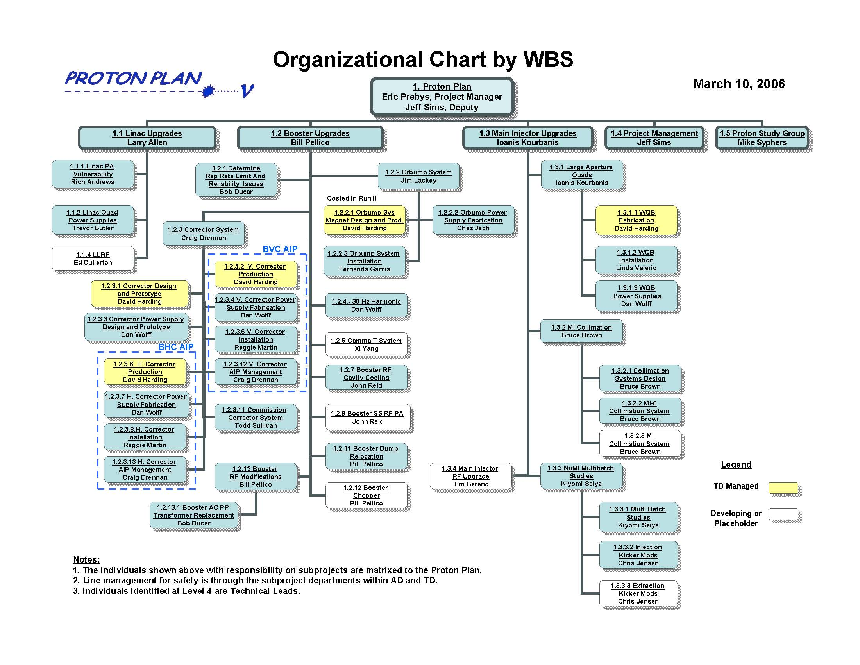

Slide 7
Plan Strategy
Increasing the proton delivery from the Booster to NuMI and MiniBooNE
  Increase maximum average Booster repetition rate.
  Increase acceptance by improving orbit control and beam quality.
Increasing the beam intensity in the Main Injector for NuMI
  Main Injector multi-batch operation.
  Slip stacking in Main Injector (requires RF upgrade).
Improving operational reliability and radiation limitations
  Linac quad supplies
  Booster and Linac Instrumentation
  Booster RF Upgrade
  Alleviate 7835 Problem
Organized along the Run II model
  “campaign” rather than “project”

Slide 8
Significant Elements of Plan
Linac
  Stockpile two year supply of spare 200 MHz power amplifier tubes (7835’s), in the event of an interruption in supply
  Characterize and improve Low Energy Linac Low Level RF
Booster:
  Replace and reconfigure injection bump (ORBUMP) system.
  Relocate 8 GeV dump from Booster tunnel to MI-8 transfer line
  Make Booster robust to 9 Hz, and understand requirements to go to 15 Hz
  Design, build, and install new corrector system
Main Injector:
  Replace seven quadrupoles with increased aperture versions, to reduce injection and extraction losses.
  Operationally develop multi-batch and multi-batch slip stacked operation
  Design and install collimation system, both in the MI-8 line and in the MI ring
  Modify injection kicker to allow multi-batch slip stacked operation
  Characterize and perhaps make improvements to RF system, to support high intensity operation.
Red = to be completed this shutdown

Slide 9
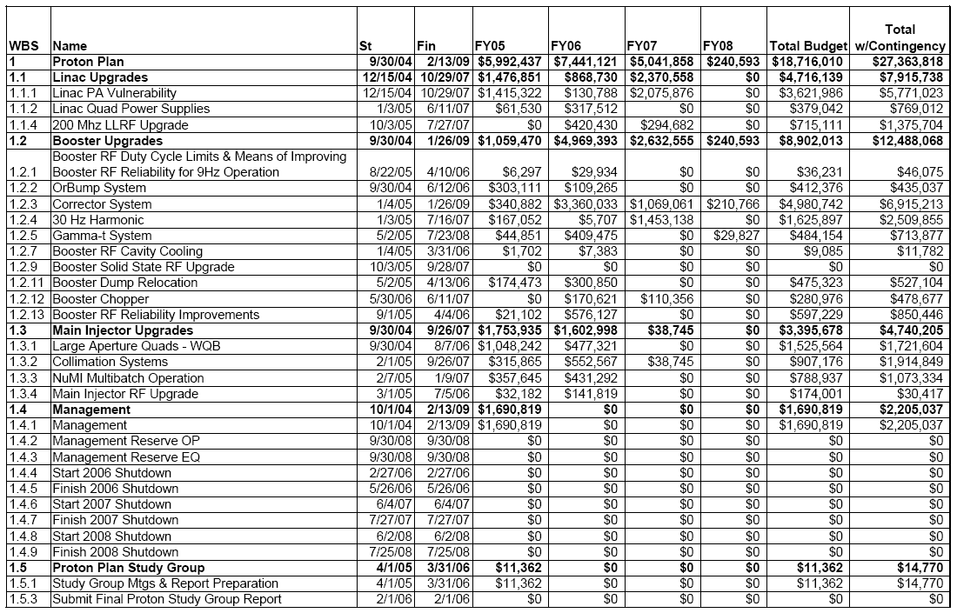
Level 3 Breakdown with Budget

Slide 10
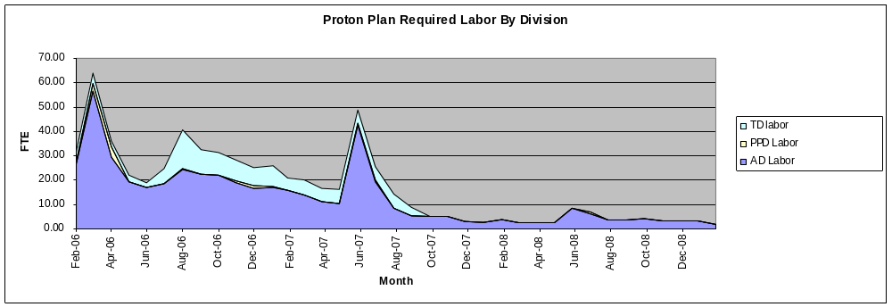
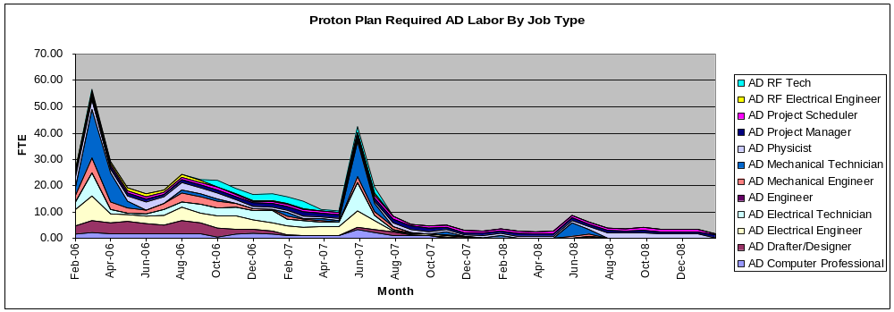
Labor Profiles
2008 Shutdown
2006 Shutdown
Build Correctors
2007 Shutdown
FY06
FY07
FY08
FY09

Slide 11
Major Accomplishments This Year
Linac
  10/12 strategic spare 7835’s delivered so far
  Design of pulsed quad supplies ongoing
  LEL LLRF studies well under way
Booster
  Operationally supported slip stacking for pBar production, NuMI, and MiniBooNE
    Required operational cogging
    Logintudinal properties improved with the intervention of Rapid Response Team (RRT)
  Worked in preparation for this shutdown
    More about this shortly
Main Injector
  Initiated routine full 2+5 operation
    Rate maximum until slip stacking begins after shutdown
  Did studies related to full slip stacking
    Demonstrated accelerated 2+9 operation at low intensity

Slide 12
Proton Projections
Phases of Operation
  Phase I (now)
    Booster lattice distortions ameliorated
    Booster limited to 7.5Hz total repetition rate
    Main Injector limited to 4E13 protons (2+5 operation)
  Phase II
    After present shutdown
    Injection bump (ORBUMP) replaced
    Drift tube cooling in Booster RF cooling finished
    Booster capable of 8-9Hz operation
    Begin to implement 2+9 full NuMI slip stack operation.
  Phase III
    Full NuMI 2+9 slip stack operation.
    Might require some MI RF modifications (under study)

Slide 13
Procedure for estimating Proton Delivery
Assume traditional operational priority:
  Protons for pBar production
    Limited by ability to slip stack
    Limited by max cooling rate
  Protons for NuMI
    Limited by max Booster batch size
    Limited by max MI cycle rate
    Limited by max MI proton capacity
    (will be) limited by ability to slip stack NuMI protons in MI
  Protons for BNB (currently MiniBooNE)
    Determined by difference between Booster capacity and maximum MI loading.
    Currently limited by Booster losses, and will continue to be for some time.
    Ultimately limited by Booster rep. rate.
    Extremely sensitive to fluctuations in total Booster output

Slide 14
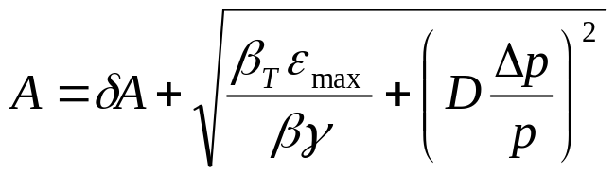
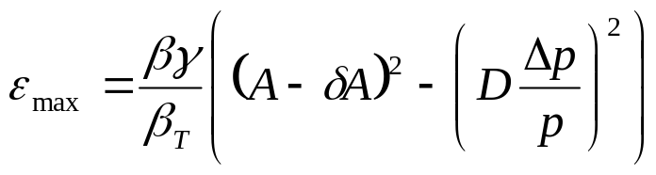
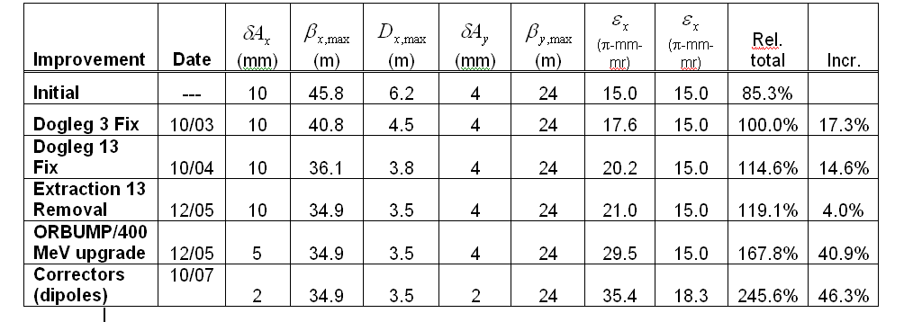
Evaluate Effect of Booster Improvements
Calculate effect of various improvements based on increased acceptance:
Use:
Effective aperture
reduction
Booster Dump Relocation

Slide 15
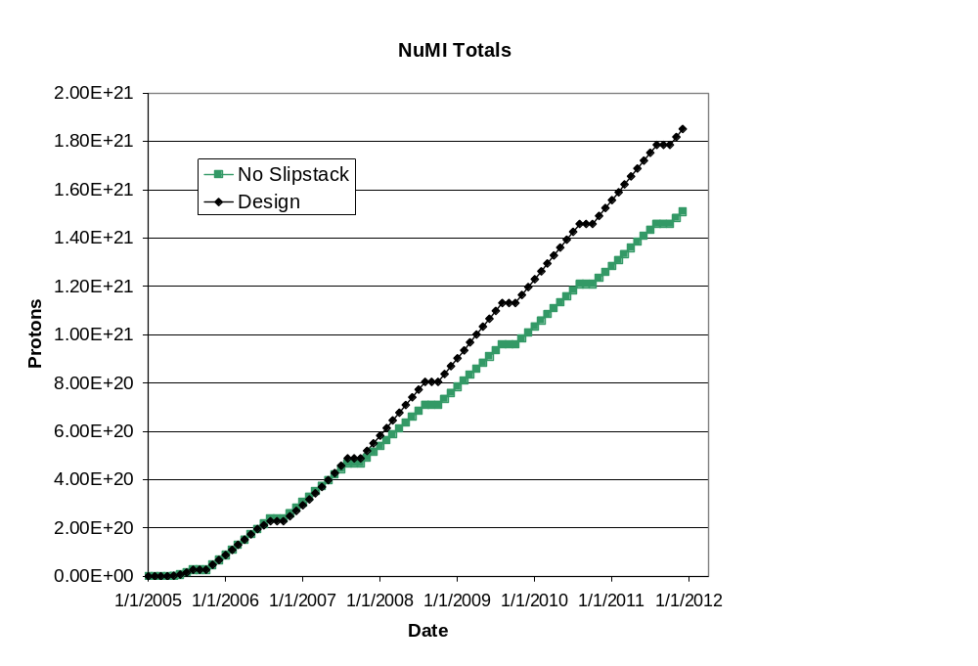
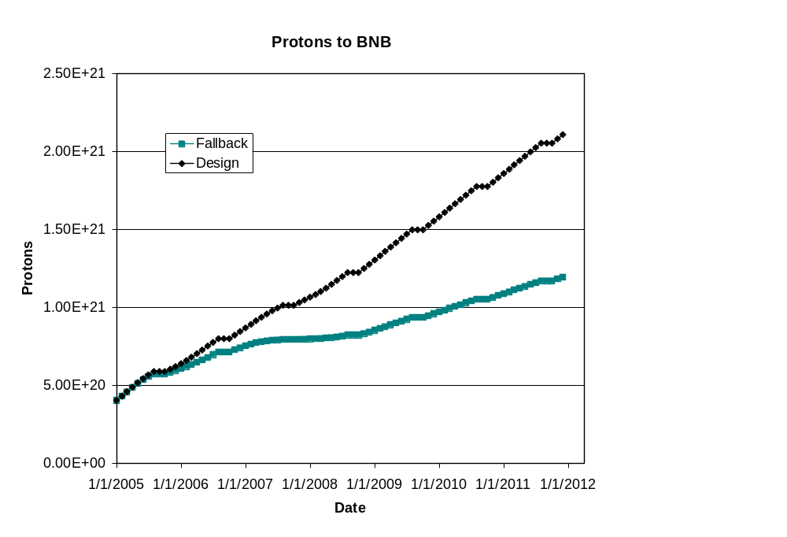
Long Term Projections
Post Collider
Post Collider
Note: these projections do not take into account the collider turning off in 2009
  NuMI rates would go up at least 20%
  Possibly much higher with Stage II improvements

Slide 16
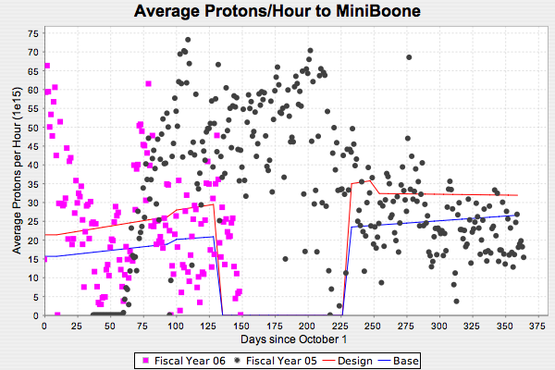
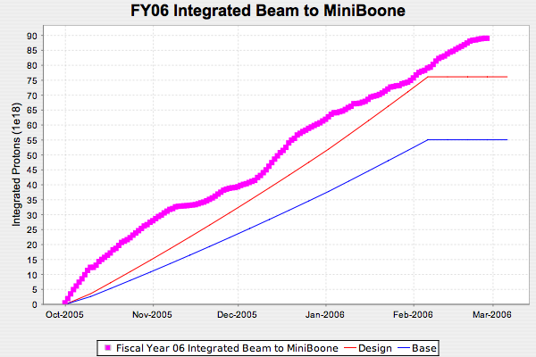
FY06 Proton to MiniBooNE

Slide 17
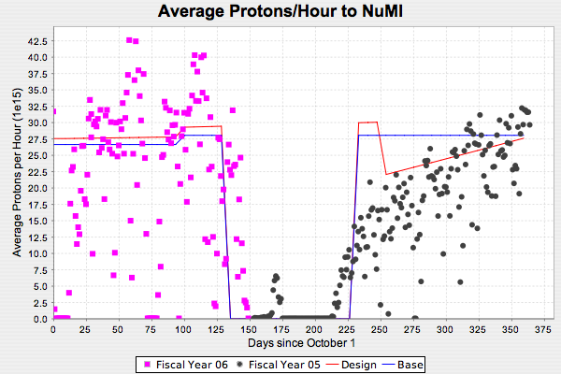
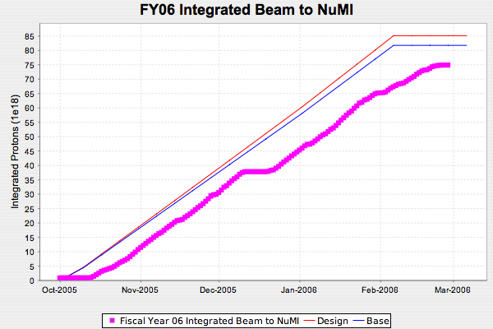
Protons to NuMI

