Slide 1
Booster Operation in Support of the Collider Program
Spite
Eric Prebys
Accelerator Technology Seminar, March 18, 2003
Outline:
  Overview
  Present and Projected Demands
  Limiting Factors
  Current Performance
  Big Projects
  Dogleg Problem

Slide 2
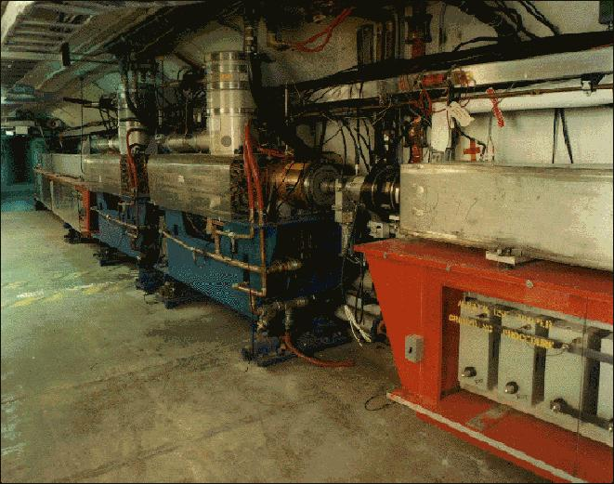
The Basics
The Booster takes the 400 MeV Linac Beam and accelerates it to 8 GeV.
From the Booster, beam can be directed to:
  The Main Injector
  MiniBooNE (switch occurs in the MI-8 transfer line).
  The Radiation Damage Facility (RDF) – actually, this is the old Main Ring transfer line.
  A dump.
The Booster is the only (almost) original accelerator in the Fermilab complex.
It maintains an average uptime of > 90%

Slide 3
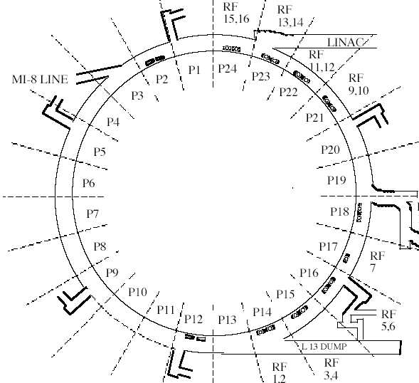
Booster layout
8GeV Beam to Main Injector and MiniBooNE
400 Mev Beam from Linac
472m in circumference
24-fold periodic lattice
Each period contains
4 combined function magnets.
Magnets cycle in a 15 Hz offset resonant circuit.
Old Main Ring Extraction Line
Used for study cycles, RDF and “short batching”

Slide 4
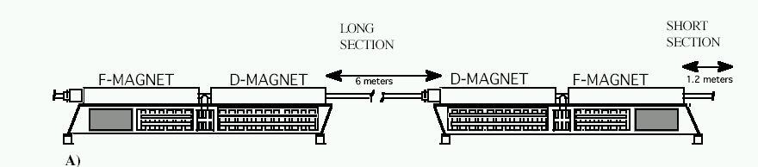
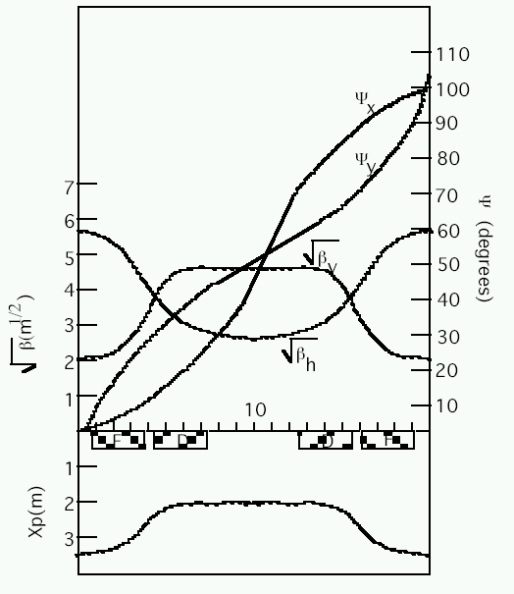
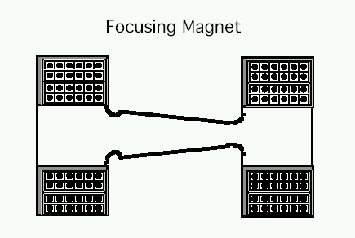
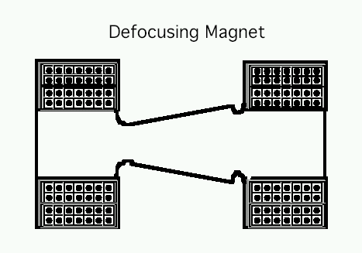
Booster Lattice Period
“Long straights” high-β in vertical plane
“Short straights” high-β in horizontal plane

Slide 5
Multi-turn Ion Injection
4 pulsed “ORBUMP” magnets
Circulating Beam
DC “Septum”
Beam at injection
400 MeV H⁻ beam from LINAC
Stripping foil
At injection, the 40 mA Linac H- beam is injected into the Booster over several “turns” (1 turn ~5E11).
The orbit is “bumped” out, so that both the injected beam and the circulating beam pass through a stripping foil, after which they circulate together.
At the moment, heating in the ORBUMP magnets limit our average rep rate (including prepulses to ~7.5 Hz).

Slide 6
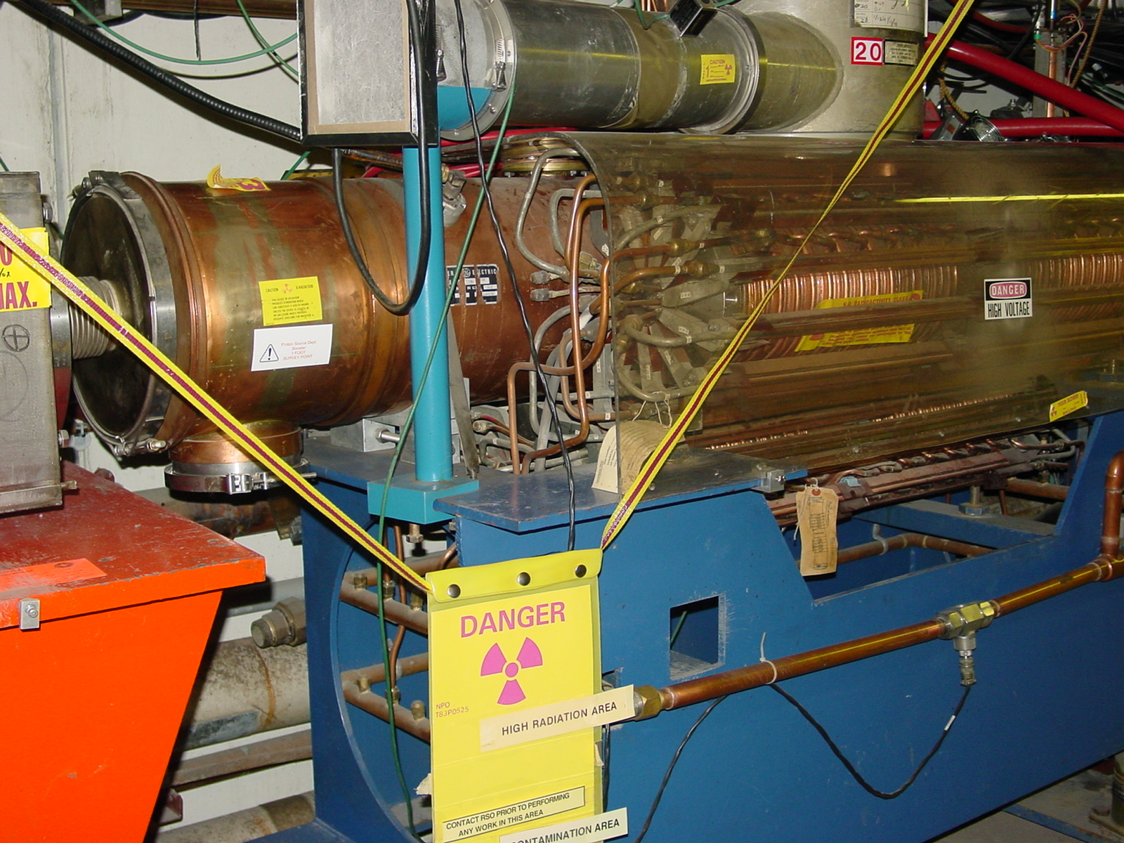
Booster RF System
18 more or less original RF cavities and power supplies.
Can run with 16 with increased losses.
biased ferrite tuners sweep frequency from 38 to 53 MHz during acceleration.
2 ¼” drift tube one of our primary aperture restrictions; new design being considered.
Pulsed when there’s beam + 2 prepulses.
Existing cavities might overheat at >7.5Hz
In-tunnel Power Amplifiers (PA’s) are by far the highest maintenance item in the Booster

Slide 7
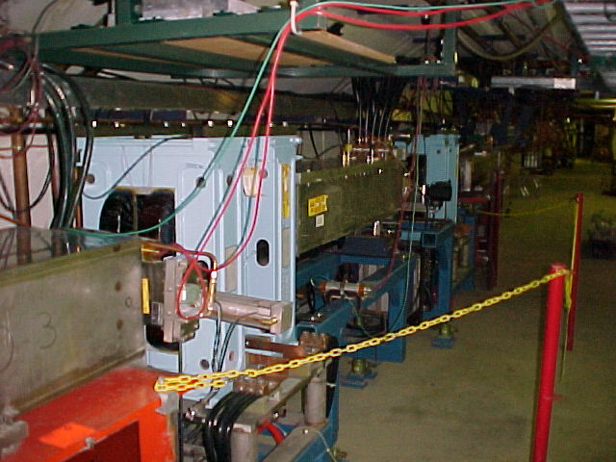
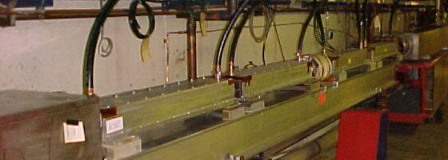
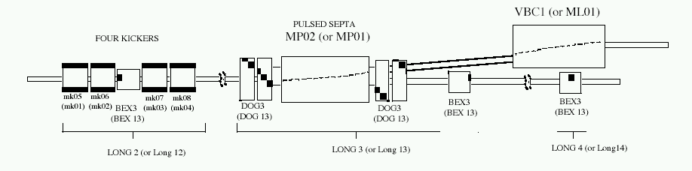
Booster Extraction (Long 3 and Long 13)
DC “doglegs” work with ramped 3-bump (BEXBUMP) to maintain 40π aperture below septum
Fast (~40 ns) kickers

Slide 8
Control and Instrumentation
Every long and short section (2x24=48) has
  A horizontal and vertical BPM
    Can read out turn by turn for two or 50 time points for all 96
  A beam loss monitor
    Can snapshot all 96 for each cycle
  Horizontal and vertical trims
    Originally DC. Working on active control for the 24 high-β ones in each plane.
  Quads and Skew Quads
    Each has an individual DC setting plus common ramp.
Chromaticity sextupoles controlled by ramps
Some individual loss monitors at key locations.
Horizontal pinger for tune measurement
  Couples to V plane
  Doesn’t work at the moment (had to steal kicker)

Slide 9
8 GeV Proton Run II Goals and Performance
Parameter | Typical Current Performance | Run II Handbook Goal | Comments
Pbar Stacking Pulse Intensity | 4.7E12/batch* = 5.9E10/bunch | >5E12/batch | Limited by Booster efficiency and residual radiation concerns
Hourly Intensity | 0.8E16 Run II | 1.2E16 | Limited by Pbar cooling cycle time
Transverse Emittance | 15-17 π mm-mr | <15 π mm-mr
Collider filling Intensity | 7 bunches @ 5.5 - 5.9E10 / bunch | 5-7 bunches @ 6E10 / bunch
Longitudinal Emittance | 0.1 - 0.15 eV-sec / bunch | <0.1 eV-sec / bunch | Better understanding of transition crossing and improved longitudinal dampers
* One batch ~80 bunches (harmonic 84 with 4 bunch gap)

Slide 10
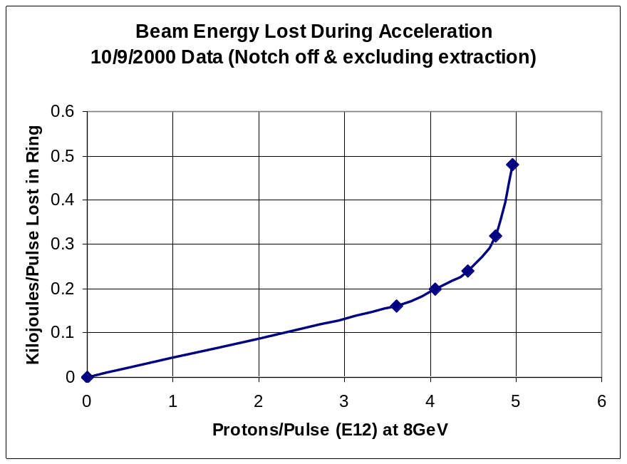
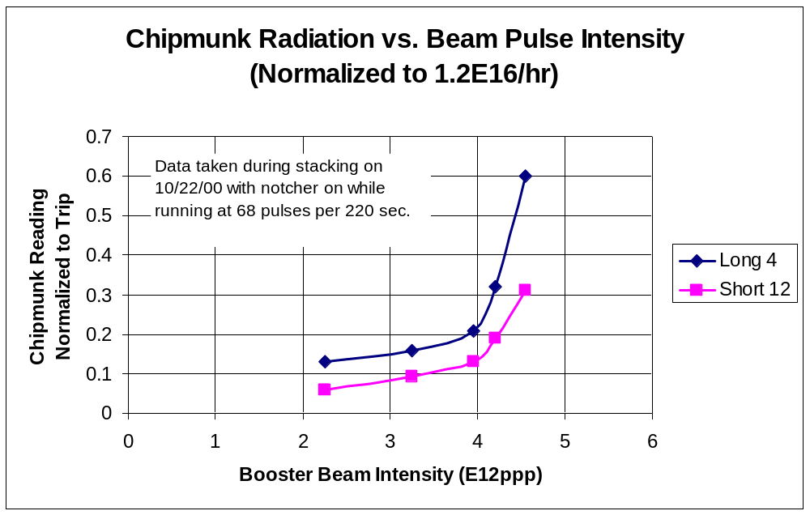
Beam Loss Intensity Sensitivity

Slide 11
The “Run II Era”
The proton source is very close the the specifications in the Run II Handbook.
Although it’s the highest priority, support of collider operations is a relatively minor facet of life in the proton source.
Proton source activities are dominated by the current and projected needs of the neutrino program (MiniBooNE+NuMI+??)
Whatever a WBS chart may say, there’s not a separate proton source for RunII, MiniBooNE, NuMI, etc.

Slide 12
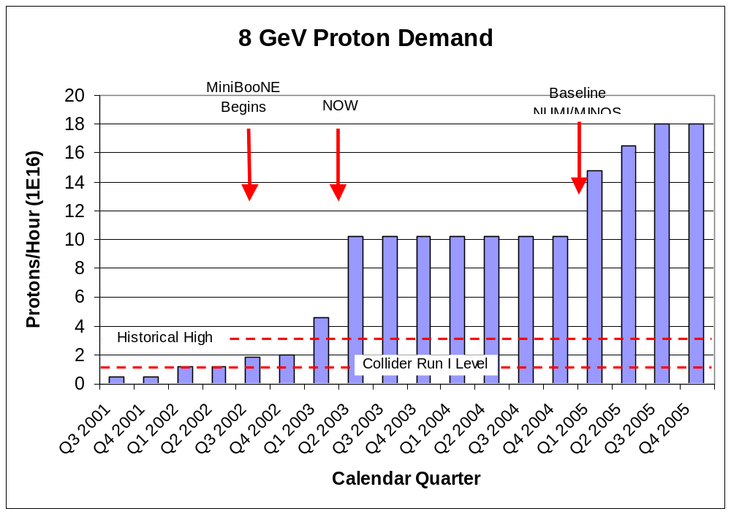
Demand for 8 GeV Protons
Fancy MI Loading schemes (or >5E12)
Shortfall
Present Operating Level

Slide 13
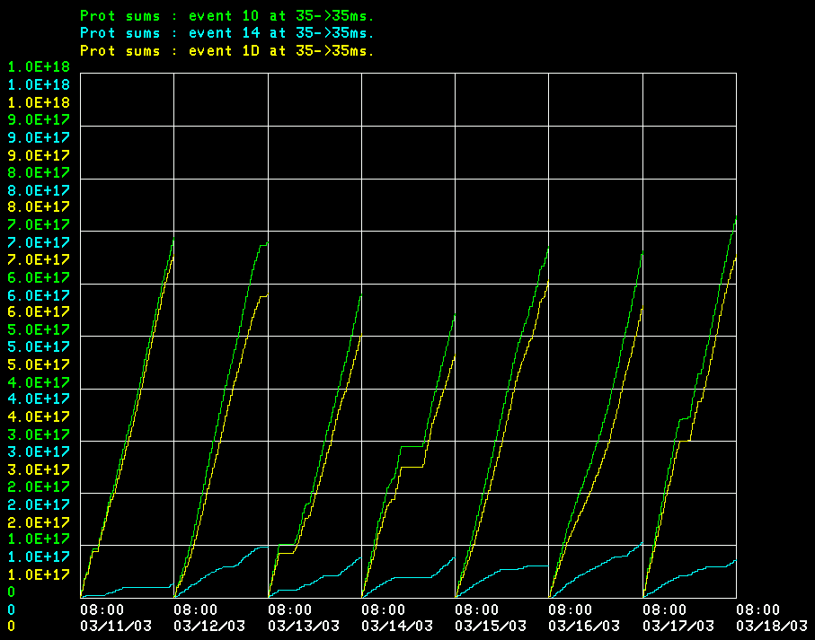
Where do Protons Go Now?
Total
MiniBooNE
Pbar production (limited by debuncher)
Operationally, the collider gets whatever it wants, and MiniBooNE gets whatever is leftover within the limits

Slide 14
Limitations to Total Booster Flux
Total protons per batch: 4E12 with decent beam loss, 5E12 max.
Average rep rate of the machine:
  Injection bump magnets (7.5Hz)
  RF cavities (7.5Hz, maybe 15 w/cooling)
  Kickers (15 Hz)
  Extraction septa (was 2.5Hz, now 15Hz)
Beam loss
  Above ground:
    Shielding
    Occupancy class of Booster towers
  Tunnel losses
    Component damage
    Activiation of high maintenance items (particularly RF cavities)
Of particular interest to NUMI
And stacking
Our biggest concern

Slide 15

Typical Booster Cycle
Various Injected Intensities
Transition
Intensity (E12)
stacking
MiniBooNE
Energy Lost (KJ)
Time (s)

Slide 16
Proton Timelines
Everything measured in 15 Hz “clicks”
Minimum Main Injector Ramp = 22 clicks = 1.4 s
MiniBoone batches “sneak in” while the MI is ramping.
Cycle times of interest
  Min. Stack cycle: 1 inj + 22 MI ramp = 23 clicks = 1.5 s
  Min. NuMI cycle: 6 inj + 22 MI ramp = 28 clicks = 1.9 s
  Full “Slipstack” cycle (total 11 batches):
    6 inject
    + 2 capture (6 -> 3)
    + 2 inject
    + 2 capture (2 -> 1)
    + 2 inject
    + 2 capture (2 -> 1)
    + 1 inject
    + 22 M.I. Ramp
    ----------------------
    39 clicks = 2.6 s

Slide 17
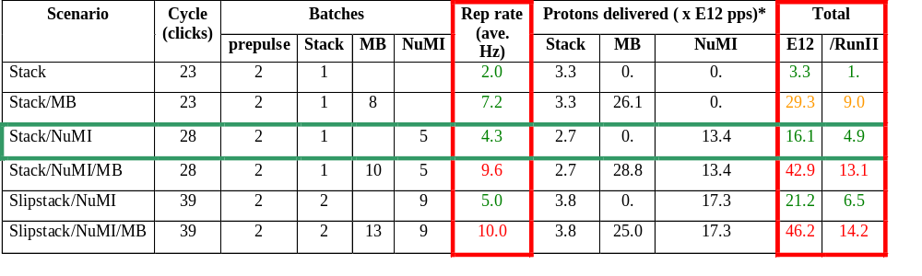
Summary of Proton Ecomomics
MiniBooNE baseline ≈ 5E20 p/year
Booster Hardware Issues
Radiation Issues
NUMI “baseline” = 13.4E12 pps x 2E7 s/year ≈ 2.7E20 p/year
Right now we’re at roughly 1/3 of the MiniBooNE baseline
*assuming 5E12 protons per batch

Slide 18
Time Line Issues
The Time Line Generator (TLG) sequences all accelerator operations.
Traditionally, each sequence (“module”) is independent, including any necessary Booster prepulses.
This wasn’t really compatible with the goal of getting the maximum possible beam out of the Booster.
In the new scheme:
  Standalone sequences are placed in the time line, with necessary prepulses
  MiniBooNE pulses are “trailer-hitched” to the end of these to achieve a specified average repetition rate, subject to an overall total rate.
  If there aren’t enough modules to trailer-hitch to, new modules will be built (still working the bugs out of this one).

Slide 19
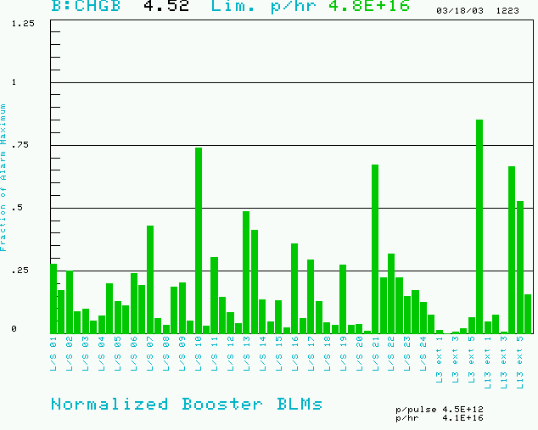
Booster Losses (Normalized to Trip Point)
Maximum based on trip point
Also limit total booster average power loss (B:BPL5MA) to 400W.
Present rate

Slide 20
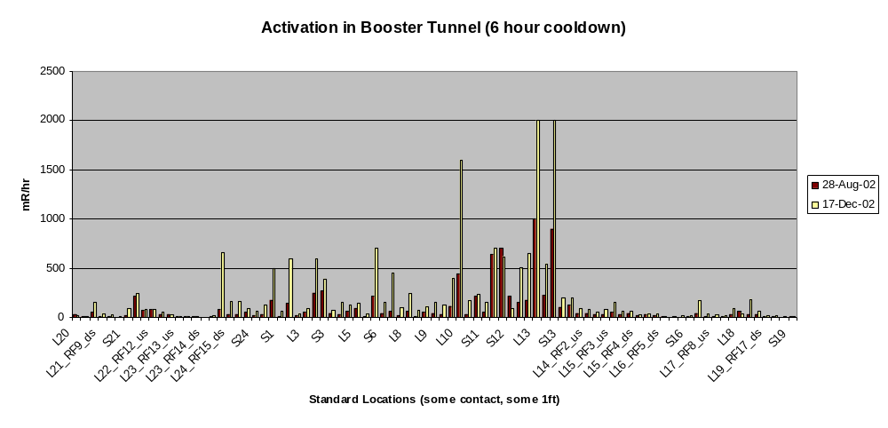
Booster Tunnel Radiation Levels
On a December access
  The people doing the radiation survey got about 20 mR.
  Two technicians received 30 mR doing a minor HV cable repair.
  We’re at (or past??) the absolute limit on our overall activation
  Some limits lowered afterwards (450W -> 400W)

Slide 21
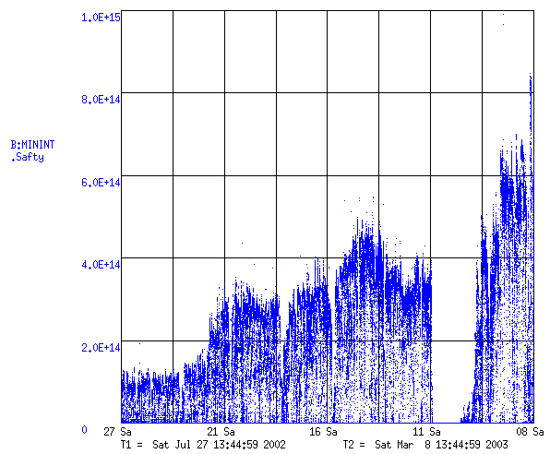
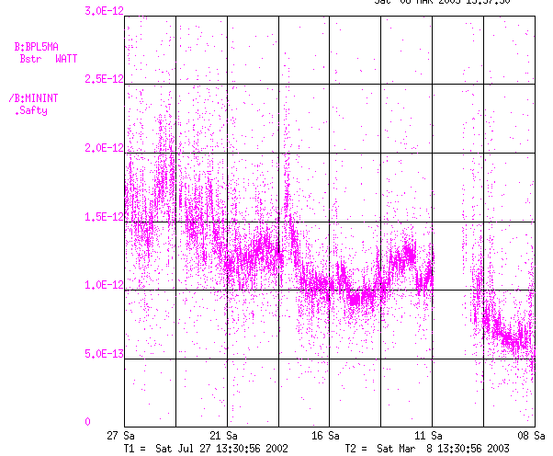
How Have We Been Doing?
Discovered dogleg problem: tune to reduce dogleg currents
MiniBooNE
Total Booster Output (protons/minute)
Test with one dogleg off (halfway to MiniBooNE goal!)
Energy Lost per Proton
(W-min/proton)

Slide 22
Some Cold Hard Facts about the Future
ten
1.8E20
Running as we are now, the Booster can deliver a little over 1E20 protons per year – this is about a factor of six over typical stacking operations, and gives MiniBooNE about 20% of their baseline.
NuMI will come on line in 2005, initially wanting about half of MiniBooNE’s rate, but hoping to increase their capacity – through Main Injector Improvements – until it is equal to MiniBooNE.
Whatever the lab’s official policy, there will be great pressure (and good physics arguments) for running MiniBooNE and NuMI at the same time.
-> By 2006 or so, the Proton Source might be called upon to deliver
10 times what it is delivering now.
At the moment, there is no plan for assuring this, short of a complete replacement!
So what are we going to try?…
33%
6

Slide 23
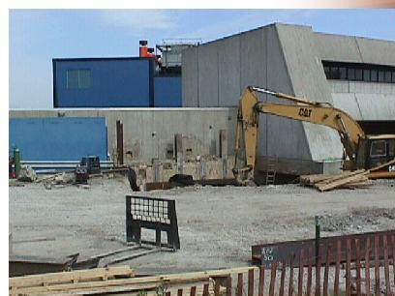
Some Things Which Have Been Done
Shielding and new radiation assessment
Vastly improved loss monitoring.
New (MP02) extraction septum and power supply (enable high rep. rate running)
New tuning strategies.

Slide 24
Booster Collimator System
Basic Idea…
A scraping foil deflects the orbit of halo particles…
…and they are absorbed by thick collimators in the next periods.
Unshielded copper secondary collimators were installed in summer 2002, with a plan to shield them later.
Due the the unexpected extent of the shielding and the difficulty of working in the area, the design was ultimately abandoned as unacceptable.
Collimators were removed during the January shutdown.
A new collimator system is being designed with steel secondary jaws fixed within a movable shielding body.
Hope to have then ready before summer shutdown.

Slide 25
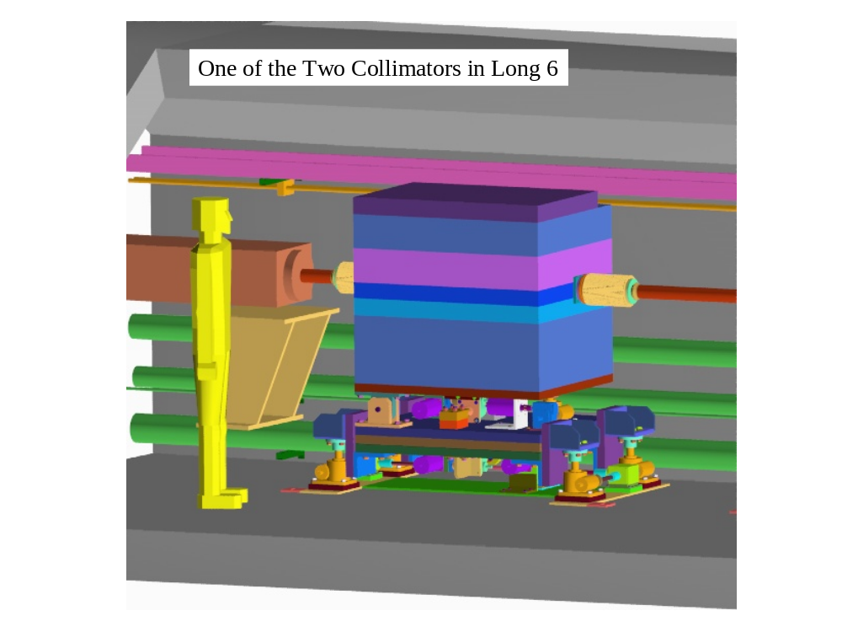
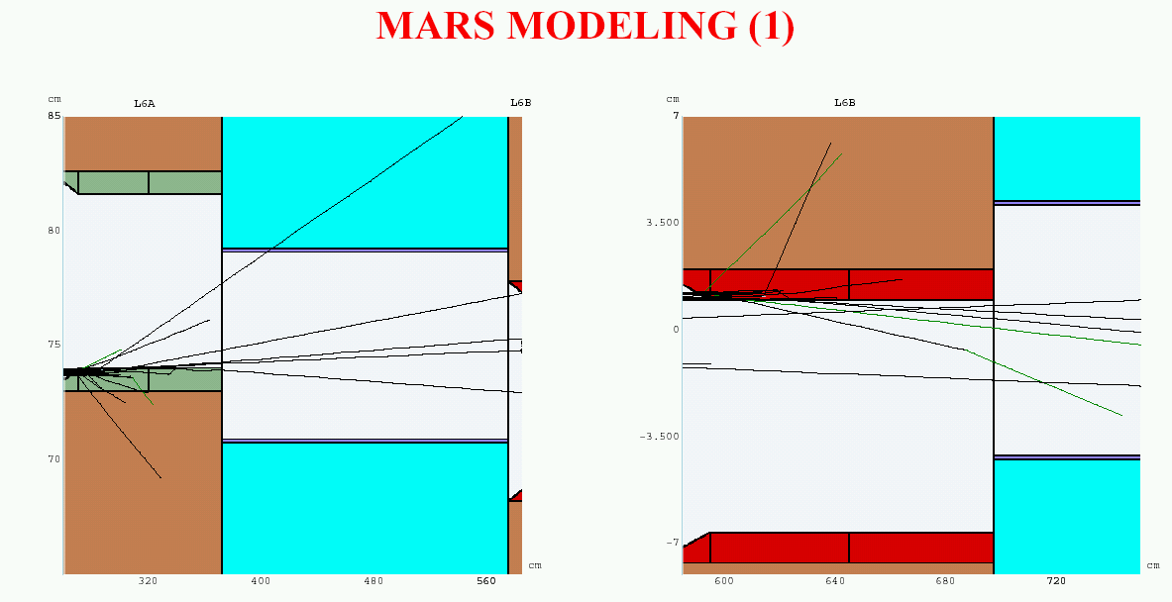
New Collimator System
System Designed to operate at full NuMI+MiniBooNE intensity and intercept:
  30% of beam at 400 MeV
  2% of beam at 8 GeV
Shielding determined by:
  Above ground radiation
  Sump water contamination
  Residual activation
No active cooling
All parts serviceable
Currently in review

Slide 26
New RF System?
The existing RF cavities form the primary aperture restriction (2 ¼” vs. 3 ¼”).
They are high maintenance, so their activation is a worry.

Slide 27
New RF System (cont’d)
There is a plan for a new RF system with 5” cavities:
  Powered prototype built
  Building two vacuum prototypes for the summer shutdown with substantial machining done at universities.
  Evaluate these and procede (hopefully?) with full system.
Total cost: $5.5M cavities + $5.5M power supplies (power supplies would pay for themselves in a few years)
Is it worth it? On of the questions for the study group is how much improvement we might expect.

Slide 28
Injection Dogleg (ORBUMP)
The current injection bump dogleg (ORBUMP) magnets can ramp at 7.5 Hz, with a substantial temperature rise.
Need to go to 10 to support MiniBooNE and NuMI.
2 spares for the 4 (identical) magnets. Most likely failure mode probably repairable.
Considering new design which will stretch existing magnets further apart, which will lower their current, but will require a pulsed injection septum between the first two.
Can new design incorporate injection improvements??
Some power supply issues as well:
  One full set of replacement SCR’s for the switch network.
  New switchbox being designed, but needs attention (or order more spare SCR’s).
  No spare for charge recovery choke.

Slide 29
Multibatch Timing
In order to Reduce radiation, a “notch” is made in the beam early in the booster cycle.
Currently, the extraction time is based on the counted number of revolutions (RF buckets) of the Booster. This ensures that the notch is in the right place.
The actual time can vary by > 5 usec!
This is not a problem if booster sets the timing, but it’s incompatible with multi-batch running (e.g. Slipstacking or NuMI)
We must be able to fix this total time so we can synchronize to the M.I. orbit.
This is called “beam cogging”.

Slide 30
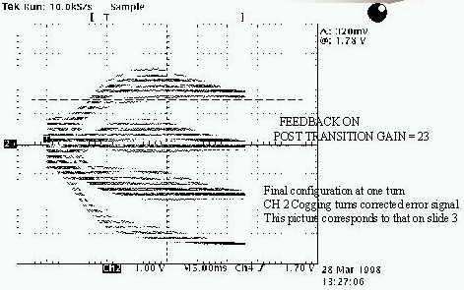
Active cogging
Detect slippage of notch relative to nominal and adjust radius of beam to compensate.
Allow to slip by integer turns, maintaining the same total time.
Does not currently work at high intensities.
Still do not really understand the problem.

Slide 31
Simulation/Studies
Historically, the booster has lacked a fundamental understanding of beam loss mechanisms.
If (!!!) it is possible at all to go the the required beam flux, it will require some mitigation of beam loss.
Recently, there has been an great increase in the involvement of the Beam Physics department in the Booster:
  Space charge group (W. Chou, et al) has begun to focus on the Booster again.
  Chuck Ankenbrandt has moved into Booster group as “Beam Physics Liaison” to help coordinate studies.
  Starting to make quantitative comparisons between predictions and measurement.
An almost immediate result of this increased effort was the discovery of the “dogleg problem”….

Slide 32
Dogleg Problem
Septum
Each of the two Booster extraction septa has a set of vertical dogleg magnets to steer the beam around it during acceleration.
More powerful doglegs were installed in 1998 to reduce losses early in the cycle.
These magnets have an edge focusing effect which distorts the horizontal injection lattice:
  50% increase in maximum β
  100% increase in maximum dispersion.
  Harmonic contributions.
Effect goes like I². Now tune to minimize.
Recently got an unusual opportunity to explore potential improvements from fixing the problem.
Working on schemes to reduce or remove problem.
Dogleg Magnets

Slide 33
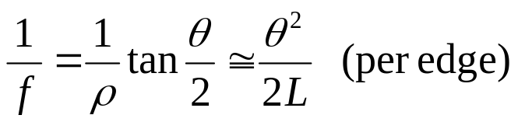
Parasitic Focusing
Rectangular (RBEND) magnet:
vertical focusing if beam has component into page
vertical focusing if
beam has component
out of page
Focusing in
non-bend plane!!
f
f
θ/2
θ/2
Side View
Top View
Always focusing!!

Slide 34
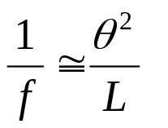




Parasitic Focusing (cont’d)
Sector (SBEND) magnet:
Focusing in
bend plane!!
Longer L
Nominal L
B ~constant
Shorter L
Trade-off:
SBEND
RBEND
Exit angle
Non-bend plane focusing
bend plane focusing

Slide 35
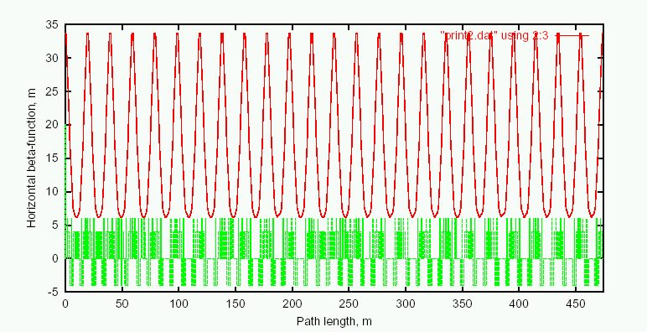
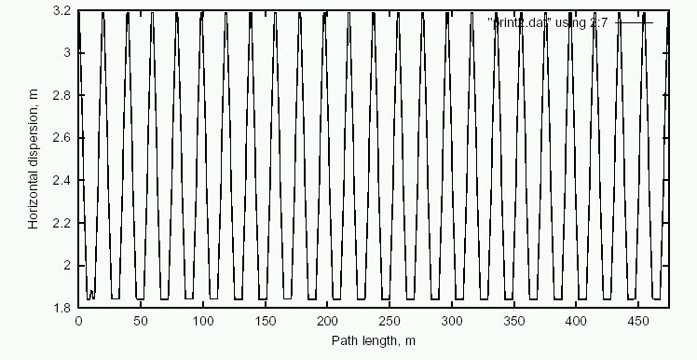
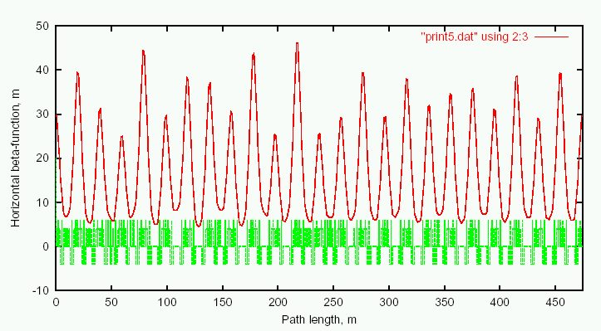
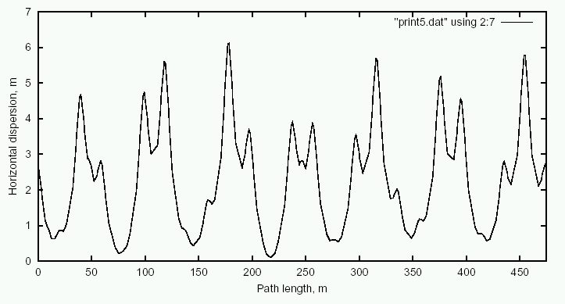
Predicted Effect of Doglegs
Ideal Lattice
β_{x}
D_{x}
Add Doglegs
β_{x}
D_{x}

Slide 36
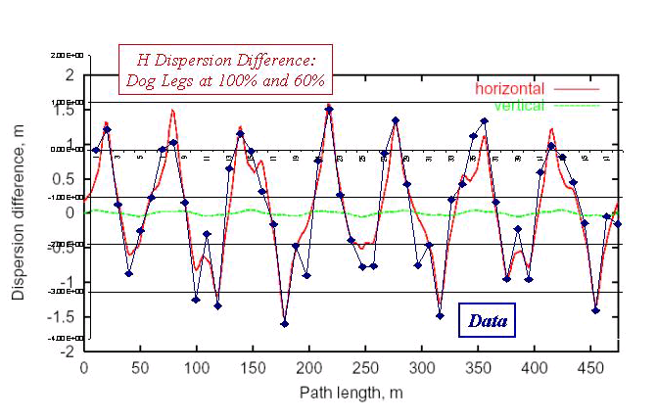
Preliminary Study: Dispersion
Measured dispersion for different dogleg currents:

Slide 37
Dead Dog Studies
Took advantage of recent TeV Magnet failure to raise the Long 13 (dump) septum and turn off the associated dogleg.
Doglegs almost exactly add, so this should reduce the effect by almost half.
The mode of operation prevents short batching, booster study cycles and RDF operation.
Had about 36 hours of study in this mode.
Bottom Line: major improvement.

Slide 38
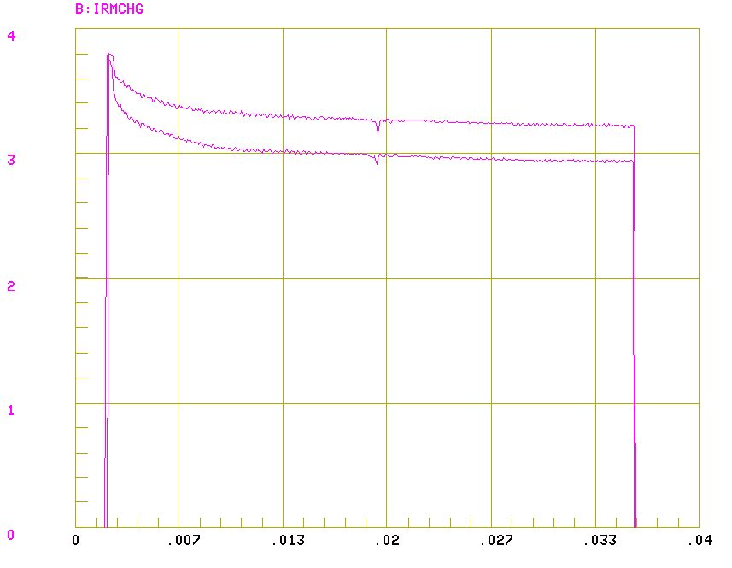
Transmission After Tuning
March 6, 7 turns, 1 dog
March 3, 7 turns, both dogs

Slide 39
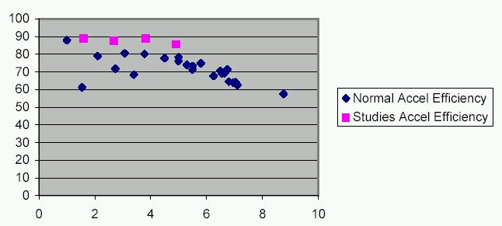
Transmission with One Dogleg
%
Injected Charge (E12)

Slide 40
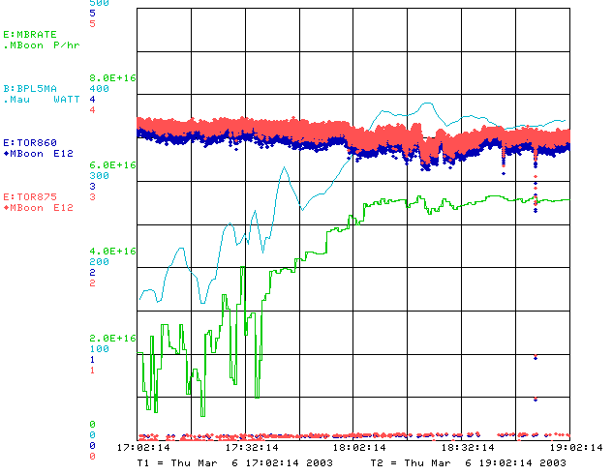
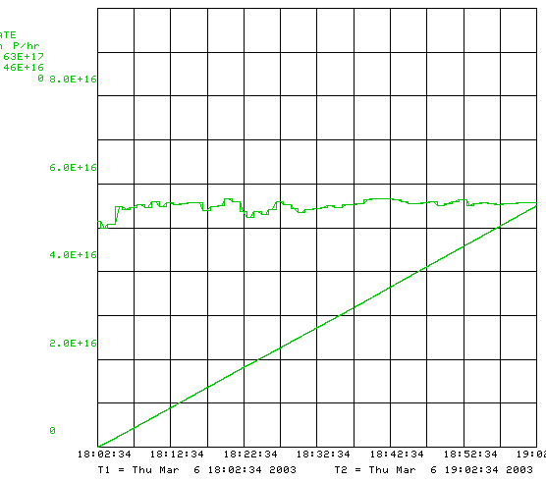
Record Running w/o Dogleg

Slide 41
Short Term Solutions
Tune to minimize current?
  helped so far, but near limit.
  Maybe raise L13 septum a bit?
Motorize L13 septum to switch modes quickly?
  Operational nightmare
Eliminate L13?
  Find another way to short-batch
  Make a dump in MI-8 for Booster study cycles?
Correctors?:
  These don’t look like quads, so can’t find a fix – yet.
Spread out doglegs (effect goes down with square of separation):
  Not a lot of room. Maybe separate downstream magnets?
Three-legged dog?
  Turn of the third of the four magnets.
  Need to increase first two reduces net improvement.

Slide 42
Long Term Solutions
Large Aperture Lattice Magnets?
  Obviously the “right” idea.
  Must match lattice AND (preferrably work with existing resonant circuit).
  Potential for big screw-up.
Pulsed extraction bump?
  Straightforward magnet design.
  Only part of the lattice for a short period at the end of the cycle.
New ideas welcome.

Slide 43
Longevity Issues (non-radiation)
GMPS (upgraded, OK)
Transformers (serviced, OK)
Vacuum system (being updated, finished 2003)
Kicker PS charging cables
  Run three times over spec
  Evaluating improved design (better cable, LCW-filled heliac, etc)
Low voltage power supplies, in particular Power 10 Series:
  Unreliable, some no longer serviced.
  Starting search for new supplier and evaluate system to minimize number of different types.
  Probably a few $100K to upgrade system.

Slide 44
Longevity Issues (non-radiation, cont’d)
RF Hardware
  (original) Copper tuner cooling lines are beginning to spring leaks. Difficult to repair because they’re hot.
High Level RF
  More or less original.
  Our highest maintenance item.
  Will probably last, BUT expensive to maintain.
  John Reid and Ralph Pasquinelli feel a new solid state system would pay for itself ($5.5M) in about four years.
Low Level RF
  Many old modules, some without spares, some without drawings.
  An upgrade plan in place.
  Not expensive, but NEED people.
Personnel!!!!

Slide 45
Radiation Damage Worries
Cables: frequent replacement of HV cables and connectors for ion pumps.
Hoses: valve actuator hoses have failed and are now being replaced with stainless steel.
Kicker magnets: A kicker which recently failed showed signs of radiation damage to the potting rubber.
Main magnet insulation: No main magnets have failed in 30 years, but…
Installed radiation “dose tabs” around the ring in January shutdown to get a real estimate of dosage.

Slide 46
Conclusions
The Fermilab Booster has maintained a remarkable level of reliability over the last 30 years.
It has now reached unprecedented performance levels while maintaining reasonably strict beam loss standards.
We still have a lot to do to meet the demands of the future.

