Slide 1
Major Projects in Linac/Booster
New Linac Lambertson
(4) New EDWA magnets in MI-8 line
(3) New Booster collimators
Rearrangement of L3 extraction region, including
  New (spare) dogleg magnets on new stands
  New C maget before VBC1
Replace RF cavities in period 15 with two large aperture spares.
Replace MP01 power supply, including
  New cable pulls
  New dowstairs cable header
Biggest ALARA worry

Slide 2
Shutdown Schedule
Sun | Mon | Tue | Wed | Thu | Fri | Sat
Sept. 7 | 8 | 9 | 10 | 11 | 12 | 13
14 | 15 | 16 | 17 | 18 | 19 | 20
21 | 22 | 23 | 24 | 25 | 26 | 27
28 | 29 | 30 | Oct. 1 | 2 | 3 | 4
5 | 6 | 7 | 8 | 9 | 10 | 11
12 | 13 | 14 | 15 | 16 | 17 | 18
BOOSTER OFF- Cool down and miscellaneous prep work
Collimators (with ironworkers) – Assumes collimators have been assembled in access bay!
Lambertson (LInac Tunnel)
EDWA Installation
Collimators (ironworkers move to EDWA installation)
Lambertson (LInac Tunnel)
EDWA Installation
Lambertson (LInac Tunnel)
Dogleg Modification at Long 3
EDWA Installation
Install Damper Cavity
EDWA Installation

Slide 3
Shutdown Schedule (cont’d)
Sun | Mon | Tue | Wed | Thu | Fri | Sat
Oct. 19 | 20 | 21 | 22 | 23 | 24 | 25
26 | 27 | 28 | 29 | 30 | 31 | Nov 1
2 | 3 | 4 | 5 | 6 | 7 | 8
9 | 10 | 11 | 12 | 13 | 14 | 15
16 | 17 | 18 | 19 | 20 | 21 | 22
Commissioning and Studies. Test MI-8 extraction.
Shutdown to Install Prototype RF Cavities
Commissioning and Studies. Possible off-hours beam to MiniBooNE
Return to normal operation

Slide 4
ALARA Philosophy (collimators and Long 3)
General:
  Wait a week to start major work
  Go in early in the shutdown (maybe also before?) and map out exposure in hall area. Indicate “loiter”/”no loiter” zones. Possibly move shield wall near work area
  Minimize exposure for key personnel, particularly: Jim Lackey, Danny Douglas, Ben Ogert
  Wherever possible, use non-essential personnel (like me) to do actual hot work
Collimator region
  Remove all beam pipes
  Place lead blankets over magnets and remaining beam elements prior to moving collimators into place
Long 3
  Move old doglegs and septum to entry hallway
  Remove lower layers of steel shielding above work area (and possibly replace with new (cool) shielding.
  Place lead blankets over remaining beamline elements.

Slide 5
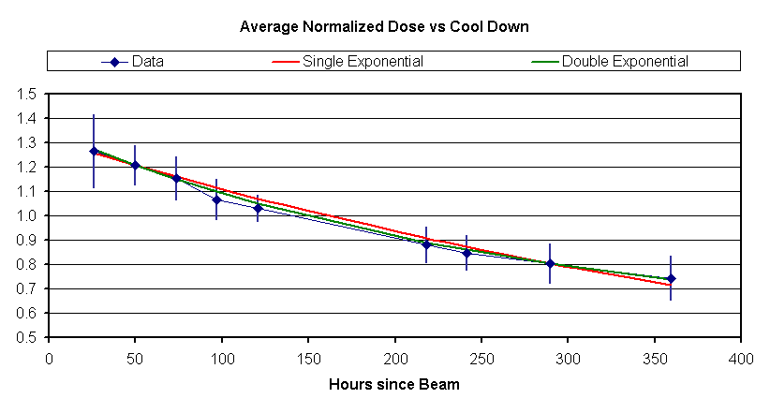
Shut Down MiniBooNE Early??
Suppressed zero
One week
Two weeks
Not a huge effect.

