Slide 1
Booster Rep Rate and Intensity Issues Beyond Proton Plan
Eric Prebys, FNAL Accelerator Division

Slide 2
Limits to Proton Intensity
Total proton rate from Proton Source (Linac+Booster):
  Booster batch size
    ~4-5E12 protons/batch, depending on beam quality requirements
  Booster repetition rate
    15 Hz instantaneous
    Prior to shutdown: 7.5Hz average (injection bump+RF)
  Beam loss
    Damage and/or activation of Booster components
    Above ground radiation
Total protons accelerated in Main Injector:
  Maximum main injector load
    Six “slots” for booster batches (3E13)
    Up to ~11 with slip stacking (4.5-5.5E13)
    Possible RF stability limitations (under study)
  Cycle time:
    1.4s + loading time (1/15s per booster batch)
Historically our biggest worry

Slide 3
Some Numbers to Keep in Mind
At 120 GeV, 100 kW is roughly
  1E20 protons/year
  1 Booster Hz @5E12*
  2E16 peak proton intensity out of Booster
ABSOLUTE limit of this Proton Source:
  5E12 batches @ 15Hz
    ~1.5MW @ 120 GeV
    1.5E21 protons/year
    3E16 pph out of Booster
    This is about ~2x the present proton plan
*not including prepulses.! Add 2Hz/(MI cycle) for total rate

Slide 4
Rep Rate Issues in Proton Plan
Proton Plan Mandate
  Slip stack to NuMI and pBar
  Maintain about 2E20 protons per year to the 8 GeV line
This requires the Booster to go to about 9Hz
  Identify rate limitations
  If something needs to be replaced or significantly modified to achieve 9Hz, do the incremental work to make it 15 Hz compatible.
  Identify and roughly cost out remaining issues to go from 9Hz to 15Hz.

Slide 5
Summary: Significant Elements of Proton Plan
Linac
  Stockpile two year supply of spare 200 MHz power amplifier tubes (7835’s), in the event of an interruption in supply
  Characterize and improve Low Energy Linac Low Level RF
Booster:
  Replace and reconfigure injection bump (ORBUMP) system.
  Relocate 8 GeV dump from Booster tunnel to MI-8 transfer line
  Make Booster robust to 9 Hz, and understand requirements to go to 15 Hz
  Design, build, and install new corrector system
Main Injector:
  Replace seven quadrupoles with increased aperture versions, to reduce injection and extraction losses.
  Operationally develop multi-batch and multi-batch slip stacked operation
  Design and install collimation system, both in the MI-8 line and in the MI ring
  Modify injection kicker to allow multi-batch slip stacked operation
  Characterize and perhaps make improvements to RF system, to support high intensity operation.
Red = to be completed this shutdown

Slide 6
History of Booster Rate Limitations
solved
MP02 extraction septum
  ~ 2 Hz
  Replaced 2003, now 15Hz
MP01 extraction septum
  ~ 5Hz
  Replaced 2004, now 15 Hz
ORBUMP magnets and power supply
  ~ 7.5Hz
  Being replaced this shutdown -> 15 Hz
RF cavity drift tube cooling
  ~ 7.5 Hz
  Installing cooling this shutdown -> 15 Hz
13.8 kV transformers
  Questionable reliability at > 7.5 Hz
  Being replaced this shutdown -> 15 Hz
Bottom line
  After this shutdown, Booster will be OK to ~9Hz
  “Done” as far as the Proton Plan is concerned.
Being solved
this shutdown

Slide 7
What’s needed for SNuMI?
At the end of the Proton Plan, the Booster will be capable of
  Peak proton rates based on beam loss of about 1.8E17 protons per hour
  Sustained operation at 9Hz
    This will limit the actual output to ~1.3E17, depending on the details of the supercycle.
This roughly accommodates the baseline Nova recycler retasking scheme
  11 booster batches into Recycler ever 1.4 seconds.
  ~700 kW to NuMI
  NO addition protons available for MiniBooNE, SciBooNE, or SY120.
Anything beyond this will involve Booster modifications beyond the Proton Plan
  This includes alternative approaches to 700 kW involving small MI loads with a short cycle time!

Slide 8
Going Beyond 9Hz
After this shutdown, the only thing limiting the Booster rate will be the RF drive system.
Half the RF bias supplies have transformers which would need to be upgraded.
  Significant effort and lead time.
  Cost: ~few hundred $K
480 distribution system
  Being investigated
  On the order of $100K to upgrade, if necessary.
Feeder from substation
  Probably OK.
  $250K if it’s not
Total cost
  Still being determined
  Of order $0.5-1M

Slide 9
Beam Quality at High Intensity
All Proton Plan projections assume slip stacking no more than 4E12 batches
  Although Booster capacity is speced out for 5E12 batches.
As the Booster goes up in intensity, the beam quality degrades
  Have demonstrated ~6E12 batches single batch
  However, when slip stacking was implemented regularly in early 2005, there were problems related to Booster beam quality above ~3.5E12
This became one of the central issues for the Stacking “Rapid Response Team”
  Jim Steimel in charge of Booster part, working with booster personnel.
  See McGinnis’ March Review talk for details

Slide 10
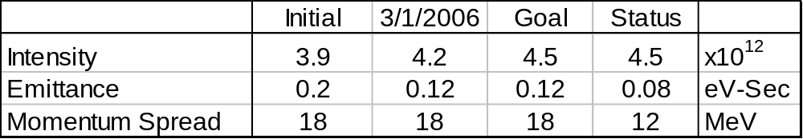
RRT Steps to Improve Booster Beam
Reduction of longitudinal emittance growth at transition
  Quadrupole Mode 0
Bunch Rotation at Extraction
  Longitudinal Dampers
    Dipole Mode 0, 1, 2, 52
  RF Cavity balancing
Results:

Slide 11
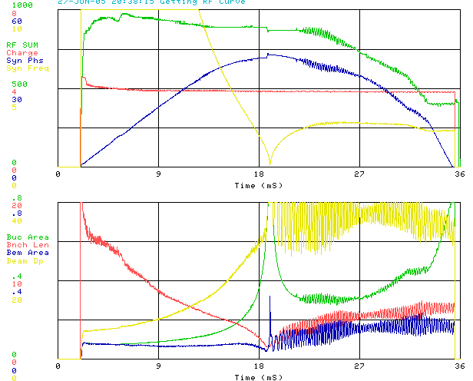
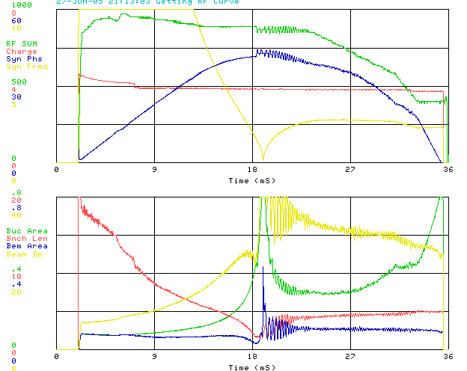
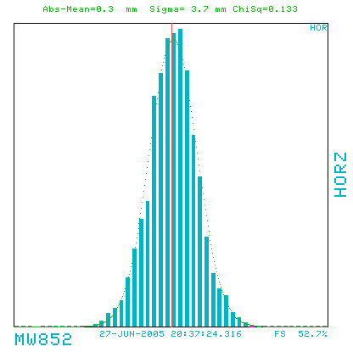
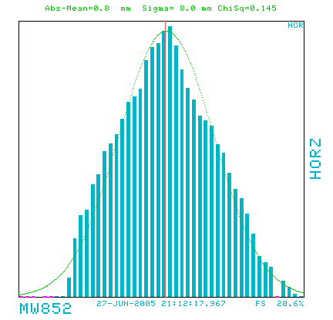
Effect Booster Quadrupole Damper
Quad Damper off
Quad Damper on

Slide 12
Future Improvements: Higher Intensity
Transverse emittance can be controlled with appropriate sextuple compensation
  We are building a bunch by bunch transverse damper system
    Lots of bunches -> lots of bandwidth
    Sweeping delay
  New Booster corrector system will have sextupoles at ever subperiod (2007 and 2008)
Other Solutions for Booster Longitudinal Emittance Blowup
  Gamma-t jump currently problematic
    Large orbit shift confuses cogging
    New gamma-t system will be installed along with correctors in 2008
  RF Step at Transition (pre-focus)
    Calculations finished – look very promising
    Requires large voltage step

