Slide 1
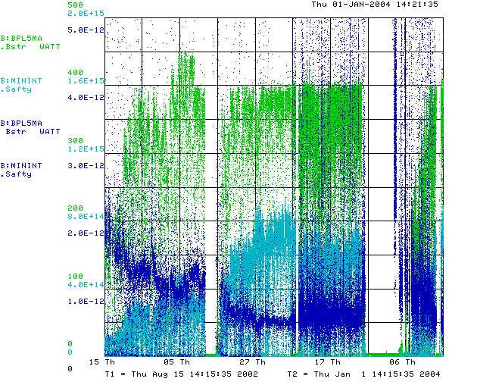
Historic Performance (through last week)
Power loss (W)
Protons (p/min)
Energy Lost (W-min/p)
Best running
Best running

Slide 2
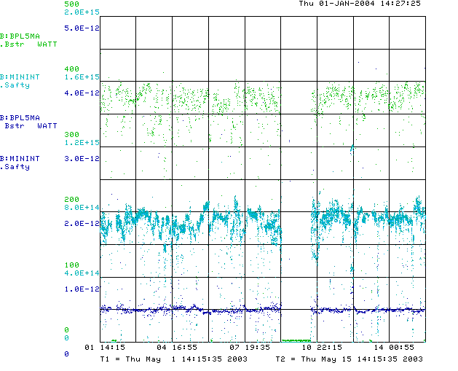
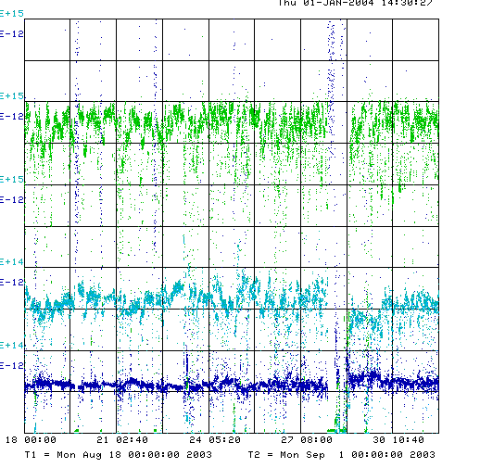
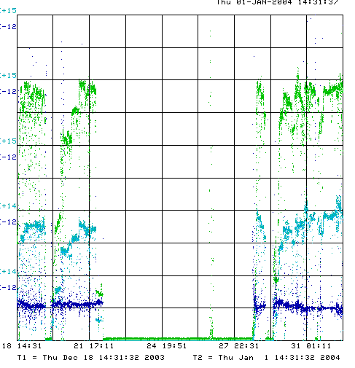
Detail
Best Running
(May, 2003)
Before Shutdown
Last Week

Slide 3
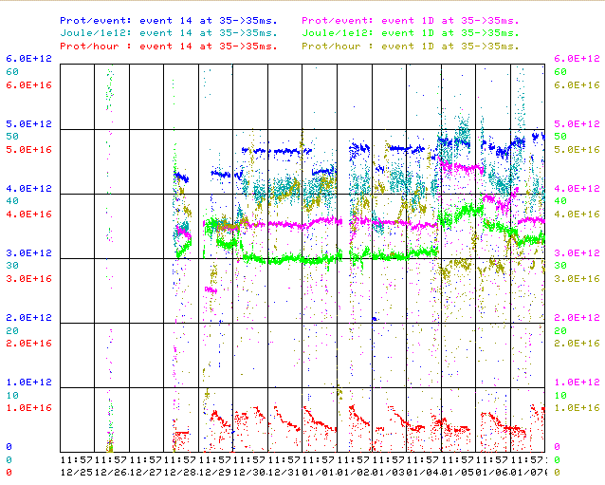
Last Two Weeks
Stacking p/batch
Stacking loss/p
MiniBooNE p/batch
MiniBooNE loss/p
MiniBooNE p/hour
Stacking p/hour
Not as good as we were last week

Slide 4
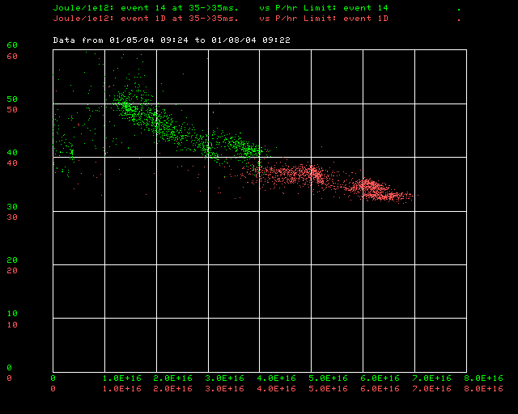
BLM’s versus Power Loss

Slide 5
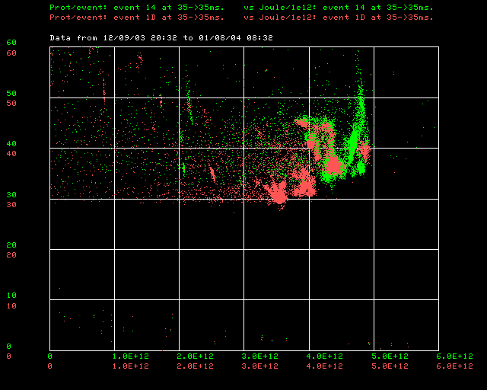
Energy Loss Versus Intensity (Courtesy P. Kasper)

Slide 6

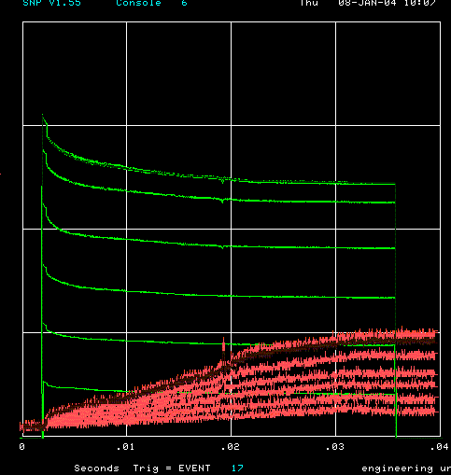
How far have we come?
Before MiniBooNE
Now (same scale!!)
Charge
5E12
Time (s)
Energy Lost
Note less pronounced injection and transition losses

Slide 7
Some Comments
We’ve hit running as good as our best. Better than before the shutodown.
Why not better?
  Compensating for some problem from before the shutdown that’s still there?
  Lingering 400 MeV problems?
  Better lattice not all good (beam survives to higher energy)? Collimation might help.

