Slide 1
MiniBooNE – “The Last Fun HEP Experiment”
Eric Prebys
FNAL Beams Division/MiniBooNE

Slide 2
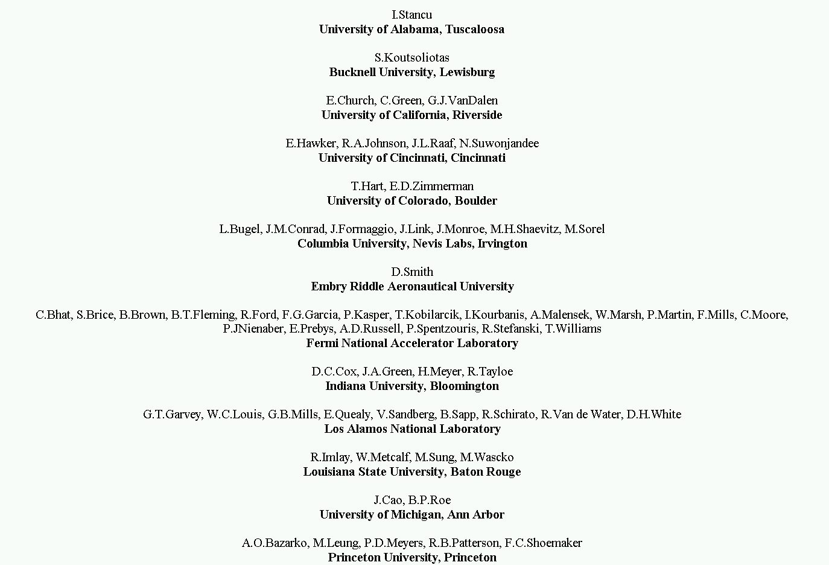
MiniBooNE Collaboration
~65 Physicists

Slide 3
Trivia Quiz
The official designation of MiniBooNE is Fermilab E-898…
  What was Fermilab E1?
  What Nobel Laureate was on the proposal?
  How does it relate to MiniBooNE?

Slide 4
Outline
Introduction:
  What are neutrinos?
  How do we study them?
  What is the problem?
  Where does MiniBooNE fit in?
The MiniBooNE experiment:
  Overview
  Detector
  Target
  Beamline
MiniBooNE Operation
  Details of MiniBooNE cycles
  Rate issues
  Timeline issues
  Running Modes

Slide 5
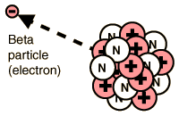

What is a Neutrino?
In “beta decay”, one element changes to another when the nucleus emits an electron (or positron)
Observed electron spectrum
Expected monoenergetic electrons
Electron Energy
It was even postulated that maybe beta decay violated conservation of energy!
In 1930, Wolfgang Pauli suggested a “desperate remedy”, in which an “invisible” particle was carrying away the missing energy. He called this particle a “neutron”.
Enrico Fermi changed the name to “neutrino” in 1933, and it became an integral part of his weak decay theory.
The theory was extremely successful, but the neutrino was not directly observed until 1956, by Fred Reines et al.

Slide 6
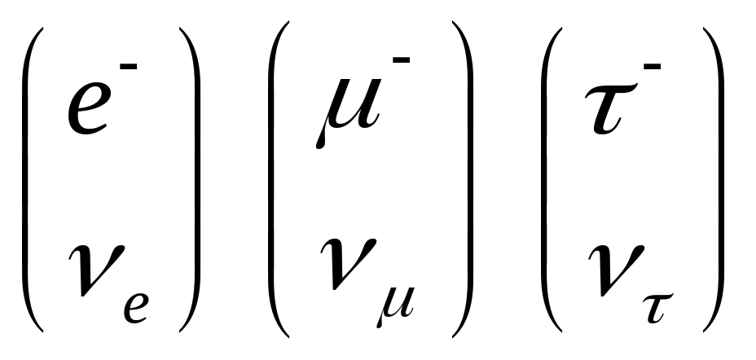
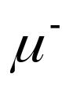
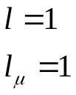

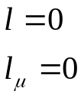

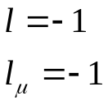
Neutrinos in the Standard Model
Each Generation lepton has an associated neutrino
The weak interaction causes a charged lepton to “flip” to a neutrino and vice versa
The weak interaction conserves “lepton number”

Slide 7
Problems Studying Neutrinos
Neutrinos interact only weakly. A 1 GeV neutrino (a la MiniBooNE) could easily pass through a block of solid lead stretching from the Earth to the sun!!! Typical neutrinos from nuclear reactions could go 1000 times further.
Even a huge detector will only detect a tiny, tiny, tiny, tiny, tiny fraction of the neutrinos passing through it.
No neutrino has ever been produced and detected in a particular interaction.
Two ways to study neutrinos:
  Detect all the particles from a particular reaction and attribute anything “missing” to a neutrino. (LEP, CDF, etc…)
  Make a hell of a lot of neutrinos and detect a very, very tiny fraction of them. (Solar Neutrinos, Reactor Experiments, BooNE)

Slide 8

Sources of a Hell of a Lot of Neutrinos
The sun:
  Mechanism: nuclear reactions
  Pros: free
  Cons: only electron neutrinos, low energy, exact flux hard to calculate, can’t turn it on and off.
Atmosphere:
  Mechanism: Cosmic rays make pions, which decay to muons, electrons, and neutrinos.
  Pros: free, muon and electron neutrinos, higher energy than solar neutrinos, flux easier to calculate.
  Cons: flux fairly low, can’t turn it on and off.
Nuclear Reactors:
  Mechanism: nuclear reactions.
  Pros: “free”, they do go on and off.
  Cons: only electron neutrinos, low energy, little control of on and off cycles.
Accelerators:
  Mechanism: beam dumps -> particle decays + shielding -> neutrinos
  Pros: Can get all flavors of neutrinos, higher energy, can control source.
  Cons: NOT free.
Path length
Different experiments probe different ranges of
Energy

Slide 9
Problems with Neutrinos
We know from the kinematics of decays that the mass of the neutrino is very small (consistent with zero in these measurements).
In the model, the mass of the neutrino is defined as exactly zero.
The “Problems”:
  “Solar Neutrino Problem”: It was discovered (~1968) that there didn’t appear to be enough electron neutrinos coming from the sun.
  “Atmospheric Neutrino Problem”: It was discovered (~1987) there weren’t enough muon neutrinos coming from the atmosphere.
Possible Solution: Enough neutrinos being created, but they’re oscillating (or decaying) to something else.
This would mean neutrinos have mass!!

Slide 10
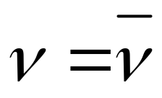
Questions to be Answered
What are neutrino masses?
What are the details of the mixing?
Are neutrinos the dark matter?
Does (“Majorana Neutrinos”) ?
Is the physics of neutrinos and antineutrinos the same (CP or CPT violation)?

Slide 11
State of Experimental Observations
Many experiments have confirmed the “neutrino problems”.
Data from SuperKamiokande supports the model that atmospheric muon neutrinos oscillate to tau neutrinos.
Data from SNO supports the hypothesis that solar electron neutrinos oscillate to muon and or tau neutrinos.
The LSND experiment at Los Alamos claims to have seen muon antineutrinos oscillate to electron antineutrinos -> Not really compatible with the other results in within a simple model.

Slide 12
Where does MiniBooNE fit in?
So far, the LSND result is the only example of a specific neutrino “appearance”.
The theoretical picture is simpler without it.
It is as yet unconfirmed.
MiniBooNE aims to definitively confirm or refute this result.

Slide 13
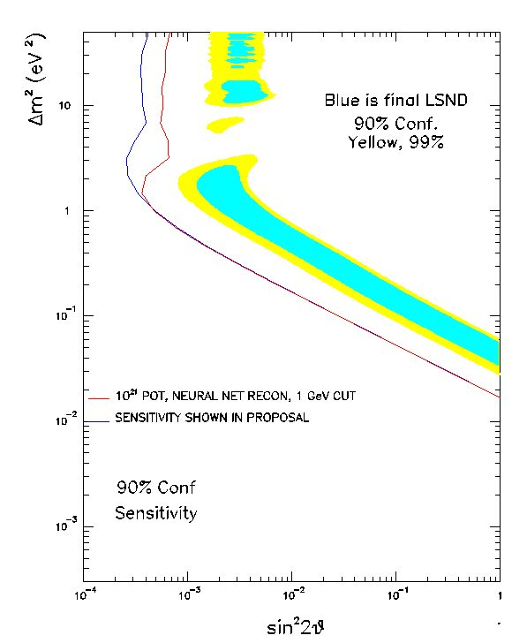
MiniBooNE Sensitivity
Difference in the square of the mass between ν_{e} and ν_{μ}
“Strength” of mixing

Slide 14






Producing Neutrinos for MiniBooNE
Proton beam
Berylium Target
Mostly pions
Select positive pions with neutrino horn.
We will look for these to oscillate to ν_{e}
Mostly below our detection threshold

Slide 15






Neutrino Horn – “Focusing” Neutrinos
Can’t focus neutrinos themselves, but they will go more or less where the parent particles go.
Coaxial “horn” will focus particles of a particular sign in both planes
Target
We select π⁺ -> ν_{μ}
p

Slide 16
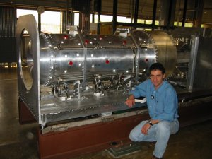
Neutrino Horn – Cont’d
Horn will pulse with 170 kA 150 usec pulse!
Horn heating limits the average rep rate to 5 Hz.
Horn fatigue is an issue.
BooNE Horn has been tested to 10 million pulses.
Under nominal MiniBooNE running conditions, it will pulse about 100 million times per year.

Slide 17
MiniBooNE Secondary “Beamline”
NOT to scale!!!!!!
Proton Beam
Counting House
removable25m Muon absorber
“Teletubby Hill”
Target vault
50m Muon absorber
25m
25m
Detector
Decay region
500 m

Slide 18
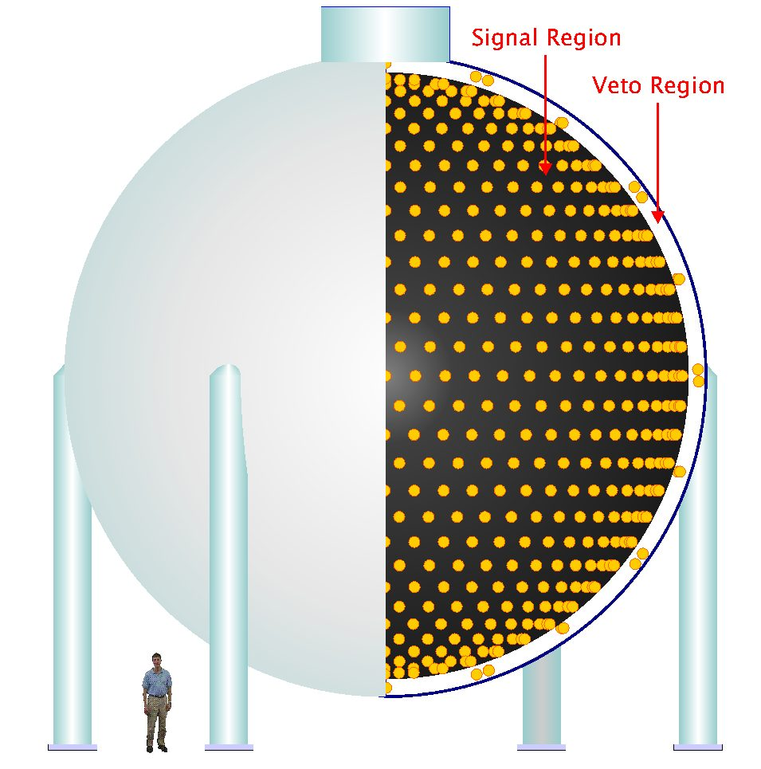

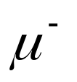


The MiniBooNE Detector
Our beam will produce primarily muon neutrinos at high energy
807 tons of mineral oil
Oscillation!!!
This is what we’re looking for
1280 PMT’s

Slide 19
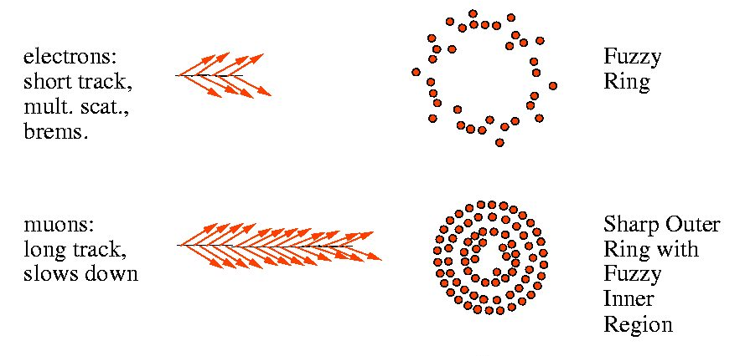
Identifying Particles
Oscillation Signature
Of course it’s a bit more complicated than that…

Slide 20
The Ghastly Economics of MiniBooNE
On average, every proton on target will produce several neutrinos.
Very few of these will interact in the detector.
We will only see 1 neutrino event for every 2.5E14 protons on target!!!!
→ If we run at the full desired intensity:
  5E12 protons/batch
  5 batches/second
  → 1 event every 10 seconds!!

Slide 21
The Road to MiniBooNE ($1D Event Cycle)
Switch Magnet (E:MBEX)
MiniBooNE Horn
Old 200 MHz Linac
750 keV→ 116 MeV
H⁻
ORBUMP Injection
Main Injector
I⁻
New 800 MHz Linac
116 MeV→ 400 MeV
Preac
25 keV→ 750 keV
Debuncher
Booster (20000 turns) 400 MeV→ 8 GeV

Slide 22
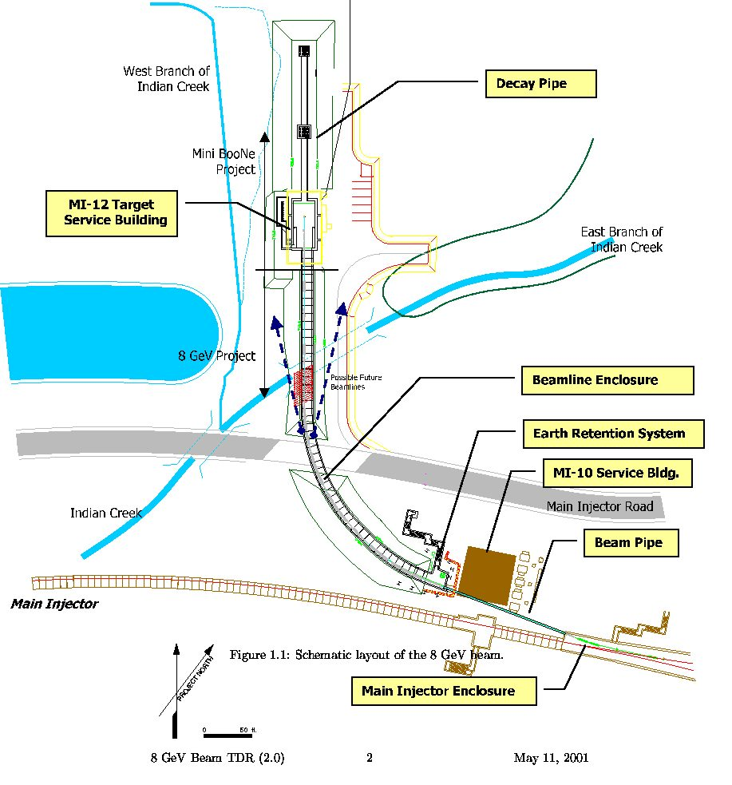
MiniBooNE Beamline

Slide 23
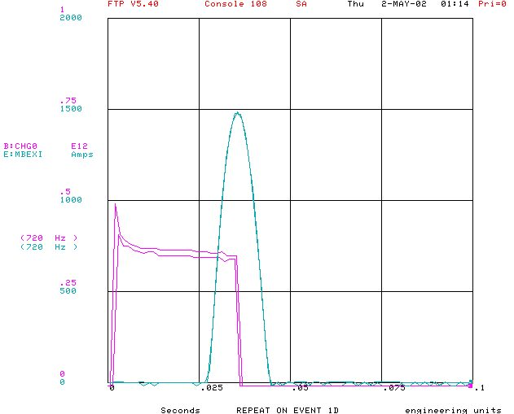
MiniBooNE Switch Magnet (E:MBEX)
MiniBooNE acceleration and extraction are handled exactly as if they were going to the main injector.
Beam is transported down the MI-8 line.
The MiniBooNE switch magnet is located where the MI-8 line enters the main injector tunnel.
On $1D cycles, the switch magnet (E:MBEX) will pulse to about 1470 Amps, which will steer the beam to the MiniBooNE beam line MI-12.

Slide 24
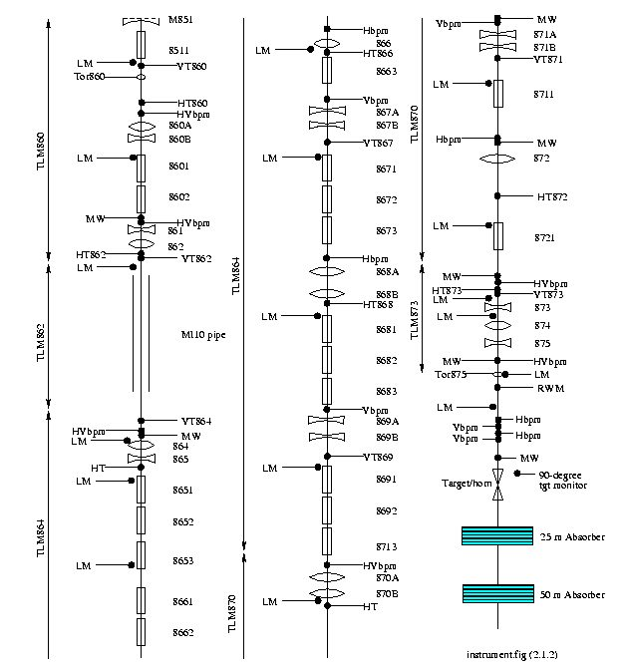
MiniBooNE Beamline Monitoring
= Multiwire
Present Location of beam dump
BPM’s and BLM’s located throughout beam line, except in jack pipe.
Resistive Wall Monitor will measure beam structure near target
90 Degree Monitor will verify beam on target.

Slide 25
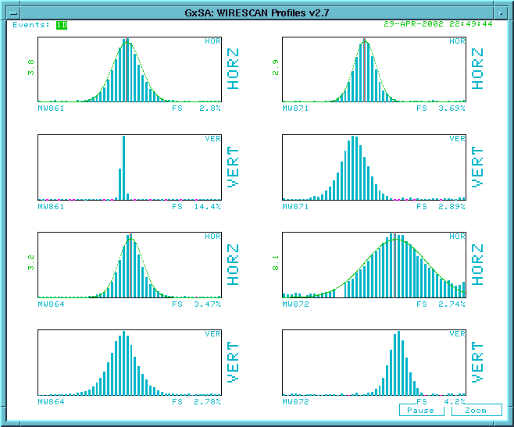
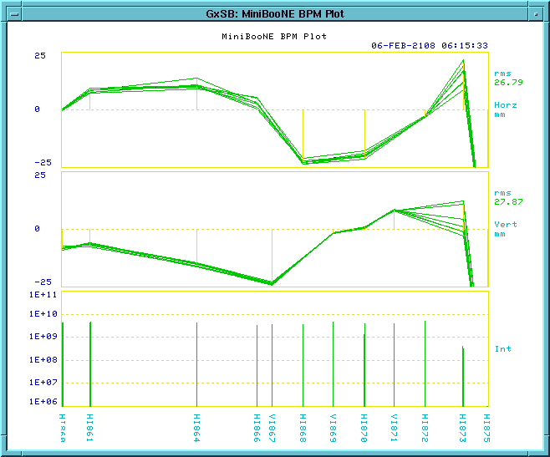
MiniBooNE Beamline Control and Monitoring
MiniBooNE beamline parameters on E25.
Eventually we’ll control with autotune program.
Multiwires on E26
BPMs/BLMs on E27

Slide 26
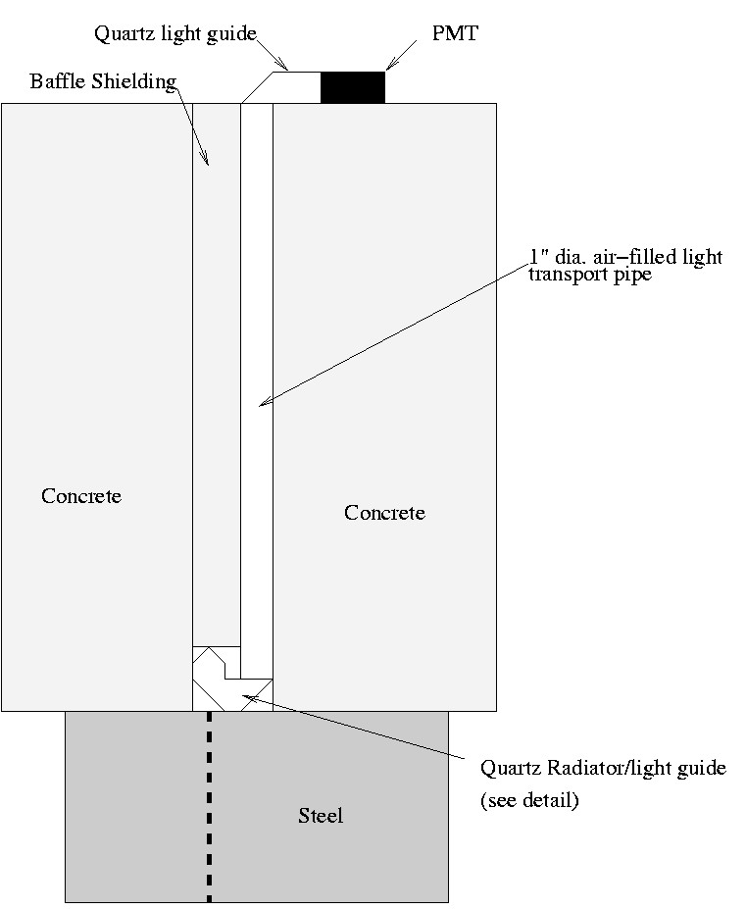
Target Monitoring (90 Degree Monitor)
Difficult to monitor target because of high radiation.
Will detect particles coming off at 90 degrees through a hole in the shielding.
Even outside the steel, still a very high background of neutrons.
Use a Cerenkov-based, neutron-blind detector.
Will also provide beam timing.
Proton Beam

Slide 27
Commissioning Plan
Rig dump at position shown (Done).
Transport beam to dump (Done).
Tune beam and minimize losses (almost done).
Rig out dump and transport beam to Multiwire at target position and down decay pipe.
Install horn and target, remove, reinstall to prove we can handle it when it’s radioactive (“Hot Horn Handling”).
Install horn and run real beam to MiniBooNE (approx. mid-June).

Slide 28
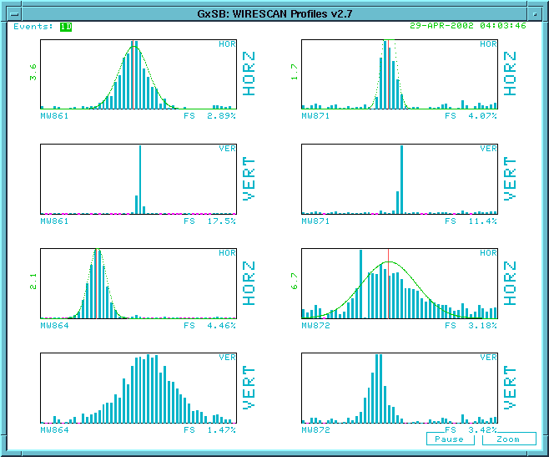
First Beam to Dump: 4/29/02 4:03AM

Slide 29
Some Running Considerations
Recall, MiniBooNE will only see one neutrino event every 10 seconds at maximum intensity.
The detector will read out every beam spill (5 Hz) plus various other triggers.
This has already been demonstrated.
It will take analysis to tell whether the beam is there at all!!
-> No detector shakedown time! We want all the beam as soon as possible.
And just how much beam is that….

Slide 30
The Numbers
Run II max 5E12 @ .7 Hz = 1.2E16 pph.
Historical High (fixed target, no buildings): 3E16 pph.
MiniBooNE wants 5E12 @ 5 Hz = 1E17 pph.
MiniBoonE+RunII = 1.1E17 pph.
This will be hard!!!
  Physical Limits of Booster
  Above Ground Radiation
  Below Ground Radiation
  MiniBooNE beamline radiation (???)

Slide 31
Pulsed element limits
Linac chopper: 15 Hz
ORBUMP Magnets: 7.5 Hz (lots of work to go to 15Hz). No spares!!
Booster RF: 7.5 Hz (Maybe go to 15 if we use existing cooling lines). No spare PS.
BEXBMP: 15 Hz
Extraction kickers: 15 Hz
MP02 extraction septum: 2.5 Hz (New PS -> ~4 Hz, New magnet + PS -> 7.5Hz, + more cables -> 15 Hz.

Slide 32
Pulsed element limits
Linac chopper: 15 Hz
ORBUMP Magnets: 7.5 Hz (lots of work to go to 15Hz). No spares!!
Booster RF: 7.5 Hz (Maybe go to 15 if we use existing cooling lines). No spare PS.
BEXBMP: 15 Hz
Extraction kickers: 15 Hz
MP02 extraction septum: 2.5 Hz (New PS -> ~4 Hz, New magnet + PS -> 7.5Hz, + more cables -> 15 Hz.

Slide 33
Radiation Issues
Radiation Limitations
  Above ground (want to avoid towers being radiation areas and keep office space as “Unlimited Occupancy”).
    Shielding added in Booster towers.
    Reclassify some work areas.
    Reduce beam losses
  Below ground (must avoid making booster elements too hot to handle).
    Reduce beam losses

Slide 34
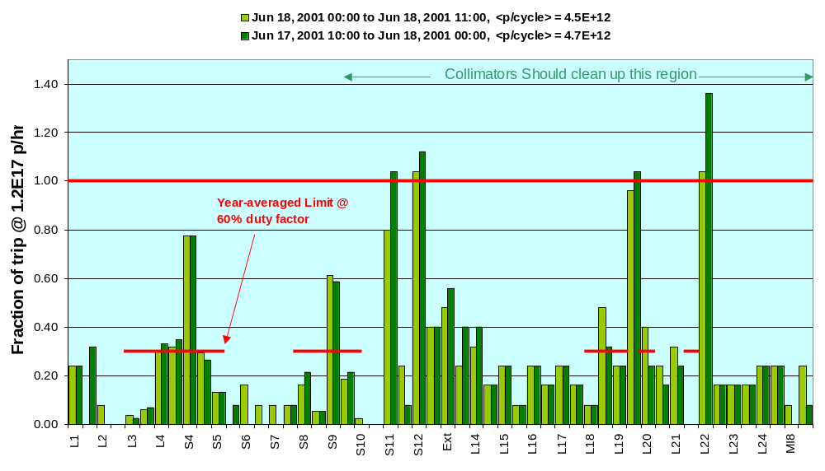
Best Performance + Shielding + BooNE Intensities

Slide 35
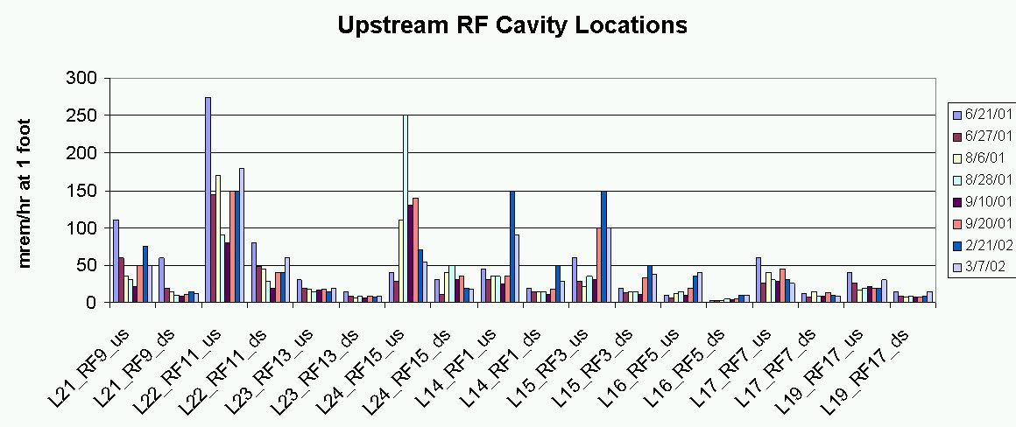
Below Ground Radiation
Below Ground Radiation does not have hard limits.
Nevertheless, we would like to prevent element damage (occurs ???).
We would like to reduce activation, particularly to elements that frequently need service, RF cavities in particular.
Here’s where radiation is now:

Slide 36
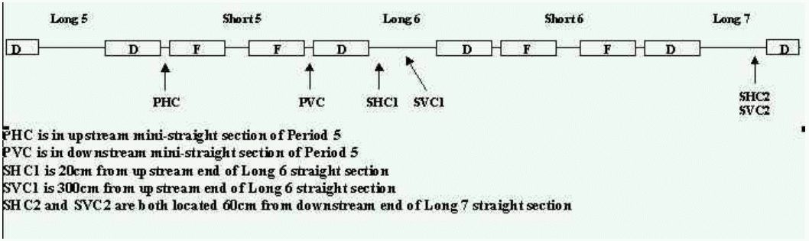
Collimator System

Slide 37
Ramped Correctors
While the main lattice magnets in the booster ramp with B∝ p, the orbit correctors have historically remained constant ⇒ beam moves around during cycle.
We have put in 24 ramped control cards in each plane to actively control the beam throughout the cycle.
The deviation of the booster orbit from an ideal orbit is measured at a number of discrete time breaks; this is used to calculate an optimum set of corrector currents to minimize the RMS of this deviation, taking into account the limitations on maximum current and current slewing.
These optimum settings are then loaded into individual ramp modules to provide a time dependent current to maintain the booster at the desired orbit.

Slide 38
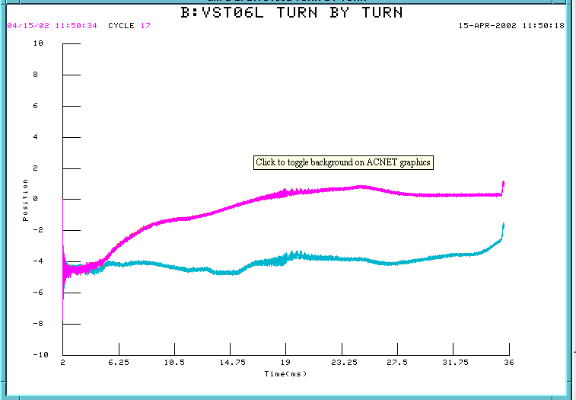
Ramped Corrector Status
Program is working.
Added more user friendly “steering” interface.
Reduced number of time breaks to speed up calculation time.
Working on misc. operational improvements.
Will become important as we start to use the collimators.
Position without ramped correctors
Position (mm)
Position with ramped
correctors
Time (ms)

Slide 39
Timeline Issues
At all times, MiniBooNE will want as many cycles as possible without reaching radiation or physical limits.
Some Booster elements require two “prepulses” ($12) prior to instantaneous 15 Hz operation.
In order to minimize average booster rep rate, we would like to have the prepulses followed by all appropriate event.
Easy example: Stacking
  $12,$12,($17),$14,$1D,$1D,$1D…….
Unfortunately, this is much more complicated during shot setup or studies which are occurring up to half the time.
In present timeline generator (TLG), $1D’s would have to be put in by hand to all the modules in the timeline –> NOT PRACTICAL.
Idea proposed by Bob Webber is that each TLG module can have a MiniBooNE “trailer hitch”, and an automatic supervisor application would distribute $1D’s throughout the cycle subject to radiation and average rep rate limitations.

Slide 40
Schedule
MiniBooNE will begin taking first physics data in mid-June (with new MP02 power supply).
We hope to be able to confirm or refute the LSND result in about 2 years of running.
What happens after that depends on what we see.
  Switch horn current to run with anti-neutrinos?
  Build a second detector to probe L/E (MiniBooNE->BooNE)?
The operation of MiniBooNE will be a challenge for proton source, both in peak performance and level of consistency.

Slide 41
Trivia Answers
The official designation of MiniBooNE is Fermilab E-898…
  What was Fermilab E-1?
    A measurement of ν_{μ} charged and neutral interaction cross-sections.
  What Nobel Laureate was on the proposal?
    Carlo Rubbia - later to win Nobel prize and become director of CERN.
  How does it relate to MiniBooNE?
    30 years later, neutrinos are still interesting and mysterious.
    Ray Stefanski is/was on both experiments.

