Slide 1
Proton Plan
Eric Prebys
FNAL Accelerator Division

Slide 2
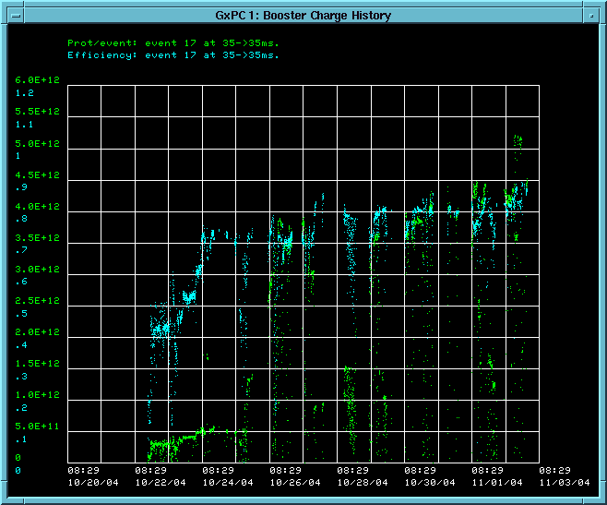
Timeline
Startup Milestones:
  October 13: Beam through linac
  October 22: Beam to Booster dump
  November 2: 5E12@80% efficiency
This was our trigger to begin studies

Slide 3
Studies – 11/1-11/7
Mon Tue Wed Thu Fri Sat Sun
Owl
Day
Eve
Operators Tune
RF Studies
400 MeV
Lattice Meas
Linac coll

Slide 4
Studies – 11/8-11/15
Mon Tue Wed Thu Fri Sat Sun
Owl
Day
Eve
DC Studies
6 GeV Running

Slide 5
Studies – 11/16-11/23
Mon Tue Wed Thu Fri Sat Sun
Owl
Day
Eve
Tuning + Collimators
RF 19 Commissioning
Misc. studies

