Slide 1
Linac Reliability Concerns
Big Items:
  7835’s: LEL power triodes
  HEL klystrons
Other
  Ion source Haefele high voltage supplies
  Ion source vacuum system
  LEL pulsed quad power supplies
Stability issues
  Ion source current line dependence
  7835 filament current line dependence
  LEL LLRF
  Energy variation?
1

Slide 2
7835’s
201 MHz, 5 MW power triodes
Need five (one low gradient) for operation
Lifetime nominally ~one year
  Need about 6 per year
Historically biggest reliability concern
  In early 2000’s, the company (Burle) experienced catastrophic yield problems
    Forced to borrow tubes from Argonne and Brookhaven
Addressing this problem a central part of “Proton Plan”
  Considered replacing 201 MHz power amps with bridged Thales 628’s
  Also considered replacing LEL entirely with new 400 MHz “turnkey system
  In the end, placed a large order and worked with company to increase yield.
We now have 18 spares, of which 12 are “strategic” (ie, will not be used unless company is going out of business)
Yield ~100%

Slide 3
Klystrons
Linac upgraded in mid 90’s with 805MHz, klystron driven π-cavities
  7 - 12 MW klystrons
Generally, much more robust than 7835’s
  4/7 have > ten years in service
  6 spares
However, two years ago, when a tube failed, we discovered a problem with the vacuum on the spares
  Leak at vacuum/water interface
  Ion gauge continued to read “zero”
Repaired/redesigned by L3
Now we warm filament to get non-zero reading and verify proper vacuum.

Slide 4
Ion Source Issues
Haefele power supplies
  Replaced
Vacuum system
  Being upgraded with newer, more reliable pumps
Ion current line dependence
  Doug Moehs installed a feedback loop to stabilize this current. It doesn’t handle pulse to pulse jitters, but can compensate for long term variations.

Slide 5
LEL Issues
Pulsed Quad Power Supplies
  Control system being upgraded as part of the Proton Plan
    Should be finished by summer
Filament current control
  Spent a long time trying to put entire system on isolation tranformers, but in the end discovered load is too reactive for commercially available transformers.
  Have switched station 5 to an improved variac with feedback to adjust for line voltage fluctiations
    If it continues to work, we will upgrade other stations
  Backburner project to develop a new filament current power supply that’s less sensitive to line fluctuations.

Slide 6
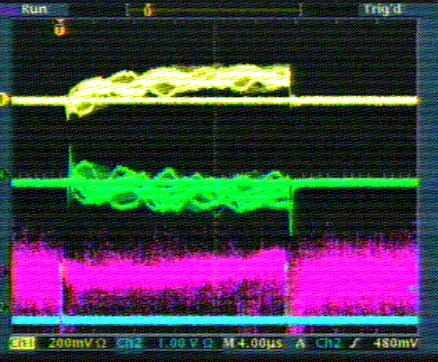
Energy Stability Issues
A pair of phase detectors in the 400 MeV line monitor the velocity of the beam out of the linac
This is a measure of the energy of the beam, and one of the most important stability factors for the efficiency of the Booster
Velocity
Phase
1 div ~.06% Δp/p
~ 3mm beam motion

Slide 7
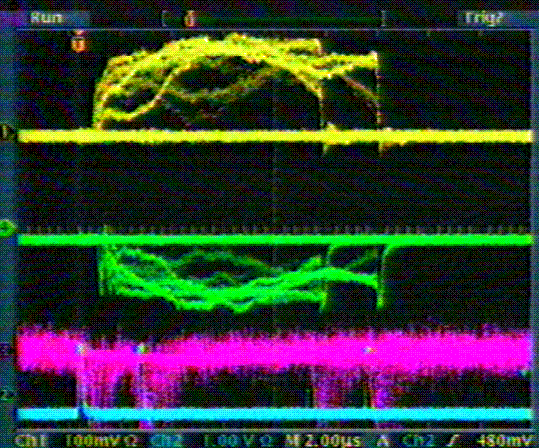
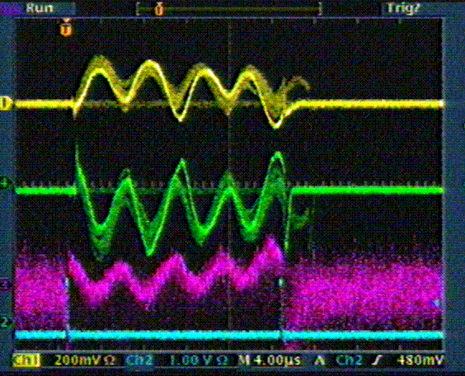
Energy Problems
Shifts and slopes: believed to be LEL LLRF related
Oscillations: believed to come from the HEL LLRF

Slide 8
Addressing Energy Problem
Low Energy Linac (Energy variations)
  As part of the Proton Plan, the LLRF system is being upgraded based on RF module devoloped for ILC
    Phase lock all 5 station to reference line, rather than “accordion-locked” as they are now.
    Delayed by board revision
    Hope to adiabatically install in the next few months.
High energy Linac (~120 kHz oscillation)
  Working group formed under Ken Quinn, working together with RF support (Brian Chase)
    Identified some intersting things
    Still working to nail down root cause.

