Slide 1

Eric Prebys
(for Ken Quinn and Brian Chase)
5/6/08

Slide 2
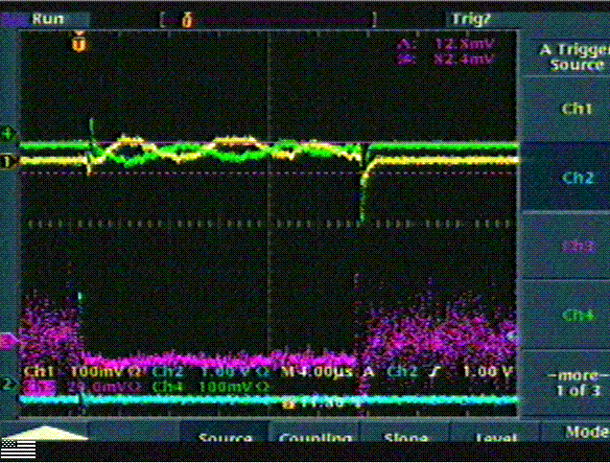
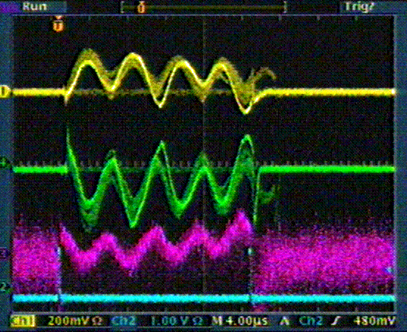
The linac has long suffered problems with energy stability, as evidences by the “velocity meter”, which measures the phase shift between two Griffin detectors:
100 mV = 5 deg. = .06% Δp/p = 3mm of beam motion
good
Very bad
velocity
Phase at debuncher
Run II strategy meeting
5/6/08

Slide 3
Low energy linac LLRF
  Offsets consisted with phase stability in LEL
  No explanation of 128 kHz structure
  Will be improved as part of LEL LLRF upgrade (Proton Plan)
Studies of the HEL showed that this effect appears to be present in the LLRF.
  Initially believed to be a harmonic of the 26 kHz difference a local oscillator in the VCXO crate and the cavity operating voltage
  Studies show this is probably not the case.
Run II strategy meeting
5/6/08

Slide 4
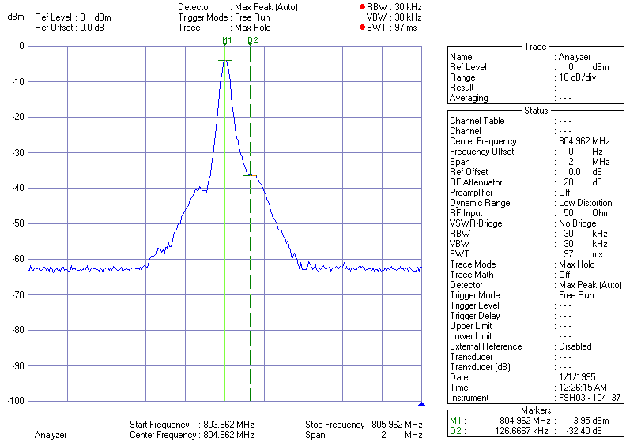
Output of cavity probe
Run II strategy meeting
5/6/08

Slide 5
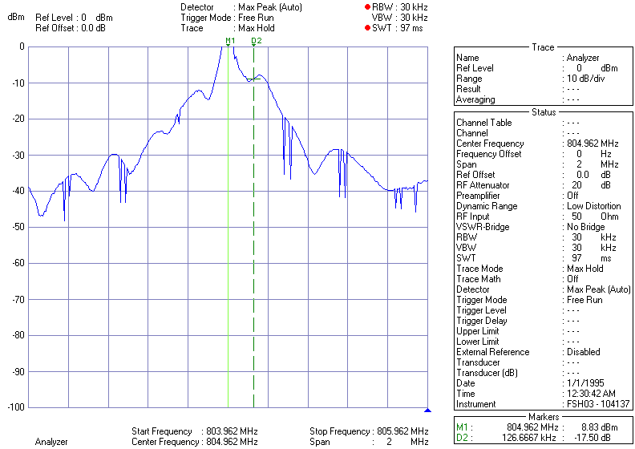
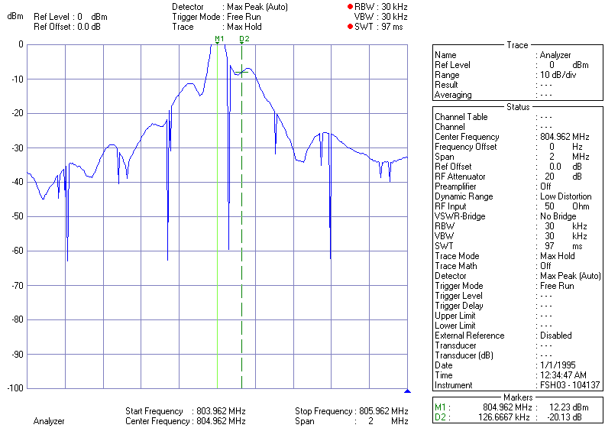
Frequency of noise remains constant
Amplitude increases as cavity is tuned off resonance to minimize reflected power.
No smoking gun in klystron or drive amplifier
Run II strategy meeting
5/6/08

Slide 6
Obtaining a spectrum analyzer from RF group
  Plan to full instrument feedback loop.
Plan to attempt to tune cavities on resonance, or as close as possible
  Minimal impact as long as we carefully control velocity as we tune it.
Run II strategy meeting
5/6/08

Slide 7
Linac beam energy instability results in loss variations early in the acceleration cycle
  Reduces headroom for total beam output
Also, complicate beams cogging
  Higher losses later in cycle
Estimate that stable linac energy could result in as much as a 5-10% increase in beam output during “good” running.
For reasons that are not clear, problem is much worse after extended shutdowns.
  Improving stability would result in quicker turn on.
Run II strategy meeting
5/6/08

