Slide 1
Plans and Limitations of the Fermilab Proton Source
Eric Prebys
Proton Source/Accelerator Division
FNAL

Slide 2
Proton Team (“Finley Report”)
Group formed in early 2003 to study proton demands and needs for the “near” future (through ~2012 or so), in the absence of a proton driver.
Work culminated in a report to the director, available at www.fnal.gov/directorate/program_planning/studies/ProtonReport.pdf
No big surprises [see P. Kasper “Getting Protons to NuMI (It’s a worry)”, 2001].
This work will form the basis of “The Proton Plan”.

Slide 3
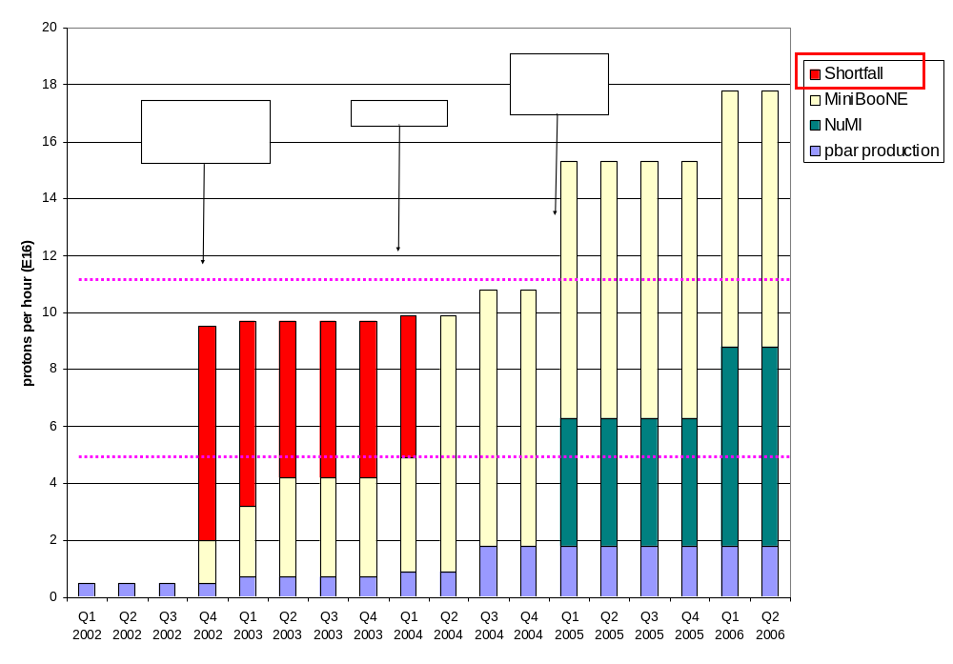
Proton Demand

Slide 4
What Limits Total Proton Intensity?
Maximum number of Protons the Booster can stably accelerate: 5E12
Maximum average Booster rep. Rate: currently 7.5 Hz, may have to go to 10 Hz for NuMI+ (full) MiniBooNE
(NUMI only) Maximum number of booster batches the Main Injector can hold: currently 6 in principle, possibly go to 11 with fancy loading schemes in the future
(NUMI only) Minimum Main Injector ramp cycle time (NUMI only): 1.4s+loading time (at least 1/15s*nbatches)
Losses in the Booster:
  Above ground radiation
  Damage and/or activation of tunnel components
Our biggest worry at the moment!!!!

Slide 5
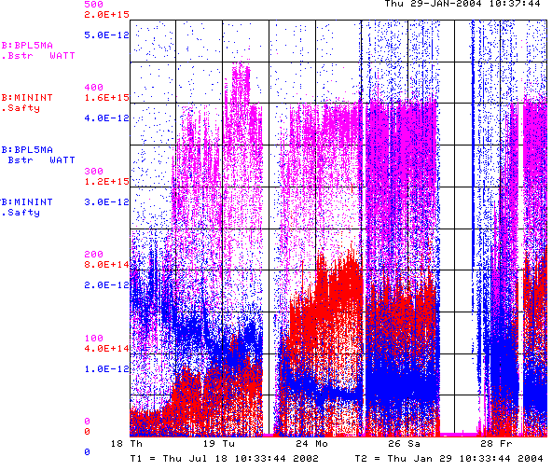
How Have we been doing
Power loss
Breaking records and contuning to improve!
Total Protons
Energy loss per proton (reduced by >3!)
BooNE turn-on
Now

Slide 6
Formulating a Plan
The lab has recognized that the proton demands of the experimental program are significant, if not daunting, and will require substantial efforts to meet.
As the financial burden of Run II begins to ease, it’s envisioned that financial resources will be diverted to these efforts over the next few years.
We are in the process of putting together a plan with the maximum likelihood of reaching these goals.
Ultimate goal is to generate a project similar to Run II
However, because the future (MiniBooNE) is already here, such a plan will necessarily have near and long term components.

Slide 7
Near Term Priorities (Booster)
Optimizing Booster for improved lattice:
  Tuning and characterizing 400 MeV line (Linac to Booster).
  Tuning Booster orbit to minimize losses.
Commission Collimators:
  Over the shutdown, we installed a new collimator system, which we are starting to commission.
  Estimate about 2 months to bring into standard operation.
Aperture Improvments:
  Alignment (discussed shortly)
  Orbit control
    Ramped orbit control program has been written.
    Will be commissioned soon (new personnel)
    Important now that collimator is in place.
  Prototype RF Cavities
    Two large aperture prototype cavities have been built, thanks to the help of MiniBooNE and NuMI universities.
    We will install these as soon as they are ready to replace existing cavities which are highly activated.
It’s hoped this work will allow us to reach the MiniBooNE baseline this year.
Very Important!!

Slide 8
Alignment in the Booster
Always been recognized as a problem
A little over a year ago, we started a vertical as-found of the entire Booster
  Level run
  4 survey points on each magnet (some a bit complicated)
  (Mostly) completed during the shutdown. Data now in hand.
  Some big problems!
Historical difficulties
  Lack of priority!
  Lack of a coherent plan, both on our part and alignment.
  Inefficient use of downtime (response time issues).
Solution? What else – a task force.

Slide 9
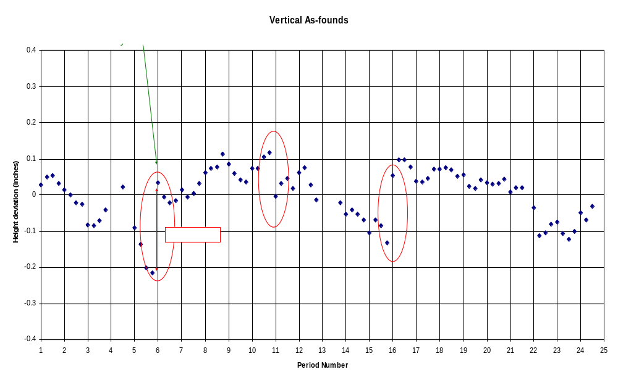
Big Alignment Problems!

Slide 10
Alignment Plan
Peter Kasper put in charge of coordinating alignment on our end.
O’sheg made task manager on the AMG end.
Andrew Feld will be trained as a liaison.
Near term goals (ASAP as opportunities arise)
  Complete vertical network (5-10% to be done or redone)
  Develop a plan for vertical moves, including both “opportunities” and longer term requests.
  Align RF cavities and other key elements to optical center of straights.
Longer term (aim to complete by next big shutdown)
  Produce a “beam sheet” based on Sasha’s MAD file
  Add non-magnetic elements
  Complete network, including horizontal.

Slide 11
Issues over the Next Year
Linac Characterization and Reliability
  Increase instrumentation of old linac to study instabilities.
  Develop set of performance parameters.
Booster improvements.
  Prepare for modification of second extraction region
    New septum
    Modified dogleg magnets
    On track for next year’s shutdown.
  Injection Bump (ORBUMP) Power Supply
    Existing supply a reliability worry.
    Limited to 7.5 Hz
    Building new supply, capable of 15 Hz.
    Aiming for next year’s shutdown.
  Under consideration: New ORBUMP Magnets
    Existing magnets limited by heating to 7.5 Hz
    Working on a design for cooled versions.
    These, with a new power supply, will make the Booster capable of sustained 15 Hz operation.
    Biggest decision for the near future.

Slide 12
Multibatch Timing
In order to Reduce radiation, a “notch” is made in the beam early in the booster cycle.
Currently, the extraction time is based on the counted number of revolutions (RF buckets) of the Booster. This ensures that the notch is in the right place.
The actual time can vary by > 5 usec!
This is not a problem if booster sets the timing, but it’s incompatible with multi-batch running (e.g. Slipstacking or NuMI)
We must be able to fix this total time so we can synchronize to the M.I. orbit.
This is called “beam cogging”.

Slide 13
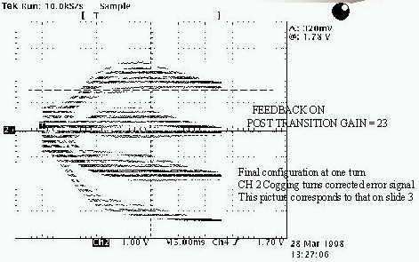
Active cogging
Detect slippage of notch relative to nominal and adjust radius of beam to compensate.
Allow to slip by integer turns, maintaining the same total time.
Efforts in this area have been recently increased, with the help of a Minos graduate student (R. Zwaska).
Aim to get working in the next few months

Slide 14
Budget Guidance (courtesy S. Holmes)
As Run II financial needs decrease, we can expect resources on the order of the following
  FY04 ~$2M (may or may not be there)
  FY05 ~$6M
  FY06 ~$5M
  Scale of $5M/yr after that
For the purposes of planning, I am treating this as upper limit.
This level of funding precludes the consideration of certain projects.

Slide 15
Long Term, Big $$ Ideas Under Consideration
New Booster RF system: (~$15M)
  Larger aperture cavities (two prototypes will be installed soon).
  New solid state preamps and modulators (would pay for itself in a few years).
  Possibly add two RF stations (increase reliability a capacity)?
New Linac front end: (~$30M)
  Replace Preac and 200 MHz linac with RFQ feeding 400 MHz klystron-driven linac.
  Addresses 7835 Amplifier Tube Problem
  Possible part of proton driver?
Reduce Main Injector ramp time: (??)
  Still needs time to load protons
  Needs to fit in with stacking.
  Necessary to get the kind of protons that off-axis is talking about.

Slide 16
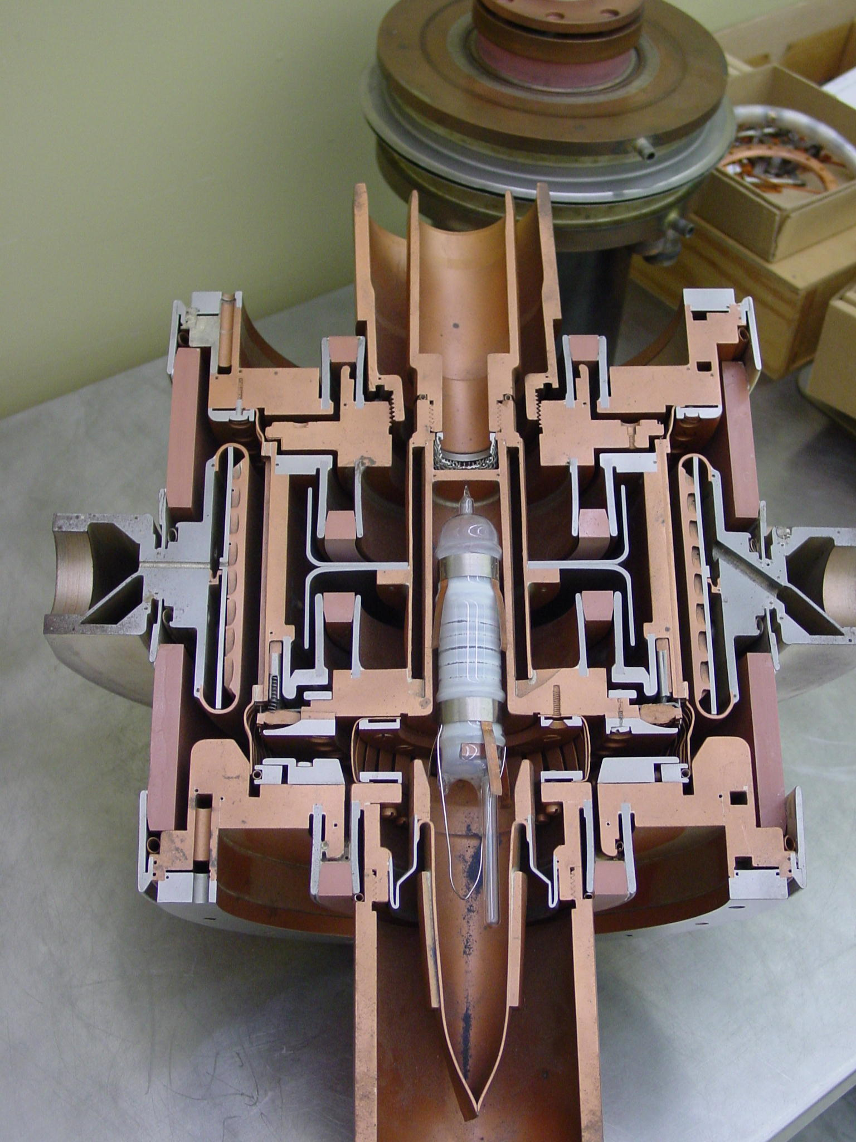
The 7835 Power Triode – A BIG Worry
Very complex technology
  RF, material science, vacuum, chemistry
Similar to other tubes made by Burle
  4617
7835 only used in the scientific community.
  One military user for 4617
Quality varies from decade to decade
Can we rely on these until proton driver?
Might feed into linac decision.
Current plan: “Keep Fingers Crossed”.

Slide 17
Output Limitations of Present Source
DISCLAIMER
  In the following slide, I make extremely optimistic assumptions, to set upper limits.
Assumptions:
  5E12 protons per batch out of Booster.
  All Booster loss problems solved.
  Booster can run continuously at 15 Hz.
  We can load 12 batches into the Main Injector with NO extra slipping/barrier time.
  NO extended shutdowns (2E7 seconds/year).

Slide 18
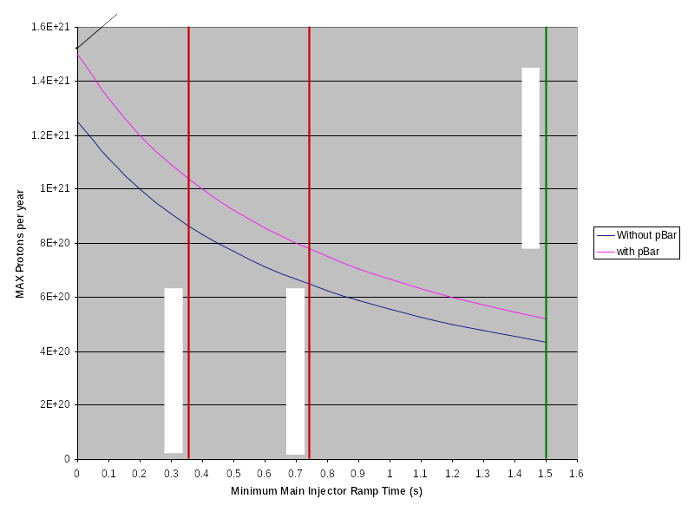
Maximum Throughput vs MI Ramp Time

Slide 19
Summary
Within the budgetary guidance we have been given, we believe we can:
  Enable the booster to run safely up to 15Hz
  Reduce Booster losses significantly, possibly allowing us to reach the MiniBooNE goal and/or continue to run MiniBooNE in parallel with NuMI
What NuMI might expect:
  Probably 2-2.5E20 in the first year of running.
  Perhaps 3-4E20 per year after a could of years of running. (This is NOT a promise)
  Anything beyond that requires money at a level that would significantly compete with other projects, particularly the proton driver.
If you want more protons than this, you want a proton driver.

