Slide 1
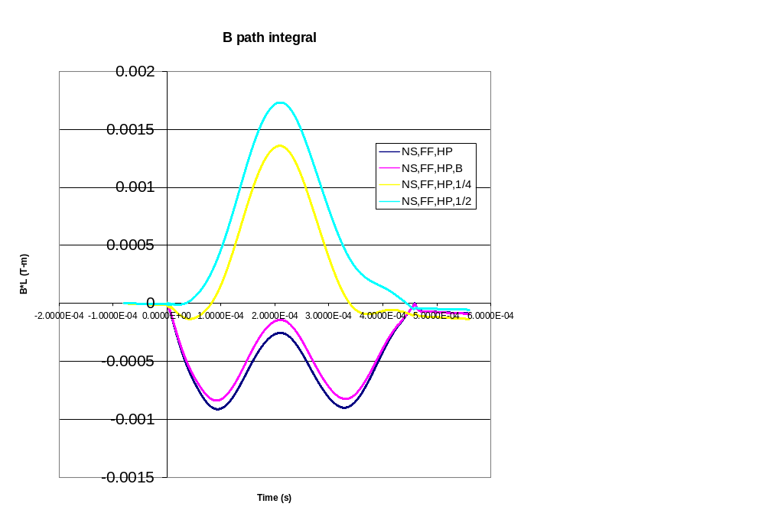
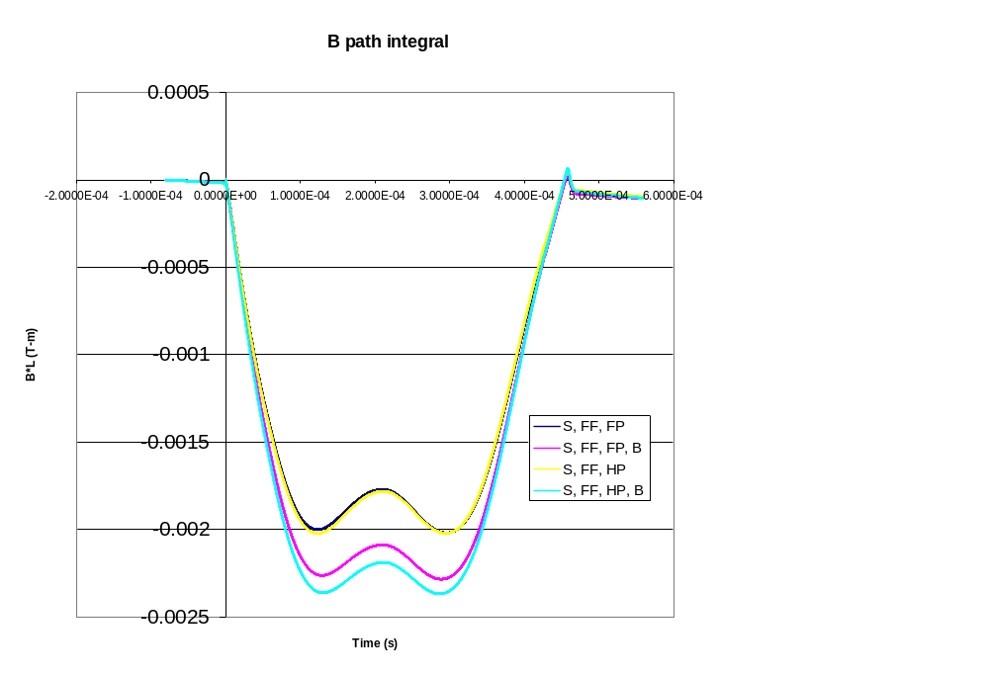
Pulled Wire Measurements
No Shunts (multiple measurements)
1% Shunts

Slide 2
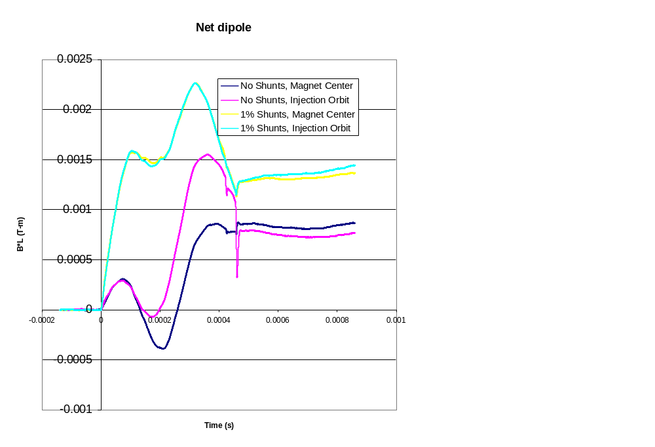
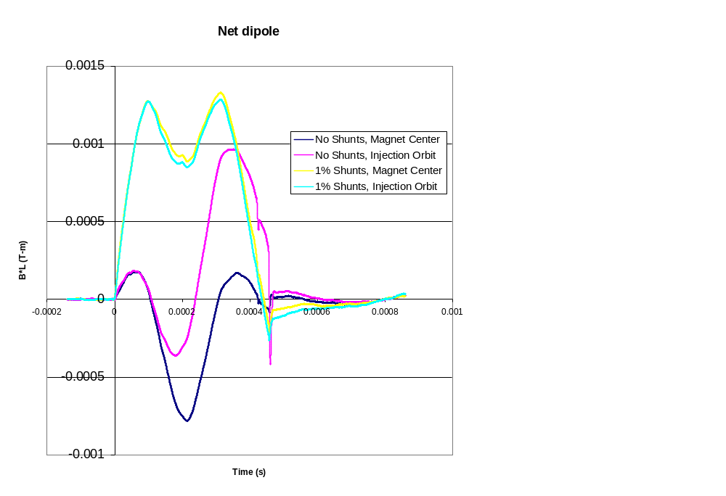
Individual Magnet Measurements
Raw
“corrected”

Slide 3
Summary
Measurements have not been repeatable at the level required.
Will probably required beam measurements with and without the shunts which were built, as well as possibly with ~2 the value.

