Slide 1
What’s Up in the Booster
Eric Prebys
February 27, 2002 and March 6, 2003

Slide 2
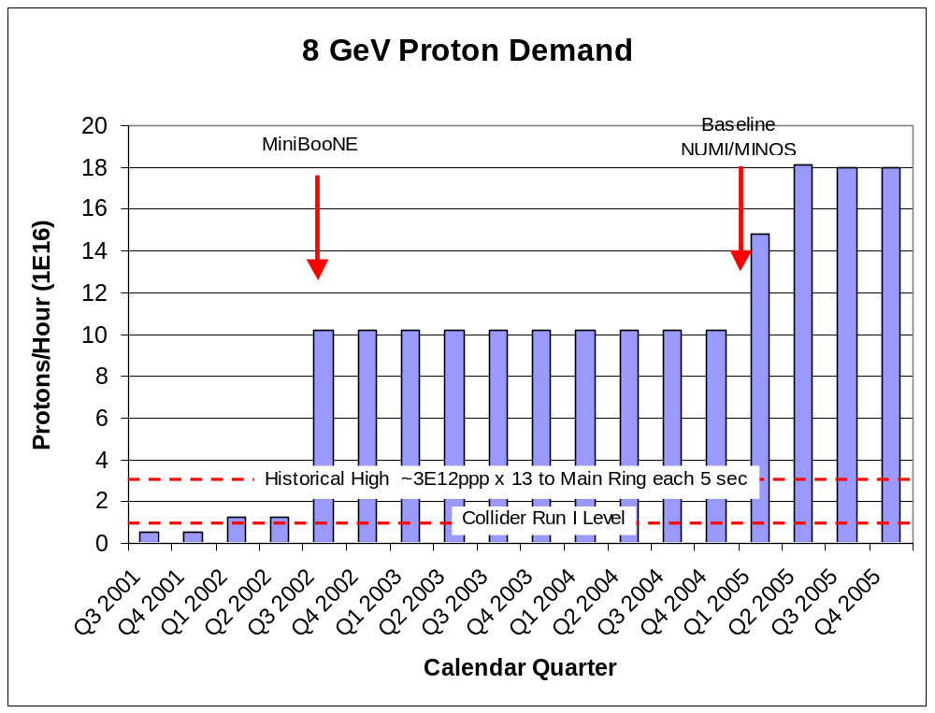
Demand for 8 GeV Protons
Fancy MI Loading schemes
Present Operating Level

Slide 3
Some Cold Hard Facts about the Proton Future
1.8E20
Running as we are now, the Booster can deliver a little over 1E20 protons per year – this is about a factor of six over typical stacking operations, and gives MiniBooNE about 20% of their baseline.
NuMI will come on line in 2005, initially wanting about half of MiniBooNE’s rate, but hoping to increase their capacity – through Main Injector Improvements – until it is equal to MiniBooNE.
Whatever the lab’s official policy, there will be great pressure (and good physics arguments) for running MiniBooNE and NuMI at the same time.
-> By 2006 or so, the Proton Source will be called upon to deliver 10 times what it is delivering now.
At the moment, there is NO PLAN for achieving this, short of a complete replacement!
ten
33%
6

Slide 4
Limitations to Total Booster Flux
Total protons per batch: 4E12 with decent beam loss, 5E12 max.
Average rep rate of the machine:
  Injection bump magnets (7.5Hz)
  RF cavities (7.5Hz, maybe 15 w/cooling)
  Kickers (15 Hz)
  Extraction septa (now 4Hz, 7.5 after Jan. shutdown)
Beam loss
  Above ground:
    Shielding
    Occupancy class of Booster towers
  Tunnel losses
    Component damage
    Activiation of high maintenance items (particularly RF cavities)
Of particular interest to NUMI
Our biggest concern

Slide 5
Proton Timelines
Everything measured in 15 Hz “clicks”
Minimum Main Injector Ramp = 22 clicks = 1.4 s
MiniBoone batches “sneak in” while the MI is ramping.
Cycle times of interest
  Min. Stack cycle: 1 inj + 22 MI ramp = 23 clicks = 1.5 s
  Min. NuMI cycle: 6 inj + 22 MI ramp = 28 clicks = 1.9 s
  Full “Slipstack” cycle (total 11 batches):
    6 inject
    + 2 capture (6 -> 3)
    + 2 inject
    + 2 capture (2 -> 1)
    + 2 inject
    + 2 capture (2 -> 1)
    + 1 inject
    + 22 M.I. Ramp
    ----------------------
    39 clicks = 2.6 s

Slide 6
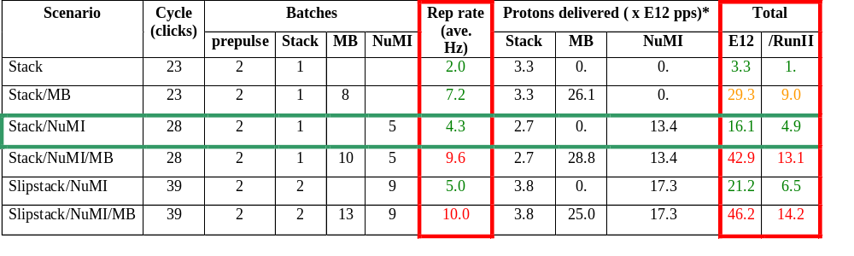
Summary of Proton Ecomomics
MiniBooNE baseline ≈ 5E20 p/year
Booster Hardware Issues
Radiation Issues
NUMI “baseline” = 13.4E12 pps x 2E7 s/year ≈ 2.7E20 p/year
Right now we’re at roughly 1/3 of the MiniBooNE baseline
*assuming 5E12 protons per batch

Slide 7

Typical Booster Cycle
Various Injected Intensities
Transition
Intensity (E12)
Energy Lost (KJ)
Time (s)

Slide 8
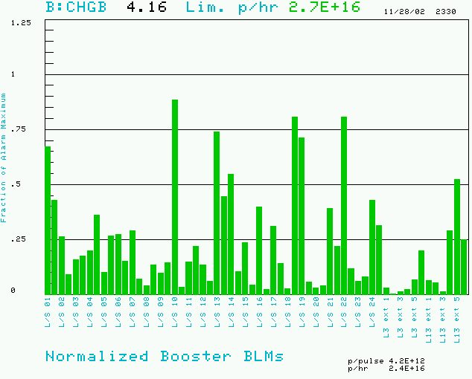
Booster Losses (Normalized to Trip Point)
BRF11: 200 mR/hr @ 1ft
BRF15: 300 mR/hr @ 1ft

Slide 9
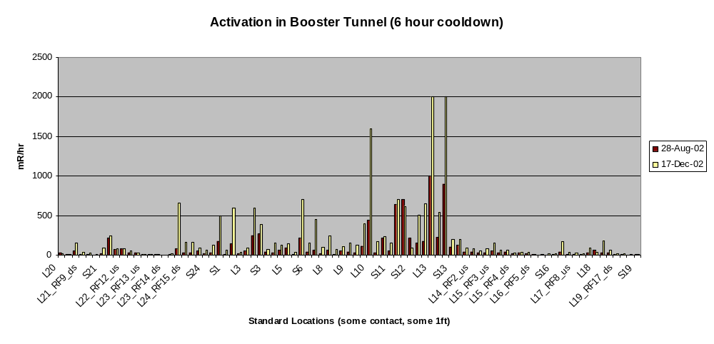
Booster Tunnel Radiation Levels
On the last access
  The people doing the radiation survey got about 20 mR.
  Two technicians received 30 mR doing a minor HV cable repair.
  We’re at (or past??) the absolute limit on our overall activation

Slide 10
Hardware Improvements to Booster
Shielding and reclassification of Booster towers: complete 2001
New extraction septum (MP02) power supply: complete 11/02
New extraction septum: magnet complete. To be installed 1/03
Collimation system: complete, but cannot be used until…
Collimation system shielding: 75 tons of steel to be stacked 1/03
Time line improvements (very important for MiniBooNE operation): more or less complete.
More cables for extraction septum (will allow 15 Hz operation): ??
New injection bump magnets and PS: ??
New RF cavities: ??

Slide 11
Near Term Plan
All near term hardware improvements will be complete by summer 2003. At the point the Booster will physically be able to run a 7.5 Hz.
Proceed with tuning improvements (C. Ankenbrandt coor.):
  Orbit correctors: complete, working out operational issues
  Precision lattice measurement: Transition studies (gamma-t jump??):
  Damping improvements: Pellico + ??
  Dogleg compensation??
  37MHz laser prechopping.
  Ramping stopband correction.
  Injection bump lengthening.
  Injection tune manipulation.
  Etc.

Slide 12
Dogleg Problem
Because of edge effects, the vertical dogleg magnets which steer beam around the extraction septa distort the injection lattice badly.
Considering several solutions:
  Two large aperture lattice magnets (best idea, lots of money)
  Stretch out or redesign doglegs. Can minimize but not eliminate the problem.
  Correction quads. No magic solution found.
Took advantage of the recent TeV failure to move the dump septum and turn off its dogleg. Doing studies now.

Slide 13
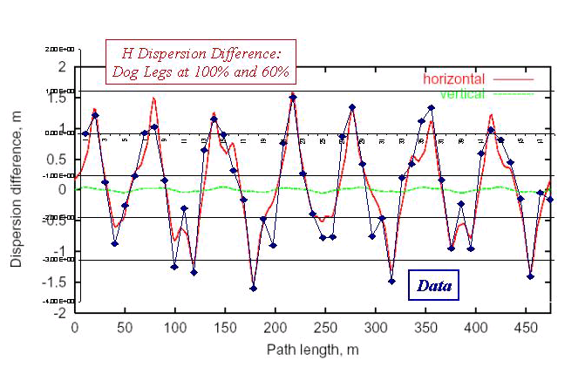
Effect of Doglegs on Booster Dispersion

Slide 14
RF Project
RF cavities form the primary aperture restiction in the Booster (2 ¼” vs 3 ¼” beam pipe).
Slight modified design will have 5” beam pipe.
Powered prototype built and tested. Two vacuum prototypes will be fabricated with fabrication done largely by MiniBooNE and NuMI universities.
These will be installed in the summer shutdown.
Full project ~$5.5M, maybe less with university help.
New solid state power supplies also ~$5.5M, but largely a separate (and separately justifiable!) project.

Slide 15
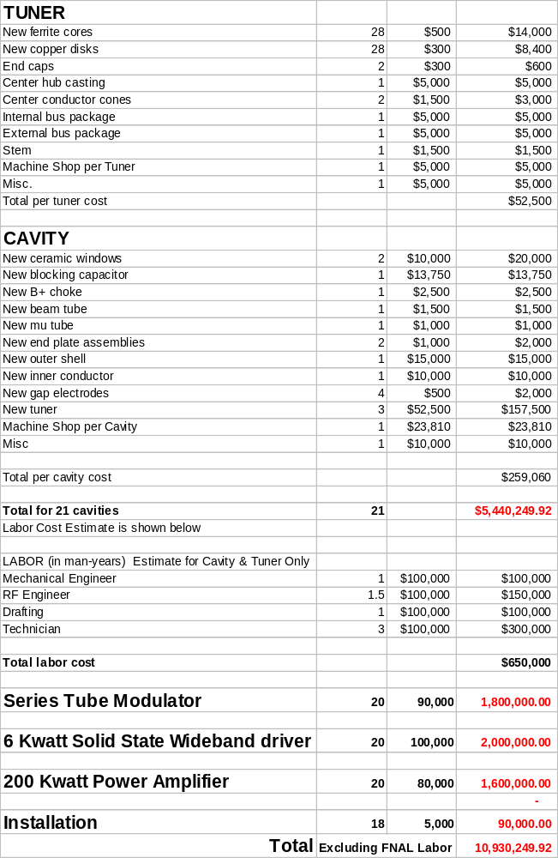
Upgrade Cost Estimate
Summary:
~$260K per cavity, of which $160K goes for the three tuners.
A roughly equal amount for the power supply chain.
About 20 cavities.
-> $11M total

Slide 16
Vague Longer Term Plans
Dogleg improvements?
  Separate downstream doglegs
  beta-bump correctors
  Large aperture lattice magnet.
Injection bump improvements?
  New magnets?
  Move existing magnets further apart and redisign injection girder (requires new injection “Lambertson”).
  Improved power supply (being designed but on the back burner).

Slide 17
Big Projects Which Have Nothing to Do with Intensity
New Linac Lambertson (done, will be installed in summer).
New EDWA magnets in MI-8 line (ditto).
New vacuum system (Eats up ~1 engineer). Finished by summer?
LLRF upgrade. Slowly but surely.
New MP01, ML01 + PS. Replace VBC1 with ML02. (magnets not built, no installation plan).

Slide 18
Conclusions
We are at or near the present limit of the Booster output.
This is a factor of up to six away from what is needed.
Current plans might realistically increase things by a factor of two or three, tops.
Getting further will be hard!!!
The Proton Source CANNOT achieve its goals parasitically.
The pressure from the collider program is not going to go away, so we have to come up with a plan to live together.

