Slide 1
Teng Scholarship
*A Letter of Intent to Search for Charged Lepton Flavor Violation in Nuclear Muon Capture

Slide 2
Issues
Release date?
  Friday, December 14?
Application Deadline?
  Friday, Feb. 15?
Website management
  Common
  Today’s meeting
Application management
  Common (hopefully)
  Which product
    IPM web application?
    Other?
Student management (housing, cars, travel, etc)
  Separate?
  IPM/SULI will coordinate at Fermilab (Carol Angarola)
    Also willing to coordinate application process

Slide 3
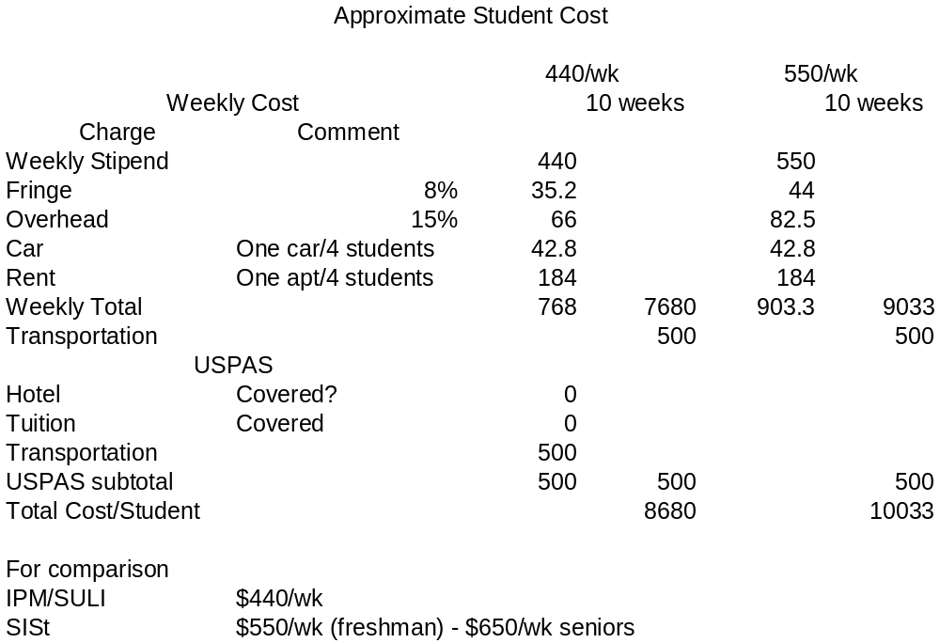
Budget: Student Costs

Slide 4
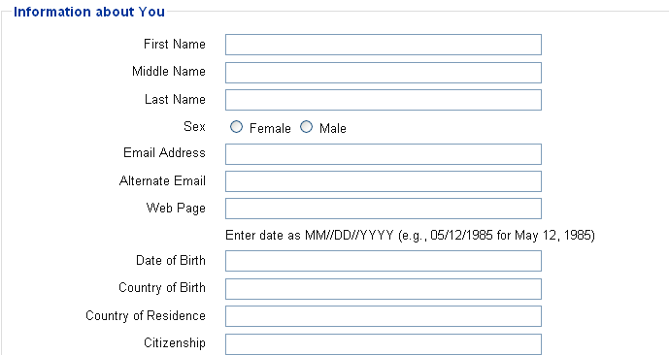
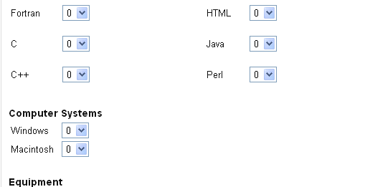
IPM Application
●
●
●

Slide 5
Some Other Issues
Require transcript?
How many letters?
Mine IPM applications?

