Slide 1
Joint Argonne/Fermilab Venture
  Under auspices of virtual “Illinois Accelerator Institute”
  ~5 students at each lab
  Joint selection process, after which program administered separately at the two labs
Program
  Nominally June 2-August 8, to match SULI/IPM
    June 16-June 27 spend at the USPS (U. of Maryland)
  Student works closely with a mentor on a predetermined project involving accelerator physics or related technology
  Includes:
    Transportation to/from lab
    Lodging and daily transportation to work
    $450/wk stipend (including time at USPAS)
    Transportation, tuition, and board for USPAS
Eligible
  Physics, Math, Engineering, or Computer Science majors at U.S. Universities (not necessarily U.S. citizens)
  Juniors or outstanding Sophomores
E. Prebys – Lee Teng Summary
4/3/08

Slide 2
~Nov. 28, 2007
  Eric hears about internship and agrees to chair “selection committee”
  Then learns there is no logo, website, posters, flyers, application, etc
Dec. 4, 2007
  First joint meeting, at Argonne
Dec. 14, 2007
  Go live!
    Website
    Online application
    Poster
    Flyer
    Wikipedia article on Lee Teng
February 15, 2008
  Application deadline
  Postponed from original 2/8/08 deadline (on posters) to match IPM
E. Prebys – Lee Teng Summary
4/3/08

Slide 3
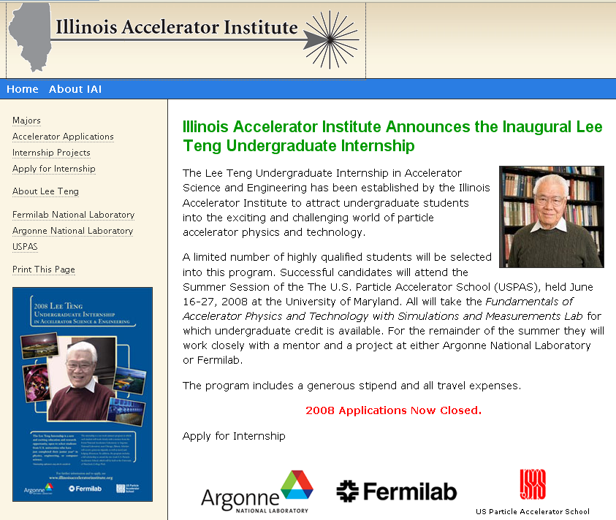
E. Prebys – Lee Teng Summary
4/3/08

Slide 4
Selection Committee
  Eric Prebys, FNAL (Chair)
  William Barletta, MIT and USPAS
  Eric Norum, ANL
  Peter Ostroumov, ANL
  Alving Tollestrup, FNAL
Also involved in creating internship
  Rod Gerig, ANL
  Vladimir Shiltsev, FNAL
  Harold Myron, ANL
  Kathy Harkay, ANL
  Jean Slaughter, FNAL
Plus…
E. Prebys – Lee Teng Summary
4/3/08

Slide 5
Anita Alamillo, ANL
  Web site
Diana Canzone, FNAL
  Poster, flyer, logo
Carol Angarola, FNAL
  Managed application materials, handling transportation/housing at FNAL
Liz Quigg, FNAL
  Set up online application on very short notice
Linda Spentzouris, IIT
  Managed mentor assignments at ANL
Susan Winchester, FNAL
  Coordinating USPAS end of things
E. Prebys – Lee Teng Summary
4/3/08

Slide 6
Solicited mentors/projects at both labs starting in January
  Argonne
    mentor must fund student out of his/her department budget
    6 submitted and accepted
  Fermilab
    Central APC budget for 5 students
    students “free” for mentors
    8 proposals
    5 accepted
35 Applications received by Feb. 15 deadline
  Expected more, but most were of high quality
Applications circulated to mentors, who returned a ranked list of their top few choices
Committee used this input, along with their own absolute evaluation of the students, to select students and assign them to labs/mentors
  Final “match list” generated by Feb. 29 (two weeks)
Called 11 students with offers
  2 rejections.
  In both cases, first alternate accepted
E. Prebys – Lee Teng Summary
4/3/08

Slide 7
First | Last | sex | Citizen | University | class | major | Lab | Mentor
Casey | Bennett | M | USA | Illinois Institute of Technology | Junior | Computer Science | FNAL | R. Fliller
Adam | Clark | M | USA | Rockhurst University | Junior | Mathematics/ Physics | ANL | Yusof/Gai
Matthew | Gooden | M | USA | University of New Mexico | Junior | Physics & Applied Math | ANL | K-J. Kim
Joshua | Hawke | M | USA | Northern Illinois University | Junior | Physics | ANL | Mustapha/Ostromov
John | Hlotke | M | USA | Northern Illinois University | Junior | Professional Physics and General Math | FNAL | R. Thurman-Keup
Teng Jian | Khoo | M | Malaysia | Williams College | Junior | Physics | ANL | Yusof/Gai
Jerry | Lee | M | Singapore | University of Illinois at Urbana-Champaign | Junior | Electrical Engineering | ANL | Maclean/Quintano
Pardis | Niknejadi | F | USA | University of California-Los Angles | Junior | Physics | FNAL | B. Zwaska
Chris | Pollard | M | USA | Yale University | Junior | Physics (intensive) | FNAL | D. Broemmelsiek
Aminur | Rahman | M | Canada | New Jersey Institute of Technology | Soph. | Mathematical Sciences | ANL | M. Borland
David | Yu | M | USA | University of Chicago | Junior | Physics | FNAL | T. Sen
Gender:
  10 Male
  1 Female
Class:
  10 Junior
  1 Sophomore
Region:
  5 Illinois Schools
  Furthest West: UCLA
  Furthest East: Yale
Citizenship
  8 US
  3 other
E. Prebys – Lee Teng Summary
4/3/08

Slide 8
Get information out early in the fall
  Easy now that we have this year’s version of everything
Online application
  Add some security
    Nothing bad happened, but…
  Automatically generate acknowledgement and request/reminders for reference letters
    I did this by hand this year
  Maybe allow students to create an account and “build” application.
    This year, just an online form, sometimes lost
Selection
  Committee should meet and shorten list before circulating it to mentors.
Bureaucratic
  Coordinate with HR from beginning
    Don’t even get me started
E. Prebys – Lee Teng Summary
4/3/08

