Slide 1

Eric Prebys, FNAL
Selection Committee Chair
6/11/2010

Slide 2
Joint Argonne/Fermilab Venture
  Patterned after existing internships, but focused on accelerator physics
  Under auspices of virtual “Illinois Accelerator Institute” (also new)
  ~5 students at each lab
  Joint selection process, after which program administered separately at the two labs
  Nominally June 7-August 13, to match SULI/IPM
    June 14-June 25 spent at the USPAS (MIT, Boston)
  Student works closely with a mentor on a predetermined project involving accelerator physics or related technology
Eligible
  Physics, Math, Engineering, or Computer Science majors at U.S. Universities (not necessarily U.S. citizens)
  Juniors or outstanding Sophomores
E. Prebys – Lee Teng Welcome
6/11/2010

Slide 3
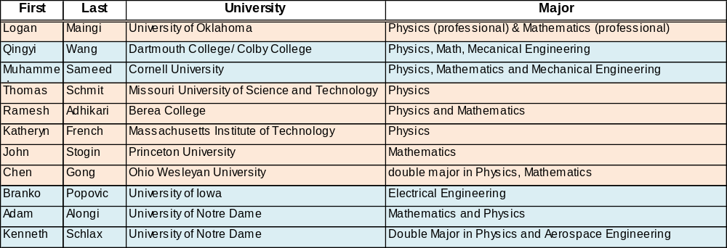
 | 2008 | 2009 | 2010
Argonne | 6 | 6 | 5
FNAL | 5 | 5 | 6
Total offers | 13 | 14 | 14
Rejections | 2 | 3 | 3
Males | 10 | 9 | 9
Females | 1 | 2 | 3
non-US | 3 | 2 | 4
Illinois schools | 5 | 2 | 0
Sophomores | 1 | 3 | 2
Juniors | 10 | 8 | 9
 | FNAL
 | ANL
E. Prebys – Lee Teng Welcome
6/11/2010

Slide 4
Accelerator science is a very exciting and growing field
  High energy and nuclear physics
  Light sources (materials, biophysics, etc)
  Spallation neutron sources
  Medical applications
    Hadron therapy
    Isotope production
  Power production (sub-critical reactors)
  Security
  Industrial applications (food sterilization, welding)
  Art (see T. Johnson’s work, 2nd floor)
This program is an excellent opportunity
  Real world experience
  USPAS!
  Good step toward graduate school
E. Prebys – Lee Teng Welcome
6/11/2010

Slide 5
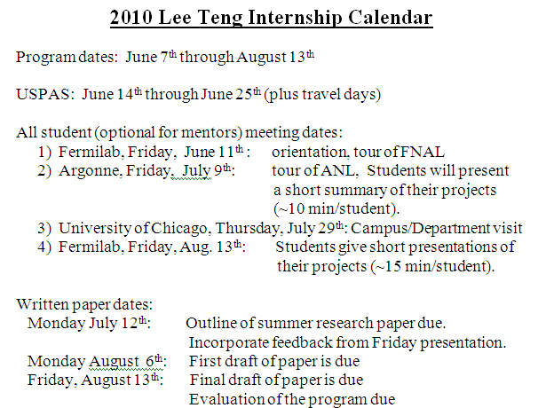
E. Prebys – Lee Teng Welcome
6/11/2010

Slide 6
Make the most of it
  Lots of opportunities to talk to scientists, graduate students and fellow undergrads
    Don’t be shy! (accelerator students can be a bit isolated)
  Lots of opportunities for fun (but keep it legal)
Let us know how it goes
  This is still a pretty new program and we’re looking for ways to improve things!
Stay in touch!
  Let us know how you’re doing, particularly if you’re considering accelerator physics as a career.
E. Prebys – Lee Teng Welcome
6/11/2010

