Slide 1

Eric Prebys, FNAL
Selection Committee Chair
6/3/2009

Slide 2
Joint Argonne/Fermilab Venture
  Patterned after existing internships, but focused on accelerator physics
  Under auspices of virtual “Illinois Accelerator Institute” (also new)
  ~5 students at each lab
  Joint selection process, after which program administered separately at the two labs
  Nominally June 1-August 7, to match SULI/IPM
    June 15-June 26 spent at the USPS (U. of Albuqueque)
  Student works closely with a mentor on a predetermined project involving accelerator physics or related technology
Eligible
  Physics, Math, Engineering, or Computer Science majors at U.S. Universities (not necessarily U.S. citizens)
  Juniors or outstanding Sophomores
E. Prebys – Lee Teng Welcome
6/3/2009

Slide 3
Selection Committee
  Eric Prebys, FNAL (Chair)
  William Barletta, MIT and USPAS (will teach “Fundamentals” course this summer)
  Eric Norum, ANL
  Peter Ostroumov, ANL
  Alving Tollestrup, FNAL
  Linda Spentzouris, IIT (coordinates Argonne projects/mentors)
Also involved in creating internship
  Rod Gerig, ANL
  Vladimir Shiltsev, FNAL
  Harold Myron, ANL
  Kathy Harkay, ANL
  Jean Slaughter, FNAL
Plus…
E. Prebys – Lee Teng Welcome
6/3/2009

Slide 4
Anita Alamillo, ANL
  Web site
Diana Canzone, FNAL
  Poster, flyer, logo
Carol Angarola, FNAL
  Managed application materials, handling transportation/housing at FNAL
Liz Quigg, FNAL
  Set up online application on very short notice
Linda Spentzouris, IIT
  Managed mentor assignments at ANL and put together the calendar
Susan Winchester, FNAL
  Coordinating USPAS end of things
Lisa Reed, ANL
  Coordination of Argonne program
E. Prebys – Lee Teng Welcome
6/3/2009

Slide 5
Mike Church – NML tour
Jim Steimel – HINS tour
Jamie Santucci/Elvin Harms – A0 tour
E. Prebys – Lee Teng Welcome
6/3/2009

Slide 6
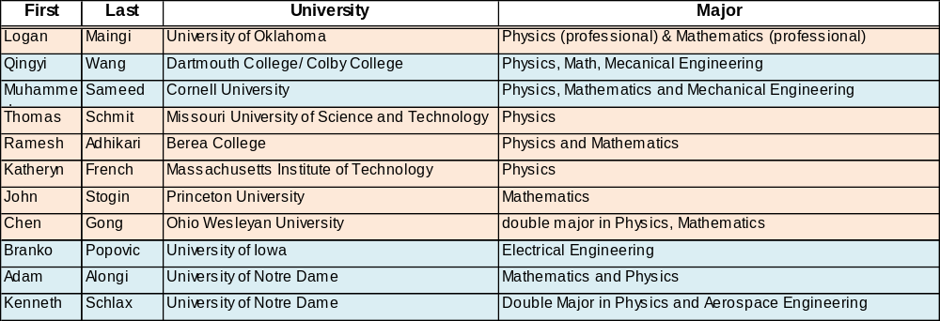
 | 2008 | 2009 | 2010
Argonne | 6 | 6 | 5
FNAL | 5 | 5 | 6
Total offers | 13 | 14 | 14
Rejections | 2 | 3 | 3
Males | 10 | 9 | 9
Females | 1 | 2 | 3
non-US | 3 | 2 | 4
Illinois schools | 5 | 2 | 0
Sophomores | 1 | 3 | 2
Juniors | 10 | 8 | 9
 | FNAL
 | ANL
E. Prebys – Lee Teng Welcome
6/3/2009

Slide 7
Accelerator science is a very exciting and growing field
  High energy and nuclear physics
  Light sources (materials, biophysics, etc)
  Spallation neutron sources
  Medical applications
    Hadron therapy
    Isotope production
  Power production (sub-critical reactors)
  Security
  Industrial applications (food sterilization, welding)
  Art (see T. Johnson’s work, 2nd floor)
This program is an excellent opportunity
  Real world experience
  USPAS!
  Good step toward graduate school
E. Prebys – Lee Teng Welcome
6/3/2009

Slide 8
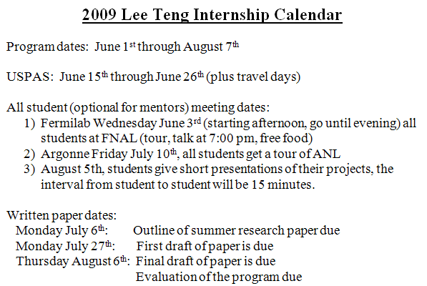
E. Prebys – Lee Teng Welcome
6/3/2009

Slide 9
Make the most of it
  Lots of opportunities to talk to scientists, graduate students and fellow undergrads
    Don’t be shy! (accelerator students can be a bit isolated)
  Lots of opportunities for fun (but keep it legal)
Let us know how it goes
  This is still a pretty new program and we’re looking for ways to improve things!
Stay in touch!
  Let us know how you’re doing, particularly if you’re considering accelerator physics as a career.
E. Prebys – Lee Teng Welcome
6/3/2009

Slide 10
17:30: Banquet/poster session in FNAL atrium
  Good chance to talk to people, particularly grad students
  Good food and drink (but save room!)
20:00: Public lecture, “Surfing on Plasma Waves”, Ramsey Auditorium
  I have tickets for interns and the Argonne mentors who asked for them (I think there are still plenty left)
21:30: Party at Village Barn
  Festa Italiana is a long time tradition
  This year, combined with “Taste of India”
At the same time…
E. Prebys – Lee Teng Welcome
6/3/2009

Slide 11
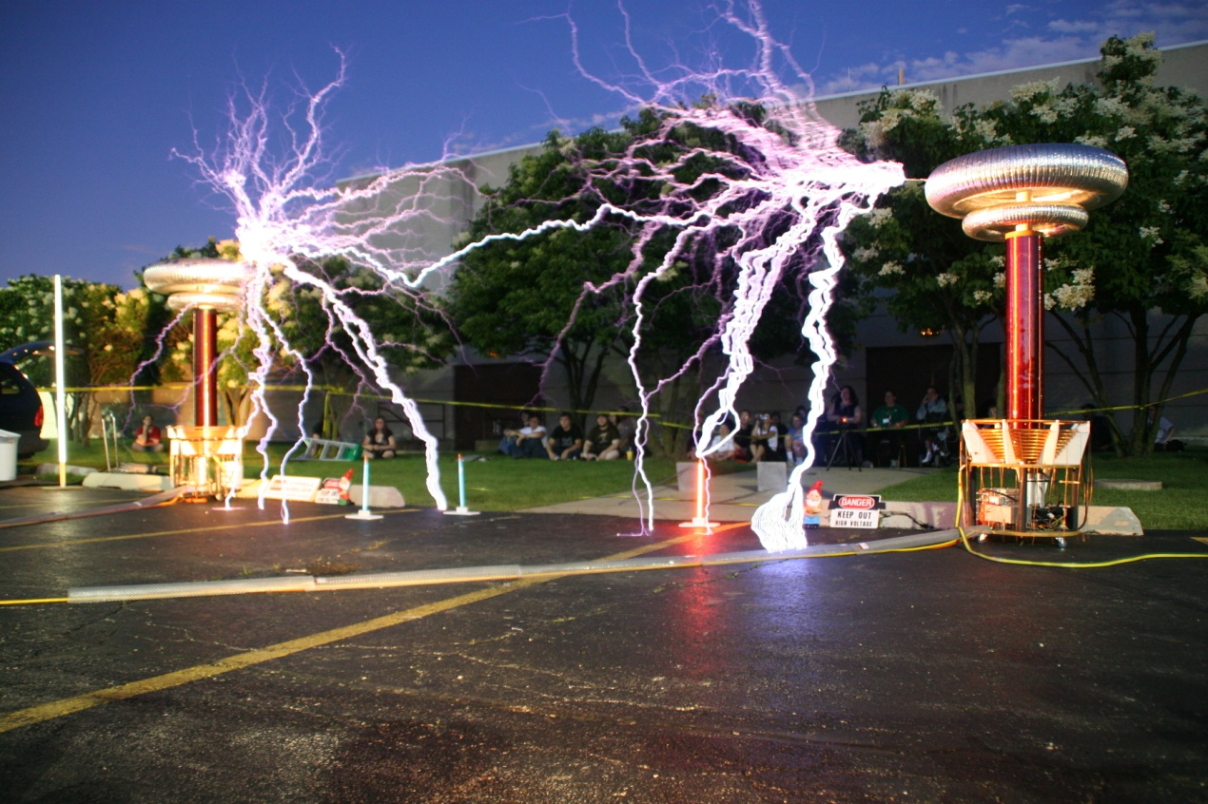
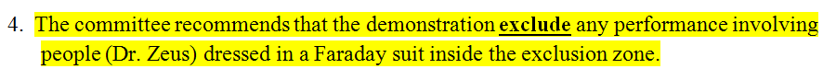
Tesla coil
demonstration,
courtesy of our
own Jeff Larson
Thanks to the UEC,
and FNAL ES&H
for making
arrangements,
particularly
  Patricia Vahle (UEC)
  Nancy Grossman (ES&H)
  John Reid and Bob Zwaska (Safety Review subcommittee)
Among their wise recommendations…
E. Prebys – Lee Teng Welcome
6/3/2009

Slide 12
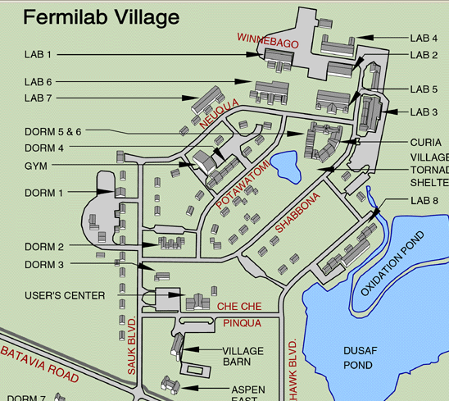
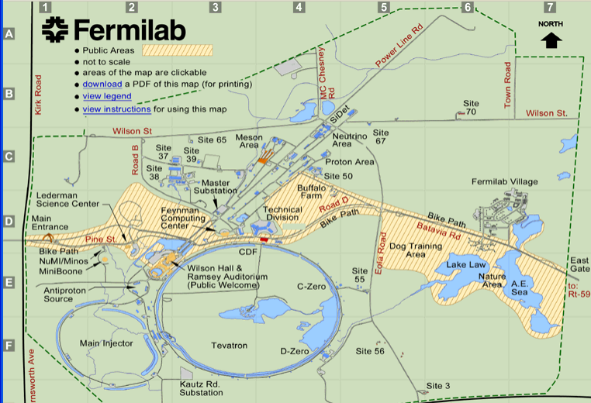
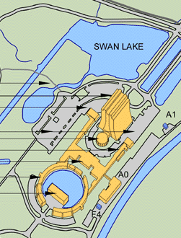
Tesla coil
Bus p/u
Party
E. Prebys – Lee Teng Welcome
6/3/2009

