Slide 1
Mu2e Experiment
Eric Prebys
For the Mu2e Collaboration

Slide 2
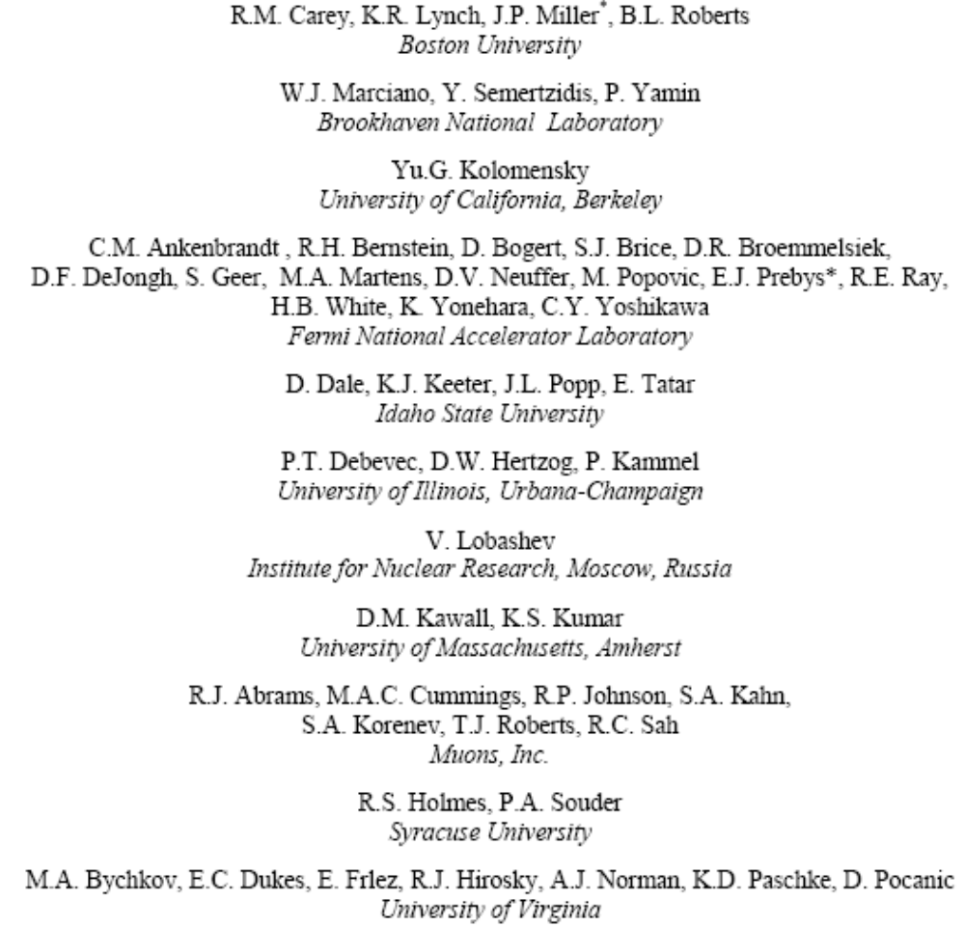
Mu2e Collaboration
50 Scientists
11 Institutions

Slide 3
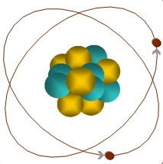
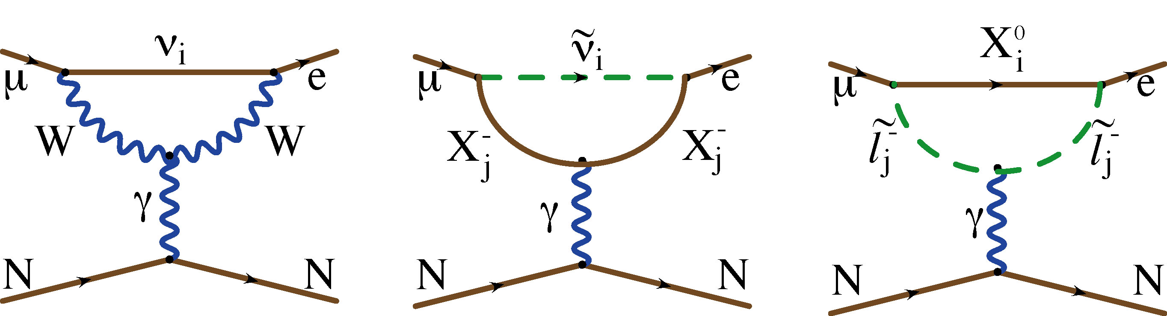
Muon Conversion
?
?
?
μ
Can occur through neutrino mixing (R<10⁻⁵²)
Virtually universal feature of Beyond Standard Model physics
Similar to μ→eγ
  No combinatoric background
  Relative rate depends on details of physics
105 MeV e⁻

Slide 4
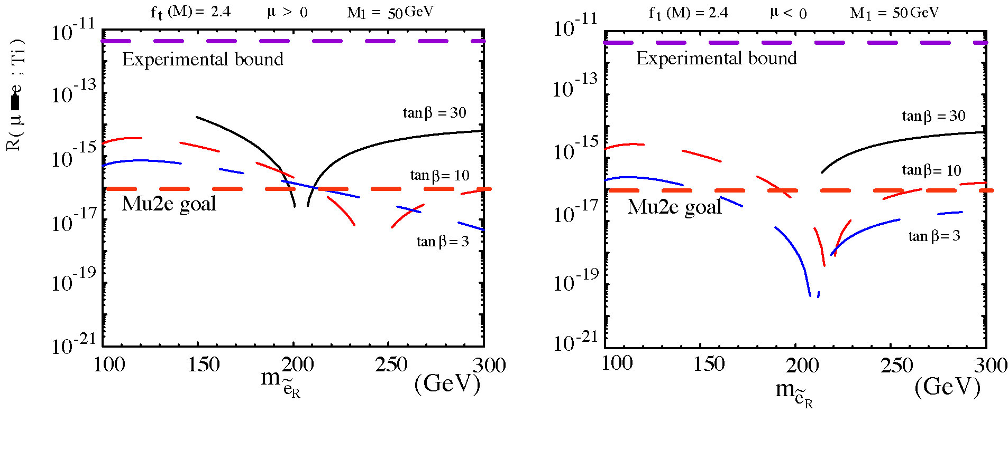
Example: Supersymmetry

Slide 5
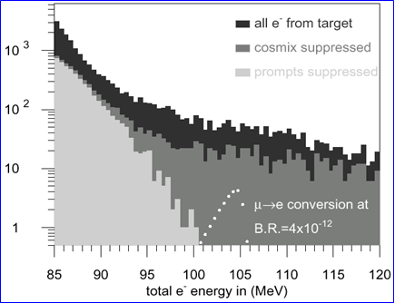
Previous Limit: Sindrum II
Limit: 4.3x10⁻¹² for μ+Ti->e+Ti
Limited by prompt backgrounds

Slide 6
Mu2e (MECO) Philosophy
Eliminate prompt beam backgrounds by using a primary beam with short proton pulses with separation on the order of a muon life time
Design a transport channel to optimize the transport of right-sign, low momentum muons from the production target to the muon capture target.
Design a detector to strongly reject electrons from ordinary muon decays

Slide 7
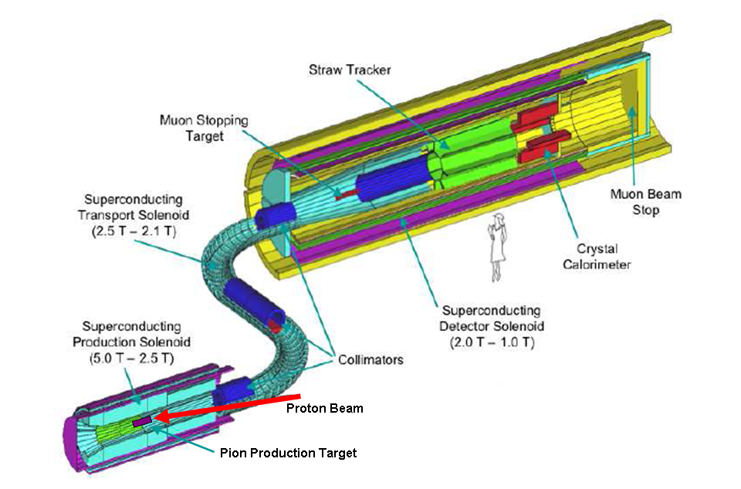
Detector Layout

Slide 8
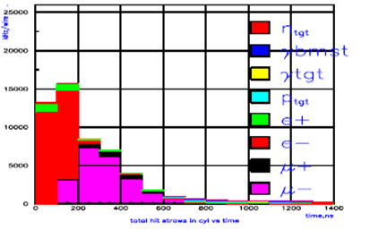
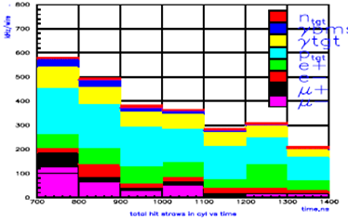
Beam Related Backgrounds

Slide 9
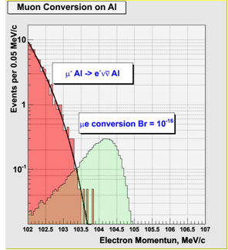
Sensitivity
5 events for 4x10²⁰ protons on target
.4 background, half from out of time beam, assuming 10⁻⁹ extinction
Coherent Decay-in-orbit, falls as (E-E_{e})⁵

Slide 10
Mu2e at Fermilab
If the current suite of proton source upgrades is effective, there should be at least enough excess 8 GeV protons during the NOvA era to do an experiment with similar sensitivity to MECO in a reasonable amount of time.
Unfortunately, the resonant operation of the 8 GeV Booster make it impossible to directly generate the desired time structure.
There is a scheme to generate this time structure using the antiproton Accumulator and Debucher rings, which will become available after the termination of the collider program.
This scheme requires only modest modifications beyond those planned for NOvA, with which it is fully compatible.

Slide 11
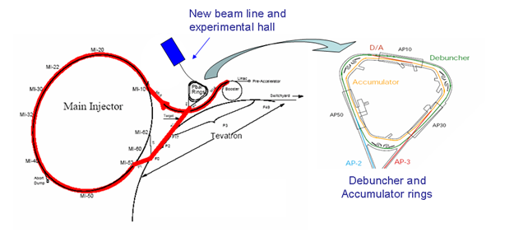
Getting Protons: “Boomerang” Scheme
MI-8 -> Recycler done for NoVA
Recycler
(Main Injector Tunnel)
New switch magnet extraction to P150 (no need for kicker)
Deliver beam to Accumulator/Debuncher enclosure with minimal beam line modifications and no civil construction.

Slide 12
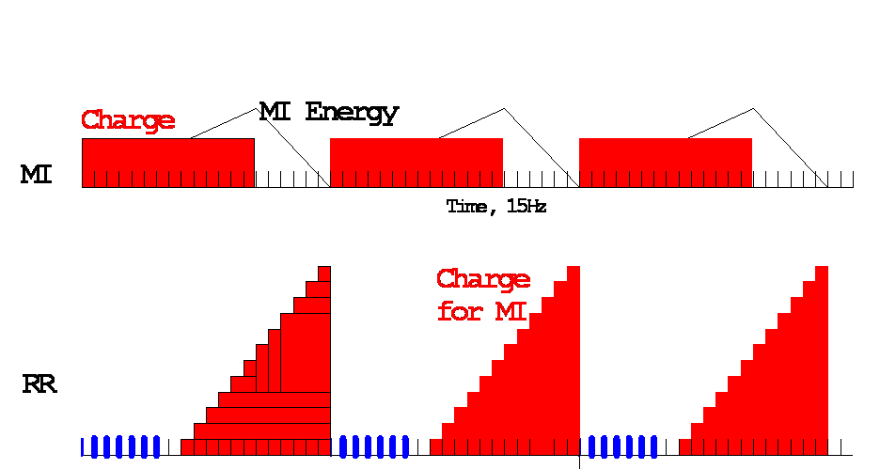

Slide 13
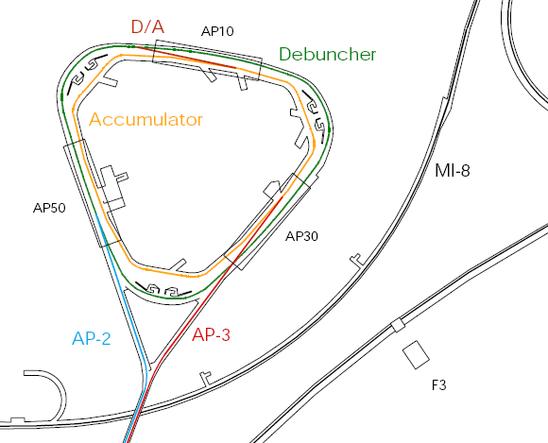
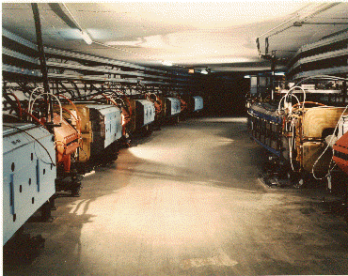
Present Operation of Debuncher/Accumulator
Protons are accelerated to 120 GeV in Main Injector and extracted to pBar target
pBars are collected and phase rotated in the “Debuncher”
Transferred to the “Accumulator”, where they are cooled and stacked
Antiproton capabilities not needed after collider program
Not used for NoVA

Slide 14
Momentum Stacking
Inject in a newly accelerated Booster batch every 67 mS onto the low momentum orbit of the Accumulator
The freshly injected batch is accelerated towards the core orbit where it is merged and debunched into the core orbit
Momentum stack 3-4 Booster batches
Energy
T=0
1st batch is injected onto the injection orbit
T<66ms
1st batch is accelerated to the core orbit
T=67ms
2nd Batch is injected
T<133ms
2nd Batch is accelerated
T=134ms
3rd Batch is injected

Slide 15
Rebunching Scheme
Accumulator
  Momentum stack 1 to 6 booster batches
  Adiabatically bunch at h=1- 4kV
    500ns gap for kicker
    Some beam/halo cleaning in Acc and transfer
    Adiabatic easier at γ_{T}=5.5
  Transfer to Debuncher
Debuncher
  h=1 90-degree phase rotation at fixed voltage
    40kV - 0.007s
  Capture and store at h=4
    ~200 to 250 kV ~0.02s; σ_{τ} = 42ns fairly long bunch
    Beam halo cleaning also ….

Slide 16
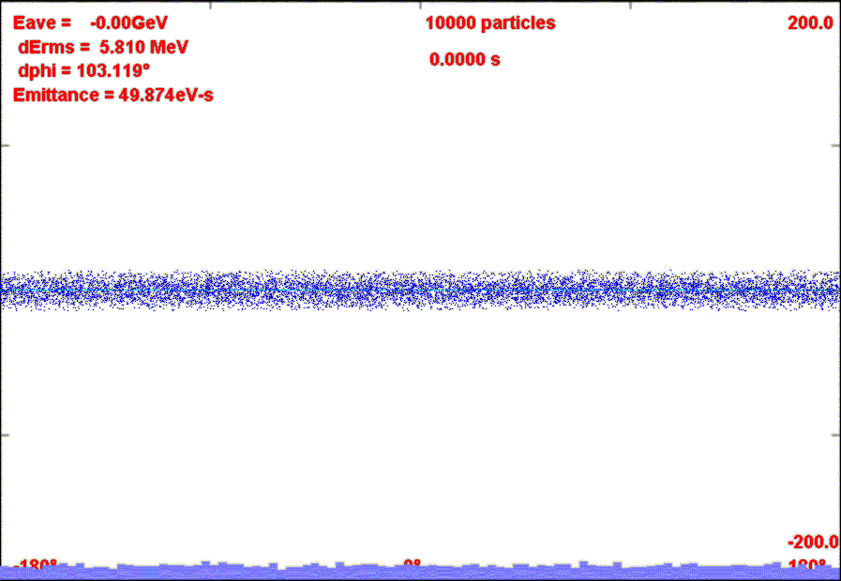
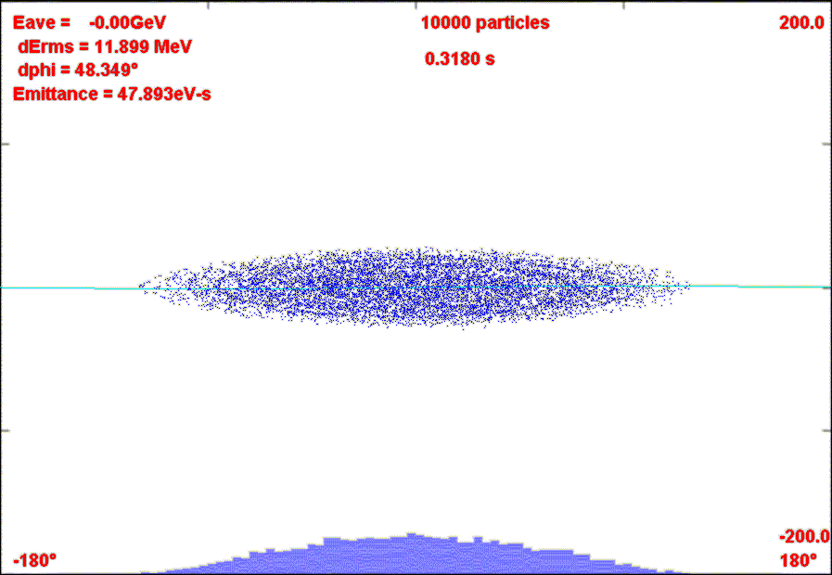
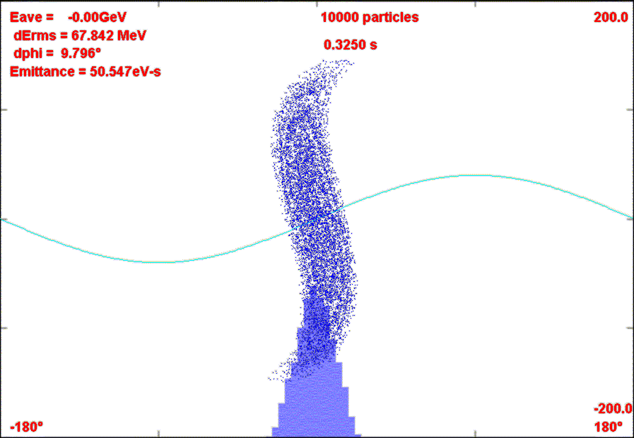
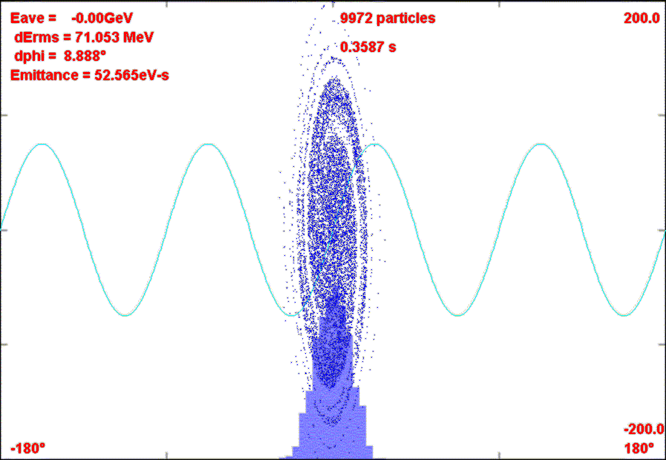
Bunch, Rotate, Store scenario

Slide 17
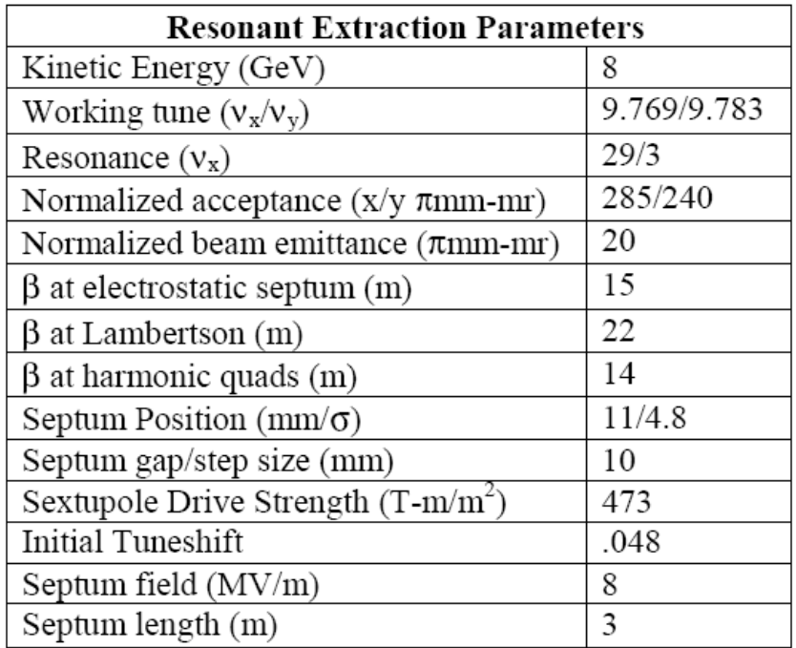
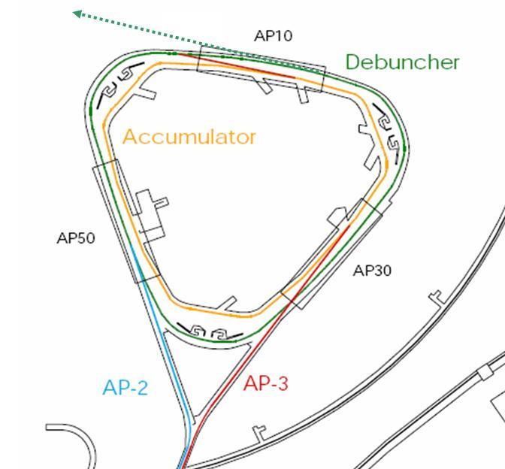
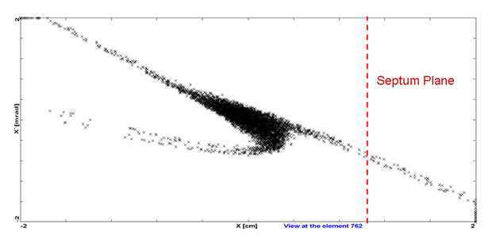
Resonant Extraction
Exploit 29/3 resonance
Extraction septum and Lambertson similar to Main Injector
  Setup 80 kV/1cm
  Lambertson ~.8T

Slide 18
Mu2e and Project X
Mu2e is based on the MECO experiment, which was designed around a data sample of 4x10²⁰ protons.
Our scheme should be able to deliver this in one to two years of dedicated operation, without impacting NOvA at all.
The 200 kW of 8 GeV protons produced by the Project X linac represent roughly a factor of ten increase in flux.
Slow extraction directly from Recycler ruled out by Project X Working Group
-> Will need to load beam from Recycler to Accumulator

Slide 19
Near Term Plans
Our goal is to produce a proposal by this time next year.
To-do list:
  Flesh out the beam delivery scheme
    Extraction
    Beam line
    Extinction
    Rad safety issues
  Rework the simulations for the slightly different beam scenario here at Fermilab, taking advantage of increased understanding of low energy muon production.
  Consider possible improvements to the muon transport line, particularly if they are more synergistic with the muon collider/neutrino factory efforts.
  Identify the key elements of an upgrade path to accommodate Project X, and estimate the potential benefit of the increased flux.
  Update cost estimates, particularly as regards civil construction here at the lab.

Slide 20
Requested resources
~$100K of FESS time for a preliminary cost of the experimental facility
~1/2 FTE beam line design expert to produce a preliminary design of the primary proton line
~1/2 FTE of ES&H radiation safety expert, to help us produce a plan to deal with the increased flux in the pBar enclosure
~1/4 FTE of a TD magnet expert, to evaluate the MECO magnet design, and advise of possible improvements.
A dedicated postdoc and guest scientist position to facilitate the required Monte Carlo work.

