Slide 1
Proton Source Status and Plans
Eric Prebys
FNAL Accelerator Division

Slide 2
Proton Team (“Finley Report”)
Group formed in early 2003 to study proton demands and needs for the “near” future (through ~2012 or so), in the absence of a proton driver.
Work culminated in a report to the director, available at www.fnal.gov/directorate/program_planning/studies/ProtonReport.pdf
No big surprises [see P. Kasper “Getting Protons to NuMI (It’s a worry)”, 2001].
This work will form the basis of “The Proton Plan”.

Slide 3
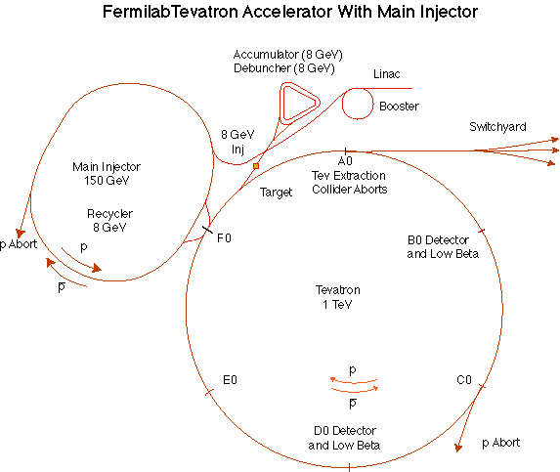
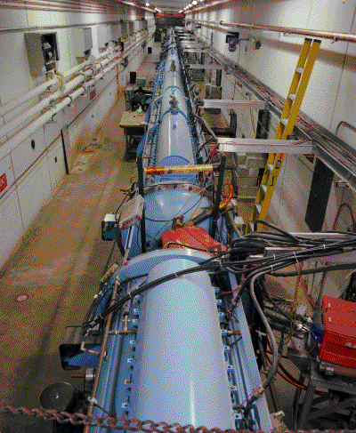
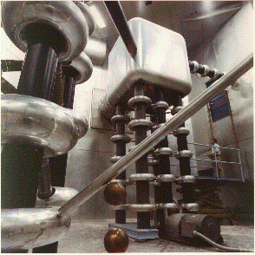
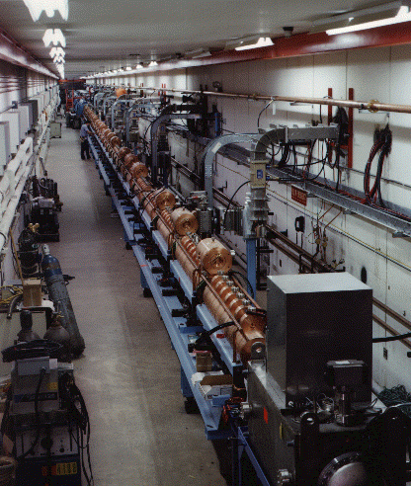
Preac(cellerator) and Linac
“New linac”- 800 MHz “π cavities” accelerate H- ions from 116 MeV to 400 MeV
“Preac” - Static Cockroft-Walton generator accelerates H- ions from 0 to 750 KeV.
“Old linac”- 200 MHz “Alvarez tubes” accelerate H- ions from 750 keV to 116 MeV
Preac/Linac can deliver about 45 mA of current for about 40 usec at a 15 Hz repetition rate (not a bottleneck)

Slide 4
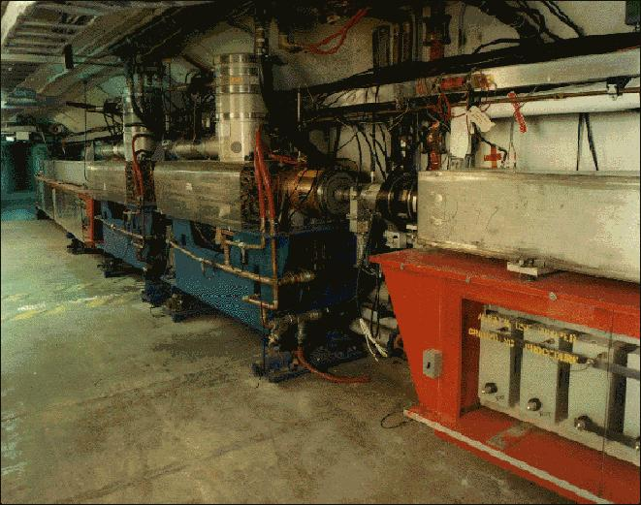
Booster
400 MeV Linac H- beam is injected into booster.
The lattice magnets in the Booster form a 15 Hz resonant circuit, setting the instantaneous cycle rate, but ramped elements limit the average repetition rate to somewhat lower.
From the Booster, beam can be directed to
  The Main Injector
  MiniBooNE
  The Radiation Damage Facility (RDF)
  A dump.
The 15 Hz cycle sets a fundamental clock rate for the entire complex.
One full booster “batch” sets a fundamental unit of protons throughout the accelerator complex (max 5E12).

Slide 5
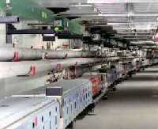
Main Injector
The Main Injector can accept 8 GeV protons OR antiprotons from
  Booster
  The anti-proton accumulator
  The Recycler (which shares the same tunnel)
It can accelerate protons to 120 GeV (in a minimum of 1.4 s) and deliver them to
  The antiproton production target.
  The fixed target area.
  (soon) The NUMI beamline.
It can accelerate protons OR antiprotons to 150 GeV and inject them into the Tevatron.
The Main Injector holds six booster batches, in the absence of exotic loading schemes (slip stacking, RF barrier, etc).
It’s envisioned that two slipstacked batches will be used for stacking and the rest for NUMI and/or switchyard 120.

Slide 6
What Limits Total Proton Intensity?
Maximum number of Protons the Booster can stably accelerate: 5E12
Maximum average Booster rep. Rate: currently 7.5 Hz, may have to go to 10 Hz for NuMI+ (full) MiniBooNE
(NUMI only) Maximum number of booster batches the Main Injector can hold: currently 6 in principle, possibly go to 11 with fancy loading schemes in the future
(NUMI only) Minimum Main Injector ramp cycle time (NUMI only): 1.4s+loading time (at least 1/15s*nbatches)
Losses in the Booster:
  Above ground radiation
  Damage and/or activation of tunnel components
Our biggest worry at the moment!!!!

Slide 7
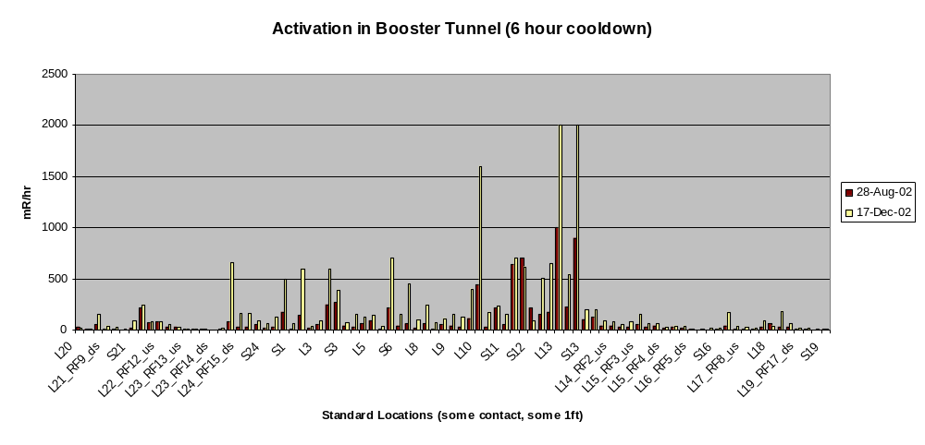
The Bad News: Booster Tunnel Radiation Levels
Any further increase in protons must come without increasing losses.

Slide 8
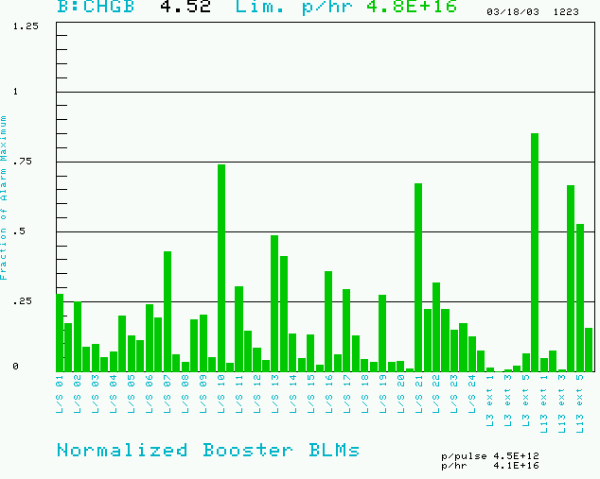
Operational Issues: Limiting Booster Losses
Maximum based on trip point
100 second running loss sums (normalized to trip point)
Also limit total booster average power loss (B:BPL5MA) to 400W.
Present rate

Slide 9
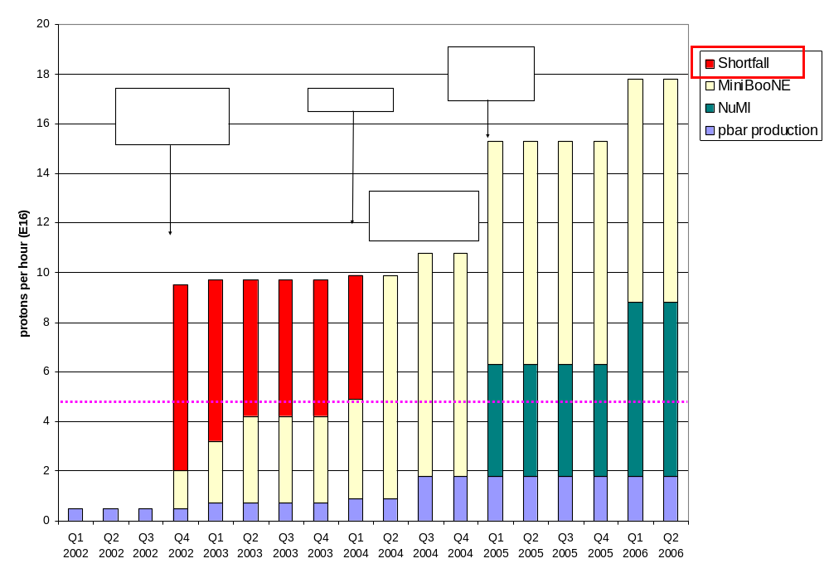
Proton Demand
Can we do this???

Slide 10
Projects in 2003 (a short list)
2003 Activities centered around preparation for the September shutdown:
  Linac:
    Major water system upgrade
    New Lambertson to steer beam to Booster
      Better optical qualities
  Booster
    two-stage collimation system
      In the works a long time
      Suffered major setbacks, but now in place.
    Major modifications at main extraction region
      Address “dogleg problem” caused by extraction chicane system.
    New, large aperture magnets in extraction line:
      Should reduce above-ground losses
    Major vacuum system upgrade.
    Lots of smaller jobs.

Slide 11
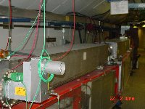
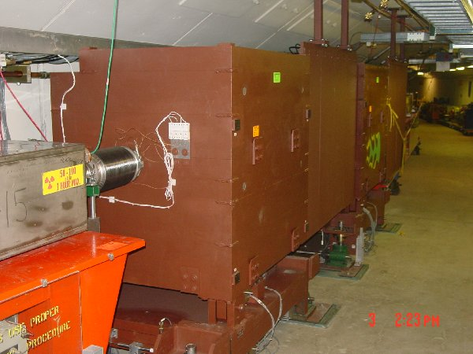
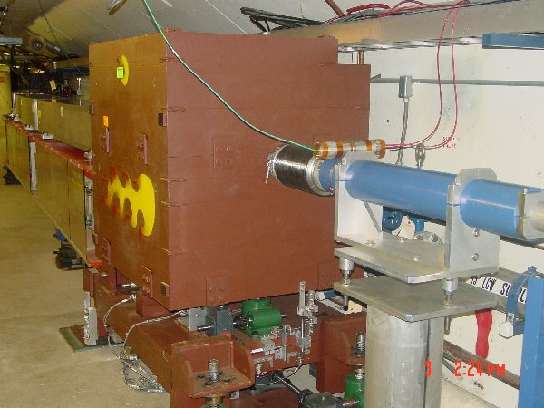
New Collimator System
Basic Idea…
A scraping foil deflects the orbit of halo particles…
…and they are absorbed by thick collimators in the next periods.
Should dramatically reduce uncontrolled losses

Slide 12
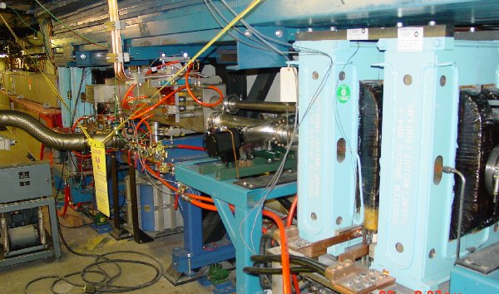
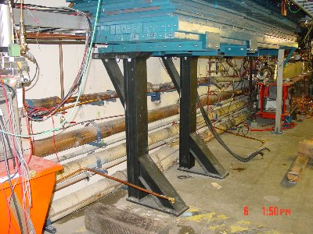
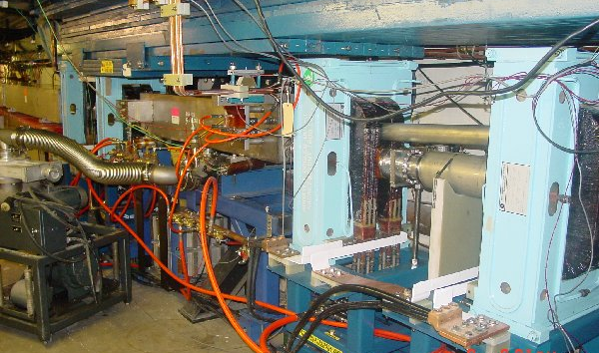
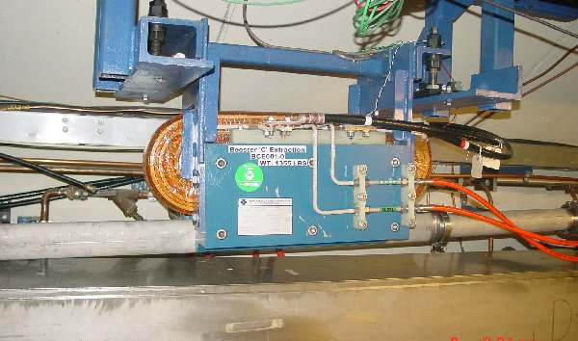
Long 3 Dogleg Work
New magnet to match extraction line
Increase spacing between dogleg pairs from 18” to 40” to reduce lattice distortions at injection.

Slide 13
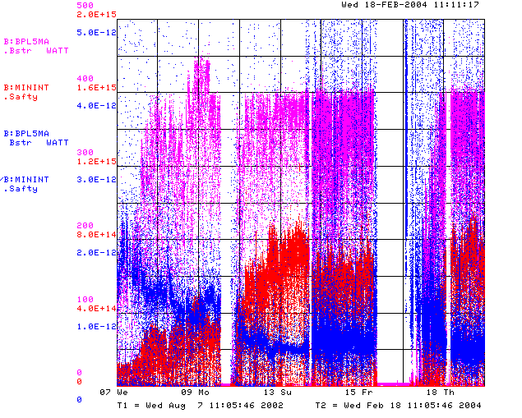
How are We Doing?
Power loss (W)
Protons (p/min)
Energy Lost (W-min/p)
BooNE turn-on (Sept. 2002)
“Mysterious”
Performance Problems
Big Shutdown

Slide 14
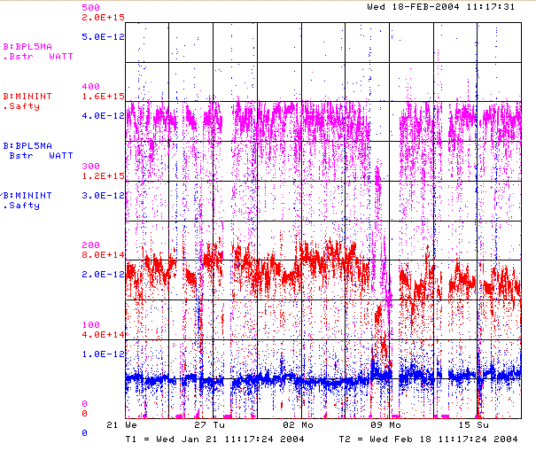
Recent Running (Last 4 Weeks)
Power loss (W)
Protons (p/min)
Energy Lost (W-min/p)
Record Performance
Several Unrelated Problems

Slide 15

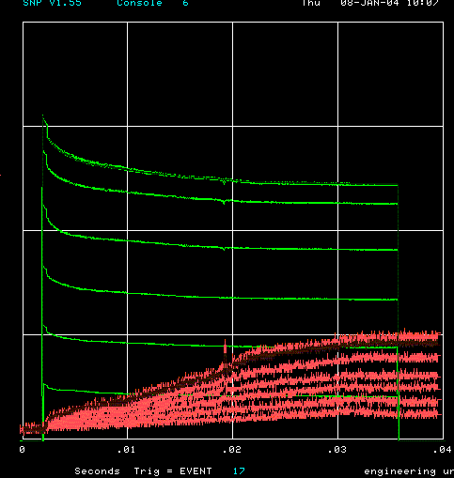
How far have we come?
Before MiniBooNE
Now (same scale!!)
Charge through Booster cycle
Time (s)
Energy Lost
Note less pronounced injection and transition losses

Slide 16
Near Term Priorities (Booster)
Optimizing Booster for improved lattice:
  Tuning and characterizing 400 MeV line (Linac to Booster).
  Tuning Booster orbit to minimize losses.
Commission Collimators:
  Estimate another month or so to bring into standard operation. (discussed shortly)
Aperture Improvments:
  Alignment (discussed shortly)
  Orbit control
    Abandoning our original global plan in favor of local control at problem spots for the time being.
  Prototype RF Cavities
    Two large aperture prototype cavities have been built, thanks to the help of MiniBooNE and NuMI universities.
    We will install these as soon as they are ready to replace existing cavities which are highly activated.
Multibatch timing: Beam cogging (discussed shortly)
Studies:
  RF capture
  Transition crossing
  Space charge effects

Slide 17
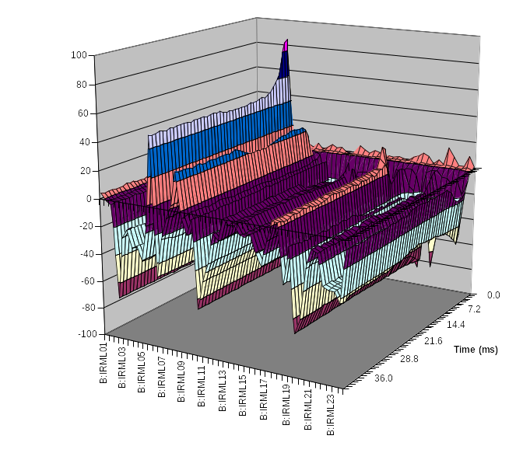
Collimator Studies
Collimator location
Shown is the effect of putting in one of the secondary collimators as a percentage change in losses as a function of time around the ring.
Studies are continuing.
  “Rapid response team” will be put on problem.
At present, primary collimators are not optimized to energy loss profile
  Will replace in upcoming shutdown.
location

Slide 18
Alignment in the Booster
Recognized as a problem for some time.
A little over a year ago, we started a vertical as-found of the entire Booster
  Level run
  4 survey points on each magnet (some a bit complicated)
  (Mostly) completed during the shutdown. Data now in hand.
  Some big problems!
Historical difficulties
  Lack of priority!
  Lack of a coherent plan, both on our part and alignment.
  Inefficient use of downtime (response time issues).
Solution? What else – a task force.

Slide 19
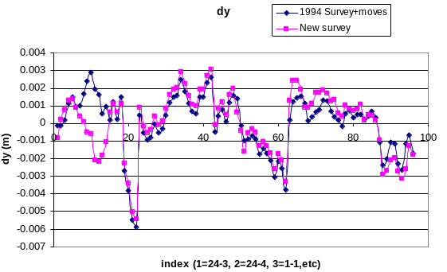
Alignment Results
Effect of Booster tower shielding
¼” Misalignment at Collimators!

Slide 20
Alignment Plan
Peter Kasper put in charge of coordinating alignment on our end.
O’sheg made task manager on the AMG end.
Andrew Feld (booster technician) will be trained as a liaison.
Near term goals (ASAP as opportunities arise)
  Complete vertical network (5-10% to be done or redone)
  Develop a plan for vertical moves, including both “opportunities” and longer term requests.
  Align RF cavities and other key elements to optical center of straights.
Longer term (aim to complete by next big shutdown)
  Produce a “beam sheet” based on Sasha’s MAD file
  Add non-magnetic elements
  Complete network, including horizontal.

Slide 21
Priorities over the Next Year
Linac Characterization and Reliability
  Increase instrumentation of old linac to study instabilities.
  Develop set of performance parameters.
Booster improvements.
  Prepare for modification of second extraction region
    New septum
    Modified dogleg magnets
    On track for next year’s shutdown.
  Injection bump (ORBUMP) improvements:
    Injection Bump (ORBUMP) Power Supply
      Existing supply a reliability worry.
      Limited to 7.5 Hz
      Building new supply, capable of 15 Hz.
      Aiming for summer shutdown (aggressive, but doable)
    New ORBUMP Magnets
      Existing magnets limited by heating to 7.5 Hz
      Working on a design for cooled versions.
      These, with a new power supply, will make the Booster capable of sustained 15 Hz operation.
      Aiming for summer shutdown (aggressive, but doable).

Slide 22
Multibatch Timing
In order to Reduce radiation, a “notch” is made in the beam early in the booster cycle.
Currently, the extraction time is based on the counted number of revolutions (RF buckets) of the Booster. This ensures that the notch is in the right place.
The actual time can vary by > 5 usec!
This is not a problem if booster sets the timing, but it’s incompatible with multi-batch running (e.g. Slipstacking or NuMI)
We must be able to fix this total time so we can synchronize to the M.I. orbit.
This is called “beam cogging”.

Slide 23
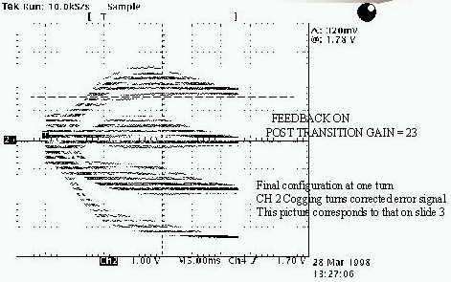
Active cogging (NOTE: will get better slide, here)
Detect slippage of notch relative to nominal and adjust radius of beam to compensate.
Allow to slip by integer turns, maintaining the same total time.
Efforts in this area have been recently increased, with the help of a Minos graduate student (R. Zwaska).
Aim to get working in the next few months

Slide 24
Planning for the future
In response to the “Finley Report”, the lab management has asked for a “Proton Plan” for the proton source over the next few years, analogous to the Run II plan, but much lower in scope.
The plan is to do what we can reasonably do to maximize the throughput and reliability of the existing proton source (incl. MI), under the assumption that a Proton Driver will eventually be built.
Beyond the things I have already mentions, the scope is largely determined by the budgetary guidance:
  FY04: $0-2M
  FY05: $6M
  FY06: $5M
  FY07: $5M
  FY08: $2.5M

Slide 25
Comment on the Budget
This budget is more than enough to do the basic things that we must do to keep the proton source going, provided some of it appears this year!
It precludes certain ideas that have been suggested:
  New Linac front end, or any significant 200 MHz upgrade.
  Decreasing the Main Injector ramp time
    Which means there will be very little to do with the Main Injector.
There are some “big” (>$1M) projects that must be discussed.

Slide 26
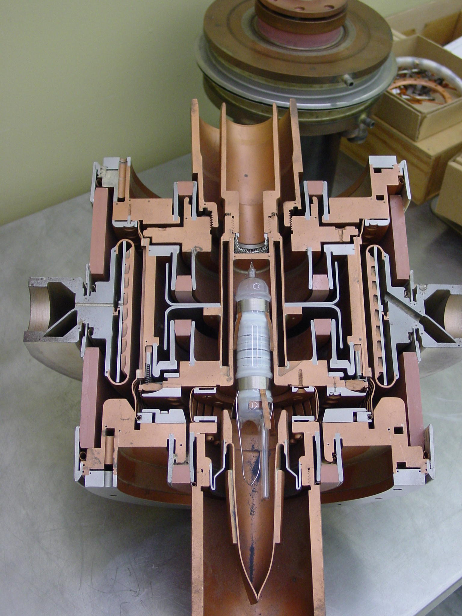
The 7835 Power Triode – A BIG Worry
5 needed for old linac
  One vendor (Burle)
  No viable substitute.
Very complex technology
  RF, material science, vacuum, chemistry
Similar to other tubes made by Burle
  4617
7835 only used in the scientific community.
  ANL, BNL, LANL
  One military user for 4617
Quality varies from decade to decade

Slide 27
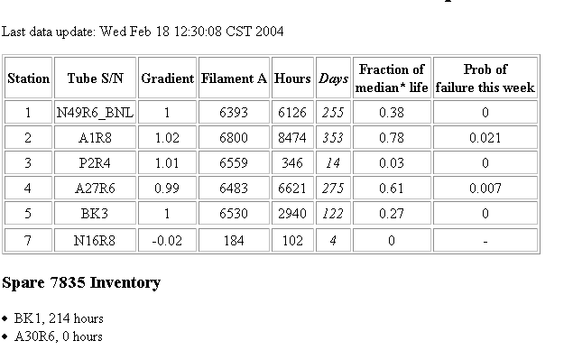
7835 Status
Lots of interaction between the lab (Czarapata) and Burle to help them improve their reliability.
They seem to remember how to make tubes again.
Present inventory:
+ one ready to be tested

Slide 28
Large Projects Under Consideration
Booster RF system:
  Commission a design for a new booster RF system
  Larger aperture, higher gradient cavities
  Solid state distributed amplifiers
  Goal to have design by January 2005.
  Two year timescale to build and install (perhaps solid-state DA’s can come sooner).
  Cost ~all of it.
Two additional booster RF cavities
  Can use large aperture prototypes, and mostly spare parts.
  Would increase efficiency and reliability (can’t run well with one station down, at the moment).
  Cost ~500K.
  Might happen in the summer shutdown.
30 Hz harmonic to booster ramp.
  Effectively increases RF power
  Cost of order $1-2M
New LEL quad power supplies.
  A reliability concern.
  Cost of order $1M.

Slide 29
Schedule for the Plan
Must proceed with the “vital” projects for this year.
Hope to have a skeleton of a plan by the end of this month.
We need to make a decision on the extra RF cavities soon
Will have a more detailed plan and major recommendations by this summer.

Slide 30
Expectation Management
What we really think we can achieve:
  Slipstacking to provide 1E13 protons per pulse for pbar production.
  5E20 protons to MiniBooNE by the time NuMI fully comes on in early 2005
  2-2.5E20 p/yr to NuMI in the first year of operation.
  Increasing that over the next few years, to something over 3E20 p/yr.
What we might achieve:
  Continuing to operate the 8 GeV line at some significant level after NuMI comes on, ultimately delivering 1E21 protons to MiniBooNE and possibly supporting other experiments (e.g. FINESSE).
  Delivering as many as 4E20 p/yr to NuMI, at which point things will be limited by Main Injector aperture and cycle time (with the present source, anyway).
It would be unrealistic to believe:
  We will ever send more than 4E20 p/yr to NuMI without significant (~$100M) investment in the existing complex.
  That would be direct competition for resources with the current Proton Driver proposal.

