Slide 1
Thoughts on University/AD Collaboration
Universities are interested:
  This whole thing was initiated by university interest.
  The AD is, by and large, highly skeptical of the whole idea.
It’s appropriate for HEP groups to work on accelerator projects:
  Example: When I was at Princeton, we took charge for developing a large scale system which counted bubbles to monitor gas flow in the RPC system; this was considered “HEP”.
  Numerous accelerator projects are more closely related to HEP than that.
This can be beneficial to Universities and HEP people:
  Next decade or so pretty bleak for “hardware-oriented” HEP groups.
  AD already rejecting piles of HEP applications.
Would be good for AD, too
  We can use the help.
  Would be good to have a more “academic” atmosphere.
Unfortunately, the experience has been mostly negative for both sides…

Slide 2
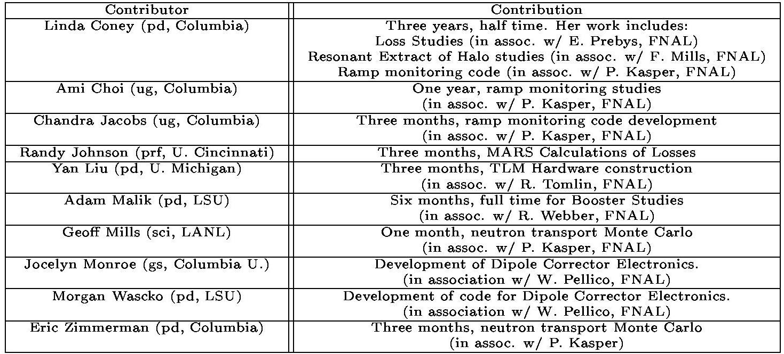
Some Examples: Perception vs. Reality
MiniBooNE Contributions to the Booster
(according to MiniBooNE Run Plan)…
Helped a bit
Did a lot of work. Didn’t finish. Code abandoned
Foundered with lack of guidance
No one’s sure what these people did

Slide 3
Booster Robot: A Cautionary Tale
Concept:
  Build a robot to follow a line around the Booster
  Could measure losses in real time with a calibrated loss monitor on an arm.
  Could do automated standard radiation survey.
Initial Reaction:
  Excellent project for a university!!
What happened:
  Some preliminary specification and costing meetings determined it would take about $200-300K to build a robot to do what we wanted.
  Presented to division management. No real enthusiasm.
  Columbia obtained a $50K NSF grant with extremely vague specification. Columbia summer student committed to project.
  I initially said I felt the division could probably match that.
  Radiation levels dropped in Booster. Robot seen as less critical.
  The budget dropped and the Main Injector RF upgrade reared its head -> division funding for this project no longer seen as reasonable.
Current status:
  Wireless installed in the Booster tunnel for control (useful in its own right).
  Prototype robot vehicle nearly ready for test (w/o arm).
  Will probably stay on the backburner for the near future.
  Columbia very upset that the division “reneged” on its commitment.

Slide 4
Booster Robot: What Went Wrong?
No clear division of responsibilities:
  My view: Columbia would manage the project and present us with a robot at the end. Fermilab would provide some funds and resources.
  Columbia’s view: Fermilab would manage the project. Columbia would provide some funds and some manpower.
Specifications went by the wayside:
  Too much emphasis on building “what we could afford” rather than building “what we needed” (Space Shuttle syndrome).
No concrete financial agreement with the lab
  Even if I had promised $50K, the fact is I had no authority to do that.
All this could have been avoided if we had had an MOU early in the process.

Slide 5
RF Cavities (kinda-sorta good)
Original project: build a prototype large-aperture Booster RF cavity as a proof-of-principle for an entirely new RF system.
University involvement:
  It was realized that a big part of the cost was machining, and that Universities could build two cavities much cheaper than the lab could build one.
  Six universities (3 Minos, 3 MiniBooNE) worked to make parts for two cavities, which have since been assembled.
  RF replacement scrapped, but cavities will be installed as 19th and 20th Booster cavities to increase max. batch size.
Pros:
  Production went like clockwork.
  Quality excellent. Impressed the RF group.
  Saved the lab a bundle.
  Some universities are looking for ways to employ their machine shops.
Cons:
  No intellectual contribution from the universities.
  No direct pressure from the universities to move the project along.

Slide 6
My Opinions
What doesn’t work:
  Short term commitments: Visiting faculty, summer students, etc.
What might work:
  Departments approach accelerator projects exactly the same way they approach detector projects:
    Institutional commitment.
    “service after sales”.
    Specific MOU with division.

