Slide 1
The Proton Source (mostly Booster) in the “Collider Era”
Eric Prebys
February 3, 2003

Slide 2
Lattice Measurement Status
Ran Shekhar’s old program during studies.
Program varies one trim over several (~10) values and measures all 96 BPM’s at 11 times for each one.
With modern BPM system, it takes ~1 hr to do full measurement with Booster @ 1/5sec.
Have written new (C++) tools to read in the files and fit the dependencies. (96*96*11=101376 individual correlation constants).
My short term goal is to get these into the closed orbit program.
Will translate to a Root file (OK?), or Ntuple
Also use to fit for lattice parameters, study dogleg effects, etc.

Slide 3
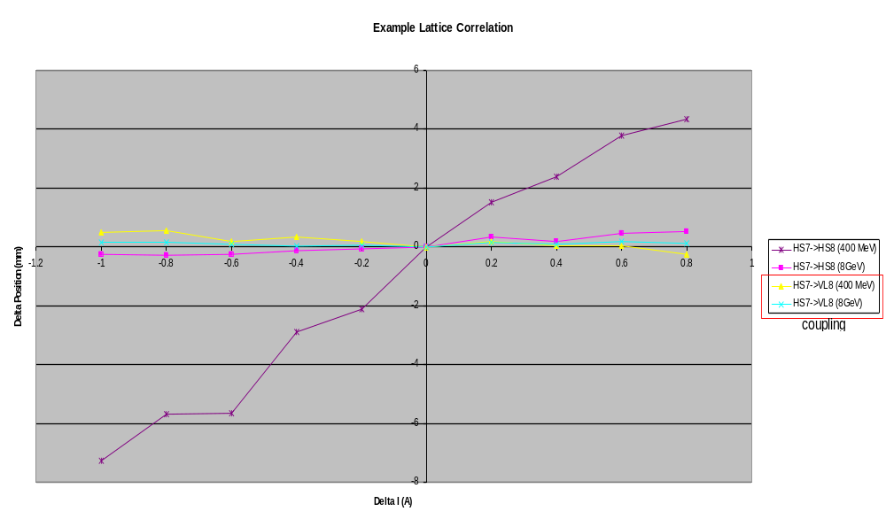
Example Data

Slide 4
Agenda
Resonance Scans: Spentz
Chromaticity Measurements (AC and DC): Ray
Effects of Dogleg and ORBUMP: Milorad?
200 Mhz injection overlap: Milorad
DC acceptance and ORBUMP painting: Weiren
Lattice Measurement: Eric
Beam Extinction: Eric
Gamma-t: Chuck?
Aborted beam IPM studies: Bill

