Slide 1
Proton Economics
Eric Prebys
FNAL Accelerator Division

Slide 2
Proton Team (“Finley Report”)
Group formed in early 2003 to study proton demands and needs for the “near” future (through ~2012 or so), in the absence of a proton driver.
Work culminated in a report to the director, available at www.fnal.gov/directorate/program_planning/studies/ProtonReport.pdf
No big surprises [see P. Kasper “Getting Protons to NuMI (It’s a worry)”, FNAL Beams-doc-1036, 2001].
This work will form the basis of “The Proton Plan”.

Slide 3
General Comments
The linac is not currently a performance bottleneck for the complex when it is running stably.
There are ongoing longevity and reliability concerns in the linac
  General state of instrumentation is inadequate to characterize linac behavior
  The 7835 tubes from Burle continue to be a major concern, although the situation is better than it was a year ago.
  There are new worries about the klystrons, which we formerly believed were not an issue.
  There are some other longevity issues, if we expect the linac to last another ~10 years.

Slide 4
What Limits Total Proton Intensity?
Maximum number of Protons the Booster can stably accelerate: 5E12
Maximum average Booster rep. Rate: currently 7.5 Hz, may have to go to 10 Hz for NuMI+ (full) MiniBooNE
(NUMI only) Maximum number of booster batches the Main Injector can hold: currently 6 in principle, possibly go to 11 with fancy loading schemes in the future
(NUMI only) Minimum Main Injector ramp cycle time (NUMI only): 1.4s+loading time (at least 1/15s*nbatches)
Losses in the Booster:
  Above ground radiation
  Damage and/or activation of tunnel components
Our biggest worry at the moment!!!!

Slide 5
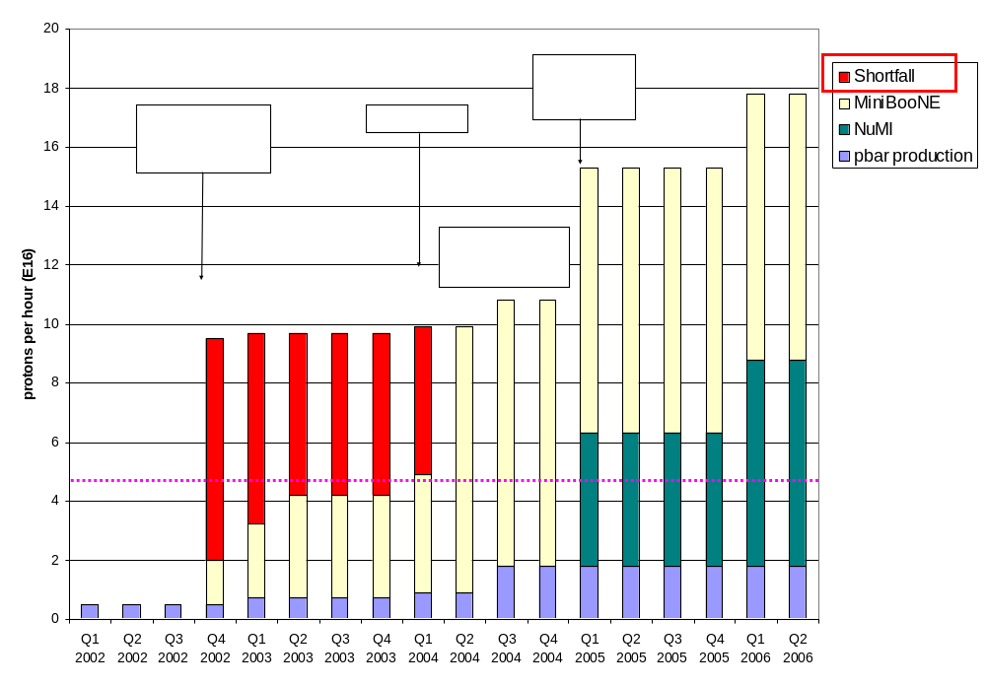
Proton Demand
Can we do this???

Slide 6
Projects in 2003 (a short list)
2003 Activities centered around preparation for the September shutdown:
  Linac water system upgrade
  New Linac Lambertson
    Better optics in 400 MeV line
  Booster two-stage collimation system
    In the works a long time
    Now in place.
  Major modifications at main extraction region
    Address “dogleg problem” caused by extraction chicane system.
  New, large aperture magnets in extraction line:
    Should reduce above-ground losses
  Major vacuum system upgrade.
  Lots of smaller jobs.

Slide 7
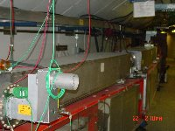
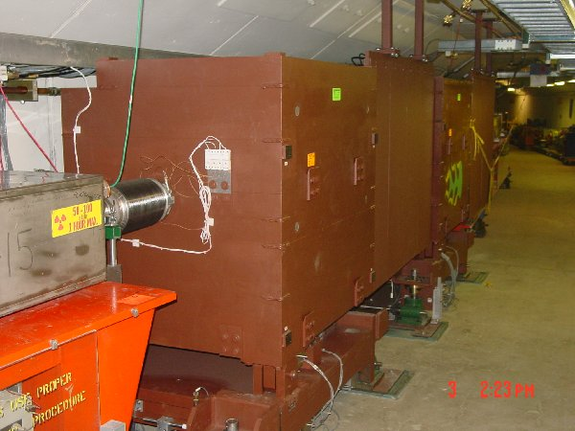
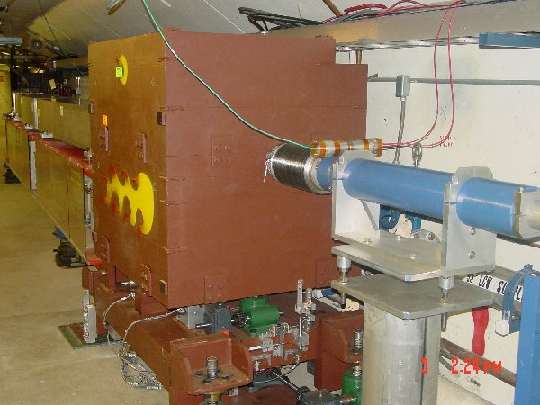
New Collimator System
Basic Idea…
A scraping foil deflects the orbit of halo particles…
…and they are absorbed by thick collimators in the next periods.
Should dramatically reduce uncontrolled losses

Slide 8
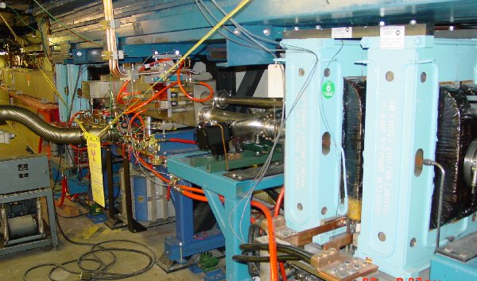
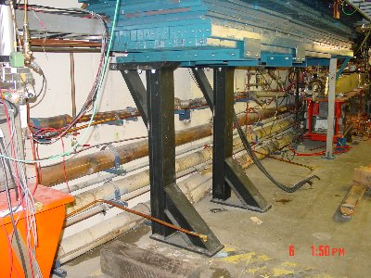
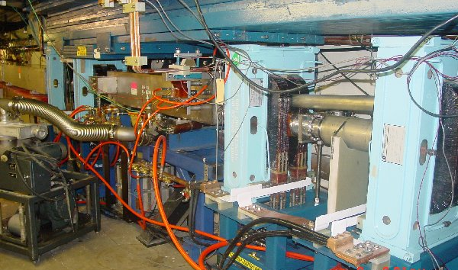
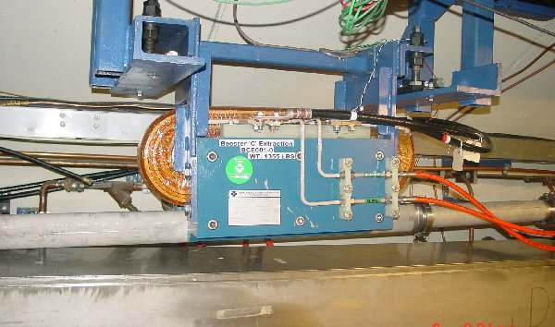
Long 3 Dogleg Work
New magnet to match extraction line
Increase spacing between dogleg pairs from 18” to 40” to reduce lattice distortions at injection.

Slide 9
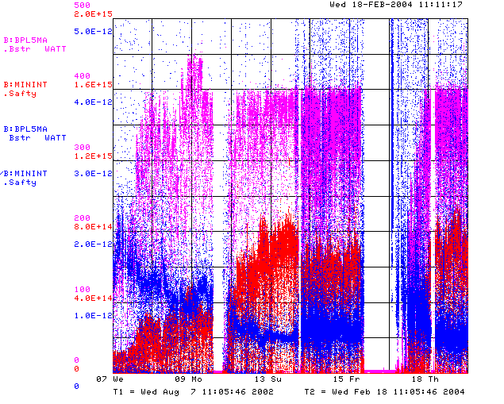
How are We Doing?
Power loss (W)
Protons (p/min)
Energy Lost (W-min/p)
BooNE turn-on (Sept. 2002)
“Mysterious”
Performance Problems
Big Shutdown

Slide 10
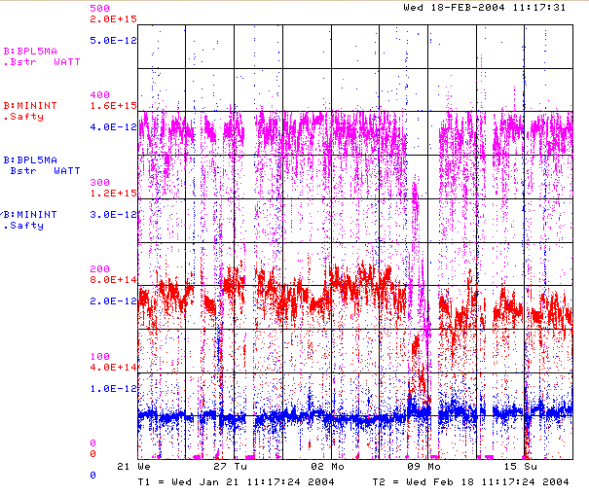
Recent Running (Last 4 Weeks)
Power loss (W)
Protons (p/min)
Energy Lost (W-min/p)
Record Performance
Several Unrelated Problems

Slide 11

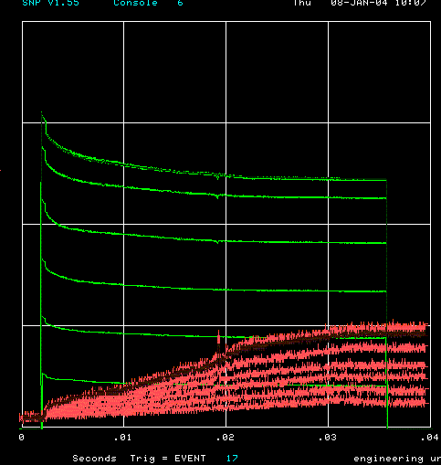
How far have we come?
Before MiniBooNE
Now (same scale!!)
Charge through Booster cycle
Time (s)
Energy Lost
Note less pronounced injection and transition losses

Slide 12
Near Term Priorities (Booster)
Optimizing Booster for improved lattice:
  Tuning and characterizing 400 MeV line (Linac to Booster).
  Tuning Booster orbit to minimize losses.
Commission Collimators:
  Estimate another month or so to bring into standard operation. (discussed shortly)
Aperture Improvments:
  Alignment (discussed shortly)
  Orbit control
    Abandoning our original global plan in favor of local control at problem spots for the time being.
  Prototype RF Cavities
    Two large aperture prototype cavities have been built, thanks to the help of MiniBooNE and NuMI universities.
    We will install these as soon as they are ready to replace existing cavities which are highly activated.
Multibatch timing: Beam cogging

Slide 13
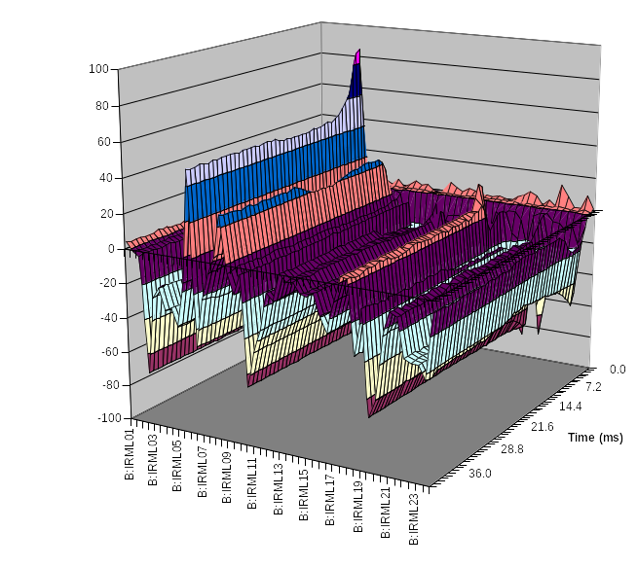
Collimator Studies
Collimator location
Shown is the effect of putting in one of the secondary collimators as a percentage change in losses as a function of time around the ring.
Studies are continuing.
  “Rapid response team” will be put on problem.
At present, primary collimators are not optimized to energy loss profile
  Will replace in upcoming shutdown.
location

Slide 14
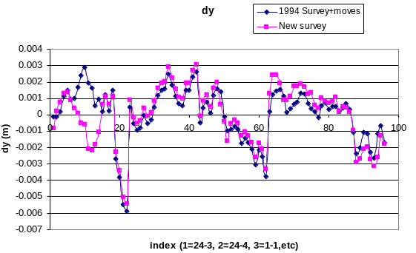
Alignment Problems
Effect of Booster tower shielding
¼” Misalignment at Collimators!
Working closely with AMG
As opportunity allows
  Fix vertical orbit
  Align RF cavities
Over the next year
  Complete network
  Integrate with MAD
  Make a horizontal plan.

Slide 15
Priorities over the Next Year
Linac Characterization and Reliability
  Increase instrumentation of old linac to study instabilities.
  Develop set of performance parameters.
Booster improvements.
  Prepare for modification of second extraction region
    New septum
    Modified dogleg magnets
    On track for next year’s shutdown.
  Injection bump (ORBUMP) improvements:
    Injection Bump (ORBUMP) Power Supply
      Existing supply a reliability worry.
      Limited to 7.5 Hz
      Building new supply, capable of 15 Hz.
      Aiming for summer shutdown (aggressive, but doable)
    New ORBUMP Magnets
      Existing magnets limited by heating to 7.5 Hz
      Working on a design for cooled versions.
      These, with a new power supply, will make the Booster capable of sustained 15 Hz operation.
      Aiming for summer shutdown (aggressive, but doable).

Slide 16
Planning for the future
In response to the “Finley Report”, the lab management has asked for a “Proton Plan” for the proton source over the next few years, analogous to the Run II plan, but much lower in scope.
The plan is to do what we can reasonably do to maximize the throughput and reliability of the existing proton source (incl. MI), under the assumption that a Proton Driver will eventually be built.
Beyond the things I have already mentions, the scope is largely determined by the budgetary guidance:
  FY04: $0-2M
  FY05: $6M
  FY06: $5M
  FY07: $5M
  FY08: $2.5M

Slide 17
Comment on the Budget
This budget is more than enough to do the basic things that we must do to keep the proton source going, provided some of it appears this year!
It precludes certain ideas that have been suggested:
  New Linac front end, or any significant 200 MHz upgrade.
  Decreasing the Main Injector ramp time
    Which means there will be very little to do with the Main Injector.
There are some “big” (>$1M) projects that must be discussed.

Slide 18
Large Projects Under Consideration
Booster RF system:
  Commission a design for a new booster RF system
  Larger aperture, higher gradient cavities
  Solid state distributed amplifiers
  Goal to have design by January 2005.
  Two year timescale to build and install (perhaps solid-state DA’s can come sooner).
  Cost ~all of it.
Adding two additional cavities
  Use university prototypes + spare parts
  Cost ~$500K
30 Hz harmonic to booster ramp.
  Effectively increases RF power
  Cost of order $1-2M
New LEL quad power supplies.
  A significant reliability worry
  Cost of order $1M.

Slide 19
Schedule for the Plan
Will proceed with the vital projects for this year.
Hope to have a skeleton of a plan by the end of this month.
Will have a more detailed plan and major recommendations by this summer.

Slide 20
Expectation Management
What we really think we can achieve:
  Slipstacking to provide 1E13 protons per pulse for pbar production.
  5E20 protons to MiniBooNE by the time NuMI fully comes on in early 2005
  2-2.5E20 p/yr to NuMI in the first year of operation.
  Increasing that over the next few years, to something over 3E20 p/yr.
What we might achieve:
  Continuing to operate the 8 GeV line at some significant level after NuMI comes on, ultimately delivering 1E21 protons to MiniBooNE and possibly supporting other experiments (e.g. FINESSE).
  Delivering as many as 4E20 p/yr to NuMI, at which point things will be limited by Main Injector aperture and cycle time (with the present source, anyway).
It would be unrealistic to believe:
  We will ever send more than 4E20 p/yr to NuMI without significant (~$100M) investment in the existing complex.
  That would be direct competition for resources with the current Proton Driver proposal.

