Slide 1
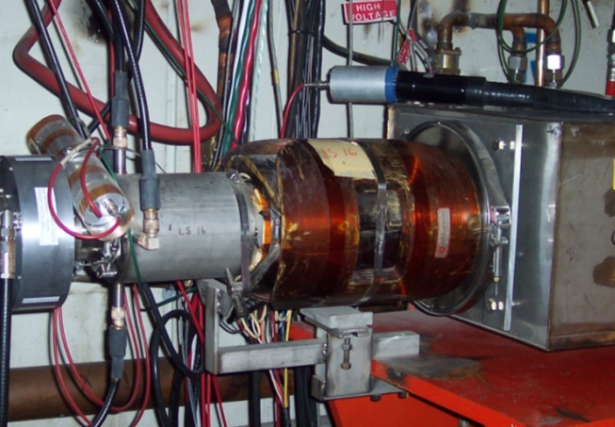
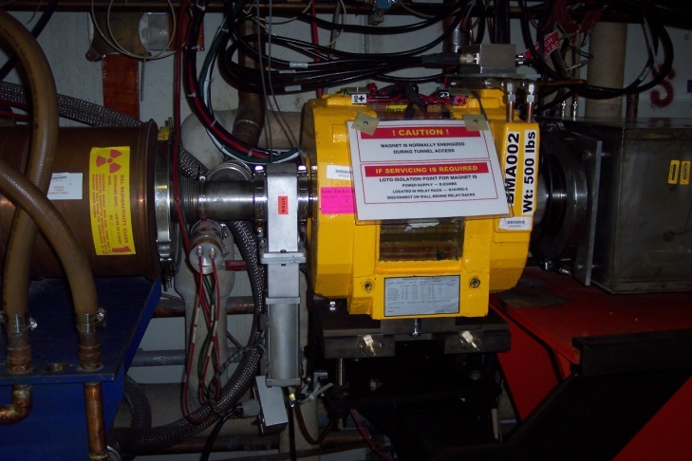
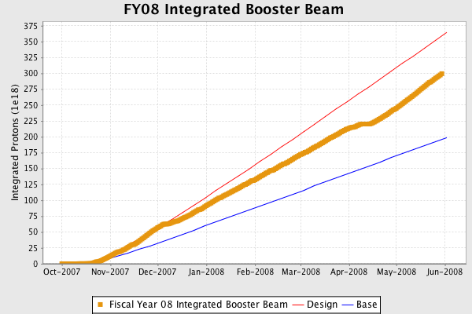
Installed ¼ of the new Booster corrector system
  Stronger
  Ramped quadrupoles and sextupoles at every period.
Delivered high quality beam to support combined pBar/NuMI slip stack operation and MiniBooNE/SciBooNE at record total rate

