Slide 1
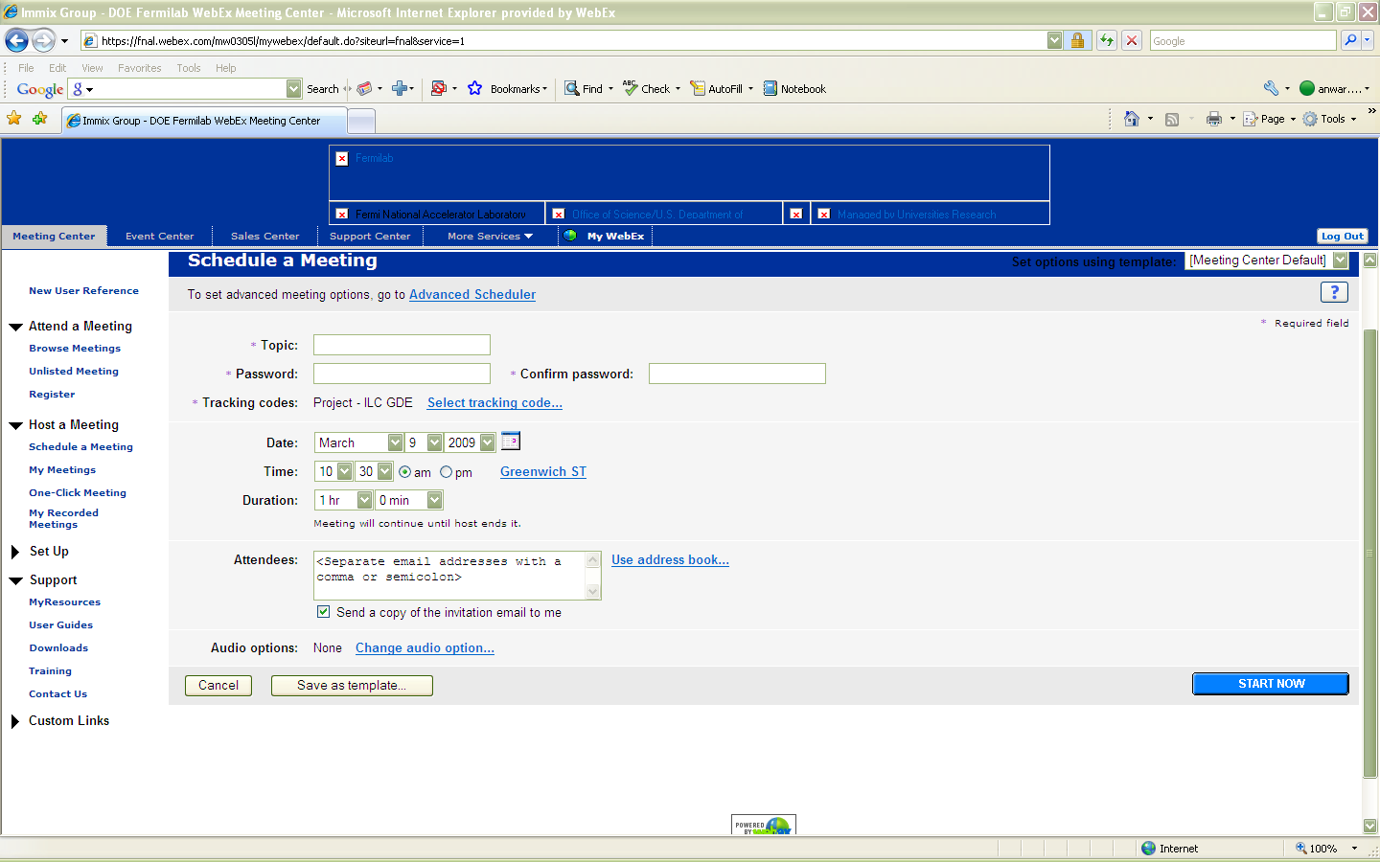
Example of scheduling on fnal.webex.com

Slide 2
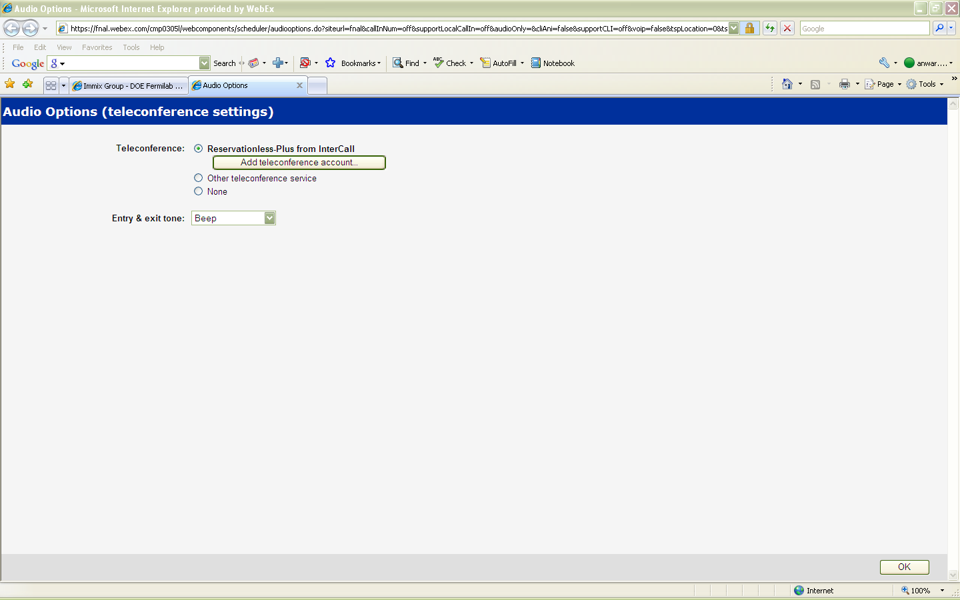
Example of scheduling on fnal.webex.com

Slide 3
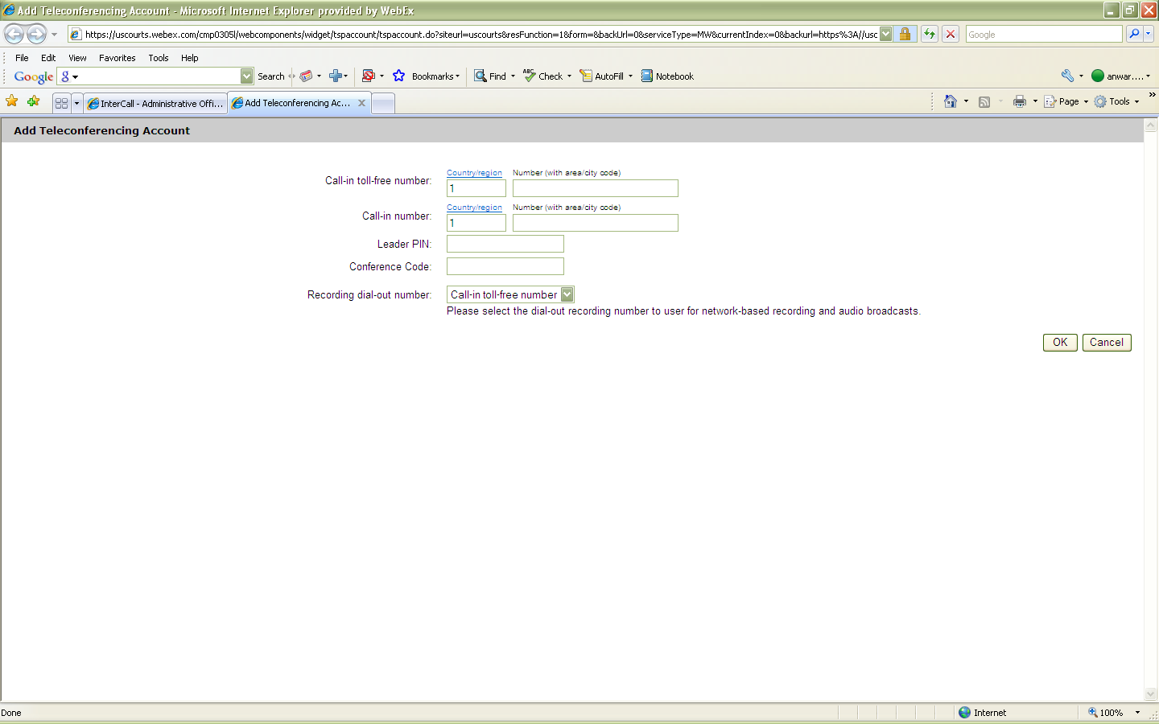
Example of Intercall integration on uscourts.webex.com

Slide 4
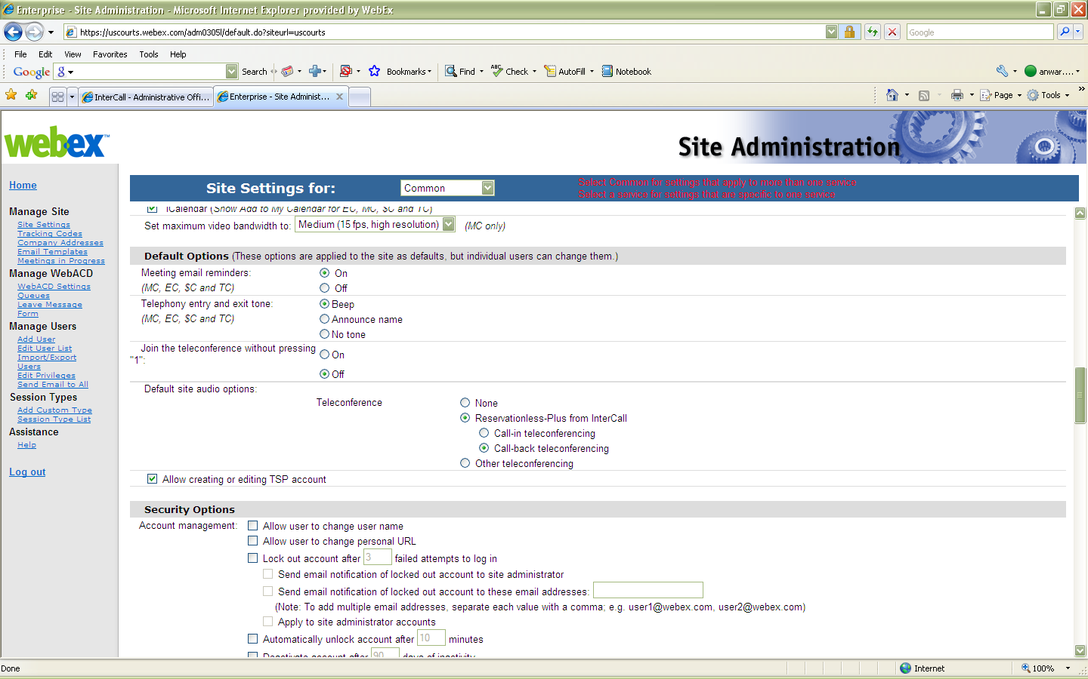
Example of set up in site admin

