Slide 1
MiniBooNE: Status and Prospects
Eric Prebys, FNAL/BooNE Collaboration

Slide 2
The MiniBooNE Collaboration
Y.Liu, I.Stancu
University of Alabama
S.Koutsoliotas
Bucknell University
E.Hawker, R.A.Johnson, J.L.Raaf
University of Cincinnati
T.Hart, R.H.Nelson, E.D.Zimmerman
University of Colorado
A.A.Aguilar-Arevalo, L.Bugel, J.M.Conrad, J.Link, J.Monroe, D.Schmitz, M.H.Shaevitz, M.Sorel, G.P.Zeller
Columbia University
D.Smith
Embry Riddle Aeronautical University
L.Bartoszek, C.Bhat, S.J.Brice, B.C.Brown, D.A.Finley, R.Ford, F.G.Garcia, P.Kasper, T.Kobilarcik, I.Kourbanis, A.Malensek, W.Marsh, P.Martin, F.Mills, C.Moore, E.Prebys, A.D.Russell, P.Spentzouris, R.Stefanski, T.Williams
Fermi National Accelerator Laboratory
D.Cox, A.Green, T.Katori, H.Meyer, R.Tayloe
Indiana University
G.T.Garvey, C.Green, W.C.Louis, G.McGregor, S.McKenney, G.B.Mills, H.Ray, V.Sandberg, B.Sapp, R.Schirato, R.Van de Water, N.L.Walbridge, D.H.White
Los Alamos National Laboratory
R.Imlay, W.Metcalf, S.Ouedraogo, M.Sung, M.O.Wascko
Louisiana State University
J.Cao, Y.Liu, B.P.Roe, H.J.Yang
University of Michigan
A.O.Bazarko, P.D.Meyers, R.B.Patterson, F.C.Shoemaker, H.A.Tanaka
Princeton University
P.Nienaber
St. Mary's University of Minnesota
B.T.Fleming
Yale University

Slide 3
Outline
State of neutrino mixing measurements
  History and background
  Without LSND
  LSND and Karmen
Experiment
  Beam
  Detector
  Calibration and cross checks
  Analysis
Resent Results
Future Plans and outlook
  Anti-neutrino running
  Path to oscillation results

Slide 4
The Neutrino “Problem”
1968: Experiment in the Homestake Mine first observes neutrinos from the Sun, but there are far fewer than predicted. Possibilities:
  Experiment wrong?
  Solar Model wrong? (⇐ believed by most not involved)
  Enough created, but maybe oscillated (or decayed to something else) along the way.
~1987: Also appeared to be too few atmospheric muon neutrinos. Less uncertainty in prediction. Similar explanation.
Both results confirmed by numerous experiments over the years.
1998: SuperKamiokande observes clear oscillatory behavior in signals from atmospheric neutrinos. For most, this establishes neutrino oscillations “beyond a reasonable doubt” (more about this shortly)
Solar Problem
Atmospheric Problem

Slide 5
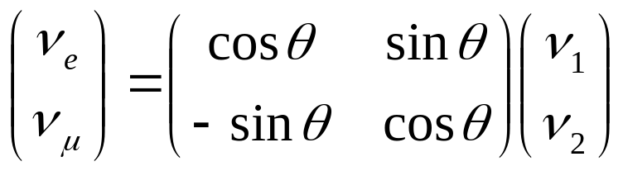
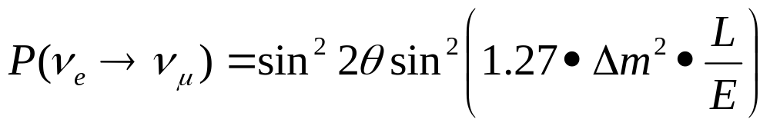

Theory of Neutrino Oscillations
Neutrinos are produced and detected as weak eigenstates (ν_{e} ,ν_{μ}, or ν_{τ} ).
These can be represented as linear combination of mass eigenstates.
If the above matrix is not diagonal and the masses are not equal, then the net weak flavor content will oscillate as the neutrinos propagate.
Example: if there is mixing between the ν_{e} and ν_{μ}:
then the probability that a ν_{e} will be detected as a ν_{μ} after a distance L is:
Flavor eigenstates
Mass eigenstates
Distance in km
Energy in GeV
Only measure magnitude of the difference of the squares of the masses.

Slide 6

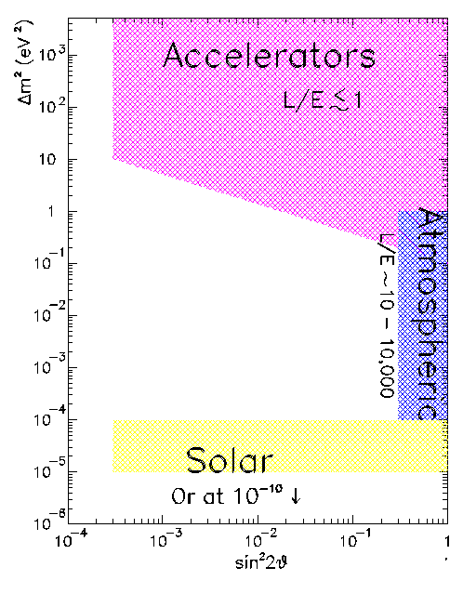
Probing Neutrino Mass Differences
Path length
Different experiments probe different ranges of
Energy
Accelerators use π decay to directly probe ν_{μ} → ν_{e}
& Reactors
Reactors use use disappearance to probe ν_{e} → ?
Cerenkov detectors directly measure ν_{μ} and ν_{e} content in atmospheric neutrinos. Fit to ν_{e}↔ν_{μ} ↔ ν_{τ} mixing hypotheses
Also probe with “long baseline” accelerator and reactor experiments
Solar neutrino experiments typically measure the disappearance of ν_{e.}

Slide 7
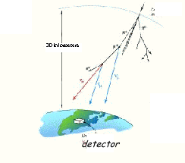
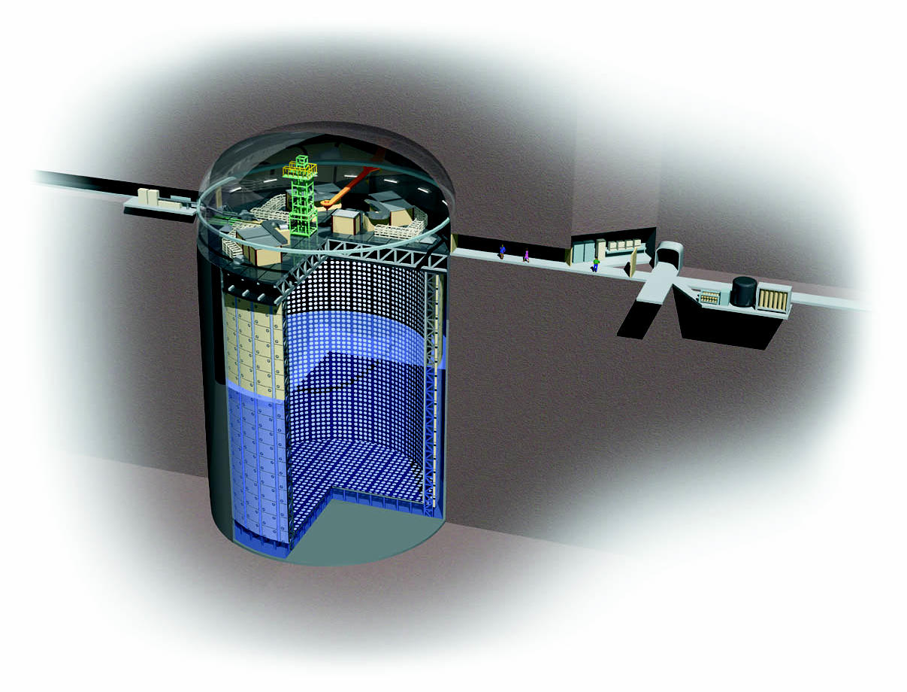
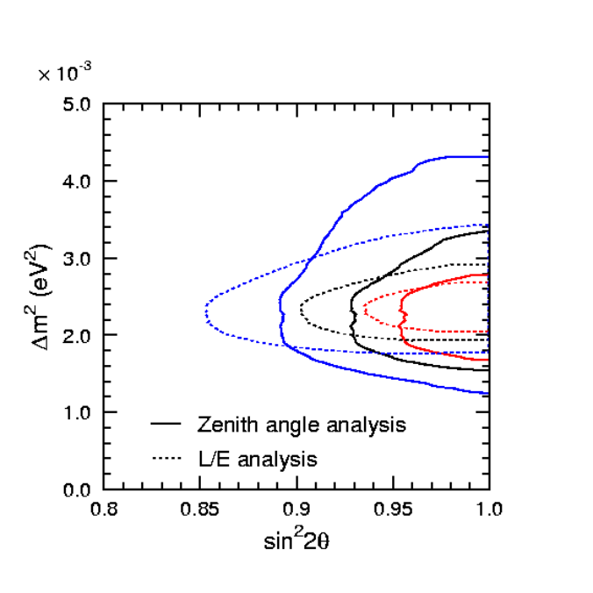
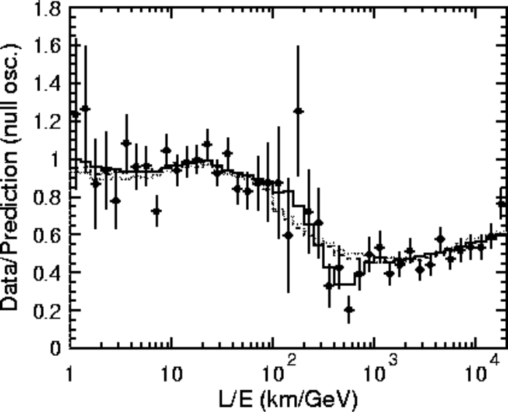
SuperKamiokande Atmospheric Result
Huge water Cerenkov detector can directly measure ν_{μ} and ν_{e} signals.
Use azimuthal dependence to measure distance traveled (through the Earth)
Positive result announced in 1998.
Consistent with ν_{μ} ↔ ν_{τ} mixing.
41.4m
39m
Inner detector
Outer detector

Slide 8
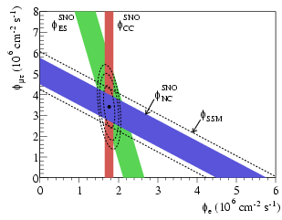
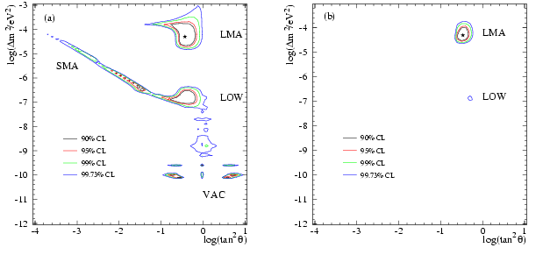
SNO Solar Neutrino Result
Looked for Cerenkov signals in a large detector filled with heavy water.
Focus on ⁸B neutrinos
Used 3 reactions:
  ν_{e}+d→p+p+e⁻: only sensitive to ν_{e}
  ν_{x}+d→p+n+ν_{x}: equally sensitive to ν_{e} ,ν_{μ} ,ν_{τ}
  ν_{x}+ e⁻→ ν_{x}+ e⁻: 6 times more sensitive to ν_{e} than ν_{μ} ,ν_{τ} d
Consistent with initial full SSM flux of ν_{e}’s mixing to ν_{μ} ,ν_{τ}
Just SNO
SNO+others

Slide 9
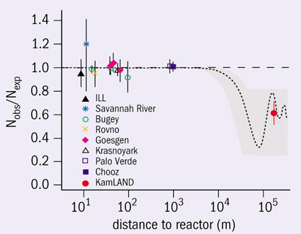
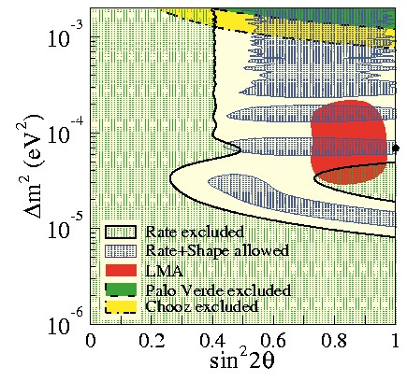
Reactor Experimental Results
Single reactor experiments (Chooz, Bugey, etc). Look for ν_{e} disappearance: all negative
KamLAND (single scintillator detector looking at ALL Japanese reactors): ν_{e} disappearance consistent with mixing.

Slide 10
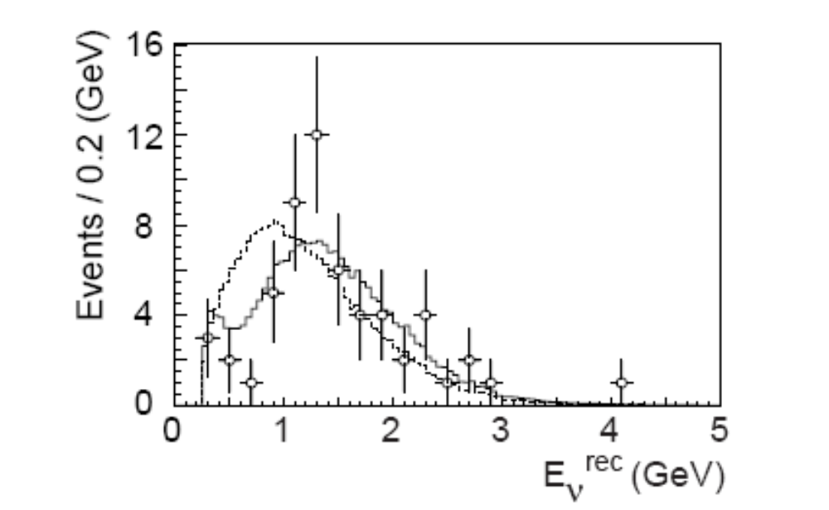
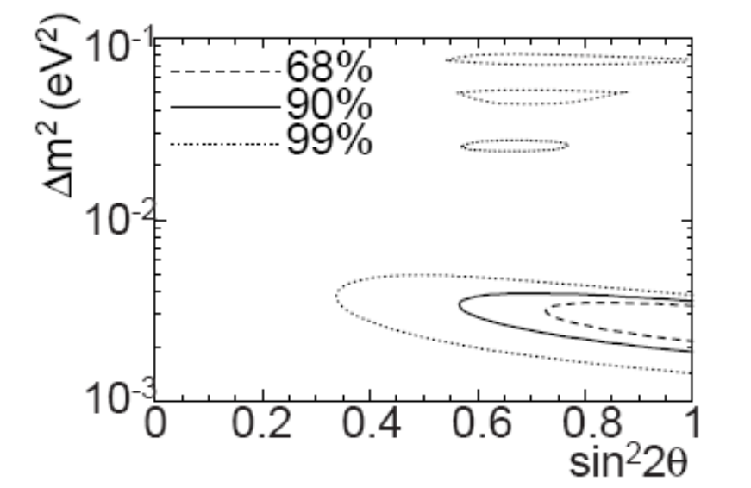
K2K
First “long baseline” accelerator experiment
  Beam from KEK PS to Kamiokande, 250 km away
  Look for ν_{μ} disappearance (atmospheric “problem”)
  Results consistent with mixing
No mixing
Allowed Mixing Region
Best fit

Slide 11
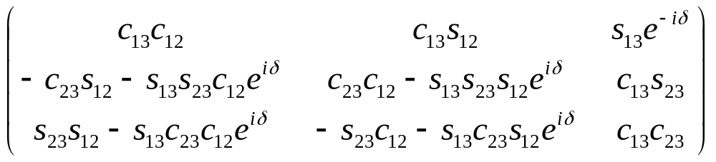
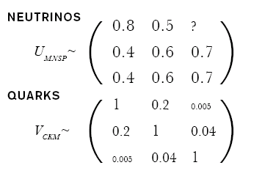
Three Generation Mixing (Driven by experiments listed)
General Mixing Parameterization
CP violating phase
Almost diagonal
Third generation weakly coupled to first two
“Wolfenstein Parameterization”
Mixing large
No easy simplification
Think of mass and weak eigenstates as totally separate

Slide 12
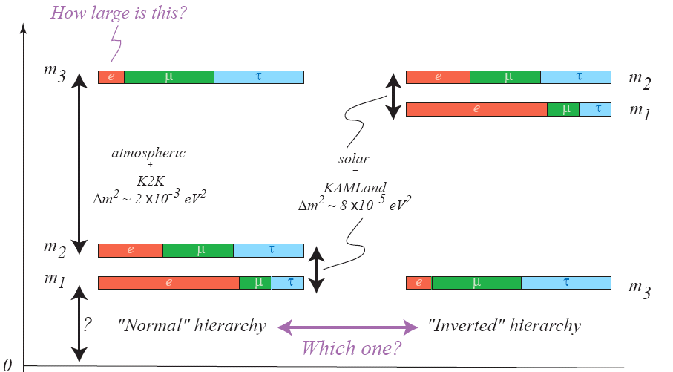
Best Three Generation Picture

Slide 13





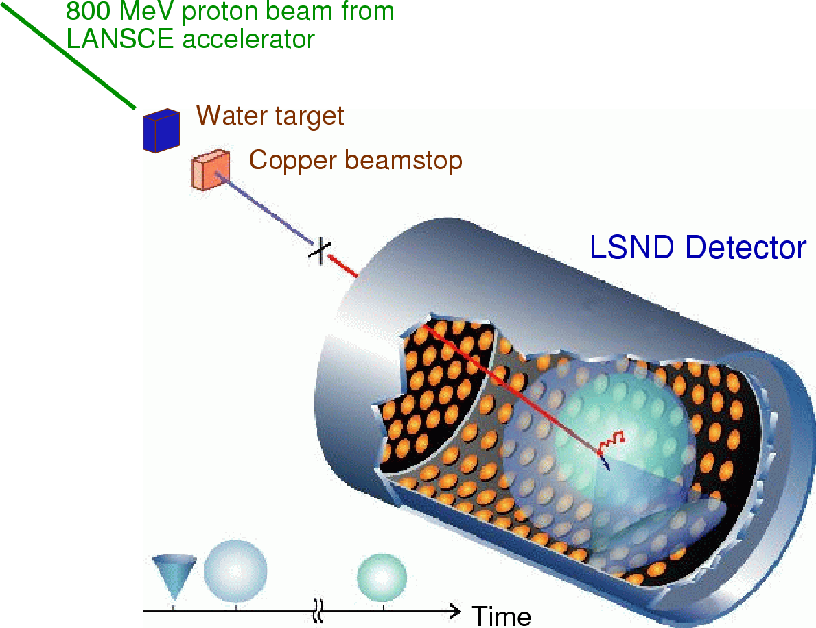

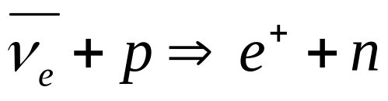
The LSND Experiment (1993-1998)
mix
~30 m
Energy
20-50 MeV
Signature
  Cerenkov ring from electron
  Delayed γ from neutron capture

Slide 14
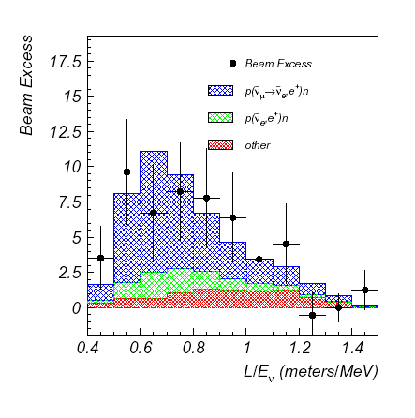
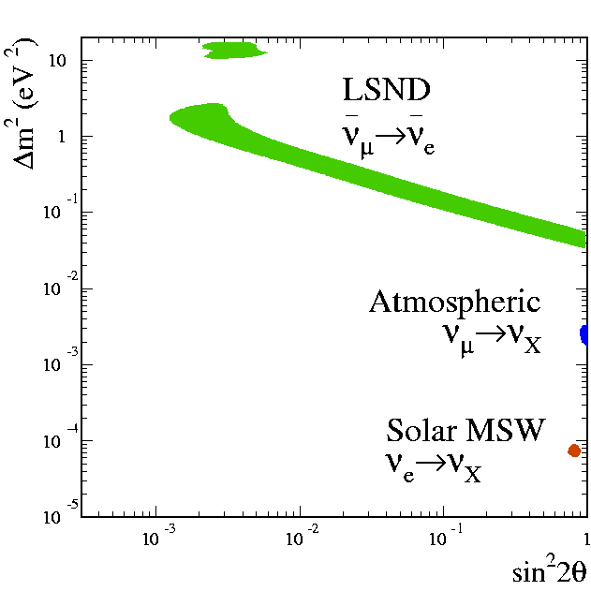
LSND Result
Excess Signal:
Best fit:
(Soudan, Kamiokande,
MACRO, Super-K)
(Homestake, SAGE,
GALLEX, Super-K
SNO, KamLAND)
Only exclusive appearance result to date
Problem: Δm² ~ 1 eV² not consistent with other results with simple three generation mixing

Slide 15
Possibilities
4 neutrinos?
  We know from Z lineshape there are only 3 active flavors
  Sterile?
CP or CPT Violation?
More exotic scenarios?
LSND Wrong?
  Can’t throw it out just because people don’t like it.

Slide 16
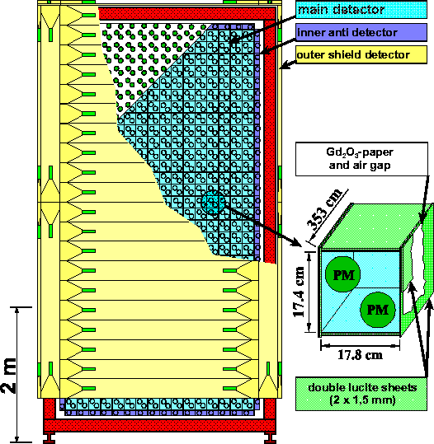
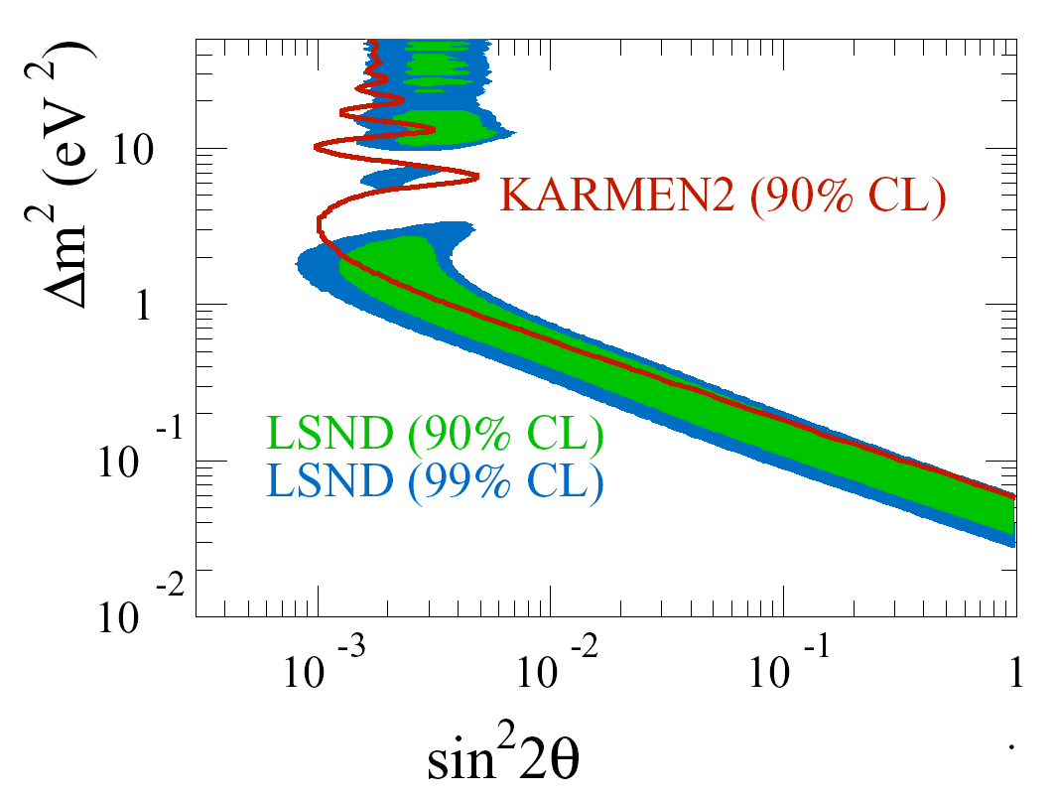
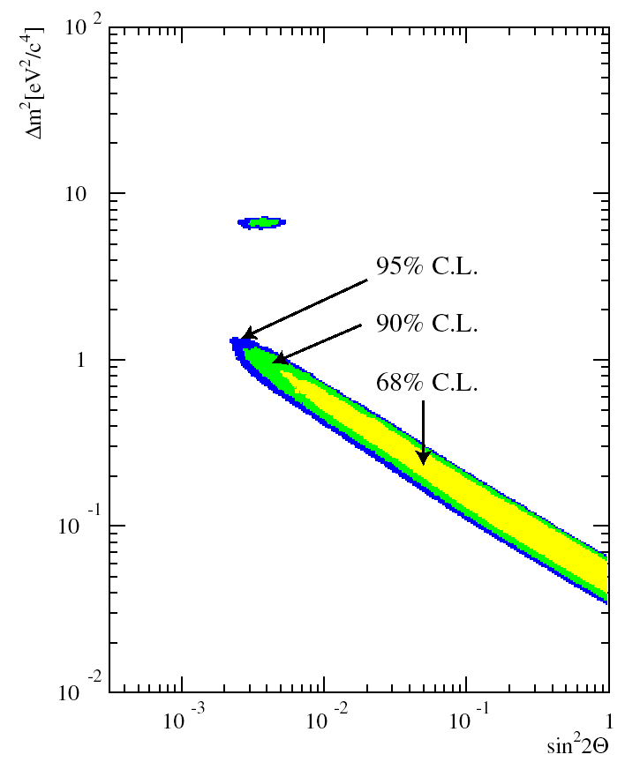
Karmen II Experiment: not quite enough
Combined
Pulse 800 MeV proton beam (ISIS)
17.6 m baseline
56 tons of liquid scintillator
Factor of 7 less statistical reach than LSND
-> NO SIGNAL
Combined analysis still leaves an allowed region

Slide 17
Role of MiniBooNE
Boo(ster) N(eutrino) E(xperiment)
  Full “BooNE” would have two detectors
Primary Motivation: Absolutely confirm or refute LSND result
  Optimized for L/E ~ 1
  Higher energy beam -> Different systematics than LSND
Timeline
  Proposed: 12/97
  Began Construction: 10/99
  Completed: 5/02
  First Beam: 8/02
  Began to run concurrently with NuMI: 3/05
  Presently ~7E20 proton on target in neutrino mode
    More protons that all other users in the 35 year history of Fermilab combined!
  Oscillation results: 2006

Slide 18
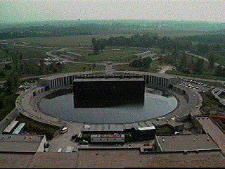
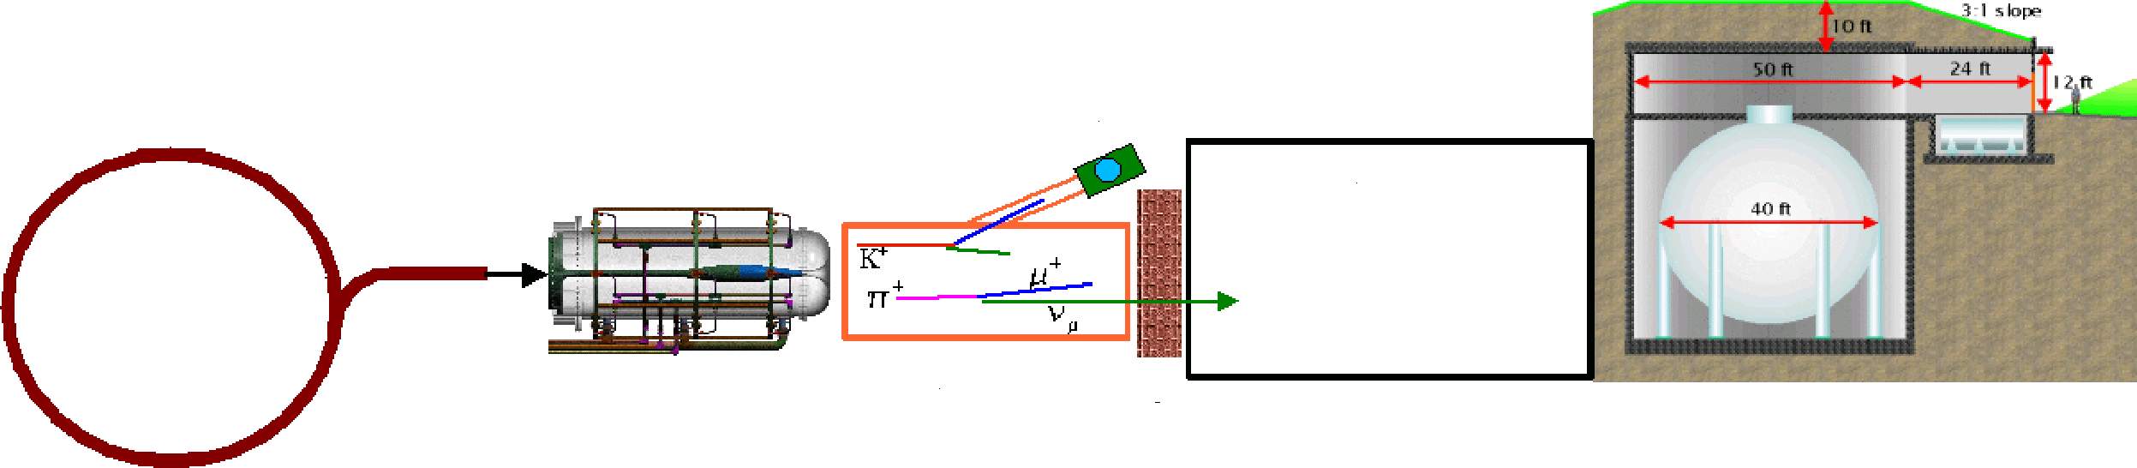
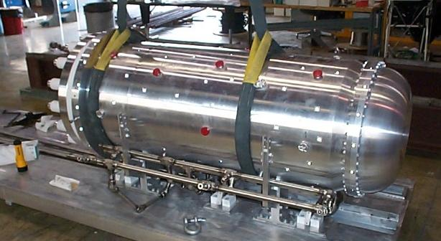
MiniBooNE Neutrino Beam (not to scale)
8 GeV Protons
  ~ 7E16 p/hr max
  ~ 1 detected neutrino/minute
  L/E ~ 1
“Little Muon Counter” (LMC): to understand K flux
FNAL
Booster
500m dirt
Be Target
and Horn
50 m Decay Region
Detector

Slide 19
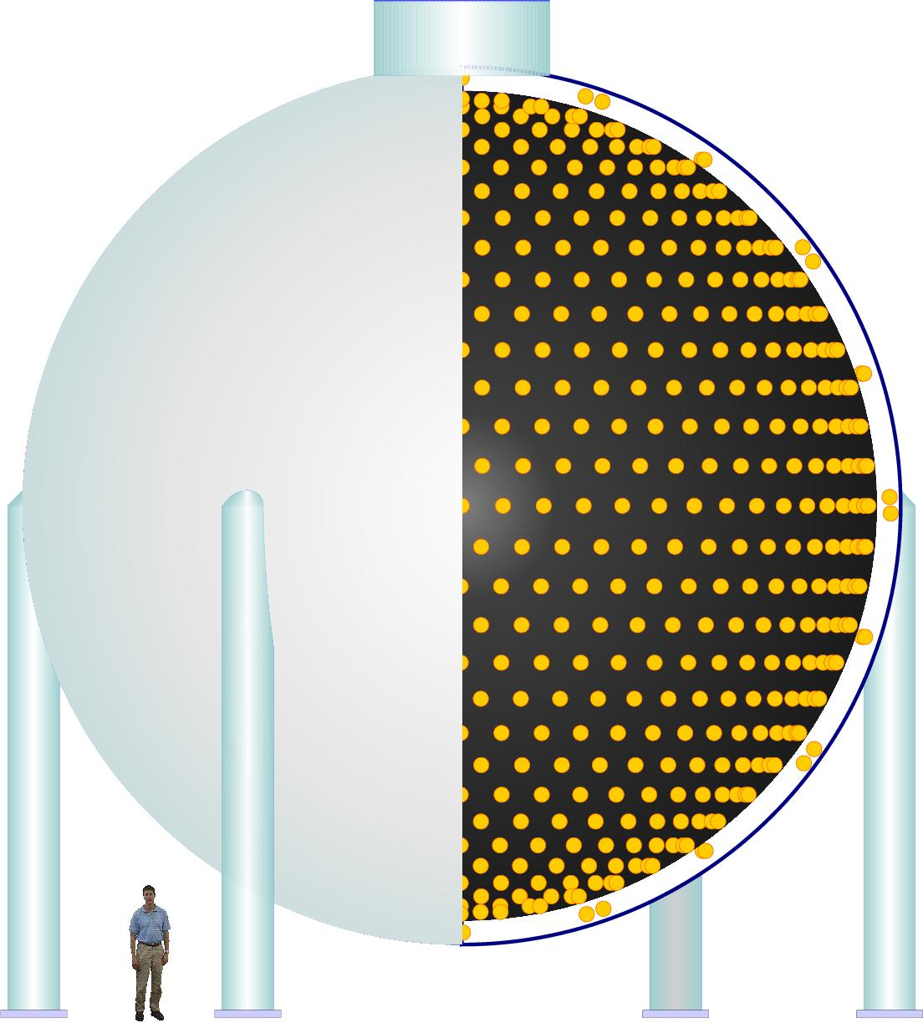
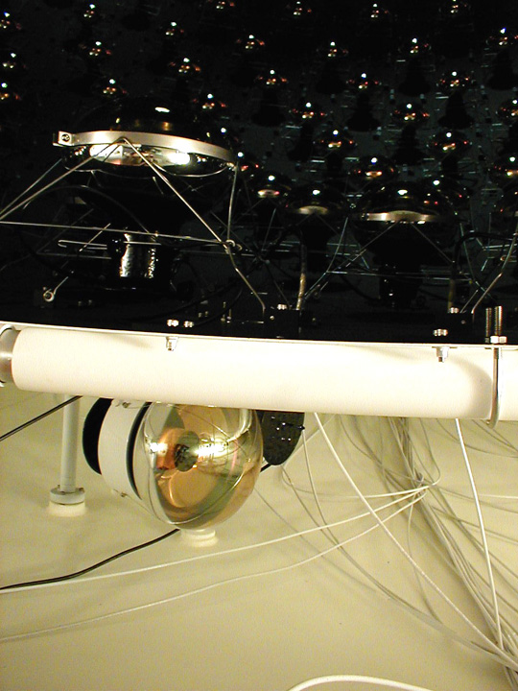
Detector
950,000 l of pure mineral oil
1280 PMT’s in inner region
240 PMT’s outer veto region
Light produced by Cerenkov radiation and scintillation
Trigger:
  All beam spills
  Cosmic ray triggers
  Laser/pulser triggers
  Supernova trigger
Light barrier

Slide 20
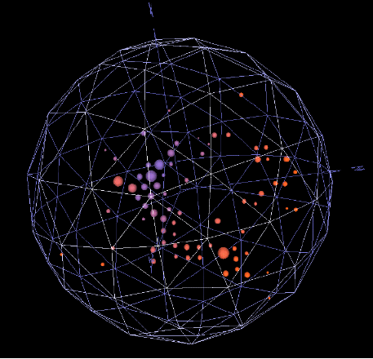
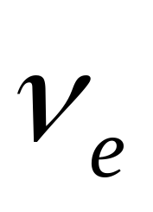
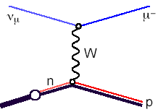
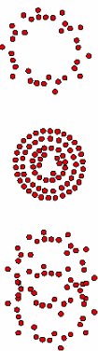

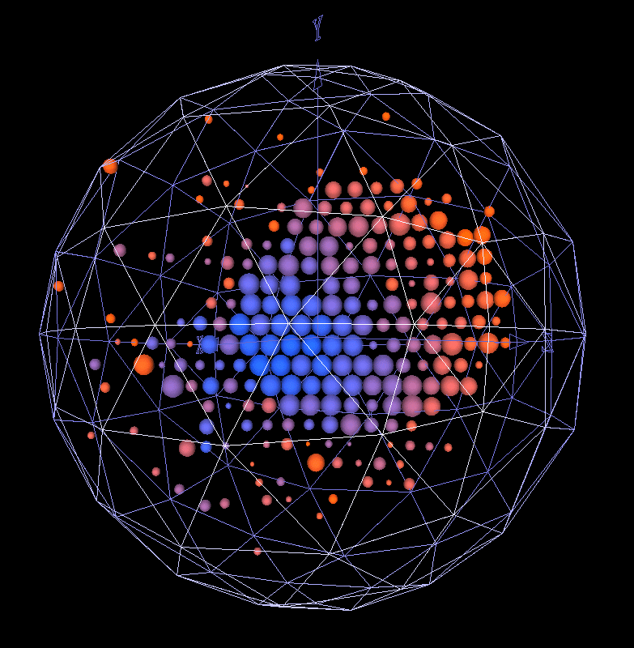
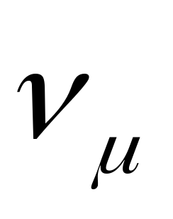
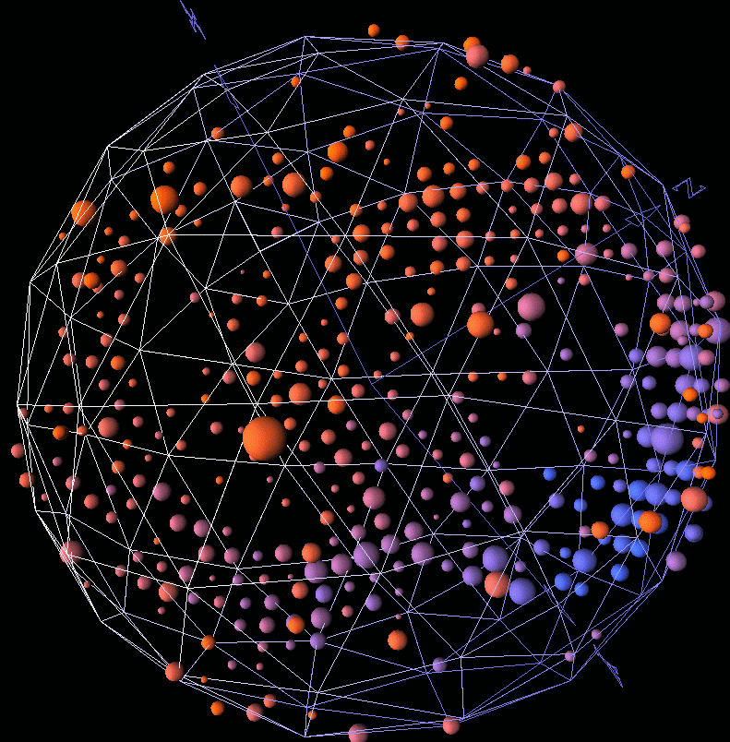
Neutrino Detection/Particle ID
ν_{e}
e⁻
W
n
p
ν_{μ}
μ⁻
W
n
p
ν_{μ}
ν_{μ}
Z
n
Δ⁰
π⁰
p
Important Background!!!

Slide 21
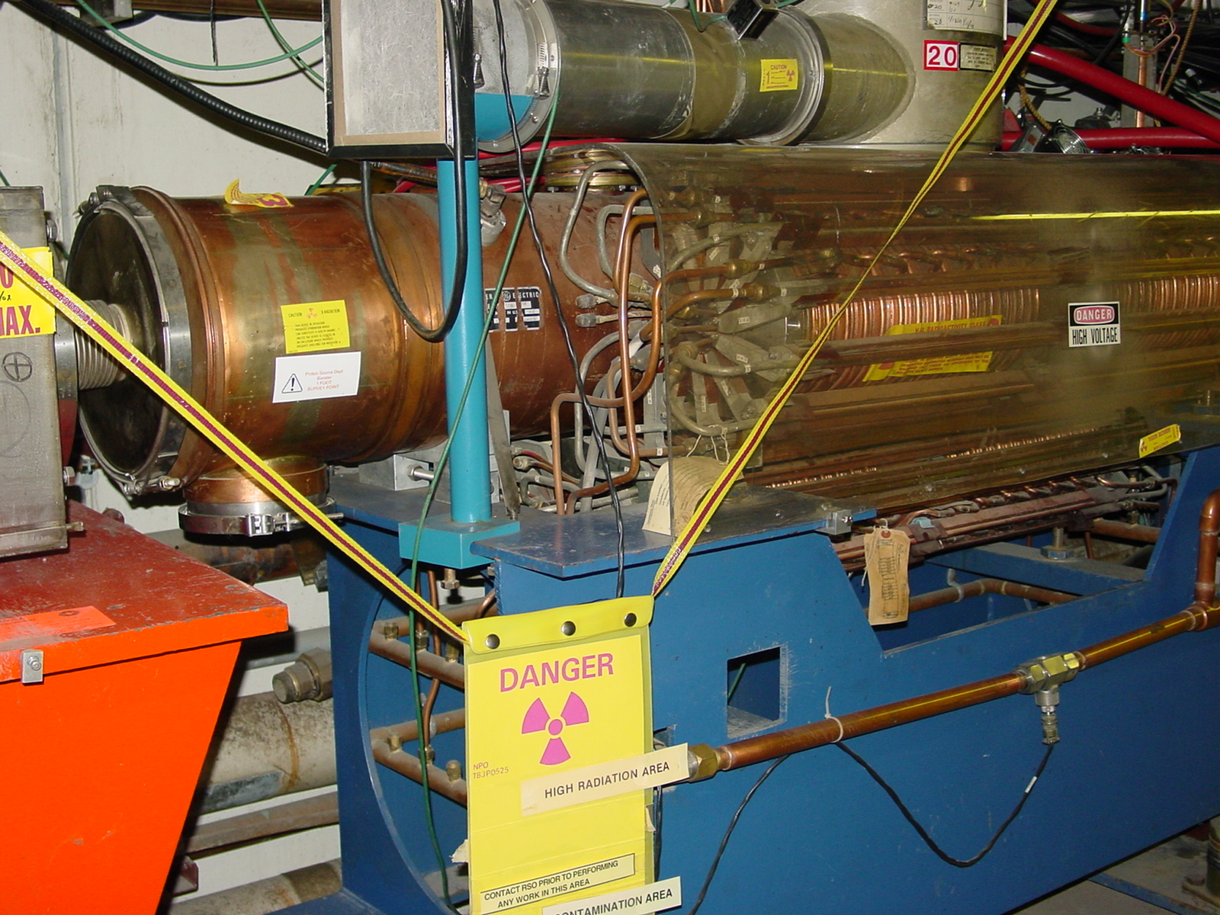
Delivering Protons
Requirements of MiniBooNE greatly exceed the historical performance of the 30+ year old 8 GeV Booster, pushes…
  Average repetition rate
  Above ground radiation
  Radiation damage and
  activation of accelerator
  components
Intense Program to improve
the Booster
  Shielding
  Loss monitoring and analysis
  Lattice improvements (result of Beam Physics involvement)
  Collimation system
Very challenging to continue to operate 8 GeV line during NuMI/MINOS operation
  Once believed imposible
  Element of lab’s “Proton Plan”
  Goal to continue to deliver roughly 2E20 protons per years to the 8 GeV program for at least the next few years.

Slide 22
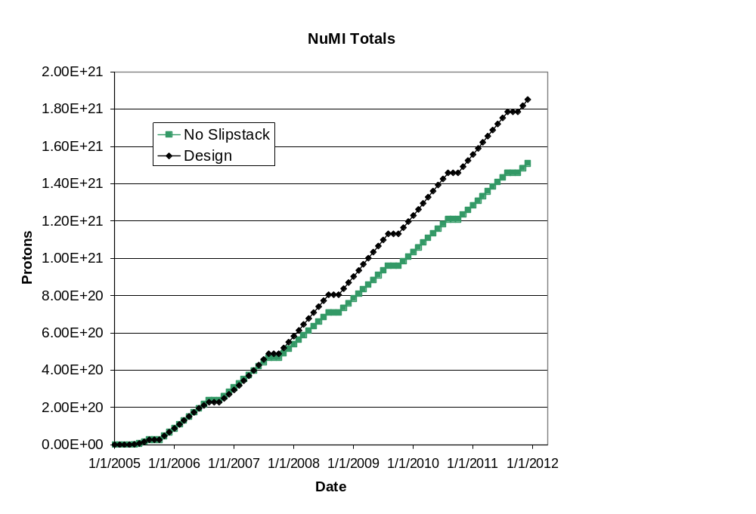
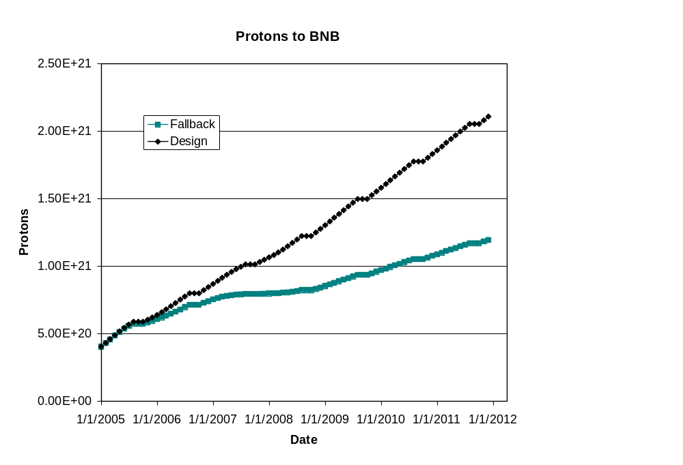
Running MiniBooNE with NuMI
NuMI/MINOS
MiniBooNE
Post Collider
Post Collider
Note: these projections do not take into account the collider turning off in 2009
  NuMI rates would go up at least 20%, possible higher
  Major operational changes could make continued operation of 8 GeV line very difficult

Slide 23
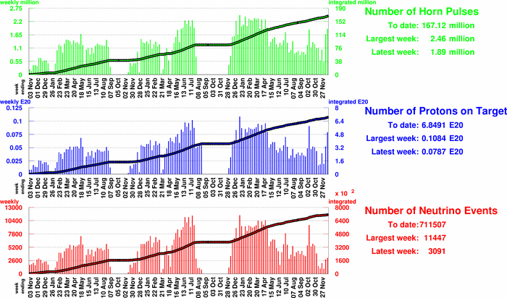
Beam to MiniBooNE
NuMI Running
NuMI Problems
~7 x 10²⁰ protons

Slide 24
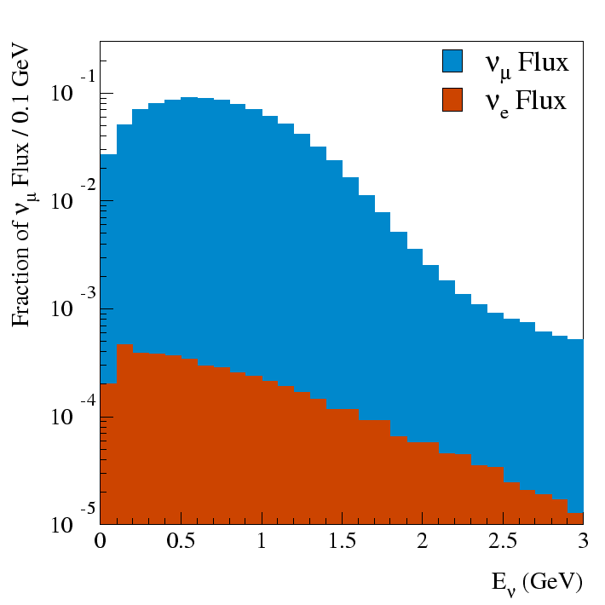
Analysis: Modeling neutrino flux
Production
  GEANT4 model of target, horn, and beamline
  MARS for protons and neutrons
  Sanford-Wang fit to production data for π and K
  Mesons allowed to decay in model of decay pipe.
  Retain neutrinos which point at target
  Soon hope to improve model with data from the HARP experiment taken from a target identical to MiniBooNE

Slide 25
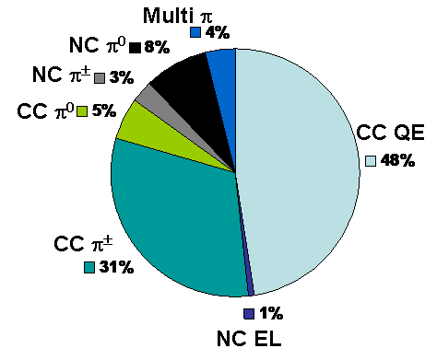
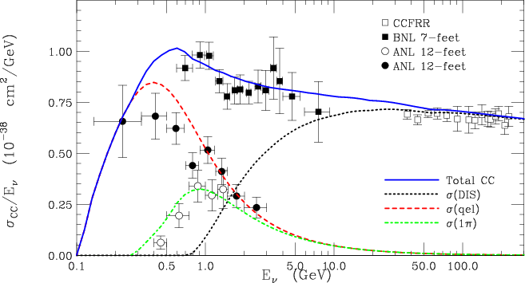
ν_{μ} Interactions
Cross sections
  Based on NUANCE 3 Monte Carlo
    Use NEUT and NEUEN as cross checks
  Theoretical input:
    Llewellyn-Smith free nucleon cross sections
    Rein-Sehgal resonant and coherent cross-sections
    Bodek-Yang DIS at low-Q2
    Standard DIS parametrization at high Q2
    Fermi-gas model
    Final state interaction model
Detector
  Full GEANT 3.21 model of detector
  Includes detailed optical model of oil
  Reduced to raw PMT hits and analyzed in the same way as real data
MiniBooNE

Slide 26
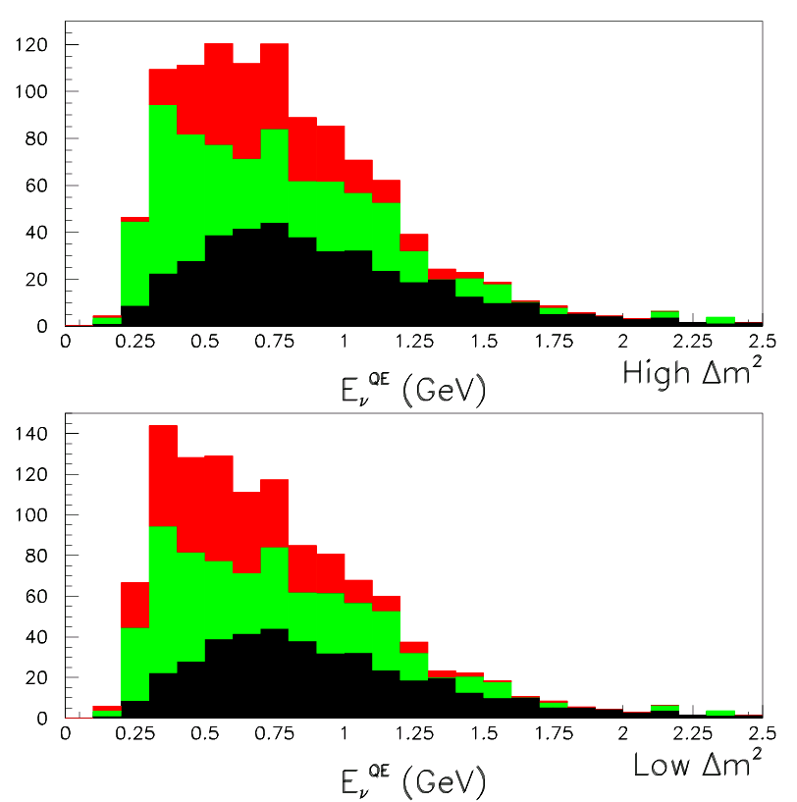
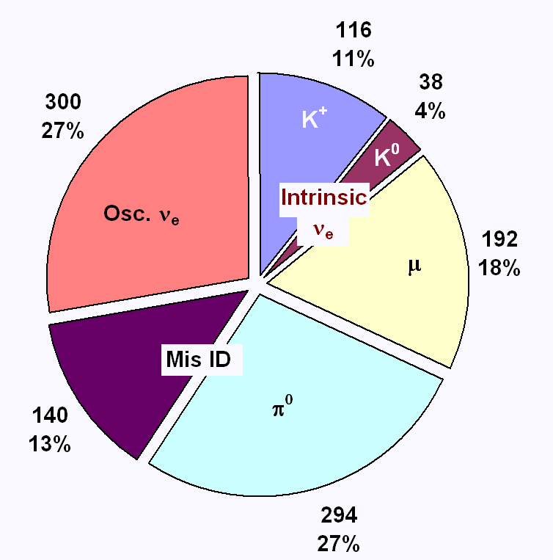
Background
If the LSND best fit is accurate, only about a third of our observed rate will come from oscillations
Backgrounds come from both intrinsic ν_{e} and misidentified ν_{μ}
Signal
Mis ID
Intrinsic ν_{e}
Energy distribution can help separate

Slide 27
Blindness
Given the low signal to background ratio and the inherent difficulty of the analysis, there are many opportunities for unintentional bias
Therefore, we consider a blind analysis essential
General philosophy: guilty until proven innocent
Events go “into the box” unless they are specifically tagged as being non-signal events, e.g
  Muons
    Single μ-like ring
    Topological cuts
  π⁰
    No Michel electron
    Clear two-ring fit, both with E>40 MeV
Will only look at remaining data when we are confident that we model the beam and detector well.
Note: This still allows us to look at the majority of our data!

Slide 28
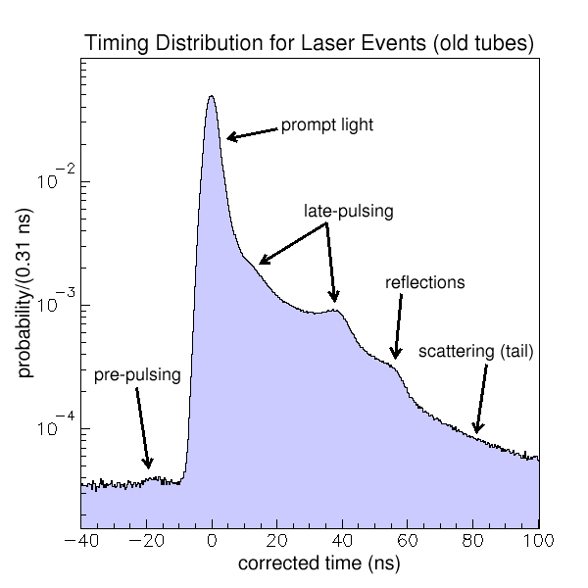
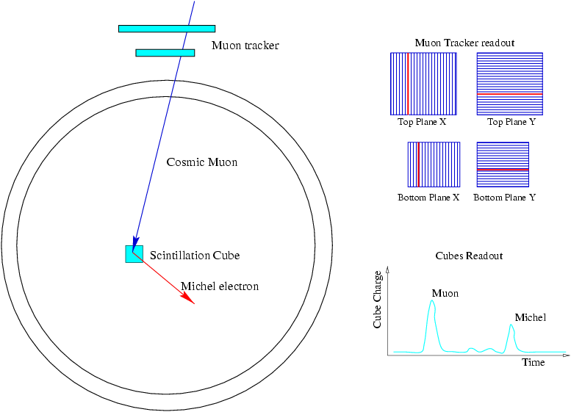
Characterizing the Detector
Laser Calibration
  Laser pulses illuminate one of 4 flasks which scatter light isotropically
  Used to understand PMT response
Cosmic Muons
  Muon Tracker used in conjunction with “cubes” to trigger on a particular endpoint (energy)
  Vital in understanding energy scale

Slide 29
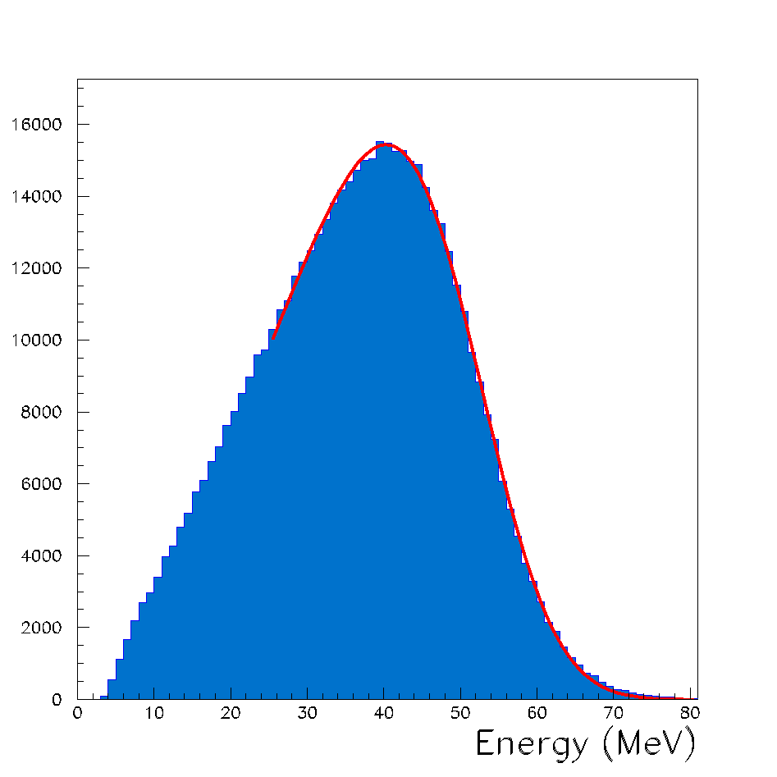
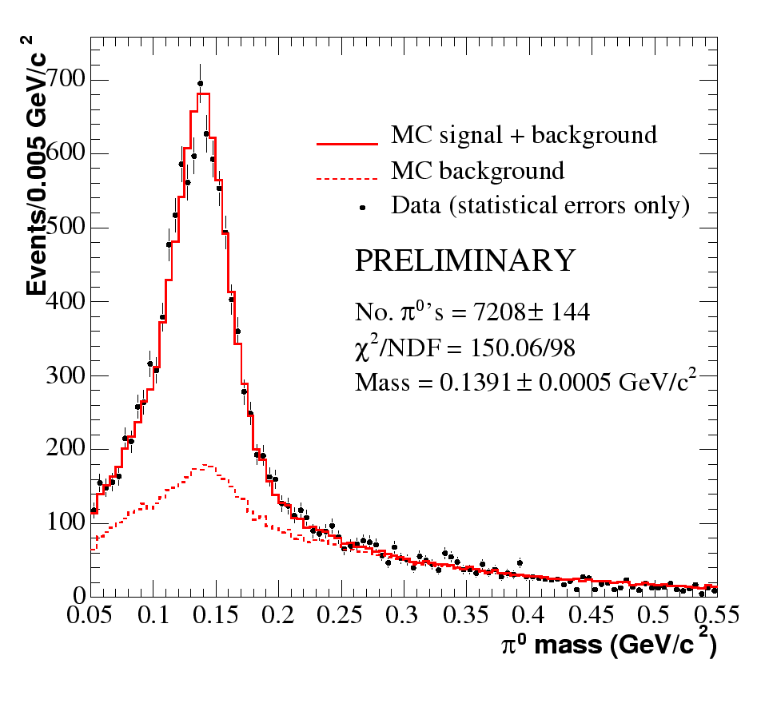
The Detector (cont’d)
Electrons from muon decay (Michel electrons)
  Vital for understanding signal events.
π⁰ Events
  Help to understand higher energy ν_{e}
  Help fix energy scale

Slide 30
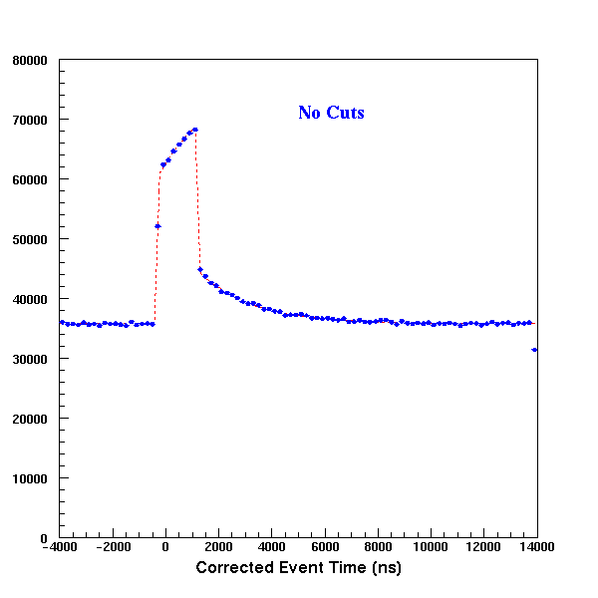
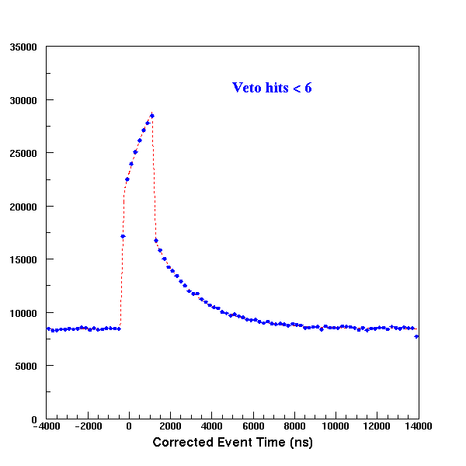

Selecting Neutrino Events
Collect data from -5 to +15 usec around each beam spill trigger.
Identify individual “events” within this window based on PMT hits clustered in time.
No cuts
Veto hits < 6
Veto hits<6
tank hits>200
1600 ns spill
Time (ns)
Time (ns)
Time (ns)

Slide 31

Muon Reconstruction
Muon reconstruction is based on a fit to PMT’s clustered in time
Position and time of arrival are used to reconstuct the origin, direction and path length of the muon track segment
Cos of angle of PMT hits relative to beam

Slide 32






Charged Current Quasi-elastic Events
Veto hits < 6
Tank hits > 200
PMT position/time fit consistent with muon

Slide 33



Recent Results: (CCPiP)*
MiniBooNE
Important for understanding backgrounds and nuclear cross sections.
*analysis by M. Wascko and J. Monroe

Slide 34





Signature of CCPiP Event
(only charged tracks shown)
Muon generates Cerenkov ring and stops
Muon decay (“Michel”) electrons
Look for exactly three events:
  First promptly with the beam
  Second two within the ~15 usec trigger window
First event consistent with CC muon
Second two consistent with Michel decays.

Slide 35



CCPiP Results
CCPiP/CCQE ratio
Corrected for efficiencies

Slide 36




Additional Cross-checks: Neutrinos from NuMI beamline*
NuMI decay pipe extends to almost just below the MiniBooNE detector
*primarily analysis of A. Aguilar

Slide 37
Path to “opening the box”
Our present sample neutrino data is sufficient to release an oscillation result
  We are not yet confident enough in our analysis to do so
Continue to refine Monte Carlo until open box samples agree within errors
  HARP data on MiniBooNE target an important constraint
Generate systematic error matrix by varying all important production and optical model parameters (“Unisim Monte Carlo”).
When confident, practice on a fake oscillation signal.

Slide 38


Experimental Sensitivity
No signal
  Can exclude most of LSND at 5σ
Signal
  Can achieve good Δm² separation

Slide 39


Accommodating a Positive Signal
We know from LEP that there are only 3 active, light neutrino flavors.
If MiniBooNE confirms the LSND results, it might be evidence for the existence of sterile neutrinos

Slide 40
Everybody Loves a Mystery
3+2 Sterile neutrinos
  Sorel, Conrad, and Shaevitz (hep-ph/0305255)
MaVaN & 3+1
  Hung (hep-ph/0010126)
Sterile neutrinos
  Kaplan, Nelson, and Weiner (hep-ph/0401099)
    Explain Dark Energy?
CPT violation and 3+1 neutrinos
  Barger, Marfatia & Whisnant (hep-ph/0308299)
    Explain matter/antimatter asymmetry
Lorentz Violation
  Kostelecky & Mewes (hep-ph/0406035)
Extra Dimensions
  Pas, Pakvasa, & Weiler (hep-ph/0504096)
Sterile Neutrino Decay
  Palomares-Ruiz, Pascoli & Schwetz (hep-ph/0505216)

Slide 41

Near Future: MiniBooNE antineutrino running
As we speak, MiniBooNE is switching the horn polarity to run in antineutrino mode
Example of new physics:
Inherently interesting
  Not much anti-neutrino data
Directly address LSND signal
Important for understanding our own systematics and those of other experiments
Problems:
  Cross section not well known
  Lower rate (about ¼)
  Wrong sign background

Slide 42
Conclusions and Outlook
MiniBooNE has been running for over three years, and continues to run well in the NuMI era
The analysis tools are well developed and being refined to achieve the quality necessary to release the result of our blind analysis
Recent results for CCQE and CCPiP give us confidence on our understanding of the detector and data.
Look forward to many interesting results in 2006

Slide 43
Backup Slides

Slide 44

Sterile Neutrinos: Astrophysics Constraints (courtesy M. Shaevitz)
Constraints on the number of neutrinos from BBN and CMB
  Standard model gives N_{ν}=2.6±0.4 constraint
  If ⁴He systematics larger, then N_{ν}=4.0±2.5
  If neutrino lepton asymmetry or non-equilibrium, then the BBN limit can be evaded.
  K. Abazajian hep-ph/0307266
  G. Steigman hep-ph/0309347
  “One result of this is that the LSND result is not yet ruled out by cosmological observations.” Hannestad astro-ph/0303076
Bounds on the neutrino masses also depend on the number of neutrinos (active and sterile)
  Allowed Σm_{i} is 1.4 (2.5) eV
  4 (5) neutrinos
N_{ν}=3 solid
4 dotted
5 dashed
0.00 0.005 0.01 0.015 0.02 0.025 0.03
Hannestad astro-ph/0303076

