Slide 1

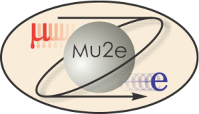
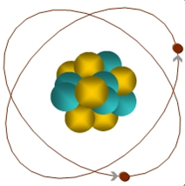
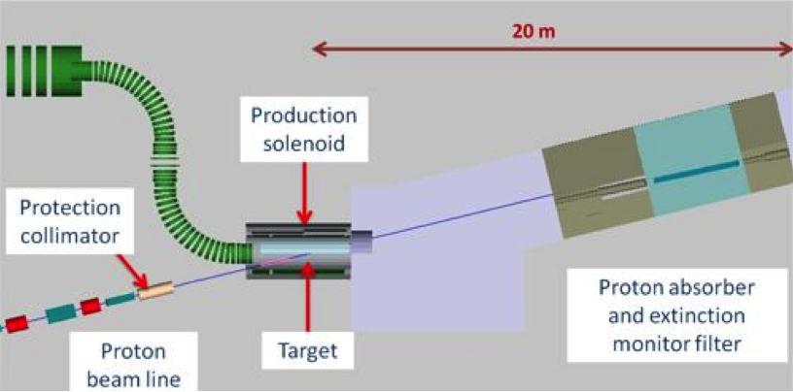
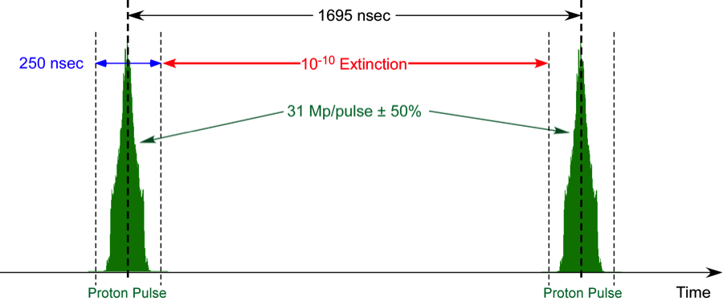
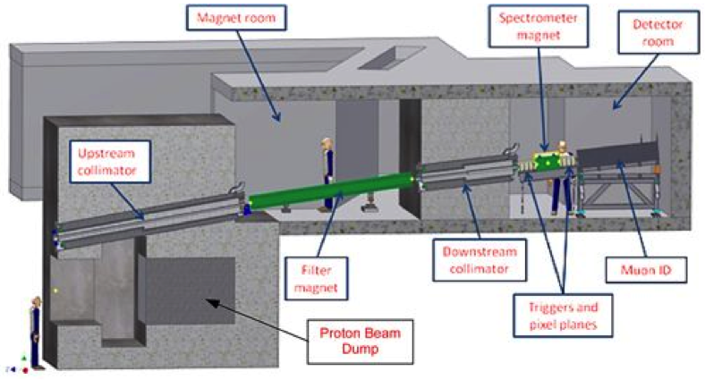
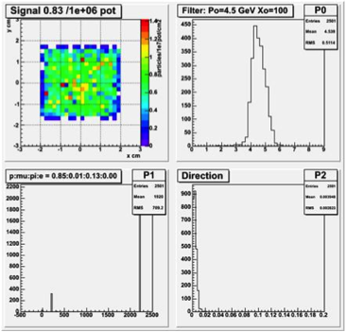
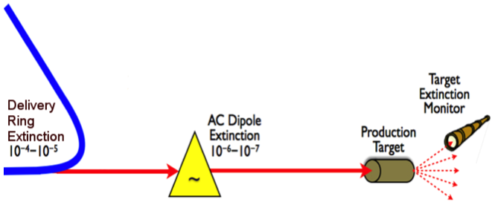
Extinction Monitoring in the Mu2e Experiment
E.J. Prebys, A. Gaponenko, P. Kasper, Fermilab, Batavia, IL 60510, L. Bartoszek, Bartoszek Engineering
ABSTRACT
The Mu2e Experiment at Fermilab will search for the conversion of a muon to an electron in the field of an atomic nucleus with unprecedented sensitivity. The experiment requires a beam consisting of proton bunches of 250 ns FW, separated by 1.7 μsec, with no out-of-time protons at the 10⁻¹⁰ fractional level. The verification of this level of extinction is very challenging. The proposed technique uses a special purpose spectrometer, which will observe particles scattered from the production target of the experiment. The acceptance will be limited such that there will be no saturation effects from the in-time beam. The precise level and profile of the out-of-time beam can then be built up statistically, by integrating over many bunches.
Motivation
Location and Design
Detector
The Mu2e experiment has been proposed at Fermilab to search for the conversion into an electron of a muon which has been captured by a nucleus.
The muon can decay via the exchange of a virtual particle with the nucleus, resulting in a two body decay.
This produces the striking experimental signature of a mono-energetic electron, carrying most of energy associated with the muon's rest mass.
Occurs in the standard model via virtual neutrino mixing at a rate of 10⁻⁵⁴ (out reach of any presently conceivable experiment)
Experiment aims to measure with a sensitivity of 10⁻¹⁶
An improvement of four orders of magnitude over previous experiments.
Sensitive to a broad range of new physics.
In the Mu2e experiment, 8 GeV protons strike a Tunsten target inside a superconducting solenoidal magnet.
The experiment uses low energy, back-scattered pions, which decay to muons.
Forward particles and non-interacting protons go into a dump, and the Extinction Monitor is integrated into its shielding.
The key feature of the design is the selection channel, consisting of collimation and a momentum selection magnet.
The design has been optimized for particles in the 4-5 GeV/c momentum range
Low rates
High confidence in the predictions of the models.
The entrance collimator has a 50 mm aperture, and must otherwise maintain the integrity of the shielding.
The concrete of the shielding will contain a roughly aligned channel.
The entrance collimator will be inserted into this channel from downstream.
Upstream and downstream alignment hardware will allow this channel to be precisely aligned with the production target.
Once it has been aligned, the space between the inner and outer channel will be filled with steel shot, thereby completing the shielding.
A set of eight pixel planes will be arranged four upstream and four downstream of a .5 m .14 T permanent magnet.
These utilize pixels developed for the ATLAS experiment at CERN.
Upstream planes will have two sensors, and downstream planes will have three sensors, each of which is 80 columns with 250 mm pitch by 336 rows with 50 mm pitch. These are bump-bonded to FE-14 readout chips.
A muon range stack has been added to the end of the spectrometer.
It consists of steel plates interleaved with four scintillator planes.
Out-of-time beam striking the target should have a very low muon content.
If a high rate of out of time tracks are observed, the muon range stack could be used to determine if they originate from other sources upstream.
A system of six scintillator planes will be used to trigger the readout.
Because we expect many tracks from each in-time bunch, these will be pre-scaled by a factor on the order of ten, to reduce data volume and bandwidth.
μ
105 MeV e⁻
A key component of the experimental technique is the proton beam structure.
The beam consists of short (250 ns FW) proton bunches with 8 GeV kinetic energy.
These produce pions that decay to muons, which are in turn transported and captured on a nuclear target.
The proton bunches are separated by approximately 1.7 μsec.
During this time, the captured muons either decay normally or potentially convert into electrons.
The experimental search takes place in this time between the bunches.
Verifying that this level of extinction has been achieved will be very challenging.
Experimental requirements specify that the extinction must be continuously monitored and verified to be below the 10⁻¹⁰ level (90% C.L. ) within a few hours at nominal beam intensity.
Performance
A GEANT4-based simulation was performed of the production target, solenoid, selection channel, and spectrometer.
The acceptance was found to be 8.3x10⁻⁷ per proton on target, or 25 tracks per nominal bunch.
Tracking was found to be efficient up to over 100 tracks, so saturation is not an issue.
With 10⁻¹⁰ extinction, this would correspond to one detected out-of-time track every protons, or about every half hour of running at nominal beam intensity.
Backgrounds were evaluated for cosmic rays, as well as fake tracks from neutrons and electronic noise, and found to be negligible at this level.
Technique
At nominal intensity, each Mu2e bunch has roughly 3x10⁷ protons, so our extinction requirement corresponds to less than one out-of-time particle every 300 bunches.
Observing single particles in the presence of the much larger in-time-bunches is not practical with currently available beam instrumentation.
For this reason, we instead focus on a statistical method, in which a spectrometer monitors particles scattered from the pion production target.
The acceptance of the spectrometer is limited, such that it is not saturated by scattered tracks from the in-time bunches.
A small fraction of out-ot-time particles will then be detected, and an accurate time profile of in- and out-of-time particles can be built up by integrating over many bunches.
The sensitivity is limited by the available integration time, and the rate of fake background tracks.
The goal is not to veto individual events, but rather to verify that the total rate of out-of-time particles is below 10⁻¹⁰.
Status and Plans
Mu2e has been granted CD-2 approval by the DOE
Preparing for CD-3 review in early 2016
Civil construction and magnet fabrication have begun.
Planning for beam in early 2020s
Related Poster
E. Prebys, et al, “Out-of-Time Beam Extinction in the Mu2e Experiment” (THPF121)
Work supported under DOE contract DE-AC02-07CH11359

