Slide 1

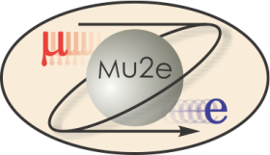
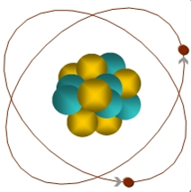
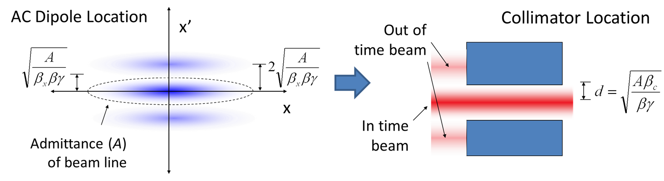
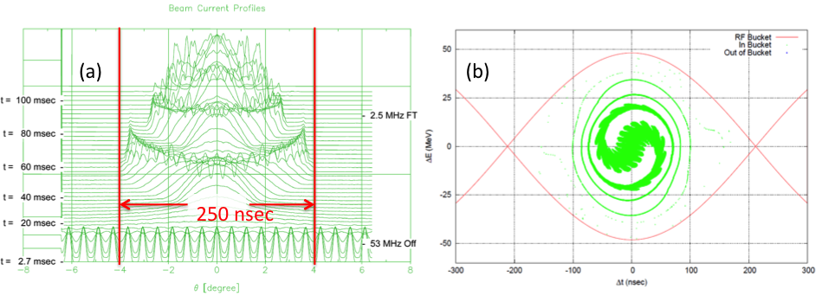
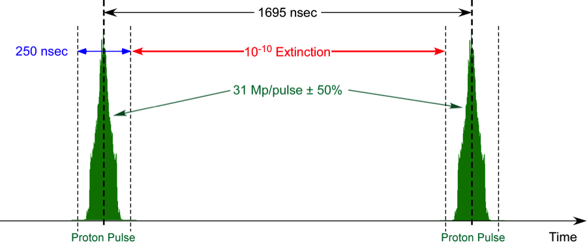
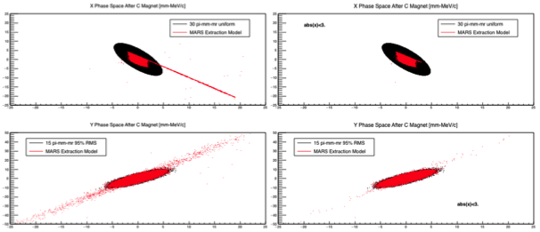
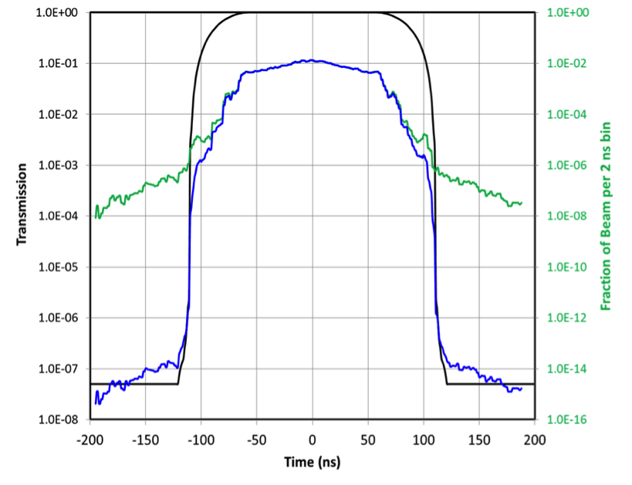
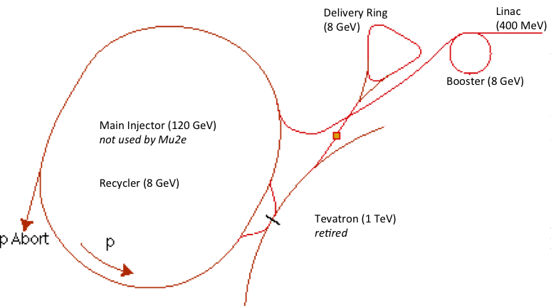
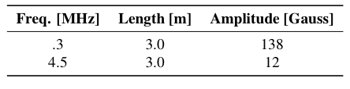
Out-of-Time Beam Extinction in the Mu2e Experiment
E.J. Prebys and S. Werkema, Fermilab, Batavia, IL 60510
ABSTRACT
The Mu2e Experiment at Fermilab will search for the conversion of a muon to an electron in the field of an atomic nucleus with unprecedented sensitivity. The experiment requires a beam consisting of proton bunches 250 ns FW long, separated by 1.7 μsec, with no out-of-time protons at the 10⁻¹⁰ fractional level. Satisfying this "extinction" requirement is very challenging. The formation of the bunches is expected to result in an extinction on the order of 10⁻⁵. The remaining extinction will be accomplished by a system of resonant magnets and collimators, configured such that only in-time beam is delivered to the experiment. Our simulations show that the total extinction achievable by the system is on the order of 10⁻¹², with an efficiency for transmitting in-time beam of 99.6%.
Motivation
Beam Line Extinction
Simulation
The Mu2e experiment has been proposed at Fermilab to search for the conversion into an electron of a muon which has been captured by a nucleus.
The muon can decay via the exchange of a virtual particle with the nucleus, resulting in a two body decay.
This produces the striking experimental signature of a mono-energetic electron, carrying most of energy associated with the muon's rest mass.
Occurs in the standard model via virtual neutrino mixing at a rate of 10⁻⁵⁴ (out reach of any presently conceivable experiment)
Experiment aims to measure with a sensitivity of 10⁻¹⁶
An improvement of four orders of magnitude over previous experiments.
Sensitive to a broad range of new physics.
A magnet (or set of magnets) will deflect the out-of-time beam.
A collimator will be placed in the beam line so that only in time beam will be transmitted.
An ESME Simulation was done for bunch formation in the Recycler and in the Delivery Ring.
μ
105 MeV e⁻
The magnet produces a shift in phase space, corresponding to a lateral deflection 90° later in phase advance, where a collimator is located.
If the admittance A of the collimator is matched to the maximum bounding emittance of the beam, we can define a normalized deflection angle:
such that
Total fraction outside of ±125 ns: 2.1x10⁻⁵
A model of beam line built with G4Beamline (scripting tool for GEANT4)
Simulated performance downstream of the AC Dipole for core of beam using
x (bend) plane: uniform normalized emittance of 30 μm
y plane: Guassian normalized emittance of 2.5 μm
Simulated entire beam line for high amplitude tails, based on MARS simulation of slow extraction
Measured transmission as a function of normalized deflection angle (up to 10⁸ initial particles per point)
Extinction Angle
Center of beam at edge of collimator
100% of beam hits collimator
A key component of the experimental technique is the proton beam structure.
The beam consists of short (250 ns FW) proton bunches with 8 GeV kinetic energy.
These produce muons, which are in turn transported and captured on a nuclear target.
The proton bunches are separated by approximately 1.7 μsec.
During this time, the captured muons either decay normally or potentially convert into electrons.
The experimental search takes place in this time between the bunches.
Most of the experimental backgrounds are prompt with respect to the muon production, transport and capture.
Very important that beam between the bunches is suppressed to the 10⁻¹⁰ level or less.
Bunch production should produce extinction at the 10⁻⁵ level.
Active suppression in the beam line should produce an additional 10⁻⁷ suppression1.
To limit radiation damage and activation, less than 1% of in-time beam should be lost.
Beam Line Optics
The stored energy in the AC dipole magnets is minimized by going to long, low field magnets, located in regions with a waist in the non-bend plane and the highest possible betatron function in the bend plane.
For our beam line, the highest β and longest reasonable length were found to be 250 m and 6 m, respectively, leading to the following design in the collimation region.
90°
Admittance: 50 μm
β_{col}: 3.15 m
half-gap: 4.1 mm
Jaw: Tungsten
Results
Bunch Formation
Convoluted transmission function with optimized AC dipole waveform to obtain transmission vs. time.
Convoluted this with simulated bunch distribution to obtain in and out of time transmission.
AC Dipole Waveforms
The AC Dipole system uses two harmonics
300 kHz (half bunch frequency) to sweep out-of-time beam into collimators
4.5 MHz (15th harmonic): to reduce slewing of in-time beam to maximize transmission
Magnets consist of 6 identical 1 m segments, with three for each frequency, running at the following peak fields, which were optimized for transmission of in-time beam
Fraction outside of ±125 ns: 10⁻¹²
Efficiency for in-time beam: 99.6%
➔Meets Mu2e Requirements
Status and Plans
Mu2e has been granted CD-2 approval by the DOE
Preparing for CD-3 review in early 2016
Civil construction and magnet fabrication have begun.
Planning for beam in early 2020s
8 GeV beam from the Fermilab Booster is injected in the Recycler (8 GeV storage ring made with permanent magnets).
A 2.5 MHz RF system rebunches it.
These bunches are transferred one at a time to the 8 GeV “Delivery Ring” (formerly the Antiproton Debuncher).
From the Delivery ring, the beam is resonantly extracted.
The 1.7 μsec period of the Delivery ring gives the beam the required structure.
Related Poster
E. Prebys, et al, “Extinction Monitoring in the Mu2e Experiment” (MOPWI017)
Work supported under DOE contract DE-AC02-07CH11359

