Slide 1


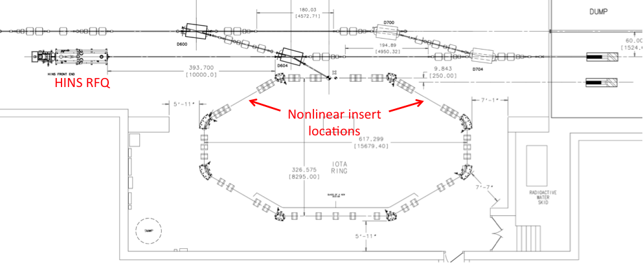
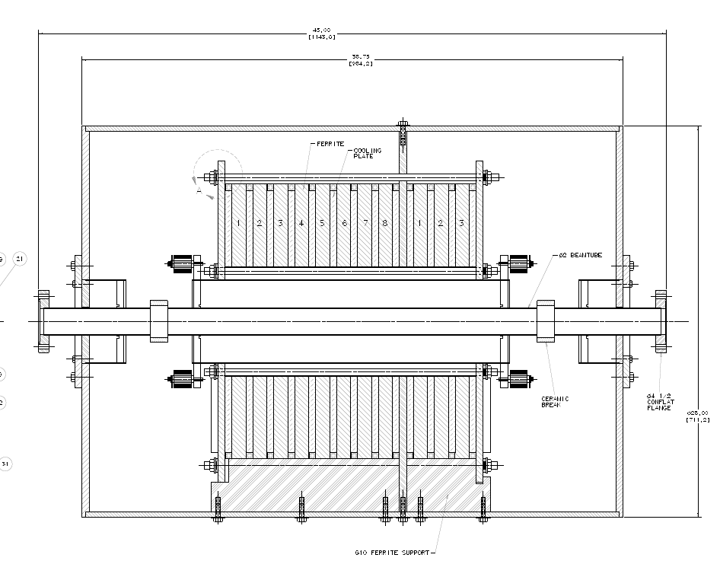
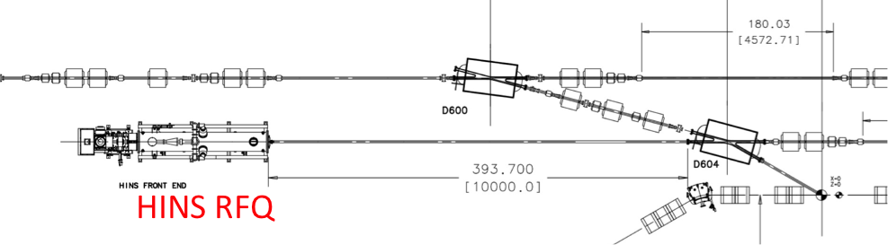
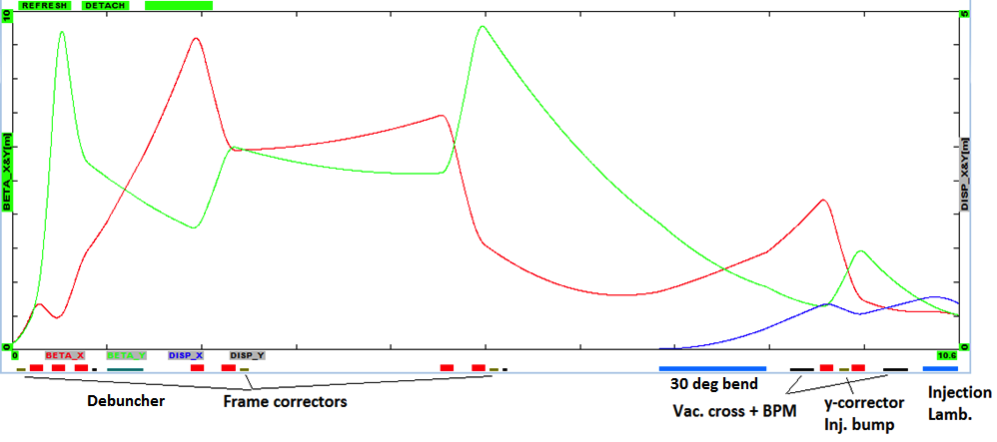
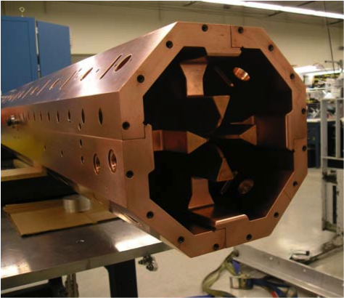
Proton Injection into the Integrable Optics Test Accelerator (IOTA)
E.J. Prebys, S. Antipov, H. Piekarz, A. Valishev, Fermilab, Batavia, IL 60510
ABSTRACT
The Integrable Optics Test Accelerator (IOTA) is an experimental synchrotron being built at Fermilab to test the concept of non-linear "integrable optics". These optics are based on a lattice including non-linear elements that satisfies particular conditions on the Hamiltonian. The resulting particle motion is predicted to be stable but without a unique tune. The system is therefore insensitive to resonant instabilities and can in principle store very intense beams, with space charge tune shifts larger than those which are possible in conventional linear synchrotrons. The ring will initially be tested with pencil electron beams, but this poster describes the ultimate plan to install a 2.5 MeV RFQ to inject protons, which will produce tune shifts on the order of unity. Technical details will be presented, as well as simulations of protons in the ring.
Nonlinear Integrable Optics Accelerator (IOTA)
Integration
RF System
  The parameters of the HINS RFQ and relevant IOTA parameters are shown below, as they relate to proton operation of the ring.
  The RFQ will be located next to the IOTA electron beam.
  A dipole will be used to switch between the beams.
  The same Lambertson and kicker will be used for the injection of both.
  The transfer line optics are shown below
  The line will use nine quadruples to match the optics of the RFQ to the injection optics of the IOTA ring.
  The lattice functions must also accommodate the aperture restriction of a 325 MHz debuncher cavity (also recycled from HINS), which will be used to reduce the momentum spread of the beam to ~10⁻³
  At this low β, Δp/p ~ Δv/v, so the beam will fully debunch in the first few turns, making it effectively DC.
  An h=4 (30 MHz) RF system will be used for electron operation. For protons, this would correspond to h=56, and the 1 kV maximum gap voltage would only bunch roughly one third of the beam
    Enough to operate BPM, but not to
    simulate real operation.
  A dual RF cavity is being designed, to allow
  both 30 MHz operation and 2.2 MHz
  operation (h=4 for 2.5 MeV protons.
  The 2.2 MHz RF system will fully bunch the
  beam at 500 V, although higher voltages
  may be used to increase linear space
  charge density.
  It’s possible that both RF systems could
  be used simultaneously to enable use of
  30 MHz BPMs during 2.2 MHz bunched
  operation.
ASTA 150 MeV e- beam
2.2 MHz section
30 MHz section
  All synchrotrons built to date are based on dipoles and linear quadrupoles.
  Any non-linearities are treated perturbatively, and eventually lead to chaotic behavior, if they grow large enough.
  It has been known for some time that stable solutions exist in principle for non-linear systems, but only recently has this been translated into realizable magnetic fields.
  The resulting orbits are stable, but do not have a unique tune. Thus, they are insensitive to harmonic instabilities, particularly those resulting from space charge tune shifts.
  Such machines should therefore allow the storage and acceleration of more intense beams that would otherwise be possible.
  The Nonlinear Integrable Optics Test Accelerator (IOTA) is being built at Fermilab to test this concept.
  Initial test will be done with a 150 MeV electron beam from the ASTA linac, which will be used to probe the optics by varying the initial trajectory; however, electrons at this energy cannot be used to directly investigate space charge effects.
  For this reason, there is a plan to inject 2.5 MeV protons, using an RFQ originally developed for the Fermilab high intensity program.
ASTA 150 MeV e- beam
HINS RFQ
Status and Plans
  The Fermilab High Intensity Neutrino Source (HINS) program was an R&D project to develop the front end of an 8 GeV proton linac, which would be the basis of a high intensity program at Fermilab –so-called “Project X”.
  The HINS test beam consisted of a filament proton source and a 325 MHz, 2.5 MeV, four-vane RFQ, followed by a series of spoke resonators, ultimately planned to reach 10 MeV. Initial specification:
    up to 40 mA
    up to 1 ms pulses at 10 Hz (= 1% duty factor)
  HINS beam successfully reached 3 MeV at 8 mA; however
    Cooling problems limited the duty factor to < .1%
    Project X was replaced by PIP-II, which requires a CW ion source.
  The HINS RFQ has therefore become available for IOTA, for which the rate limitation is not a problem.
  The ASTA accelerator has begun commissioning.
  The HINS ion source, RFQ, Klystron, and beam girder still exist; however, much of the support hardware (vacuum, HV, instrumentation, etc) has been removed.
  Work has begun to restore the ion source and RFQ to operation in their current location, prior to moving them to the IOTA enclosure.
  The IOTA ring is under construction:
    Scheduled to start electron operation in late FY16 or early FY17
    Proton operation in FY17
  A collaboration is forming among labs and universities, with the goal of outlining an experimental program for both electron and proton operation of the IOTA ring.
Related Posters
  ”Status of the IOTA Experimental Beam Physics Program at Fermilab" (MOPMA021)
  “Electron Lenses for Experiments on Nonlinear Dynamics with Wide Stable Tune Spreads in the Fermilab Integrable Optics Test Accelerator" (MOBC3)
  “Longitudinal Bunch Shaping at Picosecond Scales using Alpha-BBO Crystals at the Advanced Superconducting Test Accelerator" (MOPMA043)
  “Development of a Single-Pass Amplifier for an Optical Stochastic Proof-of-Principle Experiment at Fermilab's IOTA facility" (MOPMA049)
  “Development of a Versatile Bunch-length Monitor for Electron Beams at ASTA" (MOPWI016)
  “First Beam and High-Gradient Cryomodule Commissioning Results of the Advanced Superconducting Test Accelerator at Fermilab" (TUPJE080)
  “Stripline Kicker for Integrable Optics Test Accelerator" (WEPTY051)
  “Beam Physics Research Towards Future Multi-MW Proton Accelerators" (THPF128)
Work supported under DOE contract DE-AC02-07CH11359

