Slide 1
Intro to Accelerator Physics (bonus Material)
Eric Prebys
Fermi National Accelerator Laboratory
NIU Phy 790 Guest Lecture

Slide 2
Outline (Grab-bag of topics)
Off-momentum particles
Matching and insertions
Luminosity and colliding beams
Longitudinal motion
A word about electrons vs. protons

Slide 3
Off-Momentum Particles
Our previous discussion implicitly assumed that all particles were at the same momentum
Each quad has a constant focal length
There is a single nominal trajectory
In practice, this is never true. Particles will have a distribution about the nominal momentum, typically ~.1% or so.
We will characterize the behavior of off-momentum particles in the following ways
“Dispersion” (D): the dependence of position on deviations from the nominal momentum
D has units of length
“Chromaticity” (η) : the change in the tune caused by the different focal lengths for off-momentum particles (the focal length goes up with momentum)
Path length changes (“momentum compaction”)
Dispersion has units of length
We overloaded β and γ; might as well overload α, too.

Slide 4
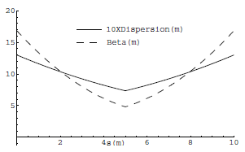
Off-Momentum Particles (cont’d)
The chromaticity (ξ) and the momentum compaction (α) are properties of the entire ring. However, the dispersion (D(s)) is another position dependent lattice function, which follows the periodicity of the machine.
If we look at our standard FODO cell, but include the bend magnets, we find that the dispersion functions ~track the beta functions
Typically dispersion is ~meters and momentum spread is ~.1%, so motion due to dispersion is ~mm

Slide 5
Insertions
So far, we’ve talked about nice, periodic lattice, but that may not be all that useful in the real world. In particular, we generally want
Locations for injection of extraction.
“Straight” sections for RF, instrumentation, etc
Low beta points for collisions
Since we generally think of these as taking the place of things in our lattice, we call them “insertions”
FODO
FODO
FODO
Insertion
FODO
FODO
FODO
Match lattice functions

Slide 6
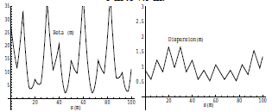
Mismatch and Beta Beating
Simply modifying a section of the lattice without matching will result in a distortion of the lattice functions around the ring (sometimes called “beta beating”)
Here’s an example of increasing the drift space in one FODO cell from 5 to 7.5 m

Slide 7
Collins Insertion
A Collins Insertion is a way of using two quads to put a straight section into a FODO lattice
Where s₂ is the usable straight region
Can do calculation by hand, or use a matching program like MAD

Slide 8
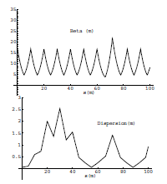
Dispersion Suppression
The problem with the Collins insertion is that it it can match α,β, and γ, but not D, so does not match dispersion, which causes distortions
This is typically dealt with by “suppressing” the dispersion entirely in the region of the insertion by adjusting the dipoles on either side
Collins Insertion

Slide 9
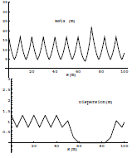
Combining Insertions
Because the Collins Insertion has no bend magnets, it cannot generate dispersion if there is none there to begin with, so if we put a Collins Insertion in a region where the dispersion has been suppressed, we match both dispersion and the lattice functions.
Collins insertion
Dispersion suppression
Dispersion suppression

Slide 10
The Case for Colliding Beams
Beam hitting a stationary proton, the “center of mass” energy is
On the other hand, for colliding beams (of equal mass and energy) it’s
To get the 14 TeV CM design energy of the LHC with a single beam on a fixed target would require that beam to have an energy of 100,000 TeV!
Would require a ring 10 times the diameter of the Earth!!

Slide 11
Luminosity
Rate
The relationship of the beam to the rate of observed physics processes is given by the “Luminosity”
Cross-section (“physics”)
“Luminosity”
Standard unit for Luminosity is cm⁻²s⁻¹ Standard unit of cross section is “barn”=10⁻²⁴ cm² Integrated luminosity is usually in barn⁻¹,where
nb⁻¹ = 10⁹ b⁻¹, fb⁻¹=10¹⁵ b⁻¹, etc
For (thin) fixed target:
Target thickness
Example: MiniBooNe primary target:
Incident rate
Target number density

Slide 12
Colliding Beam Luminosity
Circulating beams typically “bunched”
(number of interactions)
Cross-sectional area of beam
Total Luminosity:
Circumference of machine
Number of bunches
Record e+e- Luminosity (KEK-B): 2.11x10³⁴ cm⁻²s⁻¹ Record p-pBar Luminosity (Tevatron): 4.06x10³² cm⁻²s⁻¹ Record Hadronic Luminosity (LHC): 7.0x10³³ cm⁻²s⁻¹ LHC Design Luminosity: 1.00x10³⁴ cm⁻²s⁻¹

Slide 13
Luminosity: cont’d
For equally intense Gaussian beams
Using we have
Particles in a bunch
Collision frequency
Geometrical factor: - crossing angle - hourglass effect
Transverse size (RMS)
prop. to energy
Revolution frequency
Normalized emittance
Number of bunches
Betatron function at collision point ➔ want a small β*!
Particles in bunch

Slide 14
Focusing Triplet
In experimental applications, we will often want to focus beam down to a waist (minimum β) in both planes. In general, we can accomplish this with a triplet of quadrupoles.
Such triplets are a workhorse in beam lines, and you’ll see them wherever you want to focus beam down to a point.
Can also be used to match lattice functions between dissimilar beam line segments
The solution, starting with a arbitrary lattice functions, is not trivial and in general these problems are solved numerically (eg, MAD can do this)

Slide 15
Low β Insertions
In a collider, we will want to focus the beam in both planes as small as possible.
This can be done with a symmetric pair of focusing triplets, matched to the lattice functions (dispersion suppression is assumed)
Recall that in a drift, β evolves as
where s is measured from the location of the waist
This means that the smaller I make β*, the bigger the beam gets in the focusing triplets!
Symmetric
FODO
FODO
FODO
FODO
triplet
triplet
FODO
FODO
FODO
FODO
Dispersion suppression
Dispersion suppression
α=0 at the waist!

Slide 16
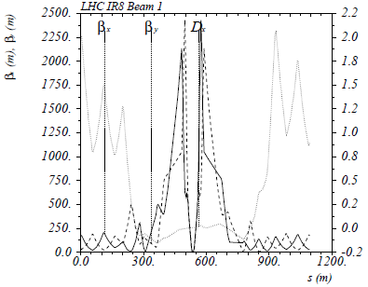
Limits to β*
β
LHC
β distortion of off-momentum particles ➔ 1/β* (affects collimation)
s
➔ small β* means large β (aperture) at focusing triplet

Slide 17
Longitudinal Motion
We will generally accelerate particles using structures that generate time-varying electric fields (RF cavities), either in a linear arrangement or located within a circulating ring
In both cases, we want to phase the RF so a nominal arriving particle will see the same accelerating voltage and therefore get the same boost in energy
cavity 0
cavity 1
cavity N
Nominal Energy

Slide 18
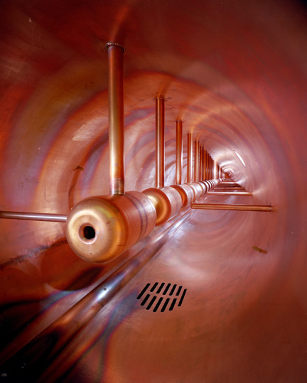
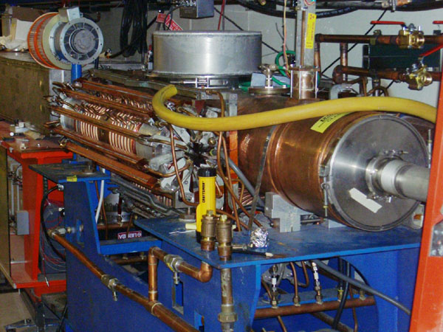
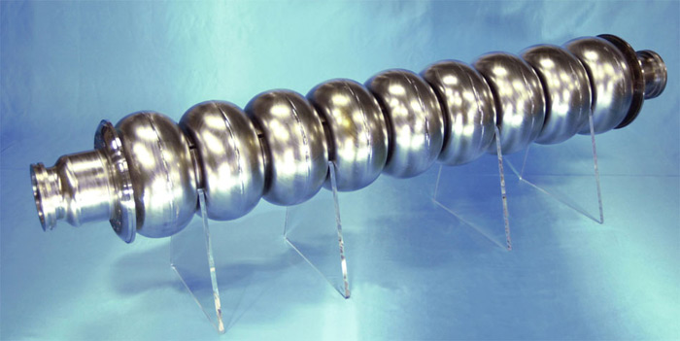
Examples of Accelerating RF Structures
37->53MHz Fermilab Booster cavity
Biased ferrite frequency tuner
Fermilab Drift Tube Linac (200MHz): oscillating field uniform along length
ILC prototype elipical cell “π-cavity” (1.3 GHz): field alternates with each cell

Slide 19
Phase Stability
A particle with a slightly different energy will arrive at a slightly different time, and experience a slightly different acceleration
The relationship between arrival time and difference in energy depends on the details of the machine
Off Energy
Nominal Energy
“slip factor” = dependence of period on momentum

Slide 20
Slip Factor
As cyclotrons became relativistic, high momentum particles take longer to go around.
This led to the initial understanding of phase stability during acceleration.
In general, two effects compete
The behavior of the slip factor depends on the type of machine
Path length
Velocity
Can prove this with a little algebra
“momentum compaction factor” we just talked about
Momentum dependent “slip factor”

Slide 21
Special Cases of Slip Factor
In a linac
In a cyclotron
In a synchrotron, the momentum compaction depends on the lattice, but is usually positive In a normal lattice, for very non-intuitive reasons
negative, asymptotically approaching 0
0 for v<<c, then goes positive. Compensating for this ➔ “synchro-cyclotron”
Starts out negative, then goes positive for
“transition”
electron machines are almost always above transition. Proton machines go through transition

Slide 22
Transition and phase stability
The sign of the slip factor determines the stable region on the RF curve.
Somewhat complicated phase manipulation at transition, which can result in losses, emittance growth, and instability
Easy with digital electronics, but they’ve been doing this since way before digital electronics.
Below γ_{t}: velocity dominates
Above γ_{t} : path length dominates
“bunch”
Particles with lower E arrive earlier and see greater V.
Particles with lower E arrive later and see greater V.
Nominal Energy
Nominal Energy

Slide 23
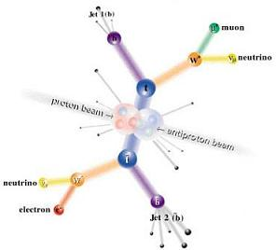
Final word: Electrons vs. Protons
Electrons are point-like
Well-defined initial state
Full energy available to interaction
Protons are made of quarks and gluons
Interaction take place between these consituents.
Only a small fraction of energy available, not well-defined.
Rest of particle fragments -> big mess!

Slide 24
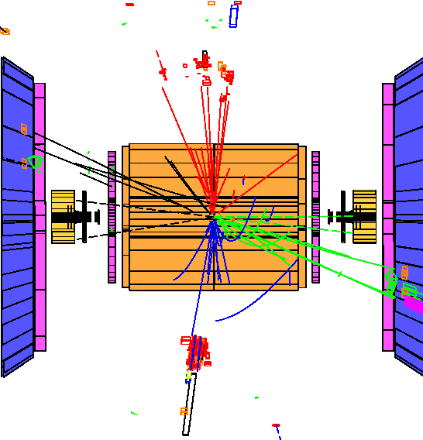
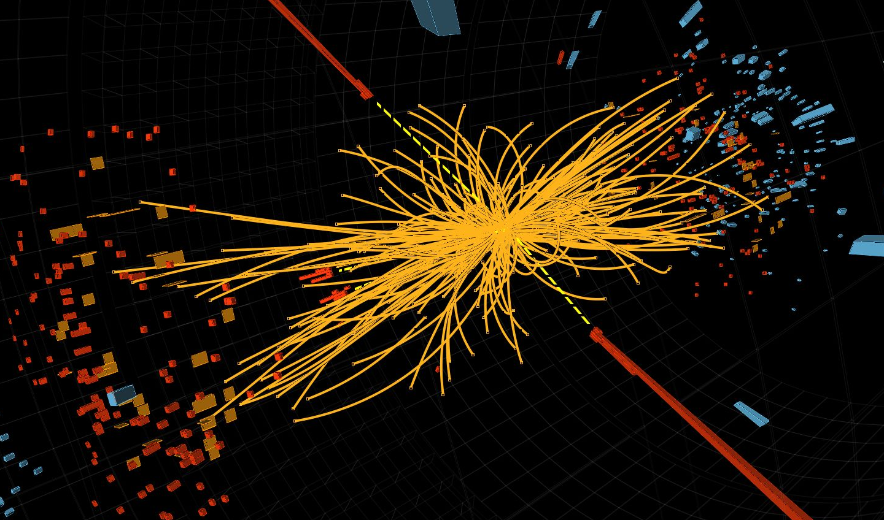
Examples
e⁺e⁻ collision at the LEP collider
proton-proton collision at the LHC collider
So why don’t we stick to electrons??

Slide 25
Synchrotron Radiation
As the trajectory of a charged particle is deflected, it emits “synchrotron radiation”
An electron will radiate about 10¹³ times more power than a proton of the same energy!!!!
Radius of curvature
Protons: Synchrotron radiation does not affect kinematics very much
Energy limited by strength of magnetic fields and size of ring
Electrons: Synchrotron radiation dominates kinematics
To to go higher energy, we have to lower the magnetic field and go to huge rings (LHC tunnel dug for LEP, which went to only 1/70th the energy!)
Eventually, we lose the benefit of a circular accelerator, because we lose all the energy each time around.
Since the beginning, the “energy frontier” has belonged to proton (and/or antiproton) machines, while electron machines have many other uses

Slide 26
Further Reading
Edwards and Syphers “An Introduction to the Physics of High Energy Accelerators”
My personal favorite
Concise. Scope and level just right to get a solid grasp of the topic
Crazy expensive, for some reason.
Helmut Wiedemann, “Particle Accelerator Physics”
Probably the most complete and thorough book around (originally two volumes)
Well written
Scope and mathematical level very high
Edmund Wilson, “Particle Accelerators”
Concise reference on a number of major topics
Available in paperback (important if you are paying)
A bit light
Klaus Wille “The Physics of Particle Accelerators”
Same comments
Fermilab “Accelerator Concepts” (“Rookie Book”)
http://www-bdnew.fnal.gov/operations/rookie_books/Concepts_v3.6.pdf
Particularly chapters II-IV
My course: http://home.fnal.gov/~prebys/misc/uspas_2014/

