Slide 1

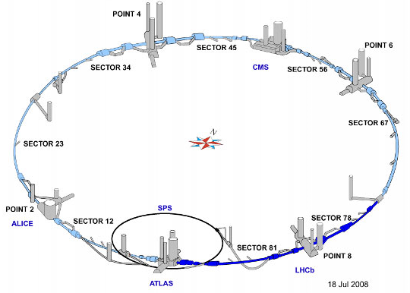
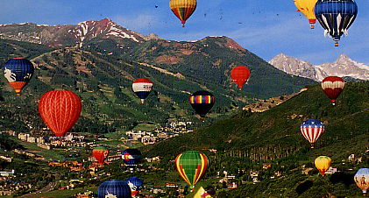
LHC Upgrade Path
Eric Prebys, FNAL
Snowmass 2013 Community Planning Meeting
Fermilab, October 11-13, 2012
Minneapolis

Slide 2
LHC Upgrade Paths (Planned and Potential)
Facility | C.M. Energy | Luminosity (10³⁴ cm⁻²s⁻¹) | Start Date | Status
Nominal LHC | 13-14 TeV pp | 1➔2 Peak | 2014 | Planned and scheduled
HL-LHC | 14 TeV pp | 5 Leveled | 2024 | In planning
HE-LHC | 33 TeV pp | ≥2 | ~2035 | Proposed
LHeC | 7 TeV p + 60-140 GeV e± | ~.1-1 | 2024 (concurrent with HL-LHC) | Proposed
Not discussed:
“High-ish Energy” LHC: Use Nb₃Sn dipoles for 26 TeV C.M.
Too little too late?
LEP3: Arguably an LHC upgrade, but put in lepton collider talk.
Caveat
Numbers for LHC and HL-LHC are reasonably solid
HE-LHC and LHeC are in a state of constant development and refinement.
This represents one snapshot

Slide 3
Sources, References, and Acknowledgments
Primary contacts: (big thanks to) Lucio Rossi, Oliver Brüning, Frank Zimmermann
Primary Resources
“LHC Design Report” (2004), [http://lhc.web.cern.ch/lhc/lhc-designreport.html]
“High Luminosity LHC (European Strategy Report)” (2012) [http://cdsweb.cern.ch/record/1471000/files/CERN-ATS-2012-236.pdf]
“HL-LHC Parameter and Layout Committee” Website [https://espace.cern.ch/HiLumi/PLC/default.aspx]
“HE-LHC’10 Mini-Workshop” (2010) [http://indico.cern.ch/conferenceDisplay.py?confId=97971]
“High Energy LHC, Document Prepared for European Strategy Update [http://cdsweb.cern.ch/record/1471002/files/CERN-ATS-2012-237.pdf]
2012 CERN-ECFA-NuPECC Workshop on LHeC [https://indico.cern.ch/conferenceOtherViews.py?view=standard&confId=183282]
LHeC “Design Concepts” [http://arxiv.org/pdf/1206.2913.pdf]

Slide 4
Baseline LHC Upgrade Path: ~7+7 TeV protons
Maximize current/brightness
Reach nominal energy
Time Line:
LS1: “Nominal” (2013-2014)
Complete repairs of the superconducting joint and pressure relief problems which cause “the incident” in 2008 and currently limit the energy to 4+4 TeV.
“Lost memory” issues may limit the beam energy to somewhere between 6.5 and 7 TeV per beam.
LS2: “Ultimate” (2017)
injector and collimation upgrades
Increase current and/or lowering emittance, increasing the luminosity further
LS3: “HL-LHC” (~2022-2023)
Lower β* and compensate for crossing angle to maximize luminosity

Slide 5
Machine Parameters Relevant to Experiments*
Parameter | Bunch Spacing
 | 25ns | 50ns
Beam Energy [TeV] | 6.5-7 | 6.5-7
n_{b} | 2808 | 1404
N_{b} | 1.15(1.7)x10¹¹ | 1.7(2.0)x10¹¹ p
β* [m] | .55 | .55
σ_{x,y} [μm] | 16.7 | 16.7
σ_{z} [cm] | 7.6 | 7.6
Total Energy/beam [MJ] | 362 (535) | 267 (314)
L (peak) [10³⁴ cm-²s⁻¹] | ~1 (2) | ~1 (2)
Events/crossing | 27 (54) | 54 (108)**
L (integrated) [fb⁻¹/year] | 40 (80) | 40 (80)
L (integrated) [fb⁻¹, total by 2022] | ~300
*“Ultimate” parameters shown in parenthesis. Other combinations are possible.
**It is unlikely that the experiments will be able to handle this pile-up, and therefore the luminosity will have to be limited to something lower if we are running with 50ns spacing.

Slide 6
Reminder: Limits to luminosity*
Total Current, limited by
instabilities (eg, e-cloud)
machine protection issues!
“Brightness”, limited by
Space charge effects
Instabilities
Beam-beam tune shift (ultimate limit)
number of bunches
Bunch size
Geometric factor related to crossing angle and hourglass effect
β*, limited by
magnet technology
chromatic effects
*a la Frank Zimmermann

Slide 7
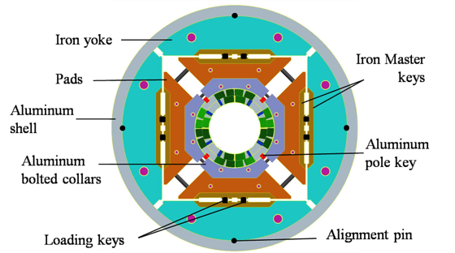
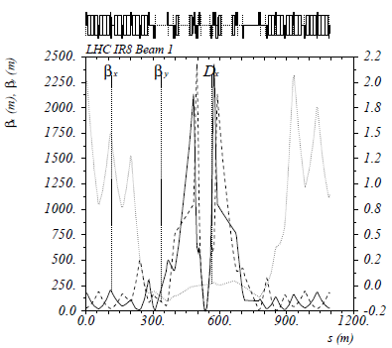
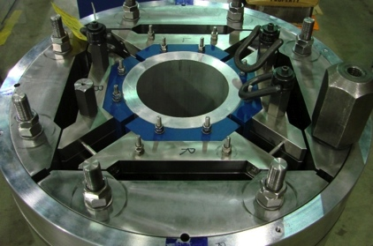
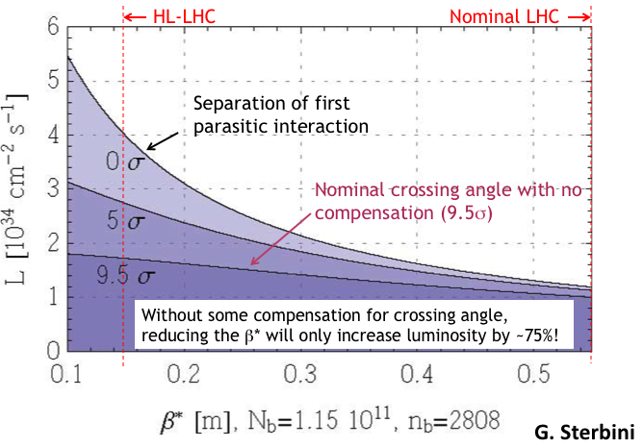
Key Components of HL-LHC
Reduce β* from 55 cm to 15 cm
Requires large aperture final focus quads
Beyond NbTi
➔Requires Nb₃Sn
never before used in an accelerator!
BUT, reducing β* increases the effect of crossing angle
“Piwinski Angle”

Slide 8
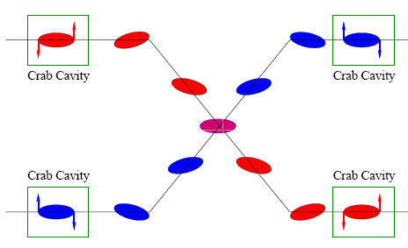
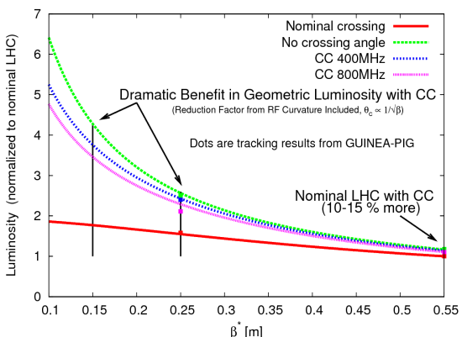
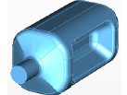
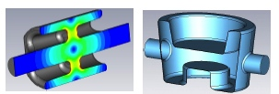
Baseline Approach: Crab Cavities
Technical Challenges
Crab cavities have only barely been shown to work.
Never in hadron machines
LHC bunch length ➔ low frequency (400 MHz)
19.2 cm beam separation ➔ “compact” (exotic) design
Additional benefit
Crab cavities are an easy way to level luminosity!

Slide 9
Luminosity Leveling
Original goal of luminosity upgrade: >10³⁵ cm⁻²s⁻¹
Leads to unacceptable pileup in detectors
New goal: 5x10³⁴ leveled luminosity
Options
Crab cavities
β* modifications
Lateral separation

Slide 10
HL-LHC Parameters*
Parameter | Bunch Spacing
 | 25ns | 50ns
Beam Energy [TeV] | 7 | 7
n_{b} | 2808 | 1404
N_{b} | 2.2x10¹¹ | 3.5x10¹¹ p
β* [m] | .15 | .15
σ_{x,y} [μm] | 7.5 | 7.5
σ_{z} [cm] | 7.6 | 7.6
Total Energy/beam [MJ] | 692 | 550
L (leveled) [10³⁴ cm-²s⁻¹] | 5 | 2.5**
Events/crossing | 140 | 140
L (integrated) [fb⁻¹/year] | 250 | 250
L (integrated) [fb⁻¹, total by 2030s] | ~3000
*Taken from latest “Parameter & Layout Committee” parameter table: [https://espace.cern.ch/HiLumi/PLC/default.aspx]
**Limited at experiments’ request to reduce pile-up

Slide 11
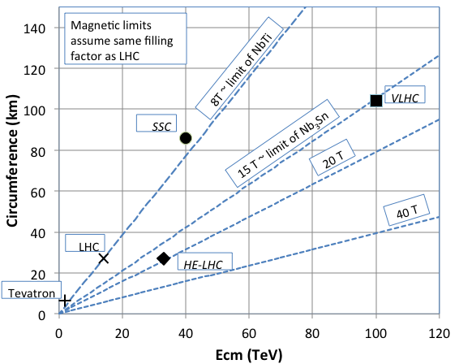
Going Beyond LHC: Limits to Energy
The energy of Hadron colliders is limited by feasible size and magnet technology. Options:
Get very large (eg, VLHC > 100 km circumference)
More powerful magnets (requires new technology)

Slide 12
Superconductor Options
Traditional
NbTi
Basis of ALL superconducting accelerator magnets to date
Largest practical field ~8-9T
Nb₃Sn
Advanced R&D, but no accelerator magnets yet!
Being developed for large aperture/high gradient quadrupoles
Largest practical field ~15-16T
High Temperature
Industry is interested in operating HTS at moderate fields at LN₂ temperatures. We’re interested in operating them at high fields at LHe temperatures.
MnB₂
promising for power transmission
can’t support magnetic field.
YBCO
very high field at LHe
no cable (only tape)
BSCCO (2212)
strands demonstrated
unmeasureably high field at LHe
Focusing on this, but very expensive
⇒ pursue hybrid design

Slide 13
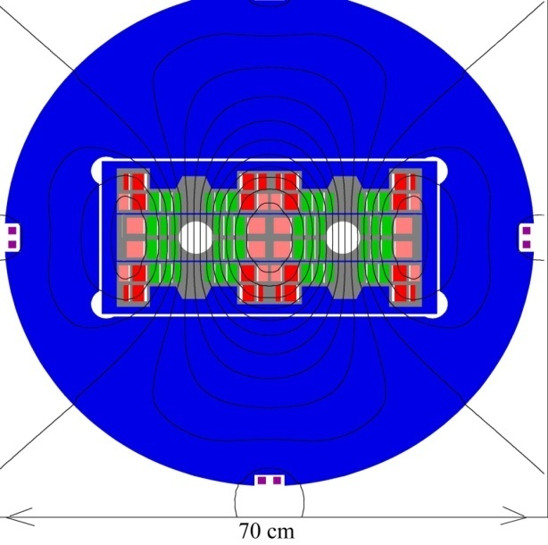
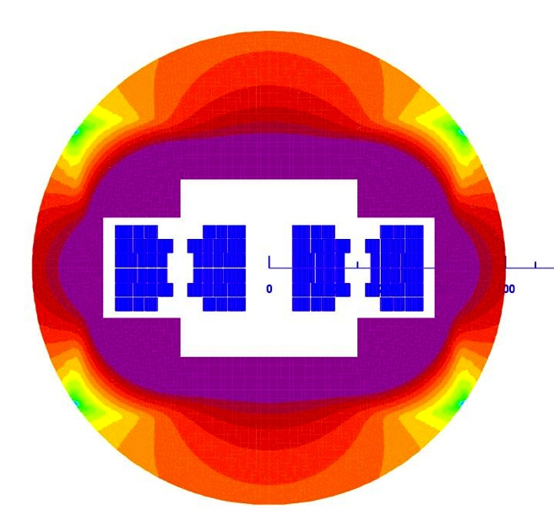
Potential Designs
P. McIntyre 2005 – 24T ss Tripler, a lot of Bi-2212 , Je = 800 A/mm2
E. Todesco 2010
20 T, 80% ss
30% NbTi
55 %NbSn
15 %HTS
All Je < 400 A/mm2

Slide 14
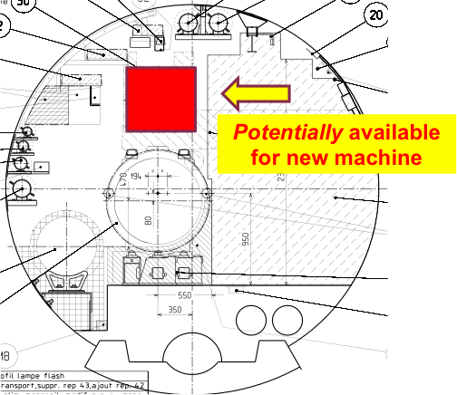
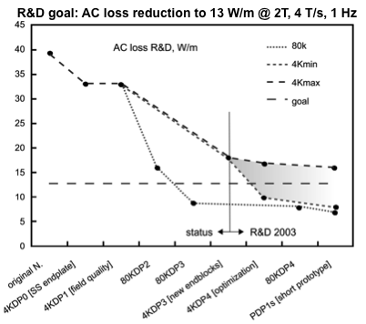
Injector Chain Challenges for HE-LHC*
Injection energy will be ≥ 1 TeV, beyond the range of the SPS
Two options:
SPS injects into a new Low Energy Ring (LER), which shares the tunnel with the HE-LHC
Technically easy
Difficult to fit!
New SPS+
450 GeV -> 1 TeV
24 injections -> Rapid cycling SC magnets
Based on SIS-100 and SIS-300 at FAIR
Synergy with EU LBNE program (Laguna)

Slide 15
Straw Man HE-LHC Parameters*
Parameter | HL-LHC | HE-LHC
Beam Energy [TeV] | 7 | 16.5
Injection Energy [TeV] | .450 | ≥1
Bunch Spacing [ns] | 25 | 50**
n_{b} | 2808 | 1404
N_{b} | 2.2x10¹¹ | 1.3x10¹¹ p
β* [m] | .15 | .4-1
σ_{x,y} [μm] | 7.1 | ~10
σ_{z} [cm] | 7.6 | ~6
Total Energy/beam [MJ] | 692 | 482
L [10³⁴ cm-²s⁻¹] | 5 (leveled) | 2 (peak)
Events/crossing | 140 | ~60
L (integrated) [fb⁻¹/year] | 250 | 250
* First pass only. This luminosity was set to keep the energy deposition in the final focus magnets ~same as HL-LHC. Could certainly go higher if machine protection and magnets can handle it. Leveling likely.
** 25 ns also possible, but 50 ns reduces current and simplifies machine protection

Slide 16
Important R&D and Questions for HE Hadron Colliders
Magnets, magnets, magnets
New conductors: Nb₃Sn, HTS, hybrid designs
Rapid cycling SC magnets
Rad hardness and energy deposition studies (simulation and experiment).
Machine Protection
Collimation design and materials research
Accelerator physics and simulation
Halo formation and beam loss mechanisms (historically not accurate)
Crossing angle issues
Crab cavity development
New ideas: eg, flat beams
Key question for the HEP community:
Luminosity vs. pile-up as a function of energy
What luminosity do you need?
What pile-up can you live with?

Slide 17
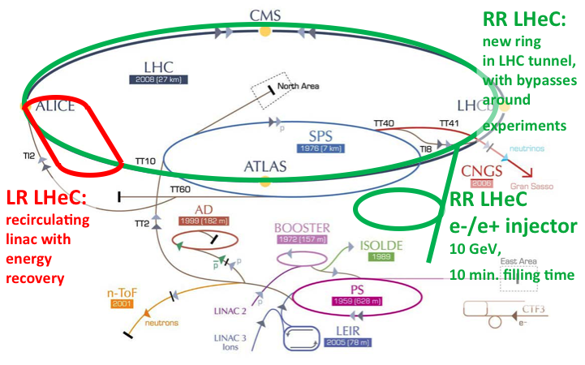
LHeC: Options Considered
RR: e± circulate in new 60 GeV ring, which shares tunnel with LHC
LR: CW Energy recovery linac collides 60 e± with LHC beam
LR:* Pulsed energy recover linac collides 140 GeV e± with LHC beam

Slide 18
Straw Man LHeC Parameters*
RR option determined to be incompatible with HL-LHC, so not being pursued further at this time
Parameter | RR | LR | LR*
Protons
Beam Energy [TeV] | 7 | 7
σ_{x,y} [μm] | 30,16 | 7
Bunch Spacing [ns] | 25 | 25
N_{b} | 1.7x10¹¹ | 1.7x10¹¹
Electrons/positrons
Beam Energy [GeV] | 60 | 60 | 140
Bunch Spacing [ns] | 25 | 25 | 25
N_{b} | 20x10⁹ | 1(2)x10⁹ | .8x10⁹
σ_{x,y} [μm] | .45,22 | 7 (3.7) | 7
σ_{z} [m] | 6 | 0.3 | 0.3
Repetition Rate [Hz] | N/A | N/A | 10
Pulse Length [ms] | N/A | N/A | 5
L [peak, 10³⁴ cm-²s⁻¹] | .08 | .1 (1) | 0.004
*possible high luminosity LR parameters shown in parenthesis – F. Zimmermann, private communication

Slide 19
Key R&D for ERL LHeC*
Superconducting RF suitable for Energy Recovery and efficient recirculating linac: SC cavities for CW operation with the highest possible Q0.
Superconducting IR magnet design: mirror magnets with openings for three beams: one aperture with a high gradient (gradient requiring Nb₃Sn technology) for the colliding proton beam and two 'field free' apertures for the non-colliding proton beam (good field quality) and the colliding lepton beam.
Positron source development: positron source with a higher performance than the ILC positron source.
Detector design with integrated dipole field for the lepton beam deflection.
Vacuum chamber development: large vacuum chambers near the experiments with the requirement of extremely thin wall thickness and rather large synchrotron radiation power next to the detector [-> absorber design].
*courtesy Oliver Brüning

