Slide 1

Mu2e Extinction and Extinction Monitoring (2.09)
Dr. Smith: We’re doomed!
Maureen: Oh really, Dr. Smith, can’t you think of some other word? “Doomed” is so final.
Dr. Smith: The only other word I can think of is “extinction”.
- “Lost in Space”, ep. 3x01
Lehman CD-1 Review of Mu2e
June 6-7, 2012
Eric.Prebys
Extinction L3 Manager

Slide 2
Outline
Scope
Extinction
Requirements
Concept
Alternatives
Operational Risks
Optimization for CD-2
Extinction Monitoring
Requirements
Concept
Alternatives
Optimization for CD-2
Cost
Risk
Summary

Slide 3
Scope
WBS 2.09
Extinction
E. Prebys
2.09.01
Conceptual (E. Prebys)
2.09.02
Internal Extinction System
(E. Prebys)
2.09.03
External Extinction System
(E. Prebys)
2.09.04
External Monitoring
(P. Kasper)

Slide 4
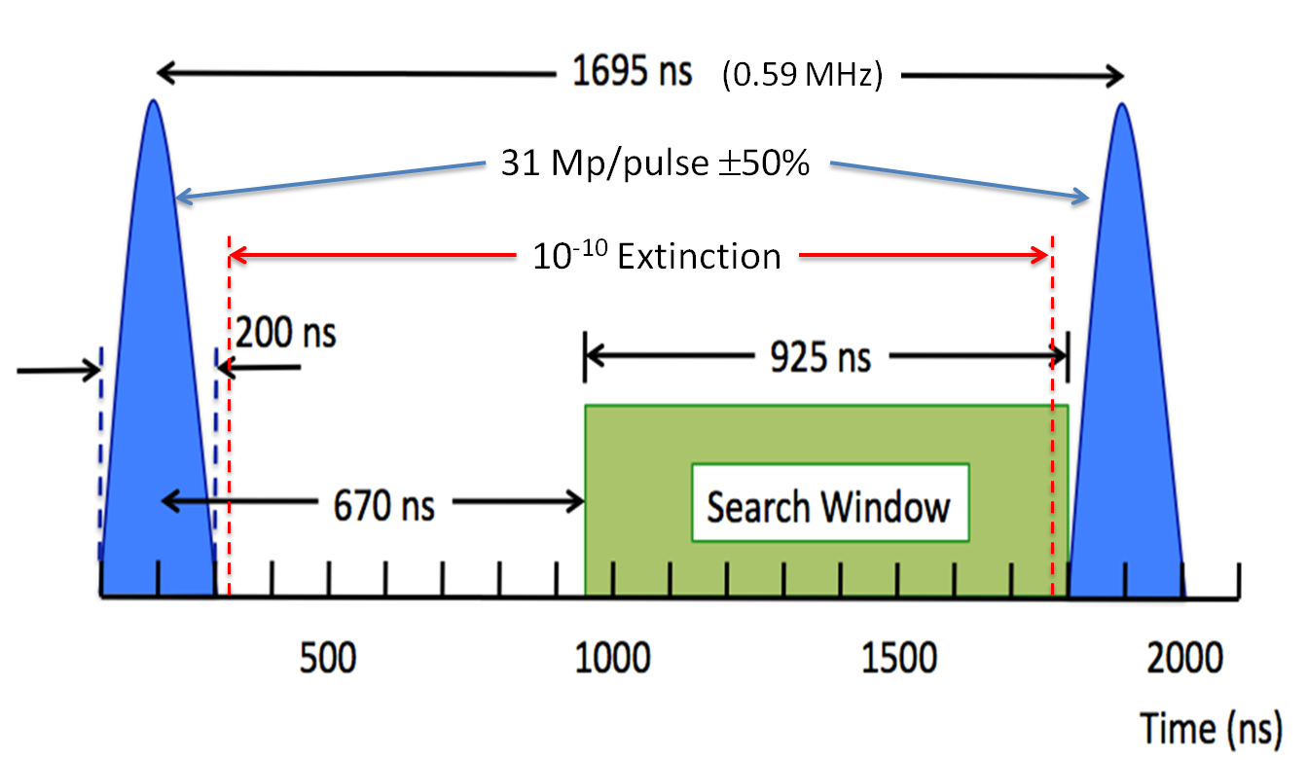
Extinction Requirements
The requirements for extinction are described in detail in Mu2e-doc-1105 and Mu2e-doc-1175.

Slide 5
Internal Extinction
The current method of beam transfer insures a fairly good level (<10⁻⁵) level of extinction going into the Delivery Ring, so the issue is how will out of time beam grow during the spill.
Effects considered (see talk Mu2e-doc-1594)
RF noise
Intrabeam scattering
Beam loading
Beam-gas interaction
Scattering off of extraction septum
Dominant effect

Slide 6
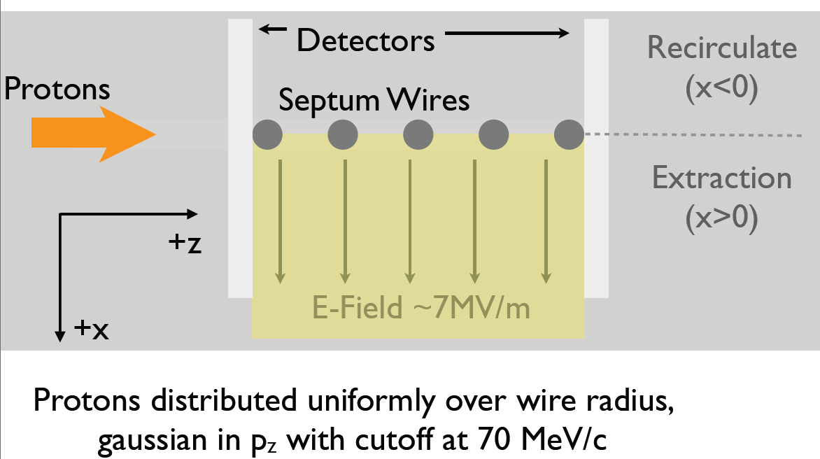
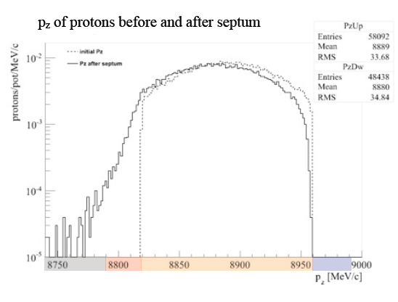
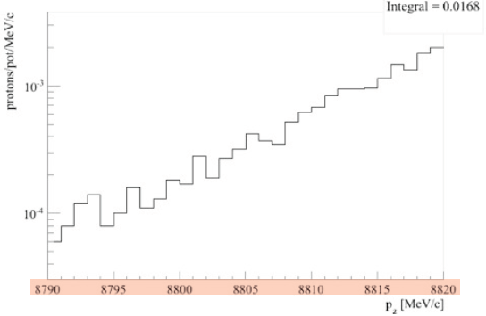
Internal Simulation*
Currently being simulated
Preminary estimate <10⁻⁴
*Nick Evans

Slide 7
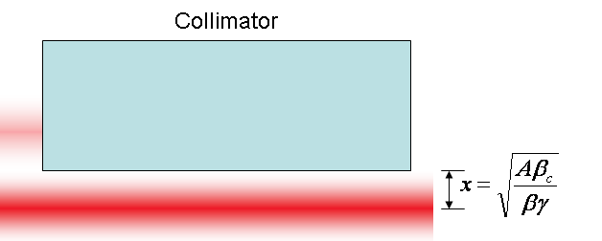
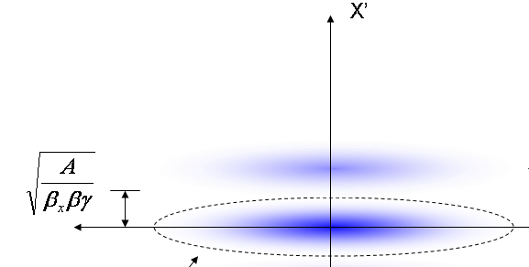
Generic Extinction Analysis
At collimator:
Beam fully extinguished when deflection equals twice full admittance (A) amplitude
At kicker:
Angle to extinguish beam
*al la FNAL-BEAM-DOC-2925

Slide 8
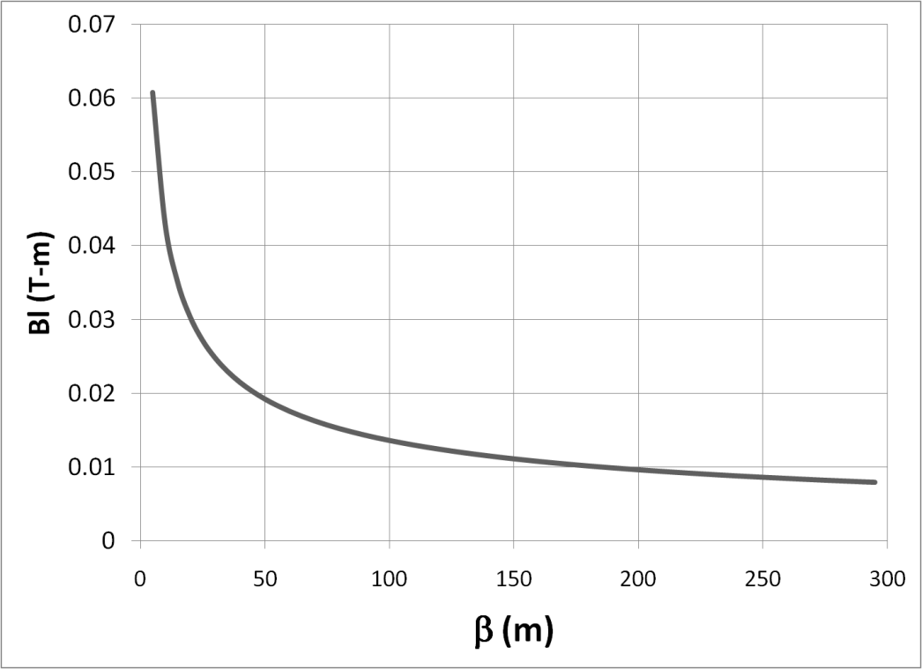
Magnet Considerations
Bend strength to extinguish:
Stored Energy:
⇒Large β_{x}, long weak magnets
- Assume β_{x}=250m, L=6m
- Factor of 4 better than β_{x}=50m, L=2m

Slide 9
Alternatives Considered
Deflection Dipole
Single frequency dipole
Nominal system in Mu2e proposal
Slewing through transmission window resulted in unacceptable transmission efficiency
Would likely require compensating dipole, which would severely impact beam line design
Broad band kicker
Beyond current state of the art
“MECO” system – three harmonic components
Lower frequency than current high frequency dipole
Additional magnet and power supply required
Inferior transmission performance

Slide 10
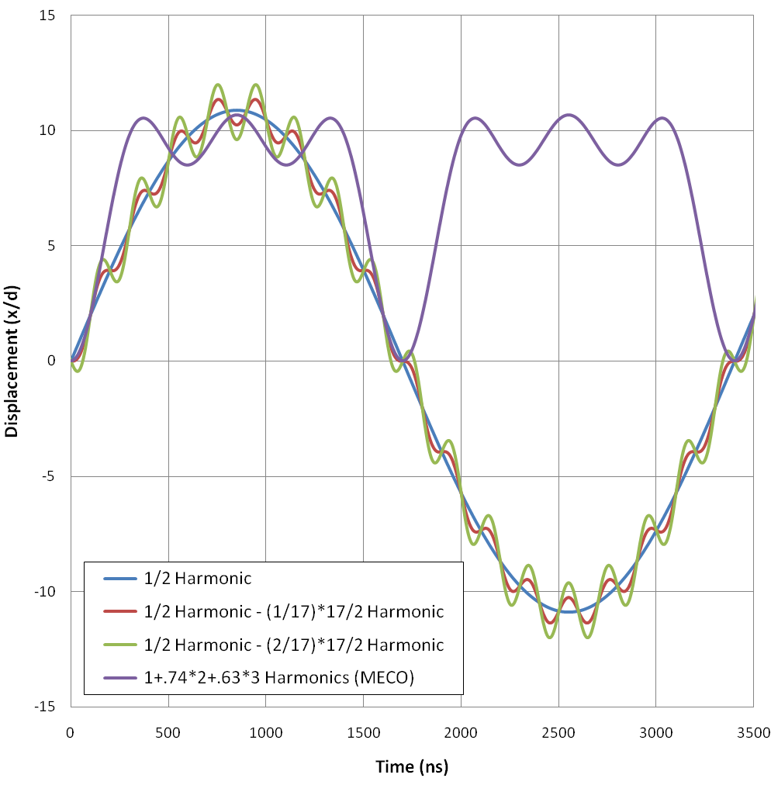
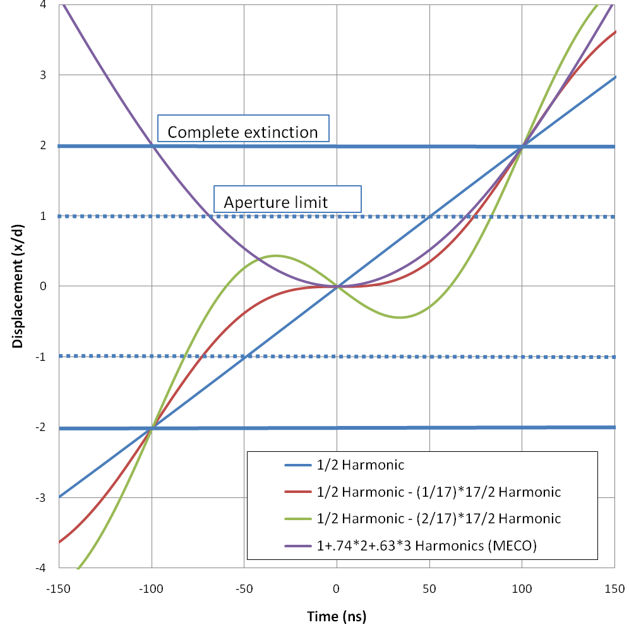
Waveform Analysis*
a)
b)
*Mu2e-DOC-552

Slide 11
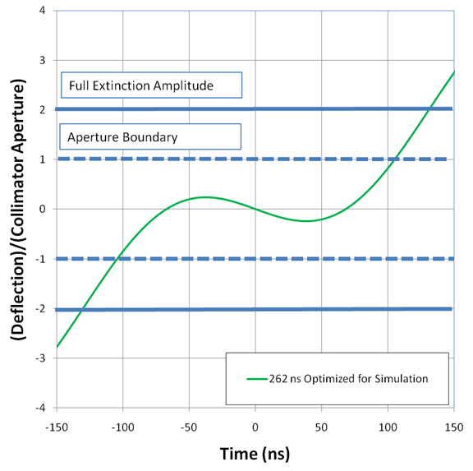
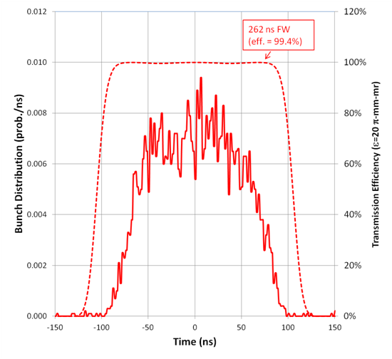
AC Dipole System
System relies on two harmonic components
300 kHz component to sweep beam past transmission channel
3.8 MHz component to reduce slewing at transmission peak

Slide 12
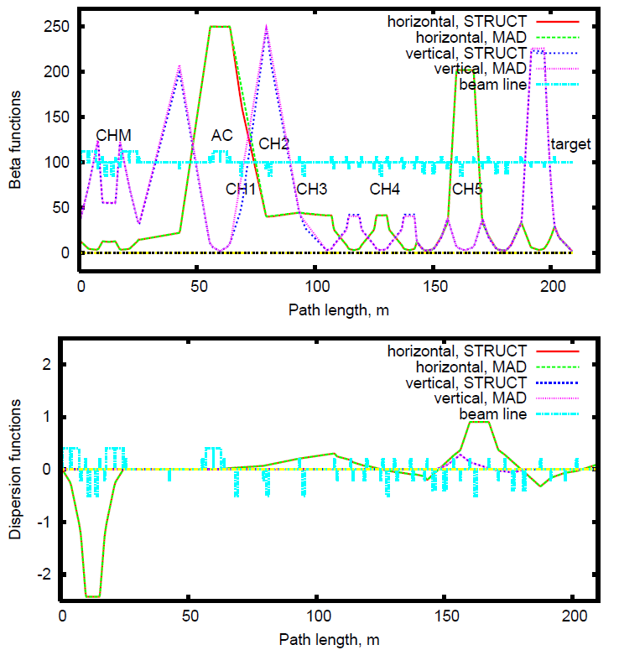
Simulations*
Working to understand this difference
Looks like ~10⁻⁷ should be doable
*A. Drozhdin and I. Rakhno

Slide 13
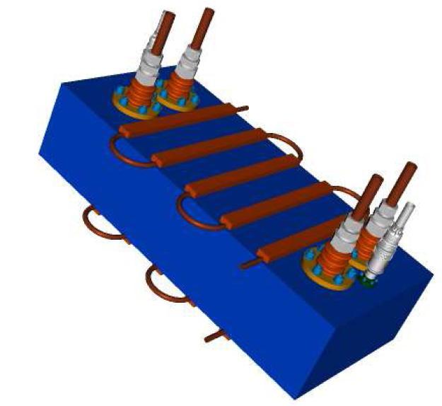
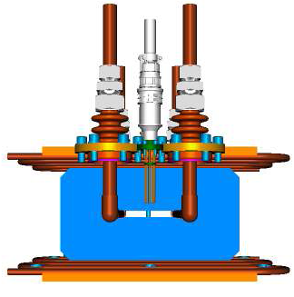
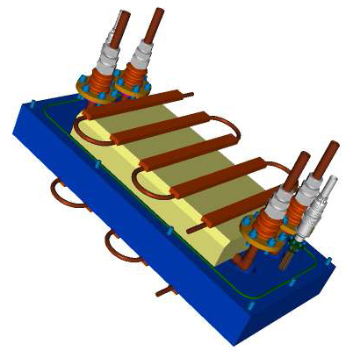
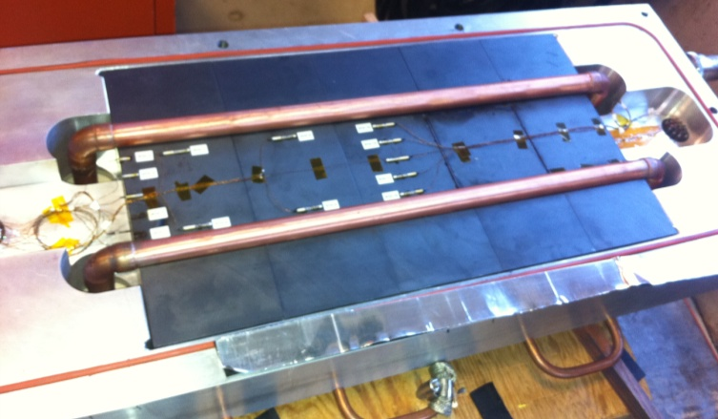
Magnet Prototype*
Conductor
Vacuum Box
Cooling channel
Gap
Ferrite
*Design by Sasha Makarov and Vladimir Kashikhin

Slide 14
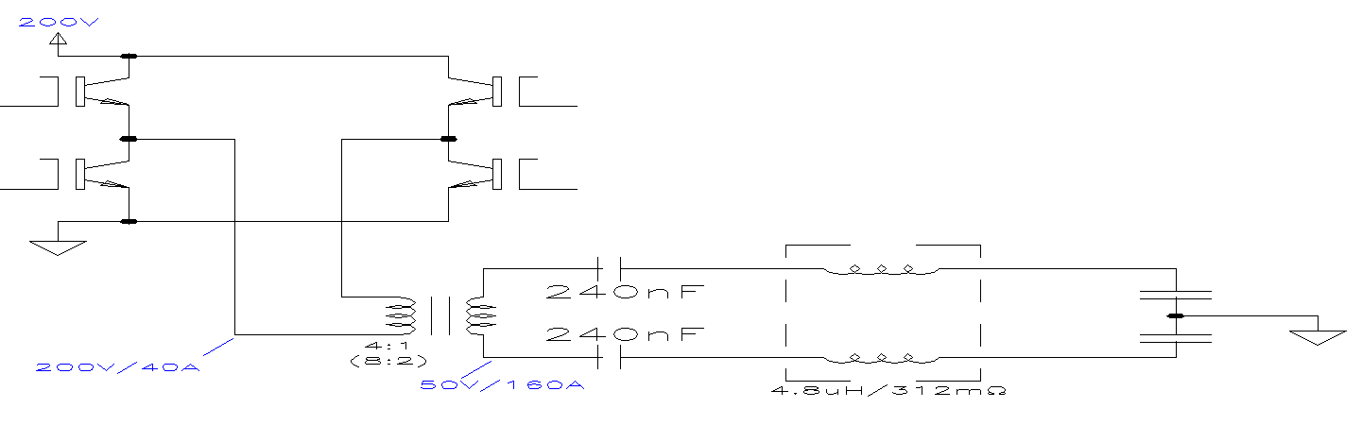
300 kHz Power Supply*
Will require electromechanical tuner to maintain resonant frequency
Phase locked to Delivery Ring RF to ~1 ns
*Howie Pfeffer, Ken Bourkland

Slide 15
Operational Risks

Slide 16
Optimizations for CD-2
Continue simulation of evolution of out of time particles in Delivery Ring ring, and optimization of in-ring collimation.
Design momentum collimation system for Delivery Ring
Placement of collimator in dispersion region very challenging.
Continue development and optimization of both low and high frequency components for AC dipole system.
Concept has been established at both frequencies
Low frequency power supply straightforward, high frequency “off the shelf”.
Simulation of extinction collimation channel.
Understand and correct asymmetric behavior
Phase locking with beam transfer from Recycler
Calculations show it should not be challenging for the hardware, but must be implemented in power supply and controls system

Slide 17
Extinction Monitor Requirements
Mu2e Extinction Monitor Requirements (Mu2e-doc-894)
Specifies the measurement, the measurement precision, and reliability of operation
Specification | Upstream Monitor | Target Monitor
Extinction sensitivity | 10⁻⁵ | 10⁻¹⁰
Integration time | < 10 s (6×10⁶ beam pulses) | ~1 hr (2×10⁹ beam pulses)
Timing resolution | < 10 ns | < 10 ns
Dead-time | < 10 ns | < 10 ns
Rate dependent error over dynamic range | < 10% | < 10%
Increase in beam emittance | < 10% | N/A
Initial readiness | First availability of beam | When production target ready
Repair Access time (assumes once monthly access required) | 4 hrs | 4 hrs
Radiation hardness (minimum protons delivered before replacement required) | 4×10²⁰ POT | 4×10²⁰ POT

Slide 18
Options Considered
Single Particle
Measure inter-bunch beam at the single particle level
Need something very fast (Cerenkov?)
Probably have to “blind” detector at bunch time
Pros: best picture of out of bunch beam
Cons: hard
Statistical:
use either a thin scatterer, or small acceptance target monitor to count a small (10⁻⁷ or 10⁻⁸?) fraction of beam particles.
Statistically measure inter-bunch beam.
Pros: straightforward
Cons: limited sensitivity to fluctuations in extinction (is that important?)

Slide 19
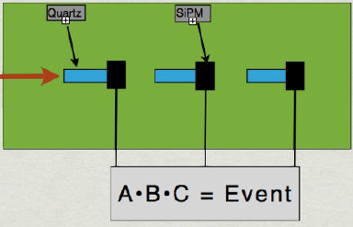
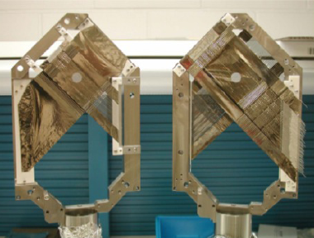
Internal (fast) Monitoring
The low resolution monitor will need to measure extinction down to 10⁻⁵ to validate the extinction of the beam coming out of the Delivery Ring.
Base line approach: Thin scatterer followed by charged particle telescope

Slide 20
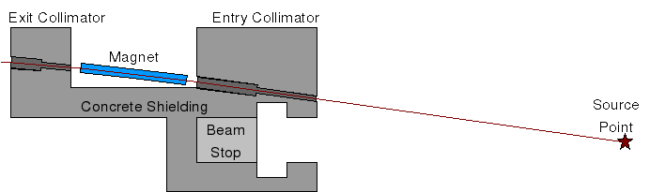
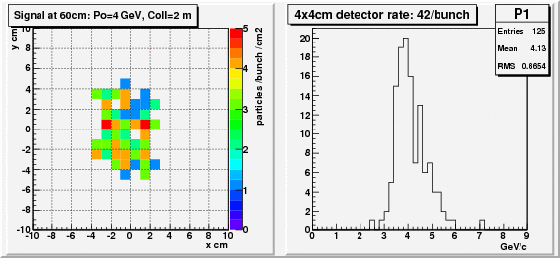
External (precision) Monitoring
Relies on channel to select high momentum scatters from the target.
Tracker, based on high speed pixels
Production Target

Slide 21
Alternatives Considered
Fast Monitoring
Various types of direct detection techniques were considered, including Cerenkov detectors.
All considered beyond state of the art.
Precision monitoring
A second detector, optimized for lower momentum and based on timing and calorimetry, is being developed at UC Irvine
Also being considered as an alternative for the fast monitor, if the simple device turns out to be impractical.

Slide 22
Optimizations for CD-2
Develop design for fast measurement.
NIU joining the effort
Optimize design for precision measurement
In particular, develop accurate model of radiation exposure.

Slide 23
Cost Estimation
Internal Extinction
One TeV style collimator
External Extinction
AC Dipole: Engineering Estimate from TJ Gardner
AC Dipole Power Supply:
Low Frequency: Engineering estimate from Howie Pfeffer
High Frequency: Off-the-shelf RF power suppy
Collimation system: 5 TeV style collimators
Extinction Monitoring
Internal (fast): based on simple telescope, Nick Evans and Paul Rubinov
External (precision)
Structure: Engineering estimate from Larry Bartoszek (Bartoszek Engineering)
Tracking and readout: Andrei Gaponenko, based on experience with ATLAS pixels

Slide 24
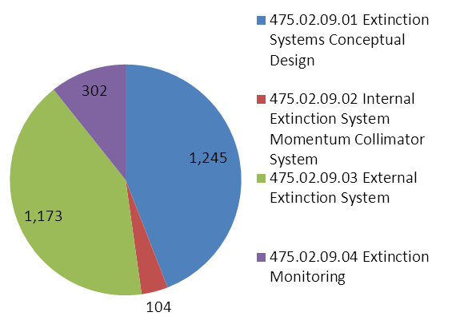
Cost Distribution

Slide 25
Cost Summary
WBS Element | WBS Description | M&S Base Cost ($k) | M&S % Contingency | Labor Base Cost ($k) | Labor % Contingency | Total
9.0 | Extinction System (Roll up) | 876 | 570 | 1948 | 578 | 3463
9.1 | Conceptual Design | 28 | - | 1216 | 1 | 1256
9.2 | Internal Extinction System | 54 | 40 | 51 | 40 | 146
9.3 | External Extinction System | 663 | 329 | 510 | 35 | 1652
9.4 | Extinction Monitoring | 131 | 570 | 171 | 473 | 409

Slide 26
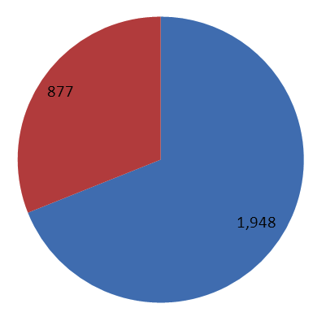
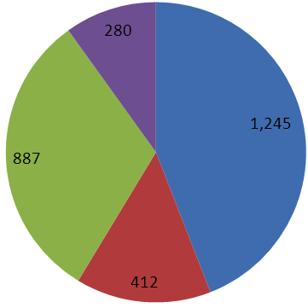
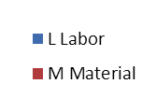
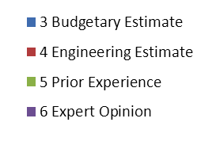
Basis of Estimate
Labor vs. M&S
Estimate Type

Slide 27
Summary
We have a feasible design to achieve the required level of extinction for the experiment.
We have conceptual designs to measure this extinction in the two time regimes required.

Slide 28
BACKUP SLIDES

Slide 29
Ferrite Measurement
Current, A-turns | B, Gauss (start) | B, Gauss (end) | Max Temperature, C
(Need 160 G)
MnZn, 300kHz, 2 plates
0.7 | 60.81 | 54.76 | 22.34
1.4 | 164.54 | 154.65 | 31.23
2 | 256.71 | 202.13 | 36.54
2.75 | 296.17 | 231.10 | 40.87
(Need 10 G)
NiZn , 5.1 MHz, 2 plates
4.35 | 4.83 | 5.3 | 23.38
10.8 | 11.17 | 8.76 | 29.32
16.36 | 16.17 | 15.88 | 44.81
27.39 | 24.04 | 22.21 | 76.21

