Slide 1
LARP Accelerator Systems
6-Year Plan
FY09-FY14
US LHC Accelerator Research Program
BNL - FNAL- LBNL - SLAC
10 April 2009
LARP CM12
Napa, CA
Tom Markiewicz/SLAC

Slide 2
General Comments
First cut of program and budget requests without sufficient review and detail
  Lab-to-lab split not specified yet
  LARP-to-Non-LARP split not completely specified yet
  Individuals and their FTEs not identified yet
  One very coarse overhead loaded salary ($250k) used to convert LARP funded FTEs to dollars
  M&S and travel requests assumed to include lab overhead
Nonetheless, having something on paper is a good way to start discussion
Will not discuss PS2 nor Crab but have included their totals (such as I know them as of 630 AM today) as their funds will come out of Accelerator System pot.
FY09 numbers have been constructed to reflect the actual budget (before contingency allocation)
LARP CM12 - 08 April 2009
Slide n° <number> / 25
Collimation Conceptual Review Summary - T. Markiewicz

Slide 3
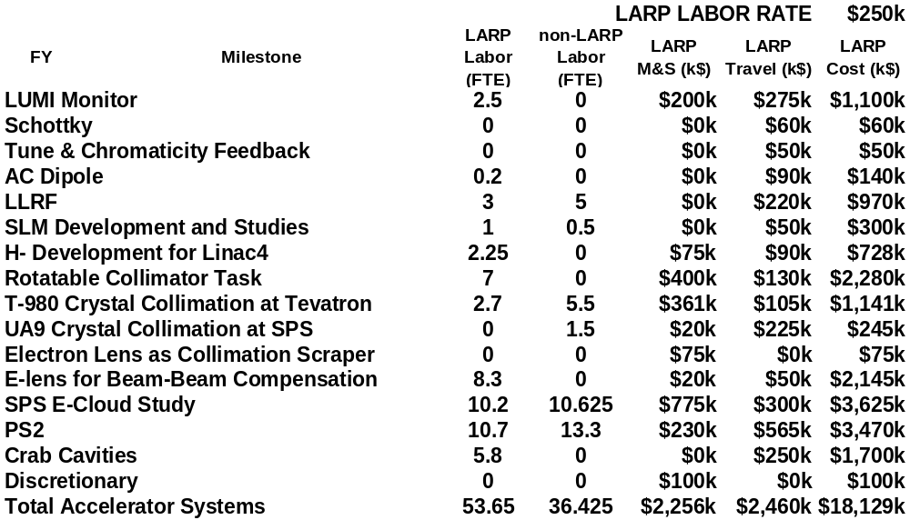
FY09-FY14 Plan
LARP CM12 - 08 April 2009
Slide n° <number> / 25
Collimation Conceptual Review Summary - T. Markiewicz

Slide 4
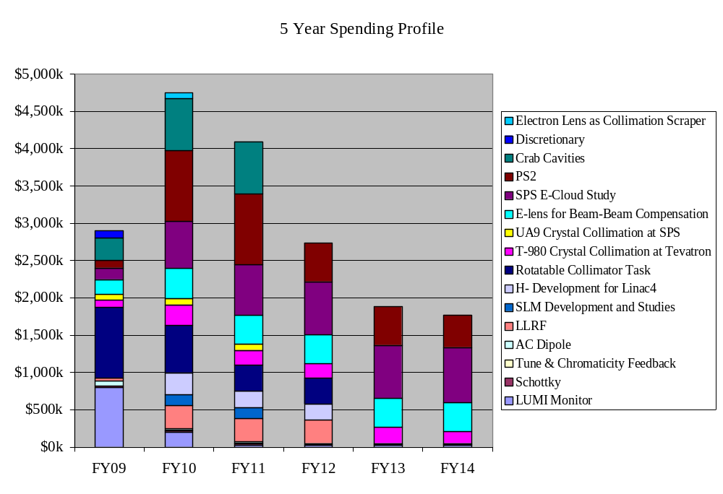
Accelerator Systems
LARP CM12 - 08 April 2009
Slide n° <number> / 25
Collimation Conceptual Review Summary - T. Markiewicz

Slide 5
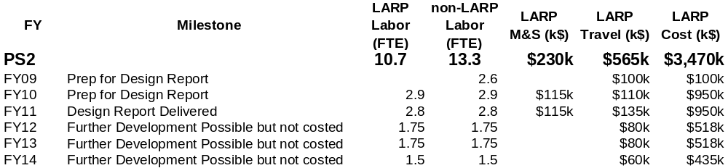
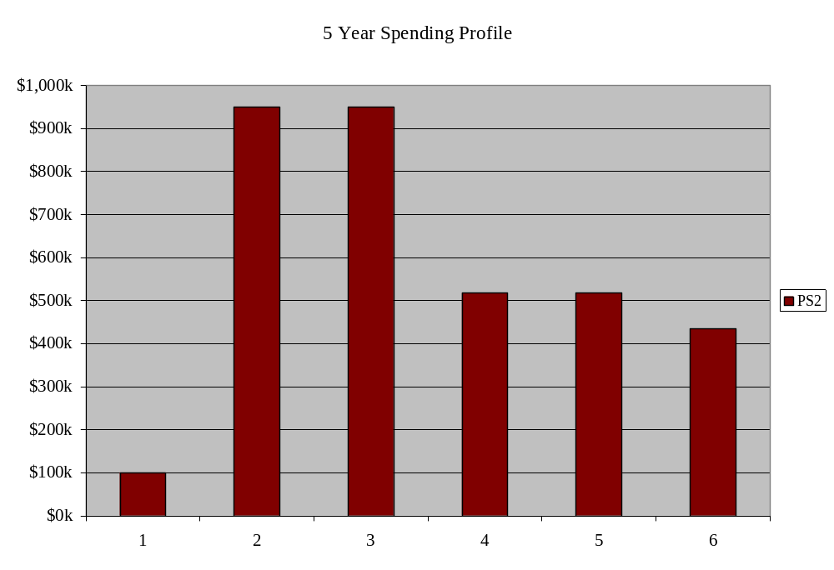
PS2
LARP CM12 - 08 April 2009
Slide n° <number> / 25
Collimation Conceptual Review Summary - T. Markiewicz

Slide 6
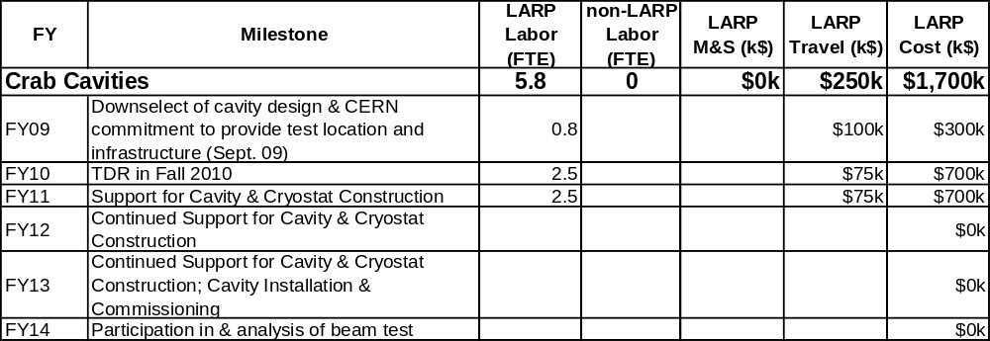
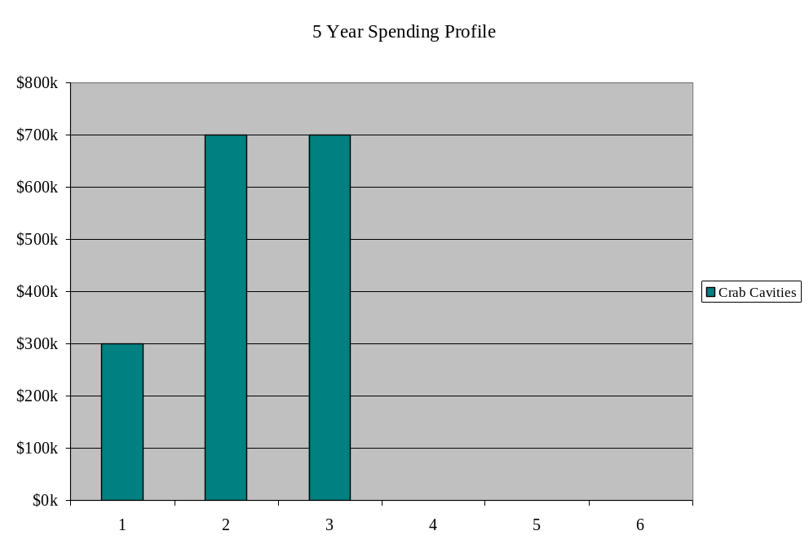
CRAB
LARP CM12 - 08 April 2009
Slide n° <number> / 25
Collimation Conceptual Review Summary - T. Markiewicz

Slide 7
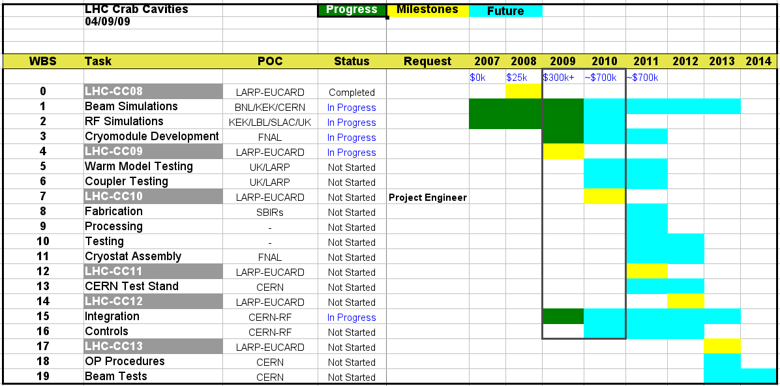
Rama’s Input to this Excercise
LARP CM12 - 08 April 2009
Slide n° <number> / 25
Collimation Conceptual Review Summary - T. Markiewicz

Slide 8
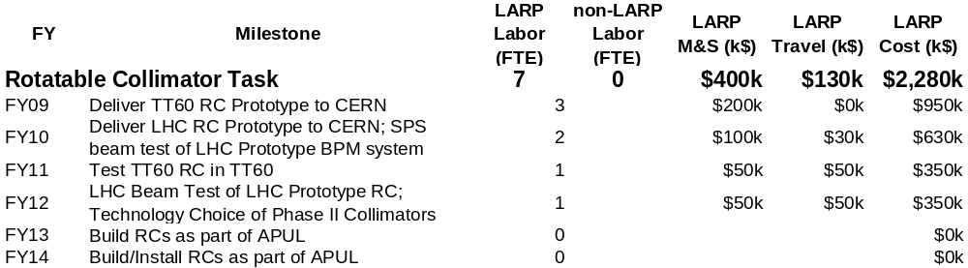
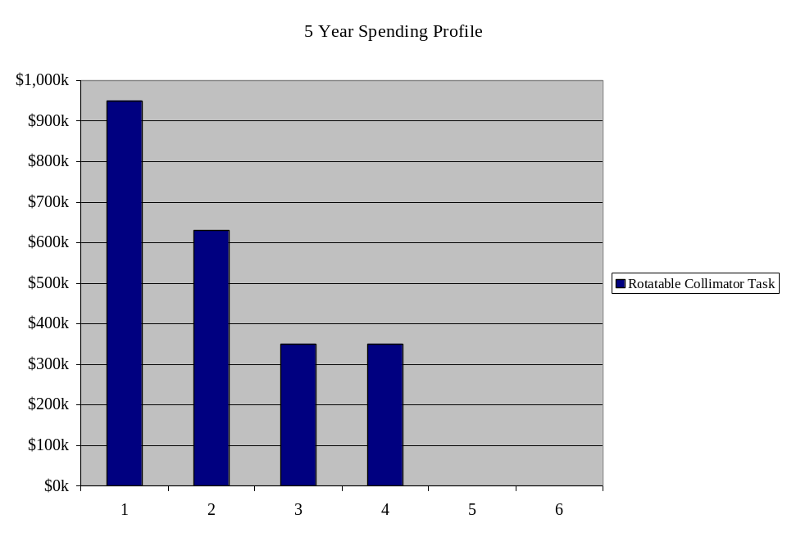
Rotatable Collimator
Plan based on schedule shown by Assmann at April 2009 Collimation Review
LARP CM12 - 08 April 2009
Slide n° <number> / 25
Collimation Conceptual Review Summary - T. Markiewicz

Slide 9
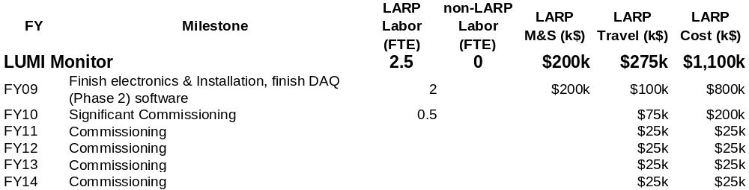
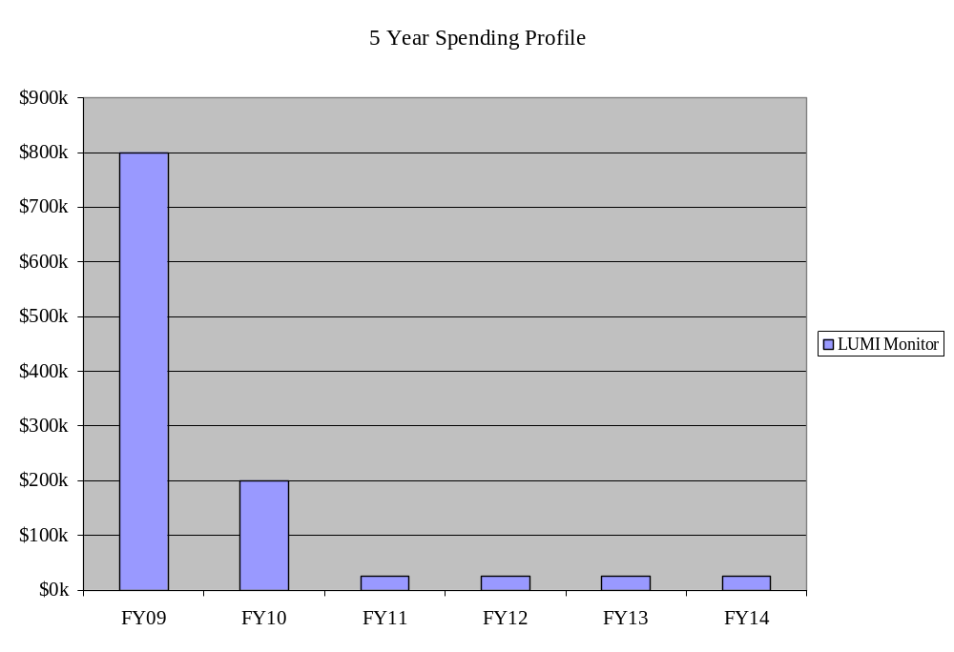
Luminosity Monitor
LARP CM12 - 08 April 2009
Slide n° <number> / 25
Collimation Conceptual Review Summary - T. Markiewicz

Slide 10
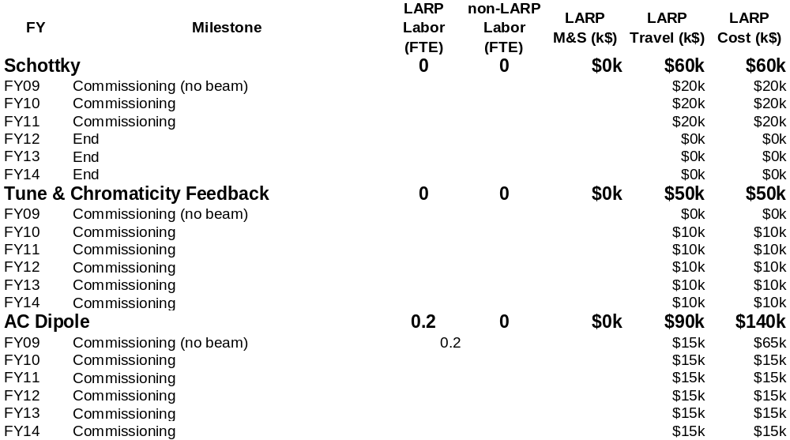
“Finished” Instrumentation Tasks
LARP CM12 - 08 April 2009
Slide n° <number> / 25
Collimation Conceptual Review Summary - T. Markiewicz

Slide 11
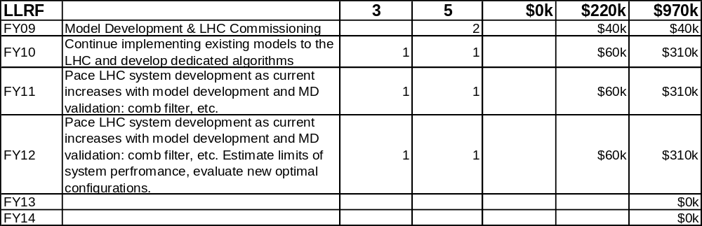
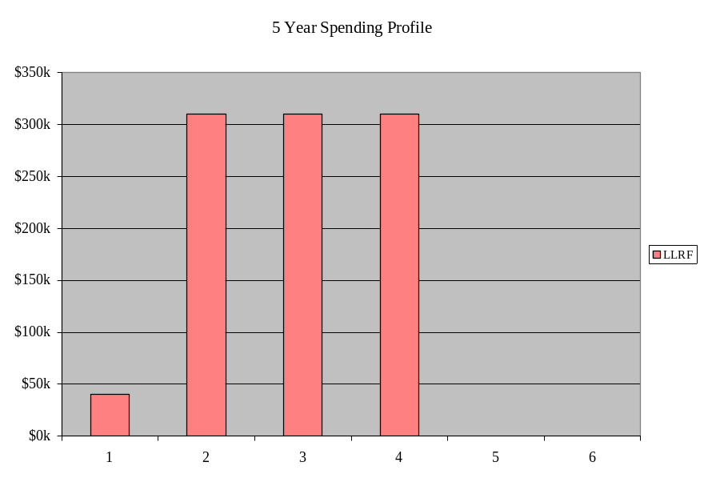
LLRF
LARP CM12 - 08 April 2009
Slide n° <number> / 25
Collimation Conceptual Review Summary - T. Markiewicz

Slide 12
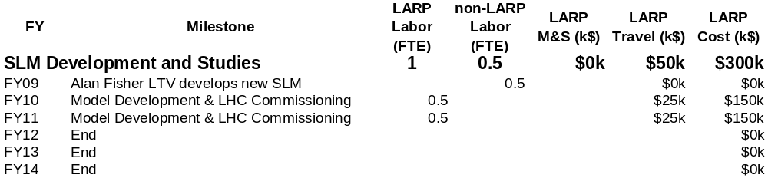
“New” Task: Synchrotron Light Monitor
LARP CM12 - 08 April 2009
Slide n° <number> / 25
Collimation Conceptual Review Summary - T. Markiewicz

Slide 13
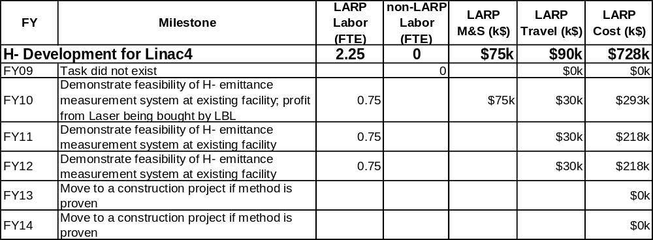
Another “New” Task that fell from the APUL Tree
LARP CM12 - 08 April 2009
Slide n° <number> / 25
Collimation Conceptual Review Summary - T. Markiewicz

Slide 14
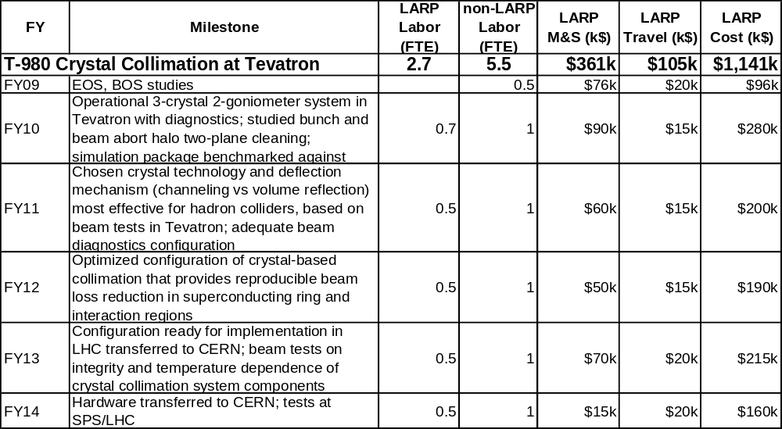
T980
LARP CM12 - 08 April 2009
Slide n° <number> / 25
Collimation Conceptual Review Summary - T. Markiewicz

Slide 15
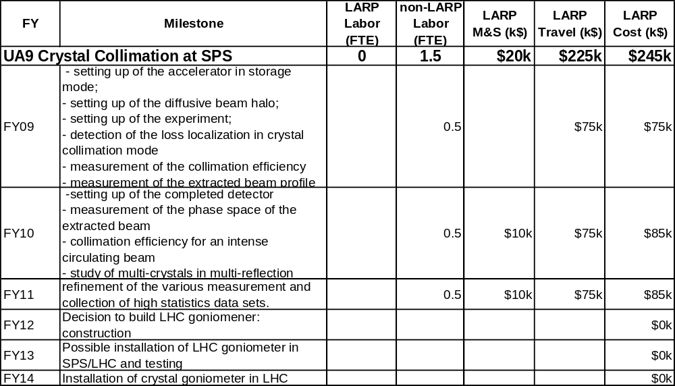
UA9
LARP CM12 - 08 April 2009
Slide n° <number> / 25
Collimation Conceptual Review Summary - T. Markiewicz

Slide 16
Hollow E-Beam Lens as an LHC Scraper
Shiltsev
Tevatron Demonstration:
  demonstrate ~1A hollow beam in DC regime with about 4 sigma of proton beam radius which goes and interacts mostly with proton halo (either at 150 or at 980 GeV)
  For that we need to perform-gun simulations (~10k$ SWF), design the gun (~15k$ SWF) build and test it at the stand-alone facility (measure profile, ~40k$ M&S), and then install it in the Tevatron and perform studies (~10k$ M&S).
Total is 75k$.
The studies will tell us how important the bends in TEL gun are (proton beam goes thru the walls of the hollow e-beam), how the losses depend on the size of the hollow beam and current of hollow beam (when we shrink it , we touch more and more protons). May be we'll be able to see tuneshift of the halo particles due to e-beam (needs some analysis and thinking).
LARP CM12 - 08 April 2009
Slide n° <number> / 25
Collimation Conceptual Review Summary - T. Markiewicz

Slide 17
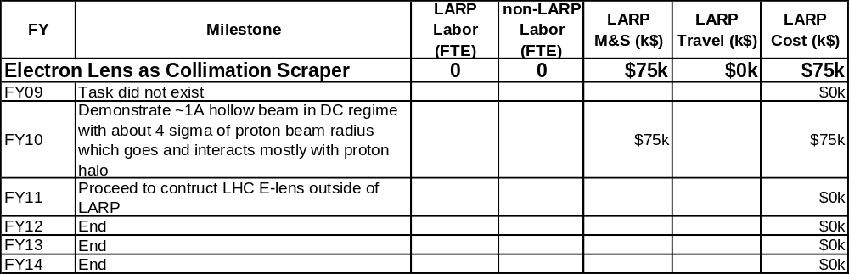
Hollow Electron Lens: New Project?
LARP CM12 - 08 April 2009
Slide n° <number> / 25
Collimation Conceptual Review Summary - T. Markiewicz

Slide 18
Beam-Beam Compensation 5 Year Plan
US LHC Accelerator Research Program
BNL - FNAL- LBNL - SLAC
W. Fischer BNL, A. Valishev FNAL
09 April 2009
LARP CM12

Slide 19
LARP Beam-Beam Task
5-year plan:
RHIC received $4M to build 2 electron lenses from
the stimulus package (Office of Nuclear Physics – not LARP)
Request LARP support on the level of 1.5 FTE for
  Simulation work at FNAL/SLAC/LBNL,
  specific to LHC and selected RHIC problems
  Experiments at Tevatron
Request LARP funds for FNAL computer cluster upgrade ($20k)
Also request travel support for BNL personnel

Slide 20
Current project situation: e-lenses for RHIC
Will receive $4M from stimulus package (includes $1M for labor)
Stimulus package has special spending and reporting requirements
Plan for tunnel installation by end of 2011
Have defined major milestones for stimulus package
Collaboration with LARP and CERN
LARP supports ~1 FTE at BNL/FNAL/LBL/SLAC for LHC simulations and
Tevatron experiments with Gaussian gun
A. Kabel, H.-J. Kim, J.-P. Koutchouk, J. Qiang, T. Sen, G. Sterbini, A. Valishev, F. Zimmermann
Work distribution
Layout : Y. Luo, W. Fischer (AIP co-PIs), S. Pikin
Beam-beam simulations : Y. Luo, G. Robert-Demolaize, (N. Abreu),
R. DeMaria, C. Montag, W. Fischer
Solenoid/gun/collector : S. Pikin, E. Beebe
Electron beam transport : M. Okamura
3D e-beam simulations : D. Raparia
Power supplies : R. Lambiase
Instrumentation : D. Gassner
Wolfram Fischer

Slide 21
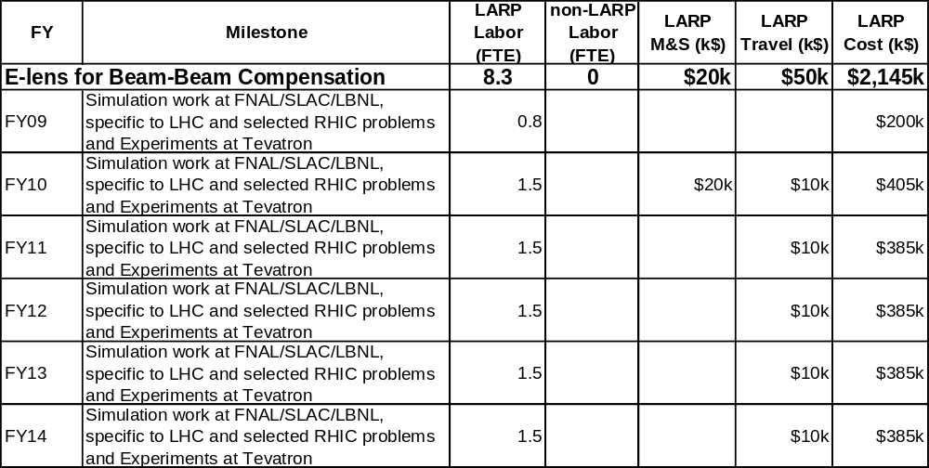
Electron Lens for Beam-Beam Compensation

Slide 22
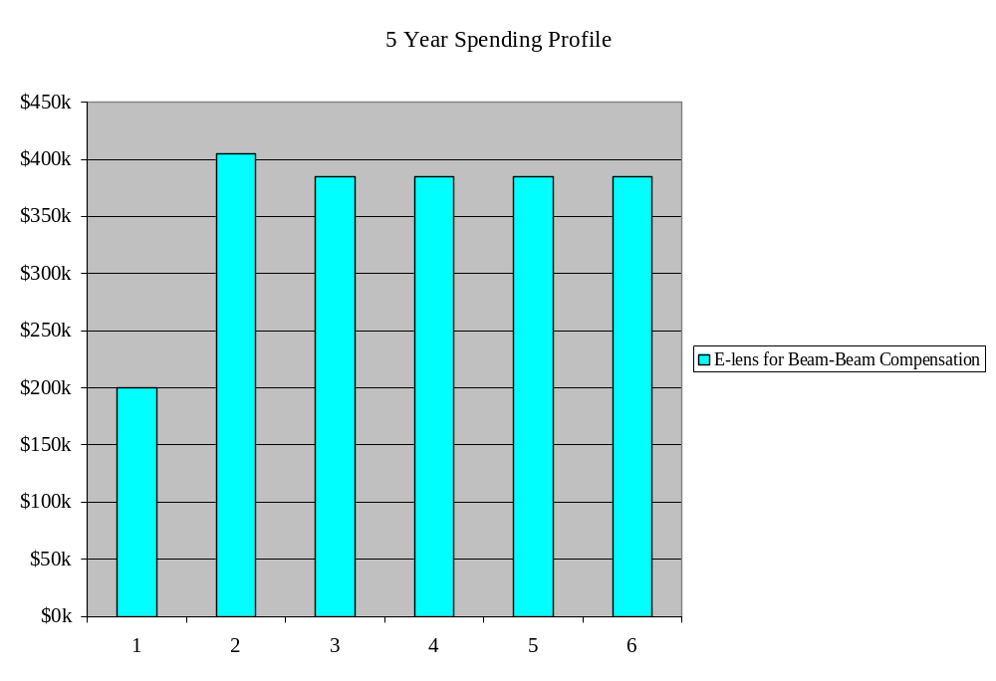
Electron Lens for Beam-Beam Compensation

Slide 23
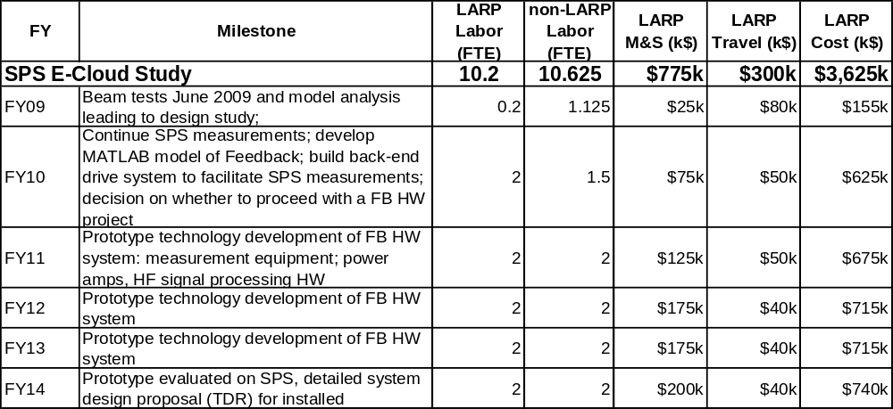
SPS Ecloud Feedback
LARP CM12 - 08 April 2009
Slide n° <number> / 25
Collimation Conceptual Review Summary - T. Markiewicz

Slide 24
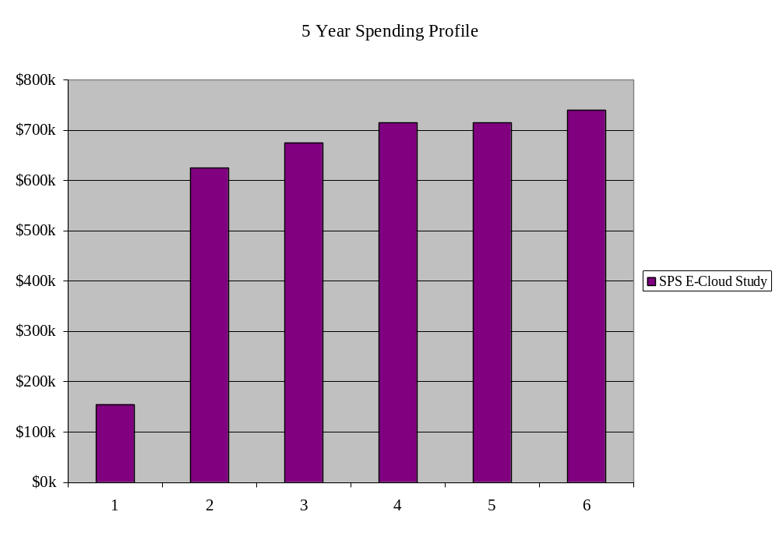
E-Cloud
LARP CM12 - 08 April 2009
Slide n° <number> / 25
Collimation Conceptual Review Summary - T. Markiewicz

Slide 25
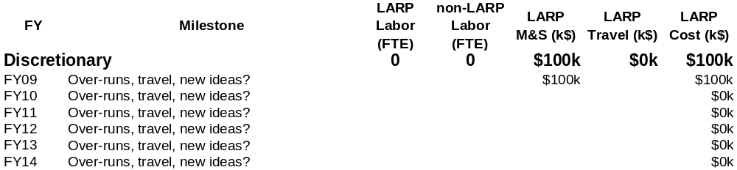
Discretionary $25k/lab in FY09 (only?)
LARP CM12 - 08 April 2009
Slide n° <number> / 25
Collimation Conceptual Review Summary - T. Markiewicz

