Slide 1
Nb₃Sn Magnet Simulations
Superconductivity breaks down above the conductor critical temperature, causing magnet ‘quenching’, which is undesirable for accelerator operation.
The main contribution to heat load in magnets is particle debris at the interaction point. Simulations of energy deposits in magnets help determine the optimal design in this respect.

Slide 2
FLUKA/MARS Interpolation
FLUKA & MARS used to simulate energy deposits in magnets
Results are not in useful coordinate system for magnets; need to interpolate

Slide 3
Current Work
2 Interpolation methods designed for both FLUKA and MARS data
bilinear method & bicubic method
Interpolation carried out in 2D on one cross section of magnets
Comparison of methods suggests maximum difference of ~10%, which is far less than the intrinsic error in either of the codes

Slide 4
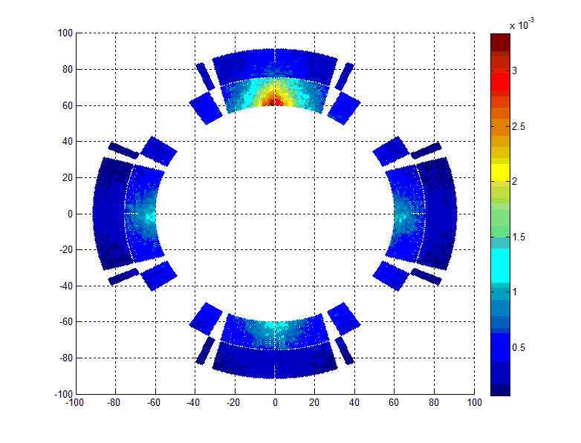

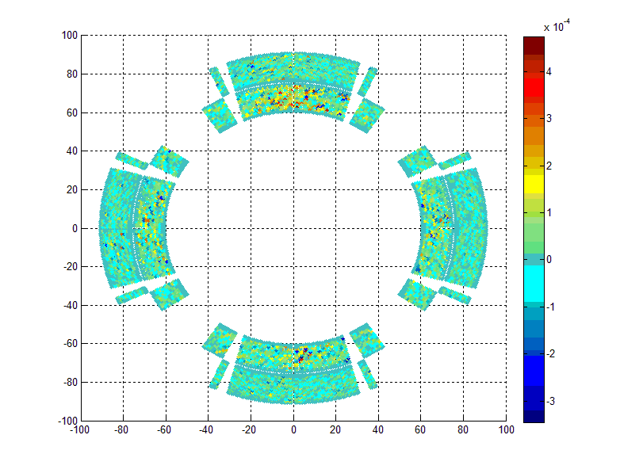
FLUKA linear interpolation
FLUKA cubic interpolation
E_{linear}-E_{cubic}

Slide 5
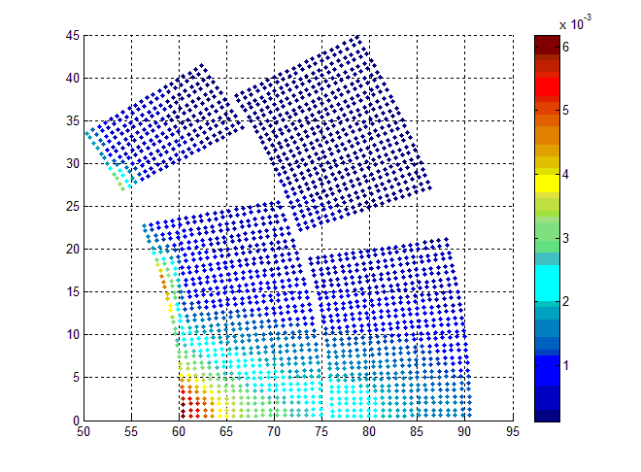

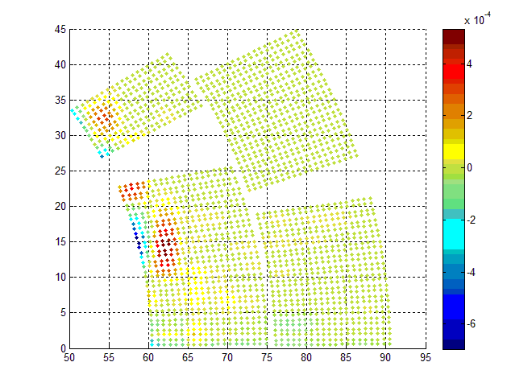
MARS linear interpolation
MARS cubic interpolation
E_{linear}-E_{cubic}

Slide 6
Future Work
Modify routine to work with 3D FLUKA output data and identify the longitudinal bin with maximal heat deposits.
Run for several coil geometries to identify those with least risk of quenching.
Find mathematical model for heat deposits based on statistical analysis of results.

